Slide 1
Software-Defined Mobile Networks
Gelareh Hasel Mehri

Slide 2
Outline
Limitations in Curent Mobile Technologies
SDN Advent
SDMN
Advantages of SDMN
Structure of a SDMN
  MFFE
  MFC
Mobile Network Applications
Mobility Management
Operator Benefits

Slide 3
Limitations in curent mobile technologies
Problems:
  Need for pricy, tightly integrated, and monolithic machinery
  Difficult to configure and troubleshoot
  All equipment must be from the same vendor
Some solutions:
  RFC5415 standard for control and provisioning of wireless access points (CAPWAP)
  Machine-type communication (MTC) for operators

Slide 4
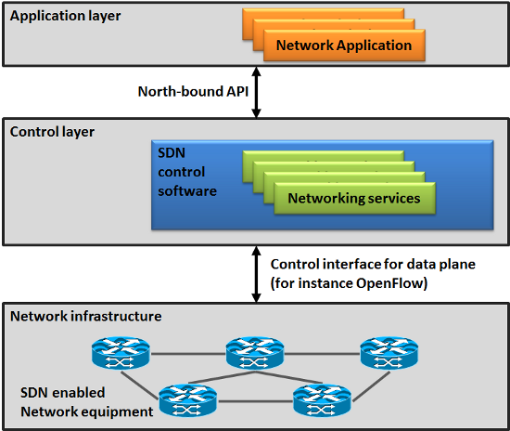
SDN Advent
Software-Defined Networking (SDN):
  a logically centralized network controller, and assorted applications that utilize controller-exposed information to orchestrate service delivery in the network
Separated control and data plane
Dominant standard:
  OpenFlow

Slide 5
Software-Defined Mobile Network (SDMN)
The term first appeared in early 2014
An approach to the design of mobile networks where all protocol-specific features are implemented in software
Maximizing the use of generic hardware and software in both core network and radio access network
Making the forwarding substrate fully software-driven

Slide 6
Advantages of SDMN
Providing maximum flexibility, openness, and programmability to future carriers without mandating any changes in UE
Equipment can be manufactured/serviced by a wider range of vendors, lowering production /maintenance costs
Support staff can be trained more quickly
The network components can be scaled up in capacity by adding more computing power.
Enabling speedy and smooth mobile network evolution and differentiation

Slide 7
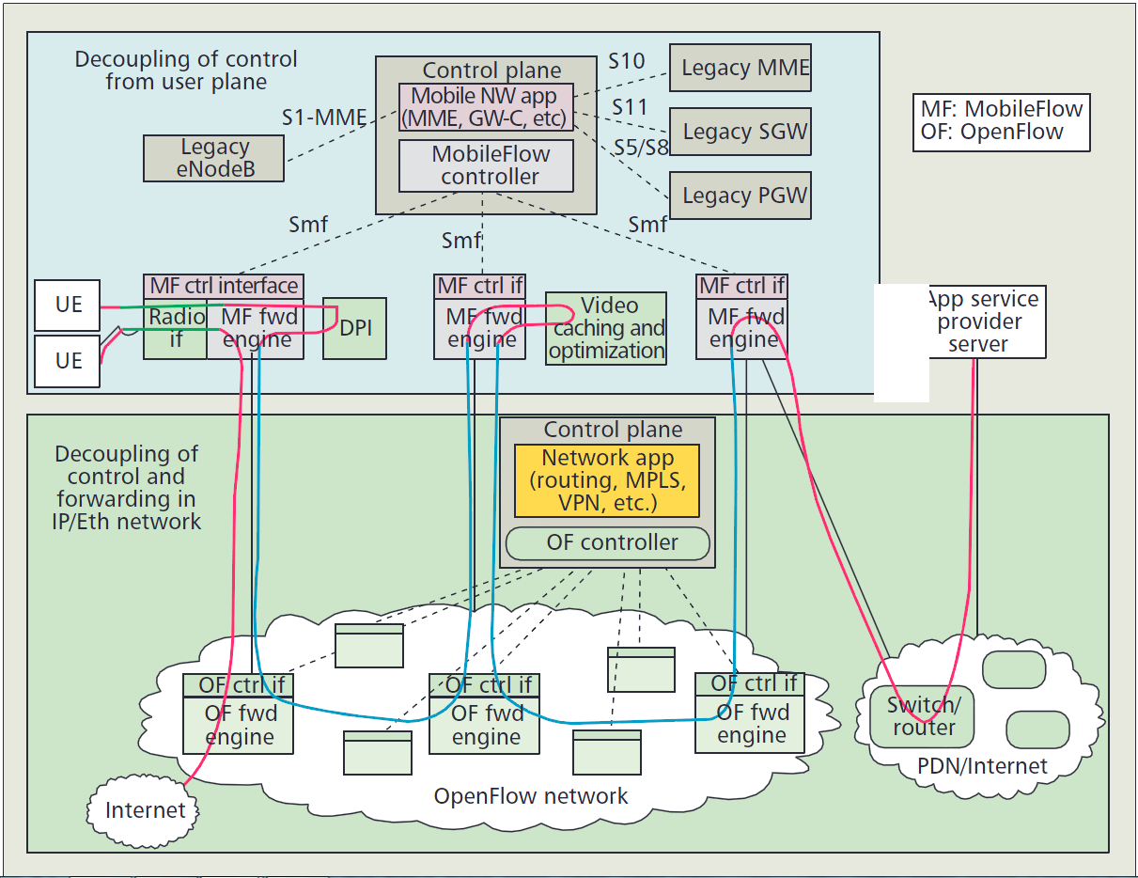
Structure of a SDMN

Slide 8
Structure of a SDMN
Two key elements in SDMN:
  Mobile-Flow forwarding engine (MFFE)
  Mobile-Flow controller (MFC)

Slide 9
MFFE
Fully software-defined forwarding
Suitable for multitenant mobile networks
Supports carrier-grade functionality
May include the key functionality of a wireless access node
Communicates with an MFC through “Smf” interface
Faster innovation and different optimalities
-

Slide 10
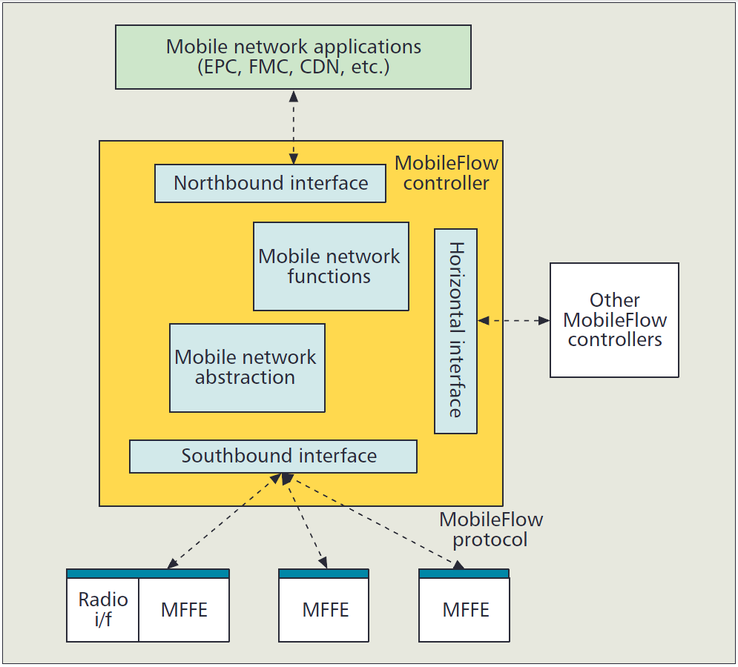
MFC
Mobile network functions
  Tunnel processing, mobility anchoring, routing, charging
Mobile network abstraction
  topology auto-discovery
  topological resource view
  network resource monitoring
  network resource virtualization
Interface corresponding functional blocks

Slide 11
Mobile Network Applications
Developed by SDMN northbound interface
2 models of mobile-Flow application:
  Network function virtualization approach; 1:1 mapping between the virtual gateway and MFFE via the mobile-Flow controller
  1:m mapping between one all-encompassing mobile-Flow application and several MFFEs
Both models support m:1 mapping between mobile-Flow applications and MFFEs

Slide 12
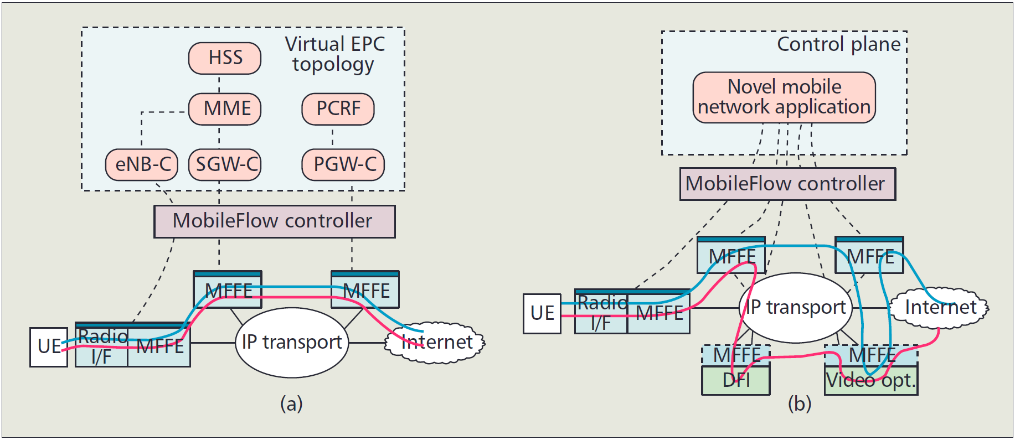
Mobile Network Applications
Mobile-Flow application models

Slide 13
Mobility Management
SDMN can be used to implement the current generation of control functionality in a 3GPP
MFFEs handling the user traffic are controlled by their “-C” control counterparts.
the -C virtualized function, translates the GTP signaling /context into flow rules and sends the rules via the MFC to each of the MFFEs involved in handling the particular flow.
One challenging aspect is how to split the functionality of an eNB. The interface between eNB-U and eNB-C consists of the forwarding control and wireless bearer control. The wireless bearer control is relevant to the radio handoffs required in mobility management processes

Slide 14
Operator Benefits
By separating the transport stratum from the mobile network stratum:
  The two strata can be developed and deployed independently.
  The operator can start to deploy MFFEs, which can interoperate with legacy equipment and experiment with new services based on software-defined part.
SDMN enables operators to use infrastructure resources to orchestrate on demand the creation of various mobile network pipes based on different mobile architectures

Slide 15
Thank you…
Any Questions?

