Slide 1
AskMe learn while playing cards
summary
Gelecsák Tamás

Slide 2
the PURPOSE
Convert .txt to structured data sets
Use learning cards in study quizes
Create learning cards from sets
Gain theoretical knowledge

Slide 3





the STACK
MSSQL
ASP.NET Core
Vite.js
Typescript
tailwindcss
Store the sets
REST API
Build frontend
Create logic
Create style

Slide 4
the BACKEND
UserController
SetController
Login
Handle formated text input
Register
Authorize
Handle unformated text input
Reset pw
Google login
Create set
Logout
Get set

Slide 5
the USER MANAGEMENT
userDto
userDto
registry request
api/users/register
UserService. RegisterAsync()
UserManager. CreateAsync()
result
result
login request
loginData
loginData
api/users/login
UserService. LoginAsync()
UserManager. FindByEmailAsync()
user
token
token
token
cookies
user
user
user
token
UserManager. FindByEmailAsync()

Slide 6

the GOOGLE AUTHENTICATION
login request
api/users/signin-google
loginData
user
api/users/google-response-handle
UserService. LoginGoogleAsync()
TokenService. CreateToken()
Google authentication service
auth cookie
token
token
user
hasUser?
RegisterAsync()
Redirect()
loginData
user
token
cookies
UserManager. FindByEmailAsync()

Slide 7

the SET CREATION
data.txt
data.txt
Set
Set
api/sets/formated /preview
api/sets/unformated/preview
data.txt
data.txt
Set
data.txt
data.txt
ITxtReader
Set
SetService. CreateFormated SetPreview()
String data
SetService. CreateUnFormated SetPreview()
List<Line>
formated data
List<Line>
unformated data
Set
formated data
Set
FillSetFromLines()
List<Line>
ITextFormater
List<Line>

Slide 8
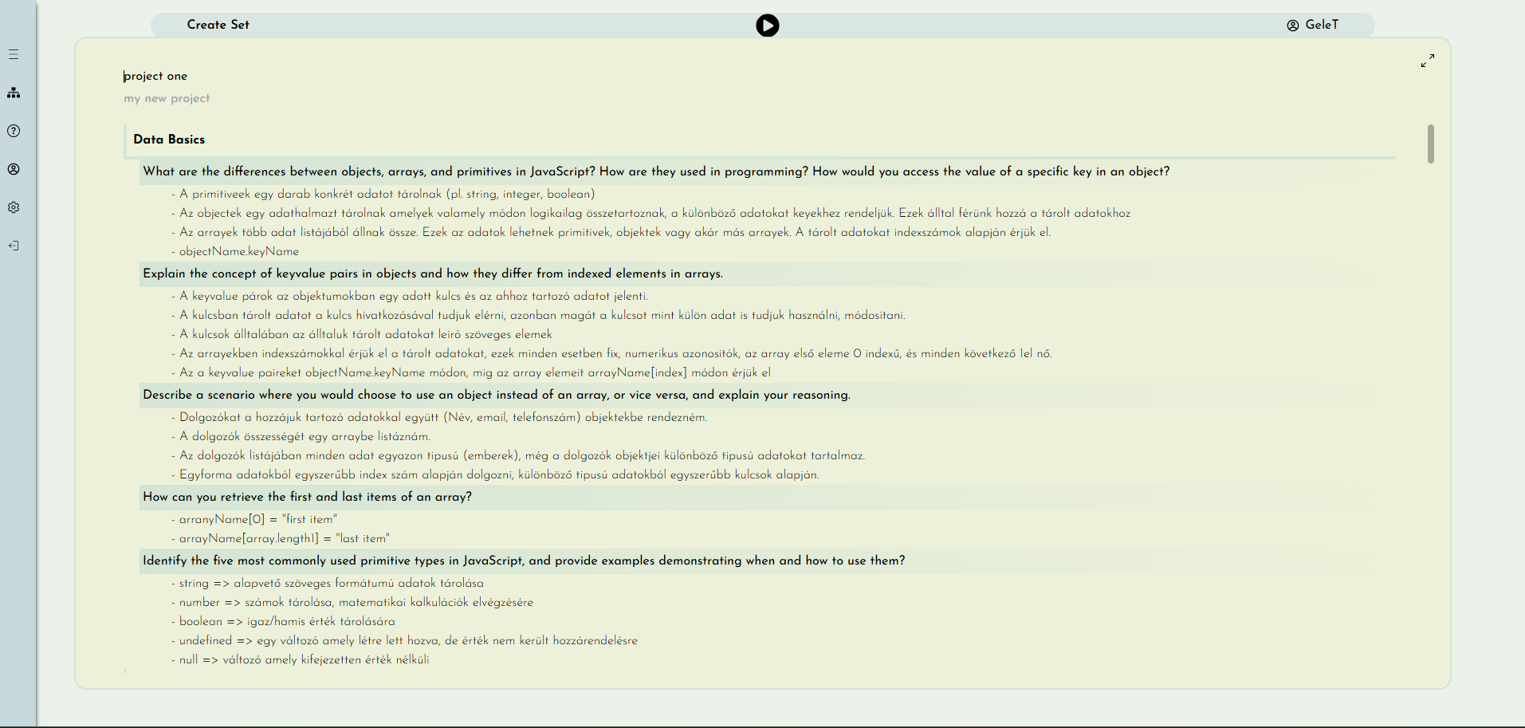
the RESULT

Slide 9
Thanks!
May you have any questions?

