Slide 1
Credit Card Fraud Detection
MARCH 24, 2018
SAURABH, AUGUSTINE JOSEPH, GELESH GORGE OMATHIL
Under the guidance of Prof James Shanahan,
Indiana University

Slide 2
Abstract:
A detailed description about the data set could be found at
https://www.kaggle.com/agpickersgill/credit-card-fraud-detection/data . The first 28 features are resultant of PCA, whereas 'Time' and 'Amount' features are present as is.
Feature 'Time' contains the seconds elapsed between each transaction and the first transaction in the dataset.
The feature 'Amount' is the transaction Amount [Para 2 of: About this Dataset].
Analysis on the data, and the visualization of the analysis could be found at https://www.kaggle.com/agpickersgill/credit-card-fraud-detection/notebook.

Slide 3
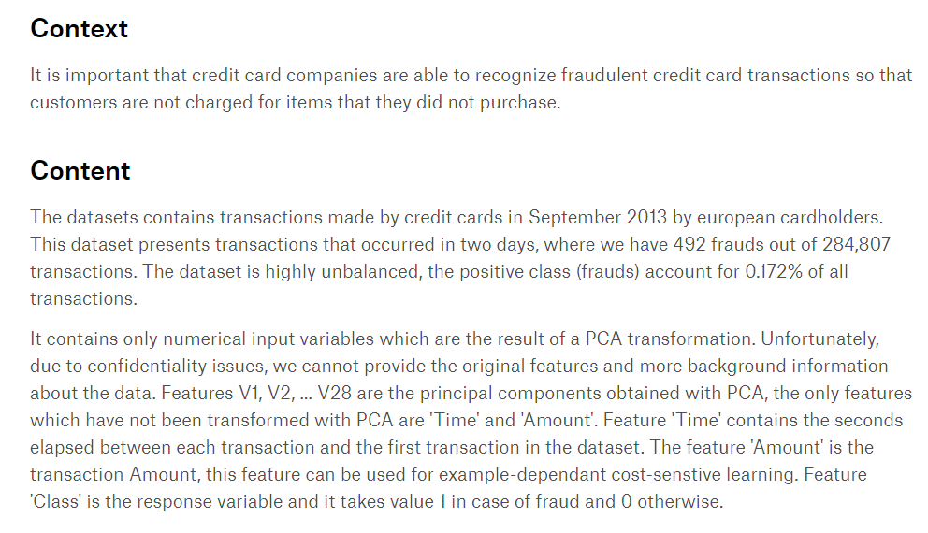
Site: agpickersgill/credit-card-fraud-detection/data https://www.kaggle.com/agpickersgill/credit-card-fraud-detection/data

Slide 4
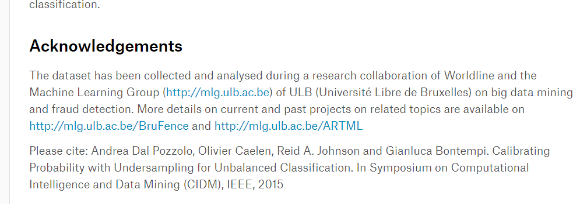
Site: agpickersgill/credit-card-fraud-detection/data https://www.kaggle.com/agpickersgill/credit-card-fraud-detection/data

Slide 5
Challenges:
Most of the features are PAC values, hence feature engineering is limited.
Fraud Transactions are under represented , 0.17 % of the data.
There is no separate validation / test data set available in Kaggle to submit and assess our score in comparison.

Slide 6
Approach:
Under Sample the data set.
Analysis of correlation of data set
Identify important features ,
via exploratory feature analysis
Pair-wise feature analysis
Base model, And extended models
K Flod validation, Grid Search ,
Pipeline Kitchen-Sink
Experimental : Features as distance to clusters
Comparison of Different,
Transformations of Data
Application of Algorithms

Slide 7
Approach: Under Sample the data set
We used all rows of ‘minority class data’ and a fraction of majority class data so that the count of both the classes are comparable.
We prepared the data set with different fractions of the majority class, and found that the best results are achieved when the majority class count was equal to the minority class count(1:1 ratio).
Under Sample the data set.
Analysis of correlation of data set
Identify important features ,
via exploratory feature analysis
Pair-wise feature analysis
Base model, And extended models
K Flod validation, Grid Search
Features as distance to clusters
Comparison of Different,
Transformations of Data
Application of Algorithms

Slide 8
Approach: Analysis of correlation of data set
Correlation of PCA values in general is of little significance. But we did a correlation of data separately for both the classes.
We found that some fields in the fraud transactions show significant correlations.
Under Sample the data set.
Analysis of correlation of data set
Identify important features ,
via exploratory feature analysis
Pair-wise feature analysis
Base model, And extended models
K Flod validation, Grid Search
Features as distance to clusters
Comparison of Different,
Transformations of Data
Application of Algorithms

Slide 9
Approach: Identify important features
We found that the feature “Time” is of very less significance, than expected.
On plotting histograms of all the features, the higher concertation of features from fraud and non fraud, were more or less the same, seems like not much scope to separate.
Further Pair-wise feature analysis showed that the classes formed clusters, and some of them were linearly separable
Under Sample the data set.
Analysis of correlation of data set
Identify important features ,
via exploratory feature analysis
Pair-wise feature analysis
Base model, And extended models
K Flod validation, Grid Search
Features as distance to clusters
Comparison of Different,
Transformations of Data
Application of Algorithms

Slide 10
Approach: Base model, And extended models, Pipeline & Validation
With 1:1 under sampling, we built a base model of logistic regression.
ML models evaluated on Precision, Recall, False Negative Rate, F1 Score, F0.5 Score and AUC
We compared performance with various sampling ratios and found 1:1 works as the best.
Further Pair-wise feature analysis showed that the data points of both classes where forming groups, and some of such groups formed clusters which were linearly separable.
A model based on random forest, helped in identifying the important features, although these findings conflicted the results of the correlation analysis (with the category variable).
Used pipeline, to standardize the data, select important features and built ML models.
Performed Kitchen Sink analysis using a Voting Classifier built using LR, RF, DT,SVC and LDA for demonstration purpose, however the approach did not improve sensitivity or reduce the false negatives.
Under Sample the data set.
Analysis of correlation of data set
Identify important features ,
via exploratory feature analysis
Pair-wise feature analysis
Base model, And extended models Pipeline
K Flod validation, Grid Search
Features as distance to clusters
Comparison of Different,
Transformations of Data
Application of Algorithms

Slide 11
Approach: Features as distance to clusters ( The Key Factor)
Inspired by the intuitions from the pair-wise comparison
We did K Means Clustering on data of class “fraud” and “non-fraud” separately, and merged the centroids of the clusters ignoring the class variable into a single array of centroids.
Each row of the data was transformed into a row of proximity towards the centroids.
We compared various models on the transformed data and found a significant improvements on sensitivity, recall score. These models greatly reduced the false negative rates. The standard deviation of the recall score was less. And Random forest was found to be preforming the best.
Using Grid Search to fine tune hyper parameters we built the best model.
Under Sample the data set.
Analysis of correlation of data set
Identify important features ,
via exploratory feature analysis
Pair-wise feature analysis
Base model, And extended models
K Flod validation, Grid Search
Features as distance to clusters
Comparison of Different,
Transformations of Data
Application of Algorithms

Slide 12
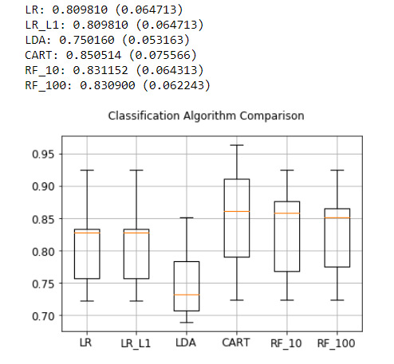
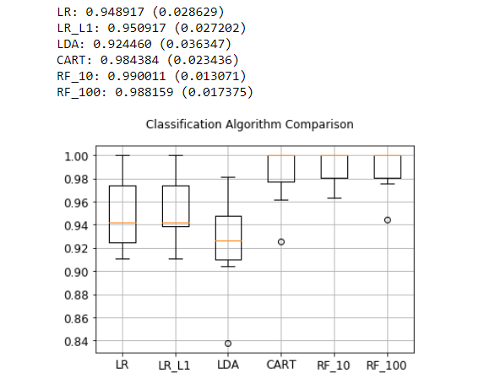
Approach: Features as distance to clusters ( Comparison)
Legend: LR: Logistic Regression
LR_L1: LR with L1 Penalty
LDA: Linear Discrimination Analysis
CART: DecisionTree Classifier
RF_10: Random Forest n_estimators=10
RF_100: Random Forest n_estimators=100
Model: Mean Recal ( Standard Div Recal)

Slide 13
Important observations and learning:
Use of recall over accuracy
Since the fraud data was under represented, accuracy was showing deceivingly great results. From a business perspective we need to have a sensitive model, hence the scores like Recall and False Negative Rate were given greater importance.
Use of under sampling
Since the fraud data was under represented, we used under sampling. Found that the best results are achieved at 1:1 ratio. But this may lead to overfitting the data, and model being not aware of data of certain range which was eliminated during under sampling.
Features as distance to clusters
This happen to be a game changer approach. The evaluation metrics were not much affected by the issue of under sampling. We tried various ratios of under sampling with this approach.
Decision tree based approach such as Random forest was found to be more resilient to under sampling compared to hyper plane based models such as Logistic regression.

Slide 14
Acknowledgement:
Prof: Dr. James Shanahan & Team,
Department of Computer science Indiana University

