Slide 1
1 — Problem & datasets
Predict yield_tons_per_ha for 3,750 unseen plots.
Plot survey + regional weather + market price tables.
Weather must be a model input; price is analysis/demo only.

Slide 2
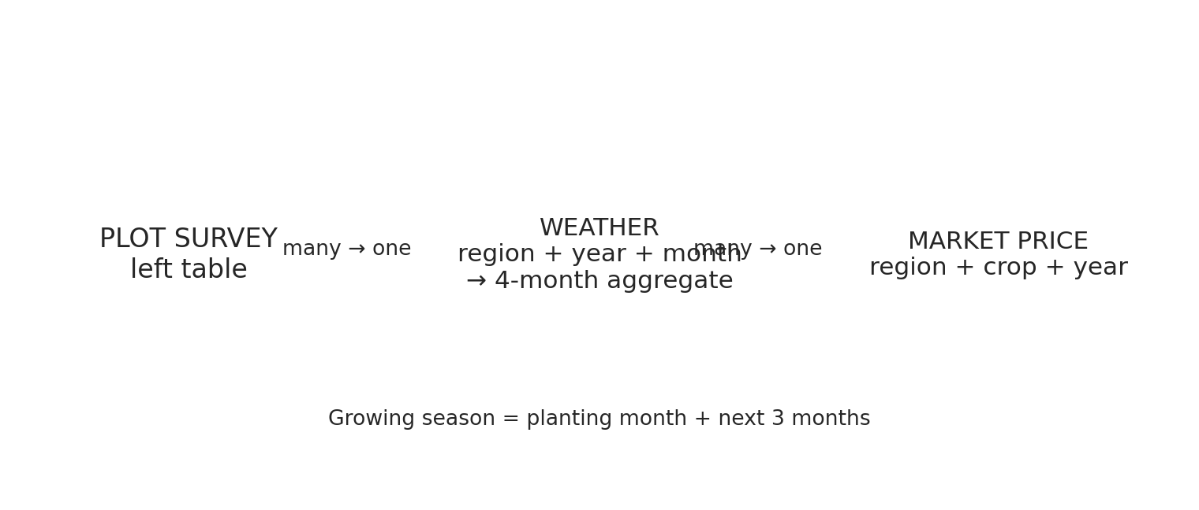
2 — Cleaning & integration
Canonical labels, duplicate removal, sentinel handling and train-fitted caps.
Weather window = planting month + next 3 months.
Many-to-one joins preserve plot rows.

Slide 3
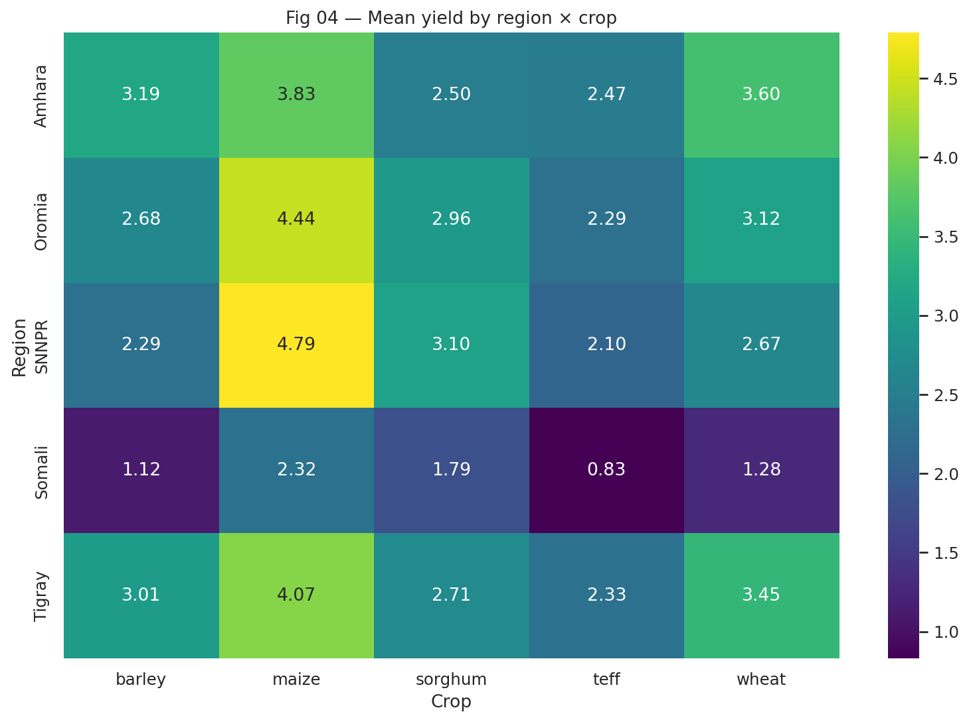
3 — What the data says
Highest-yield crop: maize (3.90 t/ha).
Best region × crop: ('SNNPR', 'maize') (4.79 t/ha).
Revenue leader: teff (153,289 birr/ha).

Slide 4
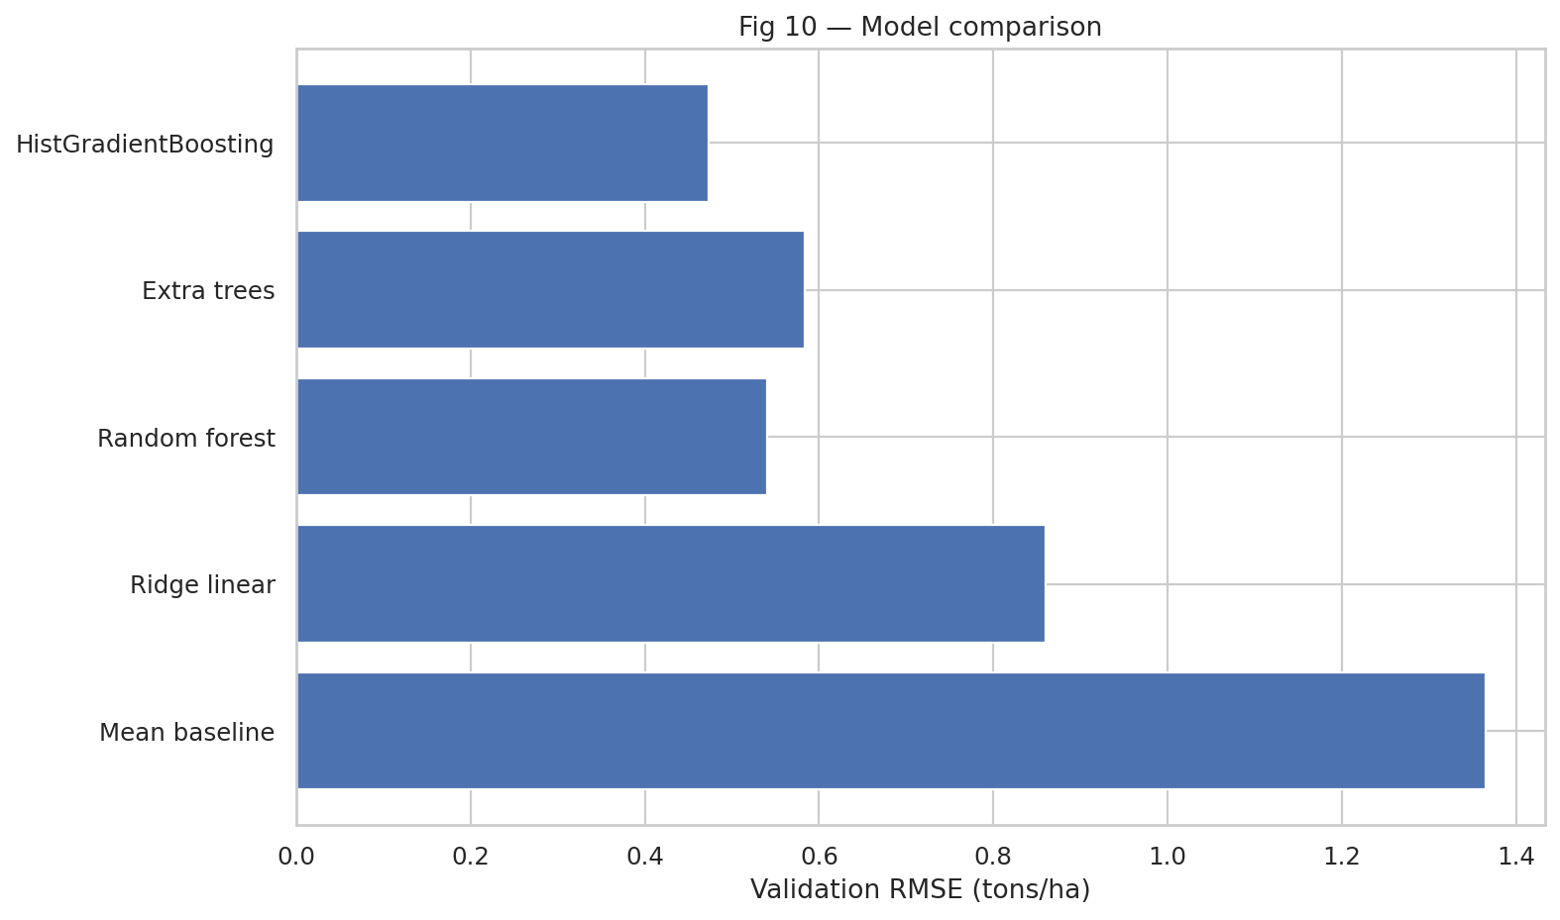
4 — Modeling
Validation RMSE: 0.473 t/ha; MAE 0.349.
5-fold RMSE: 0.488 ± 0.013.
Weather ablation RMSE difference: 0.045 t/ha.

Slide 5
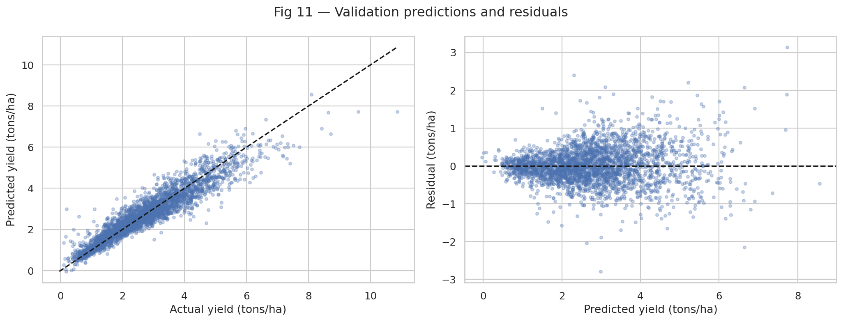
5 — Error analysis & demo
2024 out-of-time RMSE: 0.506 t/ha.
Largest validation errors are documented by crop, region and climate anomaly.
Local demo: `python app/app.py` — predicts yield and revenue with automatic lookup.

