Slide 1
Sensitivity Analysis of a Surrogate Pain-Risk Model for Antalgic Gait Synthesis
Progress and plan, now with a portable IMU path
Notes:
Today: what the thesis asks, what is already built, a first result from the new IMU direction, and the plan. At the end I have four questions where I need your input, mainly about scope and the IMU data.

Slide 2
Thesis
How sensitive are the gaits synthesized by the antalgic gait optimizer to its learned knee-load model, and do the predicted pain reductions hold up against physics-based ground truth?
New: can the same pipeline start from a portable IMU suit instead of a motion-capture lab?
Aim 1 · Parameter sensitivity
How the synthesized gait changes with φ, d and the 1.4 BW limit
Runs in William's optimizer
Aim 2 · Validity
Surrogate vs OpenSim on held-out people
Vs measured knee forces (Grand Challenge, instrumented knees)
Aim 3 · Portable sensing (new)
Perception Neuron 3 suit as input
How sensor error moves F_medial and the synthesized gait
2
Notes:
The ISRR paper used a small neural network as the knee-load constraint in William's optimizer. My thesis asks how much the synthesized gaits depend on that network and on its parameters (phi, d, the 1.4 BW limit), and whether the pain reductions it predicts are real when checked against OpenSim and, where possible, measured knee forces. Aim 3 is new since we last talked: replacing the motion-capture lab with a Perception Neuron 3 IMU suit, so the system becomes portable. It fits the same question: how sensitive is the result to how the gait was measured.

Slide 3
Where each aim fits in the pipeline
Capture
Mocap lab today
IMU suit (new)
Joint angles
OpenSim IK
OpenSense IK (IMU)
Surrogate
F_medial per frame
small MLP
Violation windows
frames above
1.4 BW
Optimizer
William's; keeps
F_medial ≤ limit near
the reference gait
The surrogate is used twice: on the measured gait (where is the knee overloaded?) and inside the optimizer (as the constraint).
An IMU suit measures segment orientation, not where the pelvis is → only the no-pelvis-position model (September) can take IMU input.
No force plates on a suit → foot contact must come from the foot sensors.
3
Notes:
Left to right: capture, joint angles, the surrogate, the windows where predicted load is above 1.4 BW, and William's optimizer, which edits the gait in those windows. Aim 3 changes the first two boxes. Aim 2 checks the surrogate box. Aim 1 varies the optimizer's parameters. Two consequences of IMUs: the suit cannot measure pelvis position, which is why the September model drops it; and there are no force plates, so foot contact comes from the foot sensors.

Slide 4
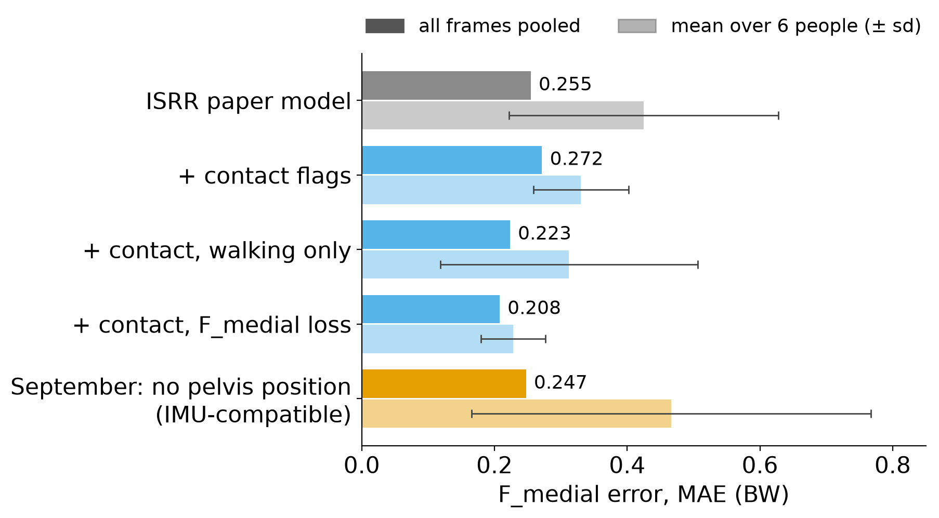
Built: surrogate evaluation on held-out people
Label pipeline: AddBiomechanics → OpenSim IK → static optimization → knee joint reaction
Evaluation harness: one command scores any model on a held-out test split (6 walking, 3 static people)
Reproduces the paper: F_y error 0.152 BW (paper: 0.153)
Provenance: every checkpoint records its data, settings and code version
Models since the paper: contact flags, F_medial-weighted loss, and the no-pelvis-position model now used in the optimizer
Walking F_medial error on held-out people, vs OpenSim labels (BW). Orange: the model an IMU suit can feed.
4
Notes:
Everything here runs on my side and does not depend on William's repo. The harness re-scores every model on people never used for training or model selection. Pooled over frames, the best model is about 0.21 BW. The September model, the one without pelvis position, is 0.25 pooled but less consistent across people (0.47 ± 0.30 person mean), mostly from one lab (Tiziana). It is the only model an IMU suit can drive, so improving its consistency is part of the plan.

Slide 5
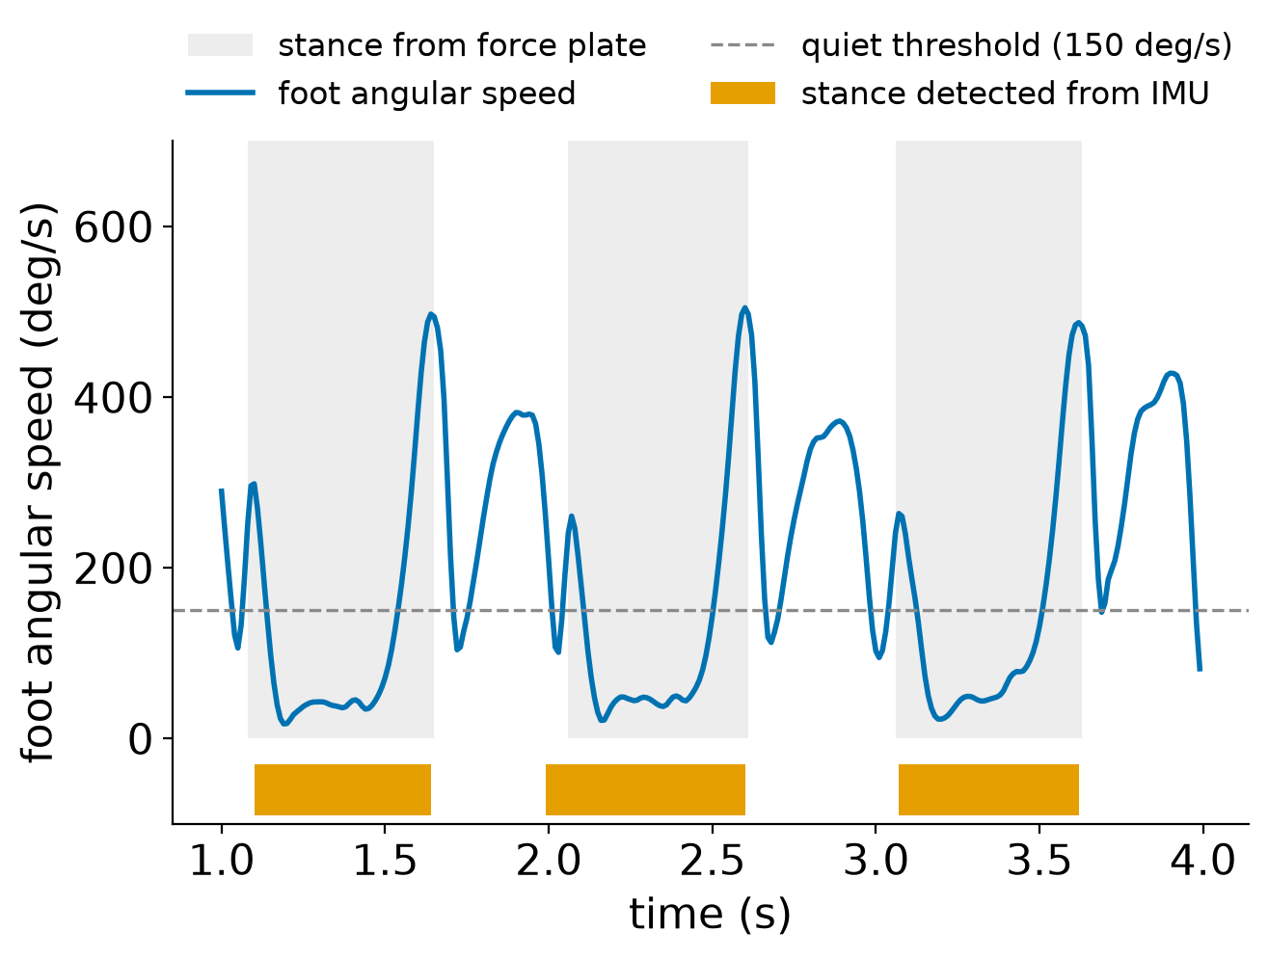
Built: IMU groundwork
Read suit recordings (BVH) → OpenSim orientation files
OpenSense calibration and IMU inverse kinematics
Foot contact without force plates: the foot is down when it stops rotating
Virtual IMUs from mocap trials, with sensor noise and drift, to test before real data
End-to-end check: IMU path vs mocap path vs OpenSim
25 unit tests · docs/IMU_PIPELINE.md · branch imu
Contact from foot rotation agrees with force plates on 96 % of frames; stance edges within ~20 ms (one test trial).
5
Notes:
This is the plumbing for Aim 3. The suit's recordings go through OpenSim's IMU tools (OpenSense) to get the same joint angles the surrogate already uses. The new piece is contact detection: during stance the foot is almost still, during swing it rotates fast, so a threshold on foot angular speed, extended to the heel-strike and push-off peaks, recovers stance. All of it is tested with virtual IMUs made from existing mocap trials, before any real suit data.

Slide 6
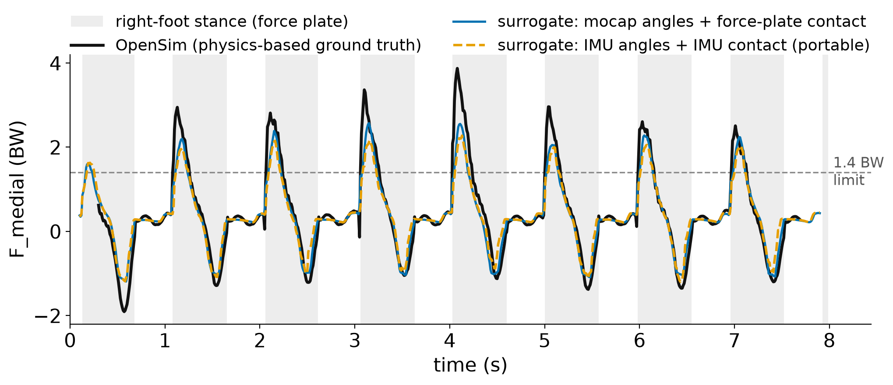
First result: the portable path follows the mocap path
≤0.05°
joint-angle error from
perfect IMUs
0.96–0.98
contact agreement with
force plates
0.207 → 0.261 BW
F_medial error vs OpenSim:
mocap → IMU (1°, 0.5°/s)
6
Notes:
One held-out treadmill trial, Carter P010 trial 10, run through simulated sensors with 1 degree noise and 0.5 degree per second heading drift. Black is OpenSim, blue is the surrogate with mocap and force plates, orange dashed is the fully portable path: IMU joint angles and IMU contact. The orange curve stays close to the blue one; both under-read the tallest peaks, which is a surrogate limitation, not an IMU one. Error vs OpenSim goes from 0.207 to 0.261 BW. This is simulated data on one trial, so it shows the pipeline works, not final accuracy.

Slide 7
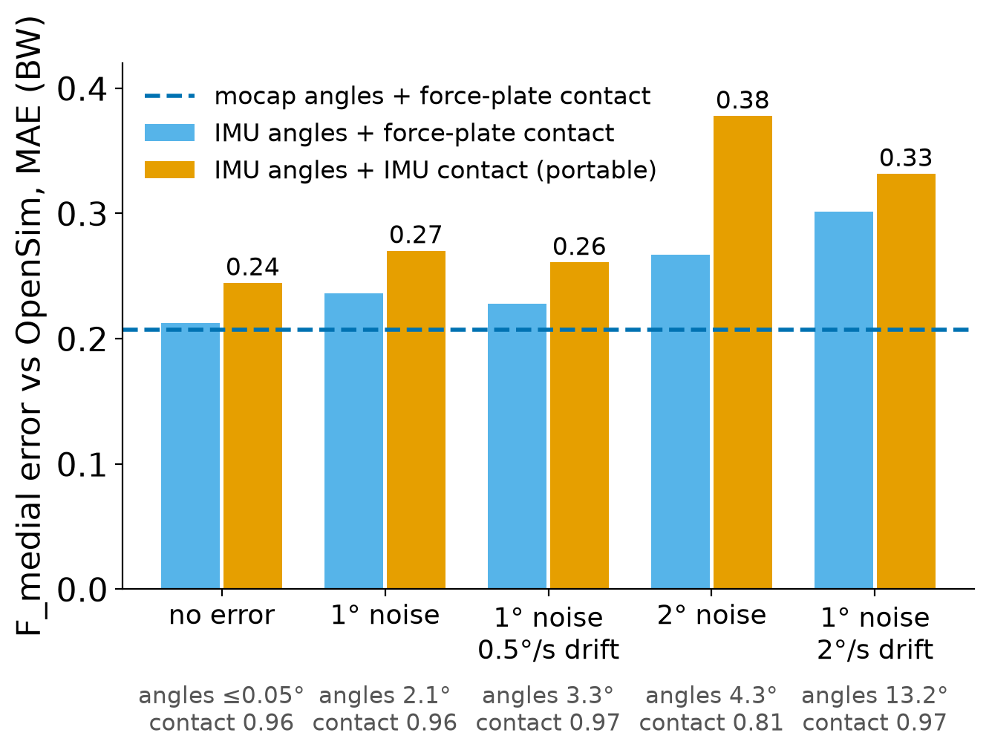
Sensitivity to sensor error
Plausible error (1°, 0.5°/s) costs ~0.05 BW: ~0.02 from joint angles, ~0.03 from contact
Contact detection fails at 2° noise: it differentiates orientation → use the suit's gyroscope directly
Heading drift mostly hits hip rotation (13° at 2°/s)
Perception Neuron 3: 60 Hz; static accuracy 1° roll/pitch, 2° yaw; published joint-angle errors 3.6–13°
Simulated sensors, one trial. Real IMU data next.
7
Notes:
Same trial, five levels of simulated sensor error. Light blue isolates the joint-angle error (contact still from force plates); orange is fully portable. The dashed line is mocap with force plates. At plausible error the portable path costs about 0.05 BW. The weak point is contact detection: at 2 degrees of noise it breaks, because I estimate rotation speed by differentiating orientation. A real suit reports angular velocity directly from its gyroscopes, which should fix this. Published validations of Perception Neuron report 3.6 to 13 degrees joint-angle error, so the real-data test matters.

Slide 8
Plan (proposed)
When | Work | Depends on
Oct – Nov | Ingest the incoming IMU datasets; gyroscope-based contact; score the IMU path on real sensors IRB application for our own suit session | IMU datasets
Nov – Dec | Integrate the surrogate in William's optimizer; Aim 1 sweeps (φ, d, limit) Adapter: IMU joint angles → optimizer reference | William's repo
Jan – Mar | Aim 2: measured knee forces (Grand Challenge) Aim 3: IMU-robust training; uncertainty margin in the limit (F_medial + kσ ≤ limit) | —
Mar – May | Suit + mocap + force plates session; gaits from mocap vs IMU references Writing and defense | IRB, lab time
Option, not now: convert the existing ~11k lab trials to virtual IMU data for training, if the new IMU datasets are too small.
Stretch: stroke cohort; live suit → OpenSai bridge.
8
Notes:
Proposed order. Now through November: the incoming IMU datasets, since real sensor data is the main open risk, and the IRB application for our own recording session, because approval takes time. When William's repo arrives after his defense: integrate the surrogate and run the Aim 1 sweeps, plus an adapter so an IMU-derived gait can be the optimizer's reference. Winter: Aim 2 validation against measured knee forces, and IMU-robust training for Aim 3, including a safety margin in the limit based on model uncertainty. Spring: our own session with the suit, mocap and force plates at the same time, then writing. Converting the existing lab data to virtual IMU data stays an option if the new datasets are small.

Slide 9
Questions for you
Scope
Three aims: is that the right size for an M.S. thesis? Move the stroke cohort to stretch?
IMU data
What will the incoming IMU datasets contain: which sensors, and force plates + mocap (needed for knee-load labels)?
Own session
Can we record the suit, mocap and force plates at the same time in the lab? IRB route and timing?
Timeline
Target defense date, and when to bring in the committee?
9
Notes:
These are the decisions I can't make alone. The most important one is the IMU data: if the incoming datasets have force plates and mocap, I can label them with my OpenSim pipeline and train on real sensors directly; if not, they are for validation only and the virtual-IMU option becomes more important.

