Slide 1
Sensitivity Analysis of a Surrogate Pain-Risk Model for Antalgic Gait Synthesis
Progress and plan, now with a portable IMU path
Notes:
Today: what the thesis asks, what is already built, a first result from the new IMU direction, and the plan. At the end I have four questions where I need your input, mainly about scope and the IMU data.

Slide 2
Thesis
How sensitive are the gaits synthesized by the antalgic gait optimizer to its learned knee-load model, and do the predicted pain reductions hold up against physics-based ground truth?
New: can the same pipeline start from a portable IMU suit instead of a motion-capture lab?
Aim 1 · Parameter sensitivity
How the synthesized gait changes with φ, d and the 1.4 BW limit
Runs in William's optimizer
Aim 2 · Validity
Surrogate vs OpenSim on held-out people
Vs measured knee forces (Grand Challenge, instrumented knees)
Aim 3 · Portable sensing (new)
Perception Neuron 3 suit as input
How sensor error moves F_medial and the synthesized gait
2
Notes:
The ISRR paper used a small neural network as the knee-load constraint in William's optimizer. My thesis asks how much the synthesized gaits depend on that network and on its parameters (phi, d, the 1.4 BW limit), and whether the pain reductions it predicts are real when checked against OpenSim and, where possible, measured knee forces. Aim 3 is new since we last talked: replacing the motion-capture lab with a Perception Neuron 3 IMU suit, so the system becomes portable. It fits the same question: how sensitive is the result to how the gait was measured.

Slide 3
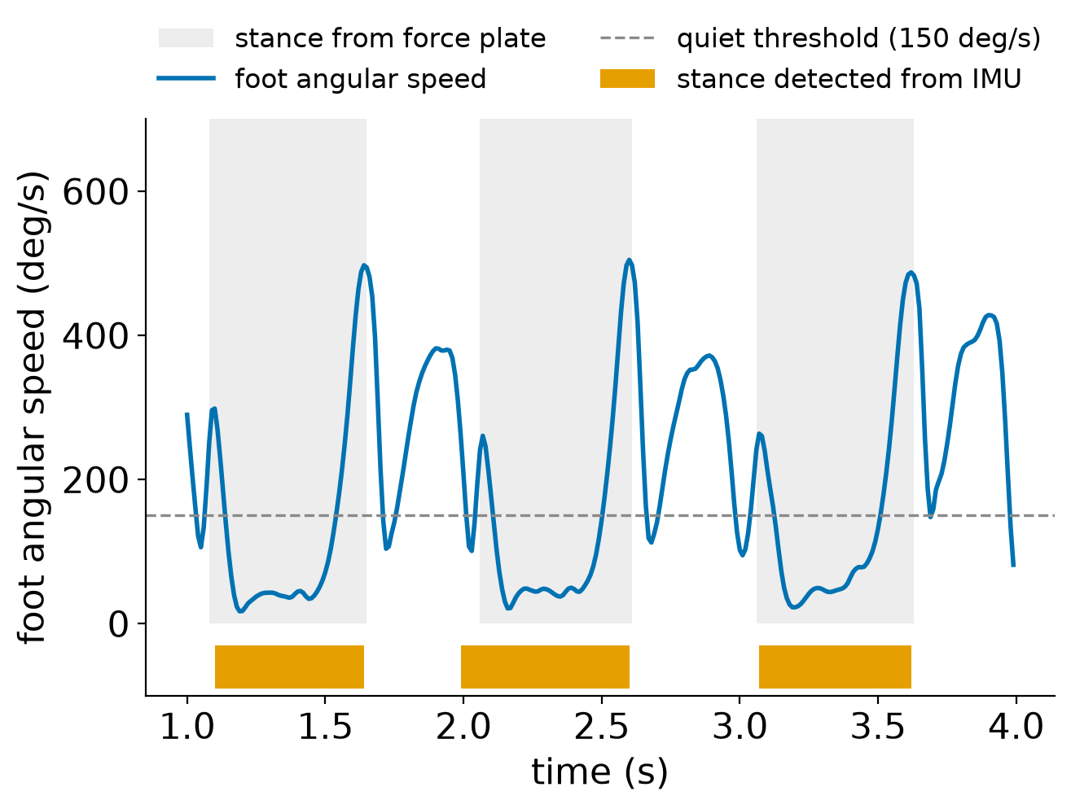
Built: IMU groundwork
Read suit recordings (BVH) → OpenSim orientation files
OpenSense calibration and IMU inverse kinematics
Foot contact without force plates: the foot is down when it stops rotating
Virtual IMUs from mocap trials, with sensor noise and drift, to test before real data
End-to-end check: IMU path vs mocap path vs OpenSim
25 unit tests · docs/IMU_PIPELINE.md · branch imu
Contact from foot rotation agrees with force plates on 96 % of frames; stance edges within ~20 ms (one test trial).
5
Notes:
This is the plumbing for Aim 3. The suit's recordings go through OpenSim's IMU tools (OpenSense) to get the same joint angles the surrogate already uses. The new piece is contact detection: during stance the foot is almost still, during swing it rotates fast, so a threshold on foot angular speed, extended to the heel-strike and push-off peaks, recovers stance. All of it is tested with virtual IMUs made from existing mocap trials, before any real suit data.

Slide 4
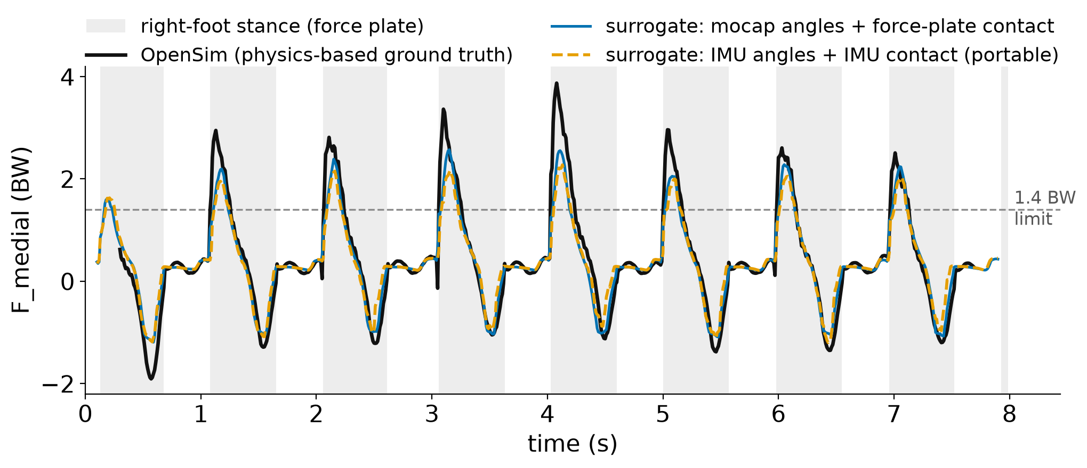
First result: the portable path follows the mocap path
≤0.05°
joint-angle error from
perfect IMUs
0.96–0.98
contact agreement with
force plates
0.207 → 0.261 BW
F_medial error vs OpenSim:
mocap → IMU (1°, 0.5°/s)
6
Notes:
One held-out treadmill trial, Carter P010 trial 10, run through simulated sensors with 1 degree noise and 0.5 degree per second heading drift. Black is OpenSim, blue is the surrogate with mocap and force plates, orange dashed is the fully portable path: IMU joint angles and IMU contact. The orange curve stays close to the blue one; both under-read the tallest peaks, which is a surrogate limitation, not an IMU one. Error vs OpenSim goes from 0.207 to 0.261 BW. This is simulated data on one trial, so it shows the pipeline works, not final accuracy.

Slide 5
Questions
Three aims: is that the right size for an M.S. thesis? Move the stroke cohort to stretch?
Does Perception Neuron 3 include force plates and mocap (needed for knee-load labels)?
9
Notes:
These are the decisions I can't make alone. The most important one is the IMU data. If the incoming datasets have force plates and mocap, I can label them with my OpenSim pipeline and train on real sensors directly; if not, they are for validation only and the virtual-IMU option becomes more important. Second, how they are recorded matters: the suit's exported BVH or FBX files only keep joint rotations and the hip position. The gyroscope and accelerometer signals, and Axis Studio's own foot-contact flags, only come through the live stream, using Noitom's MocapApi SDK. The gyroscope is what fixes the contact-detection weakness from the sensitivity slide, so I would like recordings to log the live stream as well.

