Slide 1

Where is the best place for a Latin-American based restaurant in NYC
Coursera Capstone Project

Slide 2
Restaurant location is important!
If you are in area where people do not go you will not have customers
If you are surrounded by people with the same cuisine it will saturate that cuisine in the area
Being in the right place helps build:
Reputation
Employee Skills
Profit

Slide 3
Data
The data collected was provided by:
IBM Coursera course
Foursquare API
Break down NYC into 5 clusters
Identify what people eat in NYC
Which clusters are most popular food destinations
Identify favorite restaurants in top food destinations

Slide 4
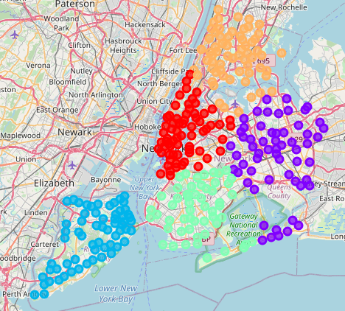
Breakdown of Clusters in NYC
Clusters help identify which zones of NYC are most important to focus on
These clusters happen to match the 5 boroughs on NYC
Each cluster will appeal to a potentially different culture which is important to capture when creating a resteraunt
Cluster 4
Cluster 0
Cluster 1
Cluster 2
Cluster 3

Slide 5
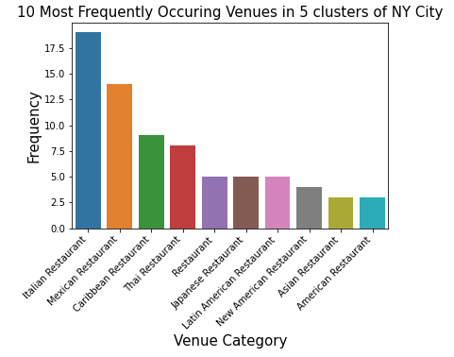
Identify what people eat in NYC
To obtain the overall picture it is important to identify what is most popular in NYC
Mexican food is favorite which would suggest it is not oversaturated relative to other resteraunts

Slide 6
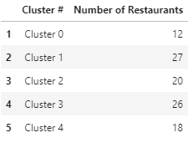
Which clusters are most popular food destinations
Cluster 1 and 3 have the most restaurants which would suggest they are popular food areas or areas which people live.
Important to identify to further understand where people are going out for food

Slide 7
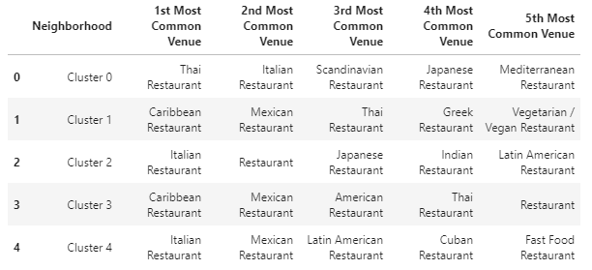
Identify favorite restaurants in top food destinations
Looking at top restaurants in specific clusters can help identify which clusters where Latin-American or Mexican cuisine where it may be preferred or there is too much competition
In the areas we are focusing on there seems to be a healthy amount of competition

Slide 8


Results
The best places to open restaurant are identified below with what is already the most common restaurants there

Slide 9
Conclusion
Cluster 1 and 3 seem to be the most popular for restaurants supporting they are common areas for food which would make for a good restaurant area. It also showed that Mexican cuisine was not one of the most popular which suggests that the placement of one would not congest the area with Mexican food but support it as it is still a common venue. After looking at those factors it would be deemed that either of these locations would be suitable for the placement of a Latin-American restaurant.

