Slide 1
Rockbuster Stealth LLC Strategy Insights - 2020
Gemma Hearne – gemmashearne@rockbuster.de
26.08.2019

Slide 2

Business Context
Rockbuster Stealth LLC is a former global movie rental company now planning to launch an online video streaming service to remain competitive against platforms like Netflix and Amazon Prime.
To support this shift, I was hired as a data analyst within the Business Intelligence (BI) team. My role is to analyse Rockbuster’s existing data using SQL and Tableau, providing insights to guide the new service launch.
This presentation answers key business questions around:
Customer distribution
Revenue drivers
High-value users

Slide 3
TABLE OF CONTENTS
01
02
03
04
05
06
Movies that Contributed to Most/Least Revenue
Objectives & Key Business Questions
Descriptive Statistics Overview
Rental Duration & Pricing Overview
Top 10 Countries by Customer Count
Top 5 High-Value Customers by Location

Slide 4
Objectives & Key Business Questions
Project Objective
Key Business Questions
To support Rockbuster Stealth’s online streaming launch by analysing customer and rental data to uncover actionable insights that inform marketing, inventory and geographic strategy.
Which movies contributed the most/least to revenue?
What was the average rental duration across all movies?
Which countries are Rockbuster‘s customers based in?
Where are high-value customers based geographically?

Slide 5
Descriptive Statistics Overview
Number of Customers | 599
Number of Rentals | 16,044
Average Rental Price | $2.98
Average Rental Duration | 5 days
Minimum Rental Duration | 3 days
Maximum Rental Duration | 7 days
Number of Movies in Inventory | 4,581
This summary provides baseline insight into Rockbuster’s customer and rental patterns
ahead of deeper geographic and revenue analysis.

Slide 6
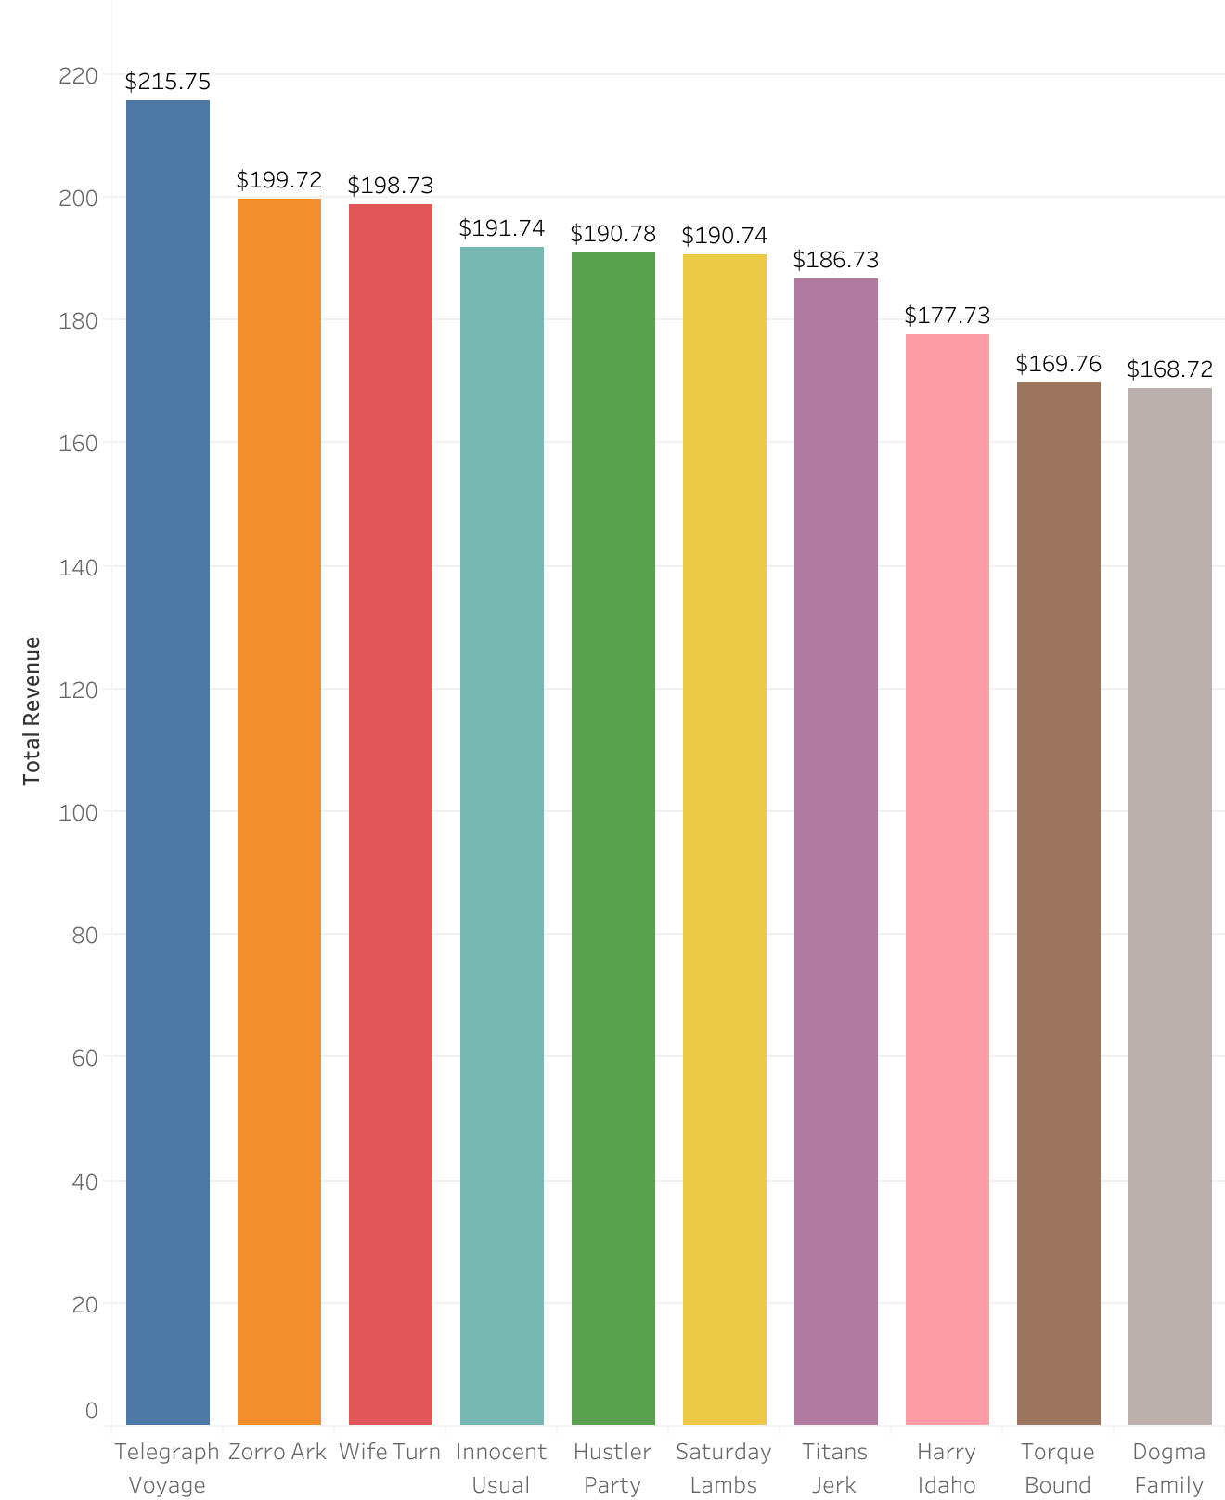
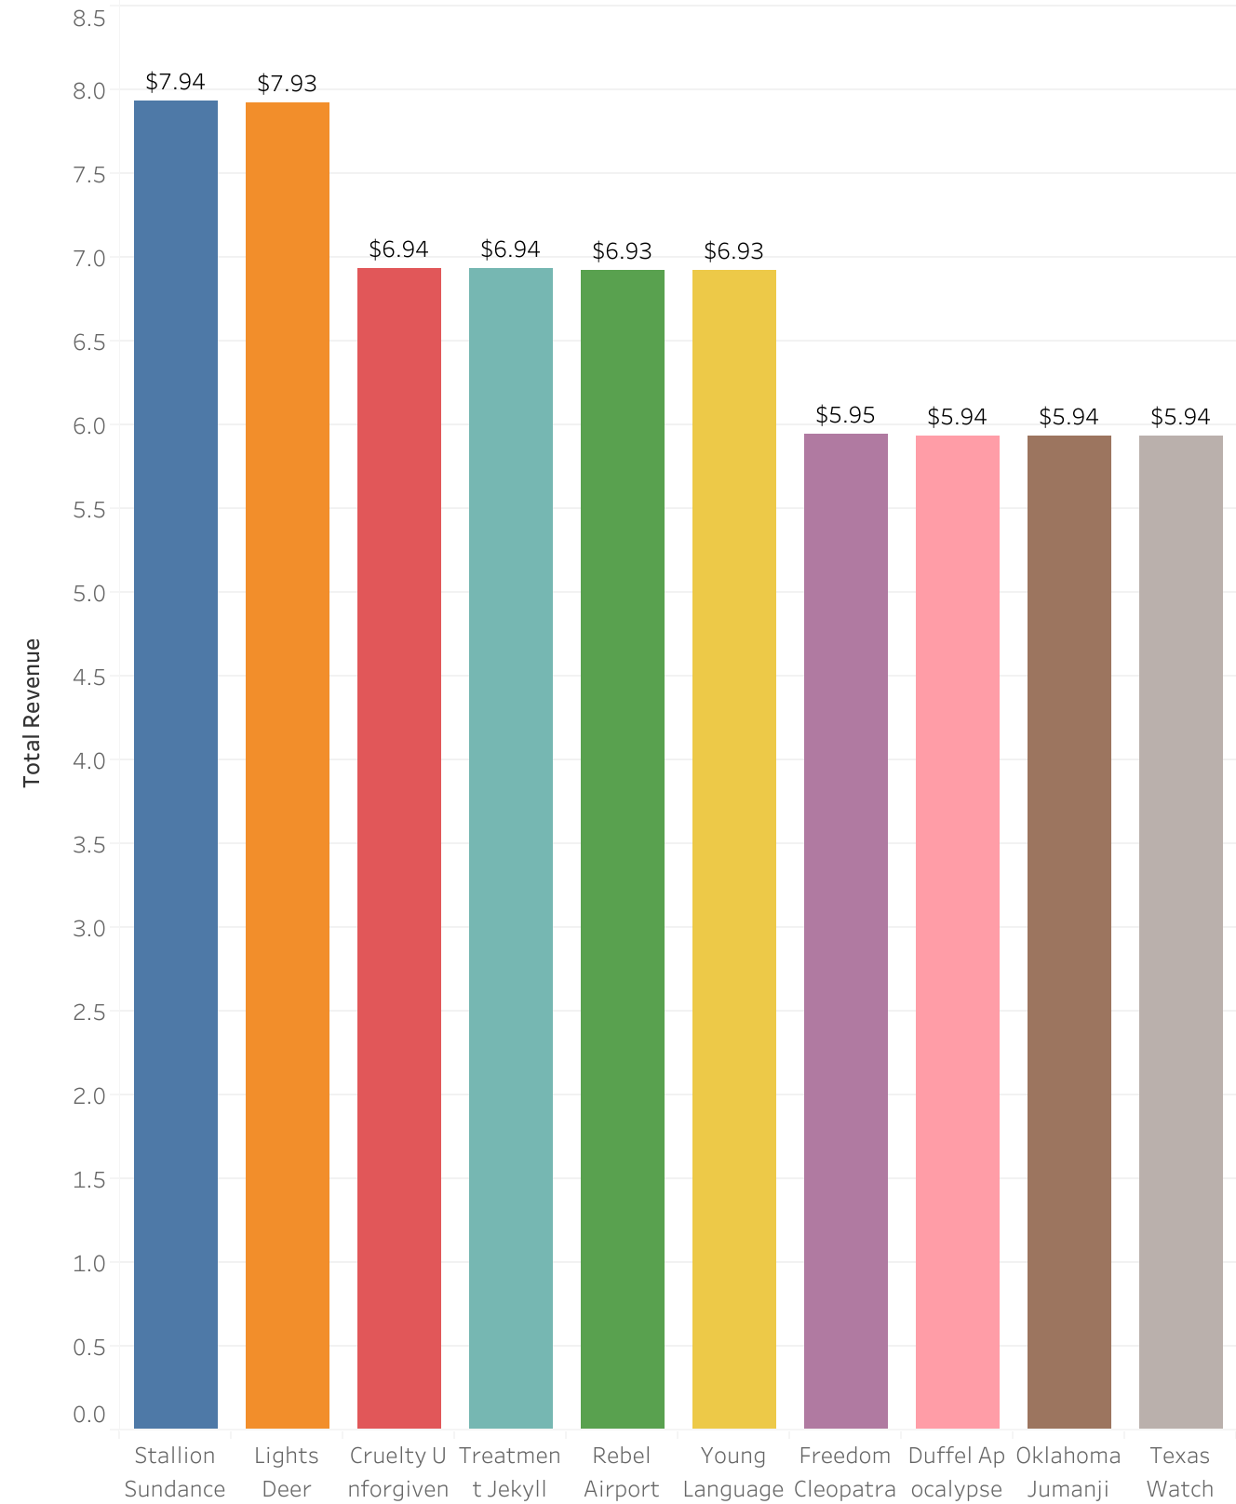
Movies that Contributed Most & Least to Revenue
The above chart are the top 10 performers.
These titles show consistent popularity
And are likely strong candidates for ongoing
Promotion or bundling.
The chart above shows the least profitable
Titles. These movies may be underperforming
Due to limited appeal, outdated content,
Or poor marketing.
Insight: This can guide inventory and marketing strategy. Rockbuster might promote top titles in
Special offers or featured slots, phase out or discontinue poor performers or investigate why certain
movies underperform – is it genre, rating or language?

Slide 7
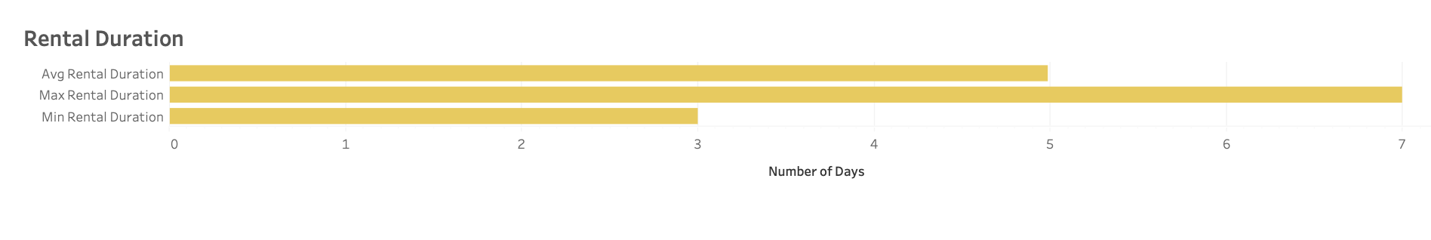
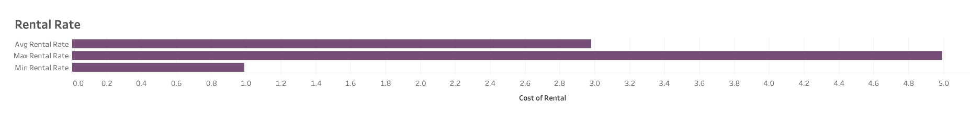
Rental Duration & Pricing Overview
The average rental duration is 5 days, with rentals ranging from 3 to 7 days.
The average rental rate is $2.99, ranging from $0.99 to $4.99.
Pricing and rental time appear consistent and predictable, which supports simple pricing strategy for the future online
rental platform.
No obvious price differentiation by rental duration– this may be an opportuntiy to explore premium pricing for longer
rentals.
Insight: Rental durations and prices are stable and predictable, suggesting Rockbuster could offer fixed-rate rentals
e.g., $2.99 for a 5 day rental). There is potential to test tiered pricing to increase revenue.

Slide 8
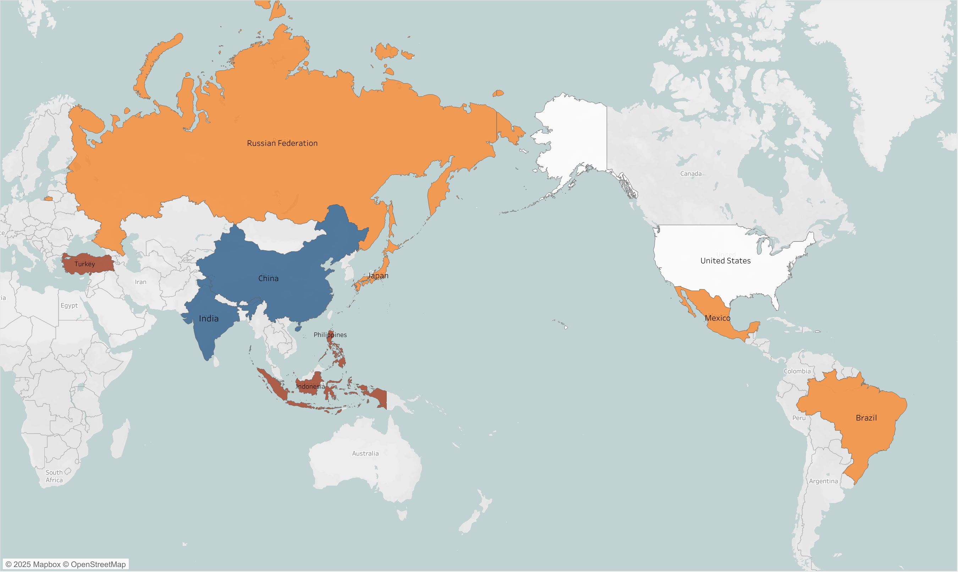
Our Global Reach: Top 10 Countries by Customer
Rockbuster has customers globally, but these top 10
Countries represent our largest customer bases. As
Shown here, India, China, U.S., Japan and Mexico lead
The list. These countries are where Rockbuster is most
Active or popular. Marketing and customer rention
Efforts should prioritise these areas.These are strategic
markets we may want to look at for localised campaigns
Or region-specific promotions.
Tableau
Insight: Rockbuster’s customer base is geographically diverse, but top markets like India, China and U.S. clearly
Stand out. This is where to double down on customer engagement strategies.

Slide 9
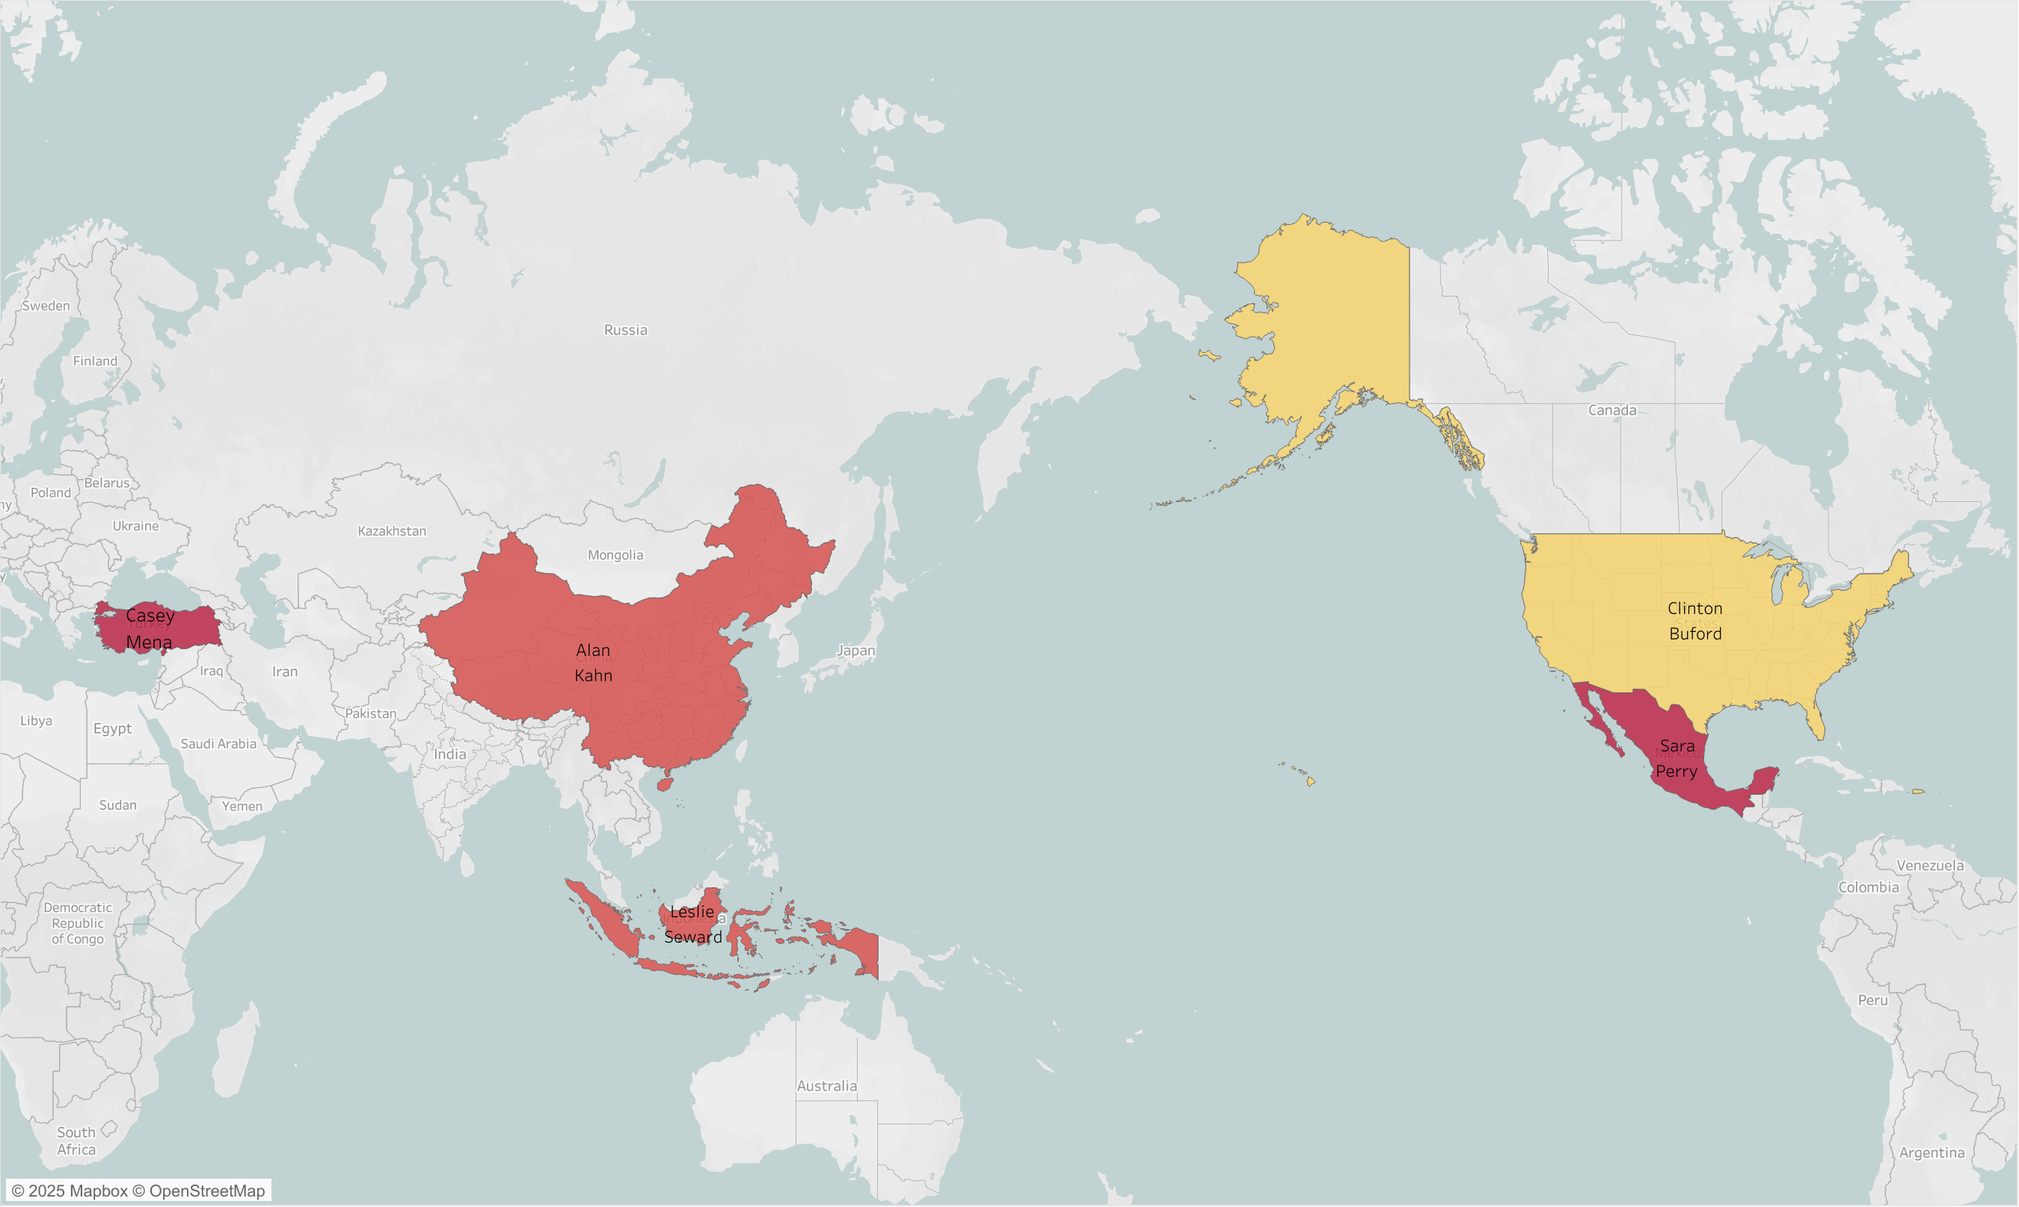
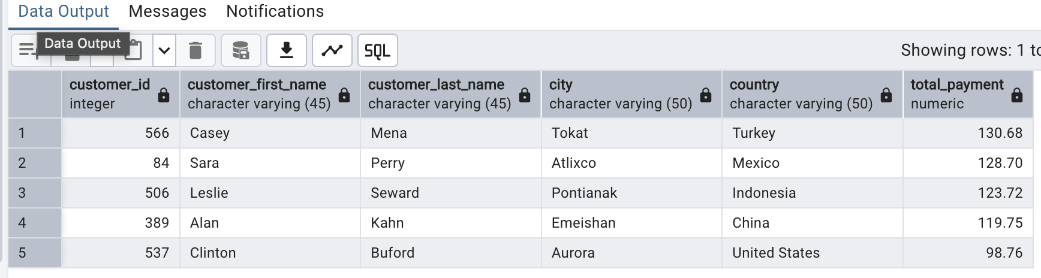
Top 5 Highest-Value Customer by Location
Insight: The top 5 highest-spending customers
Are geographically diverse, located in the U.S.,
Mexico, China, Indonesia and Malaysia. These
Customers contributed significantly to overall
Revenue, with lifetime payments ranging from
$129 to $138. This suggests potential for
Personalised loyalty strategies and
region-specific marketing efforts aimed at
retaining high-value users.
Tableau

Slide 10
Key Insights from the Analysis
High customer concentration in India, China, U.S., Japan and Mexico.
‘Telegraph Voyage’ generated the most revenue; ‘Texas Watch’ the least.
Top customers are spread across U.S., Mexico, China, Indonesia and Malaysia.
Customer location suggests global engagement.

Slide 11
Business Recommendations
Action
Based On
Target digital marketing in India, China and U.S.
Prioritise licensing for top-performing movies.
Create loyalty incentives for high-value customers.
Investigate causes of uner-performing titles.
High customer density there.
Revenue concentration from a few titles.
Top 5 customers represent outsized revenue.
Several movies contributed minimal revenue.

Slide 12
599
4,581
16,044
Customers
Movies in Inventory
Total Rentals

Slide 13
$61,312.04
Total Revenue

Slide 14
THANK YOU
DO YOU HAVE ANY QUESTIONS?
gemmahearne@rockbuster.de
Tableau Workbook

