Slide 1
JPregel
Manasa Chandrashekar
Kowshik Prakasam

Slide 2
Why is graph processing hard ?
Graphs in common problems are humongous
Examples :
World-wide web
Internet graphs
Social network analysis

Slide 3
Why is graph processing hard ?
Graph algorithms are :
Based on exploring graph structure
Not based on large computations on graph data
So graph computations are :
Data-driven
Dictated by the vertex and edge structure of the input graph

Slide 4
State of the art
Use MapReduce
State of the graph has to be fed back across iterations
Causes communication + associated serialization overhead
Difficult to coordinate steps of chained MapReduce

Slide 5
State of the art
Use a single-computer graph library
BGL, LEDA, NetworkX
Doesn’t scale to huge graphs
Use an existing parallel system
Parallel BGL, CGMgraph
Doesn’t support fault tolerance
Build your own beast
Is it reusable ?

Slide 6
Pregel
A large scale system for graph processing
Proposed by Google
Simple and easy to use
JPregel – Implementation of Pregel in Java using RMI

Slide 7
Pregel - Vertex centric approach
Each vertex is processed independently
System composes the actions to lift computation to a large data set
Best suited for distributed implementations
Reusable !

Slide 8
Vertex state machine
A vertex participates in computation when it is active
Votes to halt when it has no further work
Reactivated when it receives a message
Halt
Active
Inactive
Receive message

Slide 9
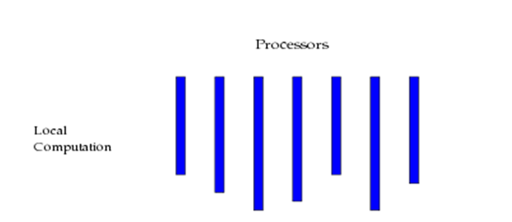
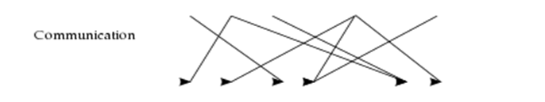

Pregel – BSP (Bulk Synchronous parallel model)
A user defined function is executed at each vertex
Messages are sent to other vertices
Wait for all vertices to finish one iteration of computation
1 SUPERSTEP

Slide 10
Pregel Computation
Performs a sequence of iterations called supersteps
In every superstep :
A user defined function specifies the behavior at every vertex
Every vertex reads messages sent to it in the previous superstep

Slide 11
Pregel Computation
After a superstep, every vertex sends messages to other vertices
These messages will be read in the next superstep
Algorithm terminates when all the vertices vote to halt

Slide 12
JPregel API
abstract class Vertex
Client writes code to be run on every vertex in input graph
abstract void compute( );
final int getVertexID( );
final int getSuperStep( );
final int getNumVertices( );
final double getValue( );
final void setValue(double value);
final List<Edge> getEdges( );
final void sendMessage(Edge e, double msgValue);
abstract void writeSolution(OutputStream o);
compute( ) uses this to send messages to other vertices
Client writes code to dump solution from every vertex
Utility methods

Slide 13
Application Packaging
Application.jar
Vertex
ClientVertex
@Override
public void compute( )
{
..
}
@Override
public void writeSolution(...)
{
..
}

Slide 14
High-Level Design
Application.jar
Copied to JPregel’s classpath
Master
JPregel
Worker Manager 1
Worker Manager 2
Worker Manager N

Slide 15
Architecture : Master
Main Thread
Partition input graph into chunks
Initialize worker managers with partitions
Child Thread
do {
for each worker manager {
begin Nth superstep
}
wait until superstep is over
} until(there are active worker managers)
Ping each worker manager to check if it
is alive
for each active worker manager {
write solutions
}

Slide 16
Architecture : Worker Manager
Thread 1
Worker
Main Thread
Thread 2
Worker Manager
Worker
Thread N
Worker

Slide 17
Architecture : Worker
Worker 1
Worker 2
Main Thread
public void run( ) {
while (true) {
if (isActive( ))
for each partition p
for each vertex v
v.compute( );
}
}
Worker Manager
Worker N

Slide 18
Architecture : Communicator
Send Messages (RMI)
Worker 1
Thread 1
Worker Manager
1
Messages
Send Messages (RMI)
Messages
Thread
Worker
Manager
Worker 2
Thread 2
Worker Manager
2
Communicator
Send Messages (RMI)
Messages
Worker N
Thread M
Worker Manager
M
Pools messages

Slide 19
Architecture : Fault Tolerance
Superstep 1
Master
Superstep 3
Superstep 2
Checkpoint !
Superstep 4
And so on
Superstep 5
Restore
Checkpoint
STOP
Ping
Resume superstep 3
Resume superstep 3
Ping
Ping
Restore
Checkpoint
STOP
Worker Manager 1 Dead
Worker Manager 1
Worker Manager 2
Worker Manager 2
Worker Manager 2
Worker Manager N
Restore vertex states
Serialize vertex states
Serialize vertex states
Restore vertex states
Disk

Slide 20
PageRank
Used by Google to assign a numerical weight to each document in the World Wide Web
A probability distribution that represents the likelihood of a surfer visiting a page
Numerical weight assigned to each element is referred to as its PageRank (PR)

Slide 21
PageRank Formula
Assumes that any surfer who is randomly clicking on links will eventually stop clicking
The probability, at any step, that the person will continue is a damping factor d
d is assumed to be 0.85

Slide 22
PageRank Formula
N -> Number of vertices
L(X) -> Number of outbound links in X
If d = 0.85, then 1-d = 0.15
Recursive
Value of the PageRank is divided among all the outbound links on a page
PR(A) = (1-d)/N + d(PR(B)/L(B) + PR(C)/L(C)
+PR(D)/L(D) + … )
0.15
0.85

Slide 23
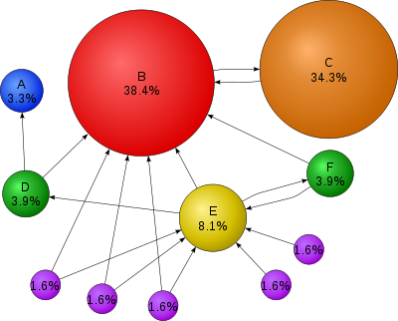
PageRank

Slide 24
Example – Pregel page rank
{
public class PageRankVertex extends Vertex
@Override
public void compute()
if(this.getSuperStep()>=1)
double sum=0;
for(Message msg : this.getMessages())
sum+=msg.getValue();
this.setValue(newPageRank);
if(this.getSuperStep()< 30)
int numEdges=this.getEdges().size();
for(Edge e : this.getEdges())
{
PR(A) = (1-d)/N + d(PR(B)/L(B) + PR(C)/L(C)
0.15 0.85 +PR(D)/L(D) + … )
{
{
}
double newPageRank=0.15/this.getTotalNumVertices()+0.85*sum;
}
{
this.sendMessage(e, this.getValue()/numEdges);
}
}
}

Slide 25
Technical Challenges

Slide 26
Graph Partitioning
Static partitioning
1-1 relation between partitions and worker threads
Reassignment during failures is easy
Worker threads are overloaded
Many-1 relation between partitions and worker threads
Reassignment during failures is difficult
Load balancing is better

Slide 27
Checkpointing
Handling failures in the first superstep
Checkpoint before the first superstep begins
How to handle checkpoint failures ?
Make checkpoint operations atomic

Slide 28
Combiners
Every machine has multiple vertices which might send messages to the same machine
Combine the messages intended for the same machine
Ex: In Dijkstra’s shortest path only the minimum of all the results generated is required to be sent
Reduces the number of RMI calls between machines

Slide 29
Dynamic Class Loading
The application JAR provided by client has to be loaded at runtime
Use Java Reflection API to check if :
Client’s vertex class extends class Vertex
Declares the default public constructor
Deploy the application JAR in JPregel’s class path

Slide 30
Communicator
Machines which receive messages should not block the incoming RMI
Remote object lookup to send messages should happen only once before the first step and once after a failure
Multiple threads send messages to different machines in parallel

Slide 31
Future Work
Generic representation of input graphs
Partitioning based on vertex degrees
Achieves better load balancing
Custom partitioning
Reduces message communication overhead
Ex: Vertices representing pages of the same site for world wide web graphs are assigned to the same worker

Slide 32
Future Work
Distributed database to store messages in communicator and checkpoint data
Dedicated machines to detect faults
Multi-threaded design to issue requests to worker machines to dump solutions once the problem is solved

Slide 33
Q & A

Slide 34
THANK YOU

