Slide 1


Slide 2




WHAT A REMOTE GUY NEEDS ?
WIFI
POWER
COFFEE
TABLE

Slide 3
A CORWORKING ???
20-25€ / day
250-300€ / monthly sub
Almost 1/3 of a rent in Paris !

Slide 4
GIVE ME DA SOLUTION MASTA !
WOFFEE WOFFEE WOFFEE WOFFEE WOFFEE WOFFEE WOFFEE WOFFEE WOFFEE WOFFEE
WOFFEE WOFFEE WOFFEE WOFFEE WOFFEE WOFFEE WOFFEE WOFFEE WOFFEE WOFFEE
WOFFEE WOFFEE WOFFEE WOFFEE WOFFEE WOFFEE WOFFEE WOFFEE WOFFEE WOFFEE
WOFFEE WOFFEE WOFFEE WOFFEE WOFFEE WOFFEE WOFFEE WOFFEE WOFFEE WOFFEE
WOFFEE WOFFEE WOFFEE WOFFEE WOFFEE WOFFEE WOFFEE WOFFEE WOFFEE WOFFEE
WOFFEE WOFFEE WOFFEE WOFFEE WOFFEE WOFFEE WOFFEE WOFFEE WOFFEE WOFFEE
WOFFEE WOFFEE WOFFEE WOFFEE WOFFEE WOFFEE WOFFEE WOFFEE WOFFEE WOFFEE
WOFFEE WOFFEE WOFFEE WOFFEE WOFFEE WOFFEE WOFFEE WOFFEE WOFFEE WOFFEE
WOFFEE WOFFEE WOFFEE WOFFEE WOFFEE WOFFEE WOFFEE WOFFEE WOFFEE WOFFEE
WOFFEE WOFFEE WOFFEE WOFFEE WOFFEE WOFFEE WOFFEE WOFFEE WOFFEE WOFFEE
WOFFEE WOFFEE WOFFEE WOFFEE WOFFEE WOFFEE WOFFEE WOFFEE WOFFEE WOFFEE
WOFFEE WOFFEE WOFFEE WOFFEE WOFFEE WOFFEE WOFFEE WOFFEE WOFFEE WOFFEE
WOFFEE WOFFEE WOFFEE WOFFEE WOFFEE WOFFEE WOFFEE WOFFEE WOFFEE WOFFEE
WOFFEE WOFFEE WOFFEE WOFFEE WOFFEE WOFFEE WOFFEE WOFFEE WOFFEE WOFFEE
WOFFEE WOFFEE WOFFEE WOFFEE WOFFEE WOFFEE WOFFEE WOFFEE WOFFEE WOFFEE
WOFFEE WOFFEE WOFFEE WOFFEE WOFFEE WOFFEE WOFFEE WOFFEE WOFFEE WOFFEE
WOFFEE WOFFEE WOFFEE WOFFEE WOFFEE WOFFEE WOFFEE WOFFEE WOFFEE WOFFEE

Slide 5
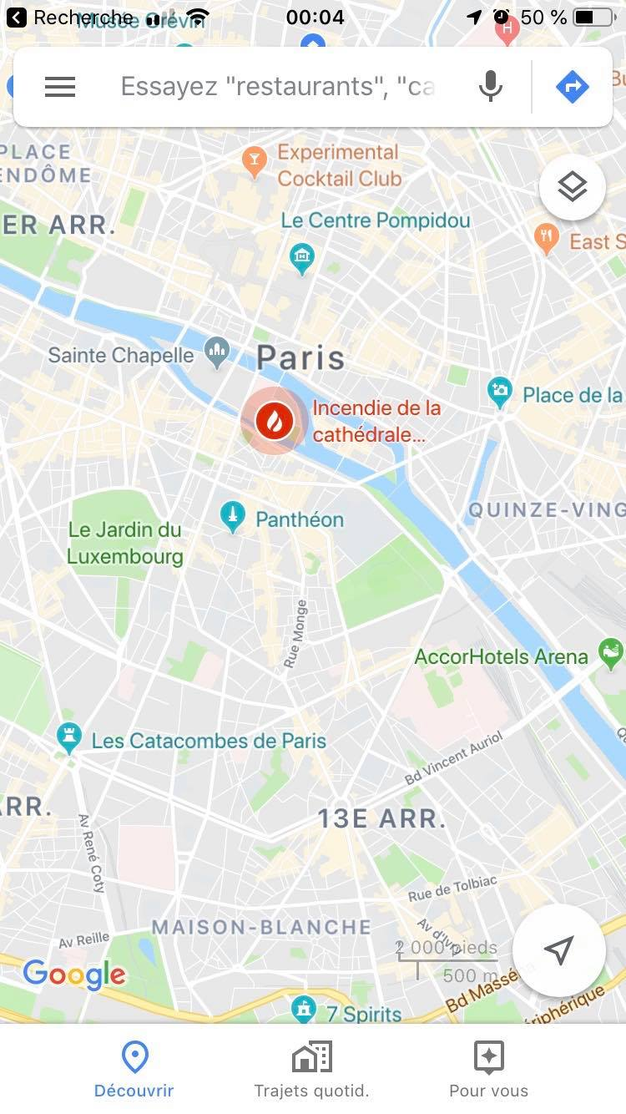
TELL ME MORE!
Curated List of the best coffees in Paris to work
You get to know :
wifi quality
size of tables
price of coffee
amount of power plugs

Slide 6
THAT’S ALL?
PHOTOS
RANDOM
RANGE
FAVORITES
ARTICLE

Slide 7
HOW DO I MAKE DA MONEY ?

