Slide 1

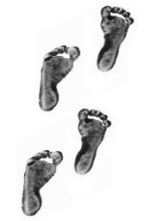
Gemathon
Lapidarists
Ankita
Vaibhav
Swarup
Prabhat
Milind
Nayana

Slide 2
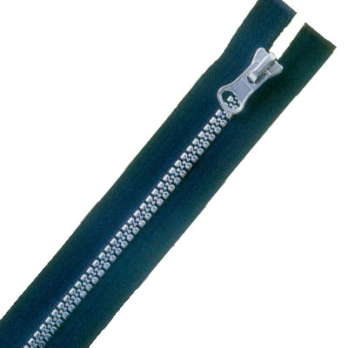
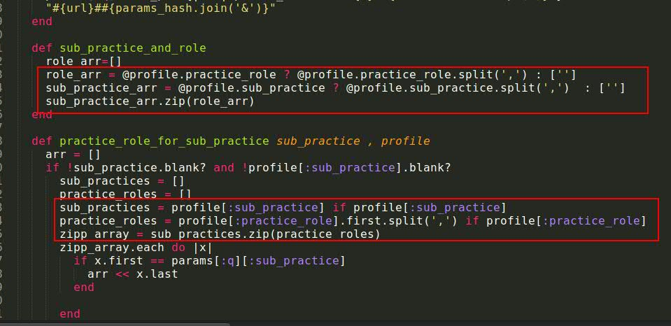
Array Zipper Our Maiden Gem
What does it do???
ArrayZipper Gem takes two strings which has some comma separated text.
Splits it into two respective arrays and then combines the array.
Where did we find it???
PETT code base.

Slide 3
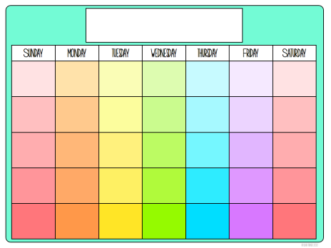
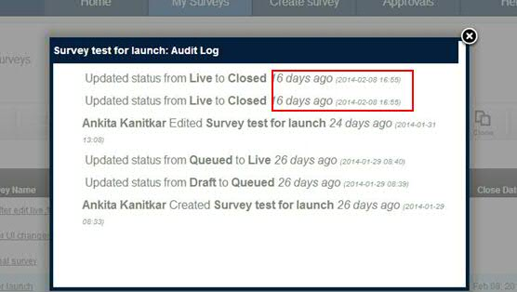
Distance In Weeks
What does it do???
DistanceInWeeks is a simple gem to calculate the distance of a given date from today's date in
weeks and returns the distance in plain English language.
Where did we find it???
DIY Survey code base

Slide 4
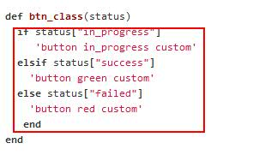
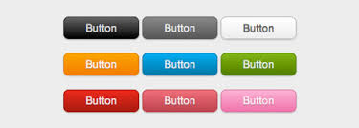
Button Helper
What does it do???
Simple Gem to customize your button class.
Returns the CSS defined for the button (success/failure/progress)
Where did we find it???
Deployer-X

Slide 5


Group Records
What does it do???
Use this gem to group ActiveRecord::Relation objects by Month or Year.
This gem provides two methods which returns hash having keys as month or year and value
as array of all the objects for that month or year.
1. group_by_month
2. group_by_year
Where did we find it???
ODC Navigator Posts

Slide 6

Multi Sort
What does it do???
Sorts an array of hashes with one or more than one key's value of hash.
Accepts an array of hashes as first parameter and array of keys to be sorted by in a order.
Where did we find it???
We have faced the issue of sorting a hash in many of the projects and tried to put an end
to it by creating this gem ☺

Slide 7
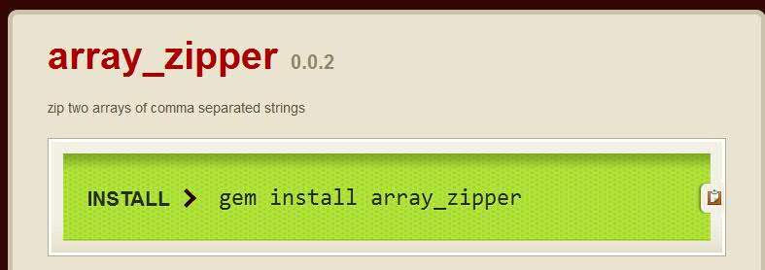
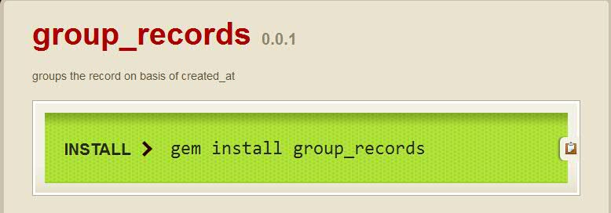
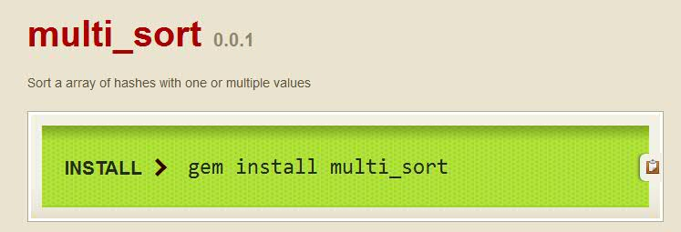
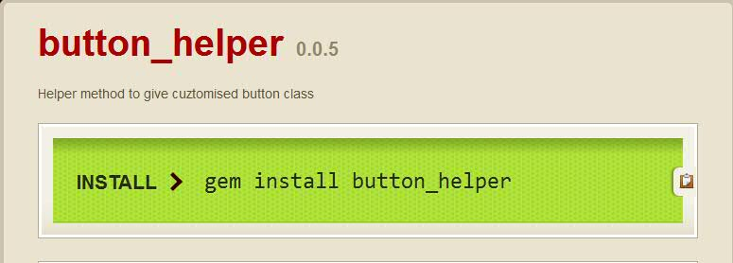
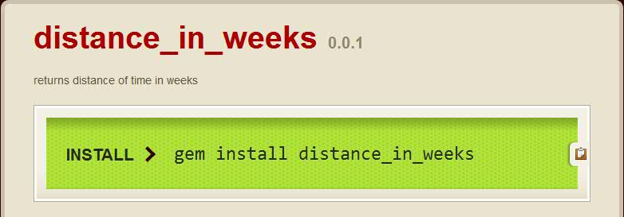
THANK YOU!!

