Slide 1
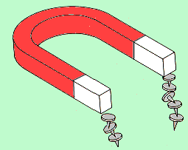
Magnetism
Since ancient times, certain materials, called magnets, have been known to have the property of attracting tiny pieces of metal. This attractive property is called magnetism.
S
Bar Magnet
S
N
N

Slide 2
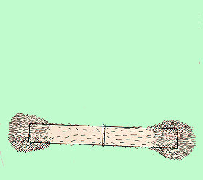
Magnetic Poles
The strength of a magnet is concentrated at the ends, called north and south “poles” of the magnet.
Iron filings
N
S
W
A suspended magnet: N-seeking end and S-seeking end are N and S poles.
N
S
N
S
N
E
Bar magnet
Compass

Slide 3
Magnetic Attraction-Repulsion
N
S
S
N
S
N
N
S
N
S
Magnetic Forces: Like Poles Repel
Unlike Poles Attract

Slide 4
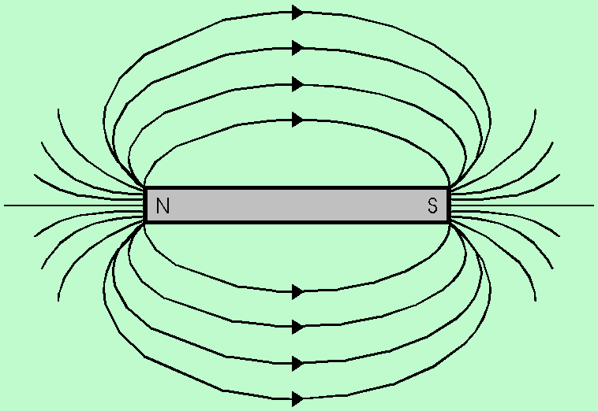

Magnetic Field Lines
We can describe magnetic field lines by imagining a tiny compass placed at nearby points.
N
S
The direction of the magnetic field B at any point is the same as the direction indicated by this compass.
Field B is strong where lines are dense and weak where lines are sparse.

Slide 5
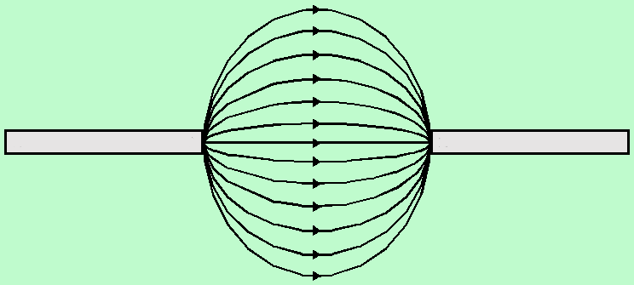

Field Lines Between Magnets
Unlike poles
Attraction
N
S
Leave N and enter S
Repulsion
N
N
Like poles

Slide 6
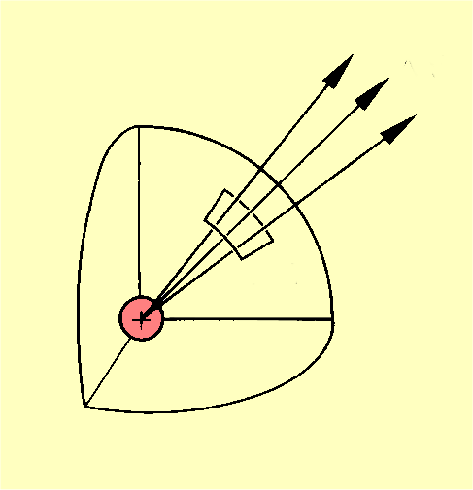
The Density of Field Lines
Electric field
ΔN
Magnetic field flux lines φ
Δφ
ΔA
ΔA
S
N
Line density
Line density
Magnetic Field B is sometimes called the flux density in Webers per square meter (Wb/m²).

Slide 7
Magnetic flux (φ)
It is defined as the total number of magnetic lines of force passing perpendicular through a given area.
Unit: weber.
It can also be defined as the total number of lines of force emanating from North Pole.
Magnetic flux density (or) Magnetic induction (B)
It is defined as the number of Magnetic Lines of force passing through an unit area of cross section. And it is given by,
F
Force
experienced
B
=
=
m
Pole strength

Slide 8
Magnetic Flux Density
Magnetic flux lines are continuous and closed.
Δφ
ΔA
Direction is that of the B vector at any point.
Flux lines are NOT in direction of force but ⊥.
Magnetic Flux density:
When area A is perpendicular to flux:
The unit of flux density is the Weber per square meter.

Slide 9
Magnetic susceptibility (χ)
It is the measure of the ease with which the specimen can be magnetized by the magnetizing force.
It is defined as the ratio of magnetization produced in a sample to the magnetic field intensity. i.e. magnetization per unit field intensity

Slide 10
Magnetic permeability (μ)
It is the measure of degree at which the lines of force can penetrate through the material.
It is defined as the ratio of magnetic flux density in the
sample to the applied magnetic field intensity.
μ ₀ = permeability of free space = 4π × 10 – 7 H m ^{– 1}
μ _{r} = relative permeability of the medium

Slide 11
Biot – Savart Law
Biot - Savart law is used to calculate the magnetic field due to a current carrying conductor.
According to this law, the magnitude of the magnetic field at any point P due to a small current element I.dl ( I = current through the element, dl = length of the element) is,
In vector notation,

Slide 12
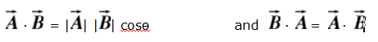
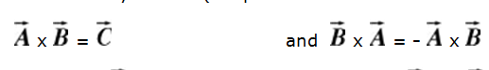
Scalar Product and Vector Product
Vectors can be multiplied in two different ways: the scalar and vector product. As the name says, a scalar product of two vectors results in a scalar quantity, and a vector product in a vector quantity.
Scalar Product:
The result of this product is a scalar quantity. The scalar product between two vector is denoted by a thick dot:
Vector Product:
The result of this product is a vector quantity. The vector product between two vector is denoted by a cross (the product is sometimes also called "cross-product"):

Slide 13




Operators
Del: it is commonly symbolized by the inverted capital Greek letter delta, is considered as an operator with the following definition:
i, j, & k are the directions
x, y, z are the variables
Gradient: when del is combined with the scalar function f, we get Gradient.
another way of writing gradient is

Slide 14

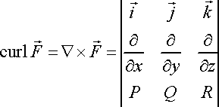
Divergence: it is also known as del dot, a dot product of del with vector, which is given by
Curl: it is also known as del cross, a cross product of del with vector. Which is given by

Slide 15
Divergence, Curl and Gradient Operations
(i) Divergence
The divergence of a vector V written as div V represents the
scalar quantity.
div V = ∇ • V =

Slide 16
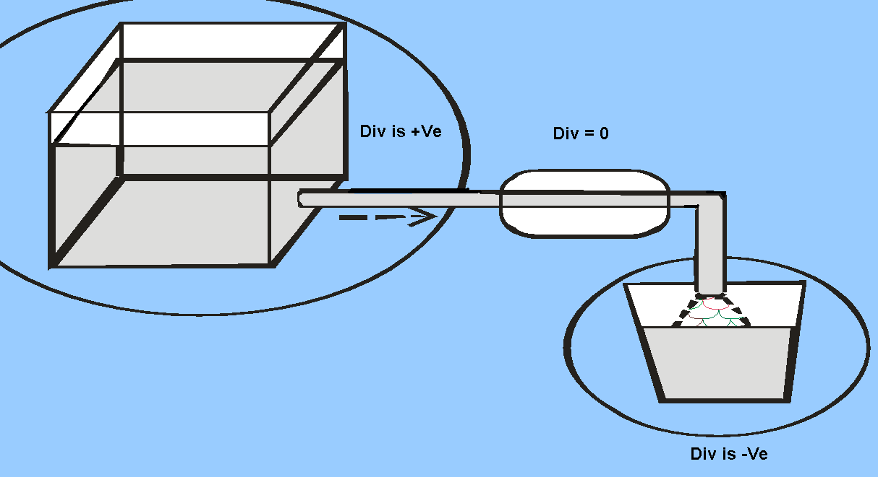
Example for Divergence

Slide 17
Physical significance of divergence
Physically the divergence of a vector quantity represents the rate of change of the field strength in the direction of the field.
If the divergence of the vector field is positive at a point then something is diverging from a small volume surrounding with the point as a source.
If it is negative, then something is converging into the small volume surrounding that point is acting as sink.
if the divergence at a point is zero then the rate at which something entering a small volume surrounding that point is equal to the rate at which it is leaving that volume.
The vector field whose divergence is zero is called solenoidal.

Slide 18
Curl of a Vector field
Curl V =
Physically, the curl of a vector field represents the rate of change of the field strength in a direction at right angles to the field and is a measure of rotation of something in a small volume surrounding a particular point.
For streamline motions and conservative fields, the curl is zero while it is maximum near the whirlpools

Slide 19
Representation of Curl
(I) No rotation of the paddle wheel represents zero curl
(II) Rotation of the paddle wheel showing the existence of curl
(III) direction of curl
For vector fields whose curl is zero there is no rotation of the paddle wheel when it is placed in the field, Such fields are called irrotational

Slide 20
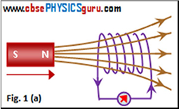
The Experiments of Faraday and Henry
Magnet and coil Experiment
When the North-pole of a bar magnet is moved towards the coil or loop, the galvanometer connected to the coil shows deflection. It confirms the flow of electric current in the coil. It is also noted that the deflection lasts as long as the bar magnet is in motion. No deflection is shown by the galvanometer when the magnet does not move.

Slide 21
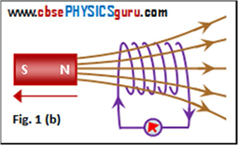
When the North-pole of the bar magnet is moved away from the coil, the galvanometer shows deflection in the opposite direction. It indicates that the current flows in the reverse direction.

Slide 22
If the same experiment is repeated with the South-pole of the bar magnet, the deflections shown by the galvanometer are just opposite to that observed with the North-pole for similar movements (towards the coil or away from the coil). In other words, if the South-pole is moved towards the coil, we will get the result shown in figure 1(b). If the South-pole is moved away from the coil, we will get the result as shown in figure 1(a)

Slide 23
The deflection, and consequently current becomes larger if the magnet is moved towards or away from the coil at a quicker rate.
Now, if the coil is moved towards or away from the stationary magnet, the same results are produced. It establishes that electric current in the coil is induced due to the relative motion between the magnet and the coil. It does not matter which is moving.

Slide 24
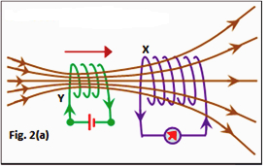
Coil and Coil Experiment
If a second coil Y carrying a steady current drawn from a battery is moved towards the coil X connected to a galvanometer, then the galvanometer shows a deflection. This confirms that an electric current is induced in coil X. See figure 2(a). The deflection in the galvanometer lasts as long as the coil Y is in motion.

Slide 25

When coil Y is moved away from the coil X, the galvanometer shows a deflection in the opposite direction. See figure 2(b). It is also noted that the deflection lasts as long as the coil Y is in motion. No deflection is shown by the galvanometer when the coil Y does not move.

Slide 26
Now, if the coil X is moved towards or away from the stationary coil Y, the same results are produced. It establishes that electric current in the coil X is induced due to the relative motion between the two coils. It does not matter which is moving.
In both the cases, the deflection, and consequently current becomes larger if a coil is moved towards or away from the other coil at a quicker rate.

