Slide 1
Bank Direct Marketing Campaign Analytics
By
Abhijeet Sethy & Akhilesh Buxi Pattnaik

Slide 2
Objective:
The information relates to telephone-based direct marketing activities of a Portuguese banking institution. The classification's objective is to foretell the client's intent to sign up for a term deposit. Data from a Portuguese banking institution's direct marketing efforts is being used. On phone conversations, the marketing campaigns were based.
Benefits:
This project will allow the bank to obtain a more detailed understanding of its prospective customers, understand behaviour of customer responses to telemarketing campaigns, and create a target customer profile for future marketing plans.
The bank can then target those customers with its marketing efforts.
This will not only allow the bank to secure deposits more effectively, but it will also increase customer satisfaction by removing advertisements that are unsuitable for certain customers.

Slide 3
Data Sharing Agreement :
Bank.csv ( Sample File)
Bank_full.csv (Full Dataset)
Number of Columns: 17
Column names: age;"job";"marital";"education";"default";"balance";"housing";"loan";"contact";"day";"month";"duration";"campaign";"pdays";"previous";"poutcome";"y"

Slide 4
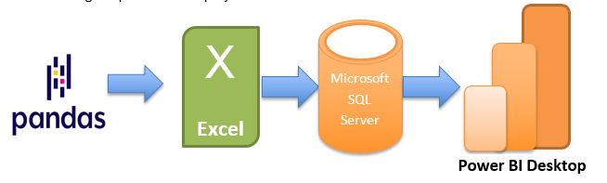
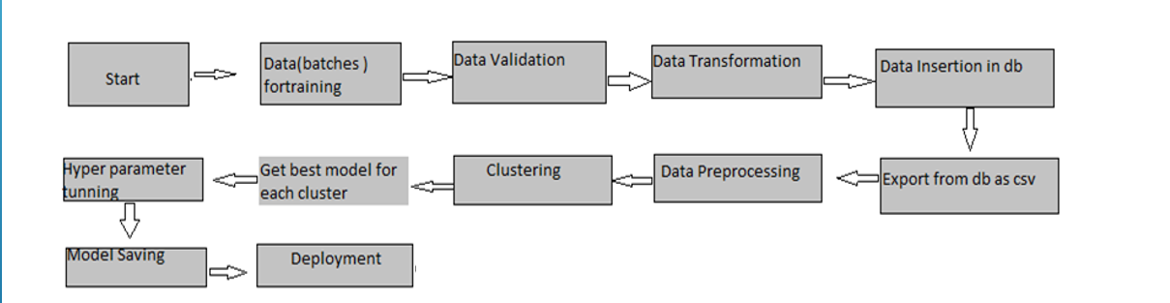
Architecture

Slide 5
Data Transformation :
Data was given in two .csv files ; one was sample file and other one was the full dataset named as ‘bank_full.csv’.
At first the data was cleaned on the basis of outliers elimination process using pandas library in python.
Later the dataset was imported to a SQL server for further process.
Then, in order to improve the visualization process, three more classified columns were added i.e. Age category, financial Category, call duration.

Slide 6
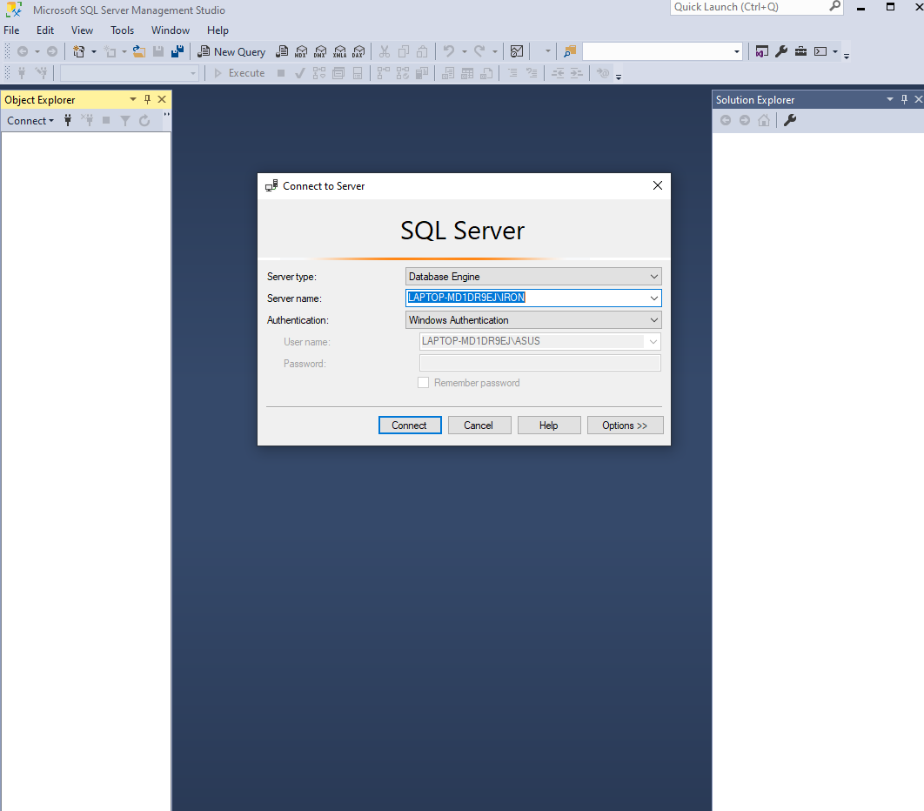
SQL server creation

Slide 7
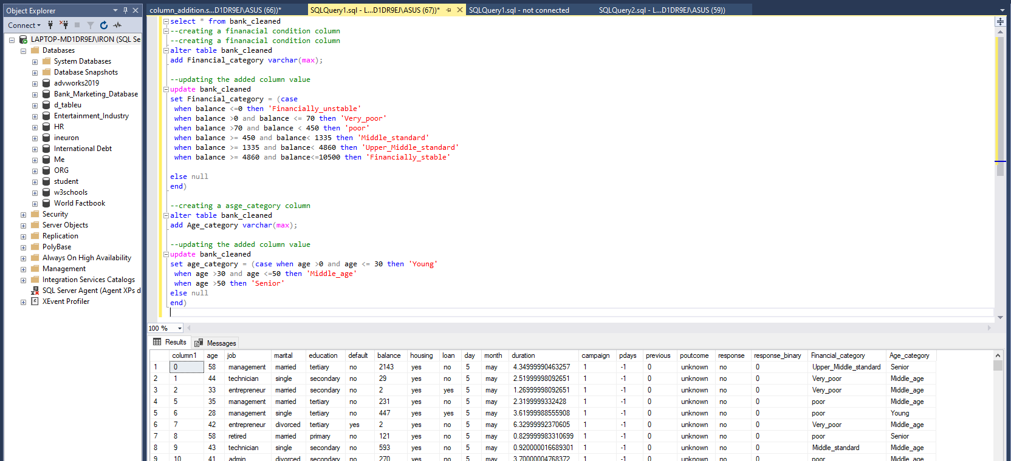
Column Addition…..

Slide 8
Final Columns and their description
Column Name | Description
Age | This column shows us the age of individual customer.
Job | Here, the customer's work type is specified.
Martial | Here, it is shown if the person is married or not.
Education | This column contains the customer's highest level of education
Default | If the consumer has credit in default or not, this field lets us know.
Balance | This column indicates the available balance on the customer's bank account.
Housing | This states if the individual has a mortgage or not.
Loan | Here it is stated whether the person has a personal loan or not.
Day and month | The last contact day of the week and the last contact month of the year are listed in these two columns
Duration | The latest contact's overall duration is displayed in this column in minutes.
Campaign | The amount of contacts made for this customer and throughout this campaign.
Pdays | The total number of days that passed by after the client was last contacted from a previous campaign
Previous | The total amount of contacts made for this client and before this campaign
Poutcome | This column shows results of the preceding marketing effort
Response | Whether or not the client has subscribed to the term deposit is shown by the final result in this column
Financial category | As stated up front, this column indicates the customer's financial situation.
Age category | For convenience in categorising the consumer in the visualisation step, the age category to which they belong is indicated here.
Call duration | Call duration has been categorized in 4 categories as mentioned above.

Slide 9
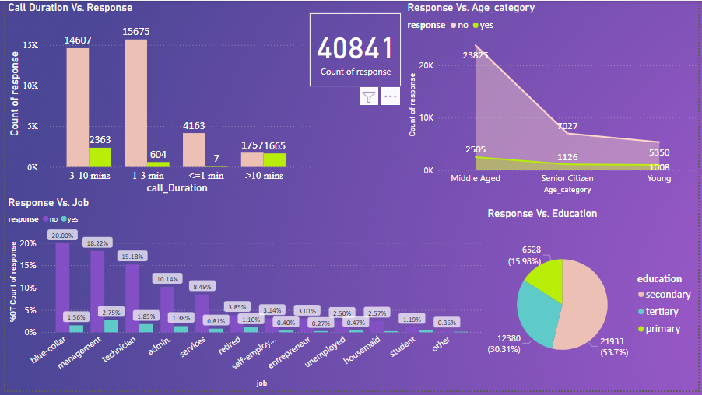
Data Visualization
Data visualization was done with the help of Microsoft POWER BI which was connected to SQL server via direct query method so that any changes data will reflect in POWER BI automatically.

Slide 10
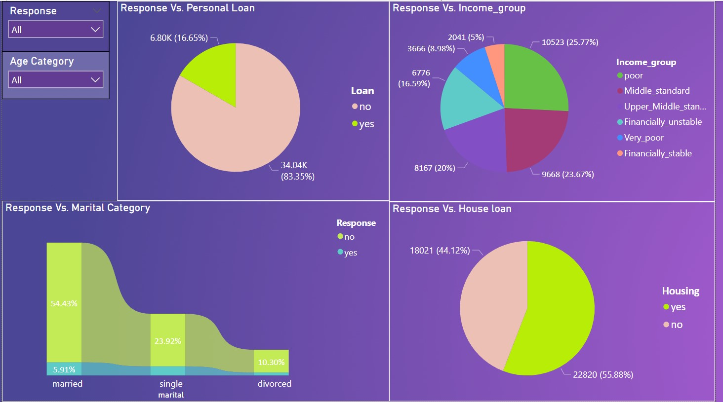
Data Visualization
Data visualization was done with the help of Microsoft POWER BI which was connected to SQL server via direct query method so that any changes data will reflect in POWER BI automatically.

Slide 11
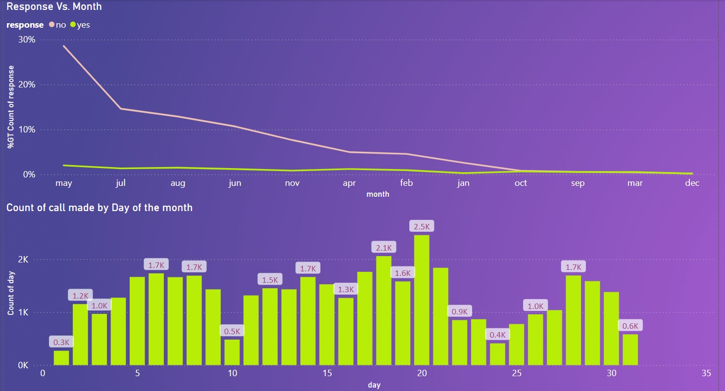
Data Visualization
Data visualization was done with the help of Microsoft POWER BI which was connected to SQL server via direct query method so that any changes data will reflect in POWER BI automatically.

Slide 12
Final Analysis:
Thus, we can see that the youngest and oldest age groups benefit more from the conversion.
Therefore, rather than focusing on the middle-aged groups, we might target these two segments.
Compared to blue-collar and self-employed workers, retirees and the jobless are more likely to convert.
However, historically, fewer retirees have been approached.
The likelihood of conversion is higher for single people than for married or divorced people.
People with positive balance are twice as likely to subscribe to term deposit plan than with nil or negative balance.
The conversion of customers on the basis of time of month converted is more or less uniformly distributed
Most of the calls made during 14-21st of the Month, and then some between 5-8th and some during 28-30th of the month. This can be explained by Initial calling after receiving salary at the beginning (5-8th) of the Month. Then to follow up after a cooling period of 2 weeks. And then at the end of the month if people are looking to invest their monthly savings.

Slide 13
Deployment :
The final report is published in Power BI service. Then the link is shared to client. Below is the document link to access the report.
Link: https://app.powerbi.com/view?r=eyJrIjoiMjJlOWVmNmEtMmU3Zi00NWM1LWE5ZmYtZTNiOGZkMTE1Mzc0IiwidCI6ImRmODY3OWNkLWE4MGUtNDVkOC05OWFjLWM4M2VkN2ZmOTVhMCJ9&pageName=ReportSection
Also the entire project is uploaded in Novypro.com for public use.
Link: https://www.novypro.com/project/abpattanaik96novyprocom

