Slide 1

2020 DISEASE DETECTIVES (B,C)
  KAREN LANCOUR
  National Bio Rules Committee Chairman

Slide 2
Event Rules – 2020
DISCLAIMER
This presentation was prepared using draft rules. There may be some changes in the final copy of the rules. The rules which will be in your Coaches Manual and Student Manuals will be the official rules.

Slide 3
Event Rules – 2020
BE SURE TO CHECK THE 2020 EVENT RULES FOR EVENT PARAMETERS AND TOPICS FOR EACH COMPETITION LEVEL

Slide 4
Disease Detectives
Part 1 – Background & Surveillance
Part 2 – Outbreak Investigation
Part 3 – Patterns, Control & Prevention

Slide 5
Event Rules – 2020
Disease Detectives emphasizes the process of investigating health-related events
When specific events are being analyzed,
competitors should not be expected to know facts such as latency or incubation periods or causative agents about diseases or conditions.
These should be provided in background information or the body of the question.

Slide 6
SOSI
TRAINING MATERIALS
Training Power Point – content overview
3 Training Handout – Parts 1,2 & 3
Practice Activities – to help learn the process
Sample Tournament – sample problems with key
Event Supervisor Guide – prep tips, event needs, and scoring tips

Slide 7
SO WEBSITE
TRAINING MATERIALS
EVENT RESOURCES – the Science Olympiad website www.soinc.org
under Event Information-will be posted throughout the fall
  Training Power Point – content overview
  Internet Resource – links to good resources for learning content
  Training Handouts – overview, general principles
  Sample Tournament – sample problems with key
  Event Supervisor Guide – prep tips, event needs, and scoring tips
Training CD’s – the Science Olympiad Store at www.soinc.org
  Biology-Earth Science CD (BECD) – current year topics for all bio events
  with training materials and extra resources
  Disease Detectives CD (DDCD) – all content, extra resources, exams from from invitational, regional, state & national competitions
  Division B and Division C Test Packets – national exams from the previous year

Slide 8
On-line Text Books
Principles of Epidemiology 3rd edition from CDC
http://www.cdc.gov/osels/scientific_edu/SS1978/SS1978.pdf
Epidemiology Basics published by the World Health Organization
http://whqlibdoc.who.int/publications/2006/9241547073_eng.pdf

Slide 9
Game Plan
Use the POWERPOINT for an overview
Study the HANDOUTS – for background information and content
Use the INTERNET RESOURCES and CD’S for more help – see the Science Olympiad National website at www.soinc.org under event information and the Science Olympiad store
Prepare a RESOURCE BINDER and use OTHER TOOLS to LEARN THE CONTENT AND PROCESS SKILLS
Prepare your ONE PAGE OF NOTES for effective use in competition
Do PRACTICE ACTIVITIES to prepare for doing a competition
Do the SAMPLE TOURNAMENT under timed conditions to experience being timed in competition.
Prepare and do PRACTICE STATIONS, OLD TESTS, and INVITATIONALS –to master knowledge, teamwork, and using your notes effectively under timed conditions.

Slide 10
Event Makeup
Format and material of the Division B and C event is similar except that the level of reasoning and math skills should be consistent with the grade level. Differences between the two levels should be reflected in both the type of questions asked and the scoring rubrics.

Slide 11
Types of skills needed
  Recognize risk factors for health problems
  Know the components of the scientific method used in investigating a disease outbreak to real-life situations affecting health
  Understand and interpret the basic concepts of mathematics (rates & proportions as attack rate, relative risk & odds ratio) used to assess health risks
  Recognize an epidemiological case definition
  Know the different types of study designs used by epidemiologists and be able to recognize them from written accounts

Slide 12
PART ONE: BACKGROUND & SURVEILLENCE
Clinical Approach vs. Public Health Approach
History of Epidemiology & Population Health
Components of Public Health
Epidemiology & Public Health
Natural History & Spectrum of Disease
Public Health Surveillance

Slide 13
Clinical vs. Public Health Approaches
 | Public Health | Clinical Medicine
Primary Focus | Populations | Individuals
Emphasis | Prevention | Diagnosis
 | Health Promotion | Treatment
 | Whole Community | Whole Patient
Paradigm | Interventions aimed at Environment, Human Behavior and Lifestyle, and Medical Care | Medical Care
Organizational Lines of Specialization | Analytical (Epidemiology); | Organ (Cardiology);
 | Setting and Population (Occupational Health); | Patient Group (Pediatrics);
 | Substantive Health Problem (Nutrition); | Etiology, Pathophysiology (Oncology, Infectious Disease)
 | Skills in Assessment, Policy Development, and Assurance | Technical Skill (Radiology)
[Adapted from: Fineberg, Harvey, MD, PhD, Dean, Harvard University School of Public Health, 1990. Traditional Distinctions Between Public Health and Medicine. Table 5-1, Who Will Keep the Public Healthy? Educating Public Health Professionals for the 21st Century. Institute of Medicine, 2003.

Slide 14
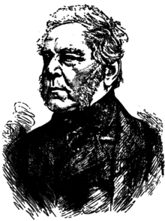

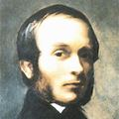
History of Public Health
& Epidemiology
John Gaunt – analysis of mortality rates- 1662.
William Farr – father of vital statistics & surveillance - 1800
John Snow – father of field epidemiology – cholera in London 1850s

Slide 15


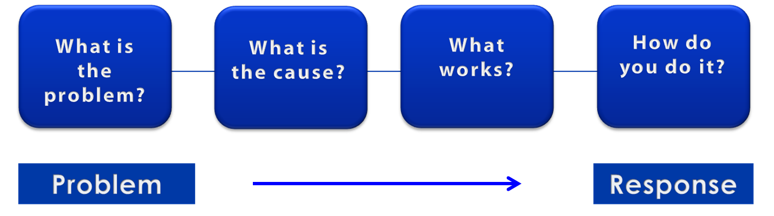
A Public Health Approach
Risk Factor Identification
Intervention
Evaluation
Surveillance
Implementation
15
Notes:
SAY:
Let’s talk about public health in a broader context. Public health problems are diverse and can include infectious diseases, chronic diseases, emergencies, injuries, environmental health problems, as well as other health threats.
Regardless of the topic, we take the same approach to a public health problem by following four general steps.
<CLICK for first arrow to appear.>
First, we ask, “What is the problem?”
In public health, we identify the problem by using surveillance systems to monitor health events and behaviors occurring among a population.
After we’ve identified the problem, the next question is, “What is the cause of the problem?”
<CLICK to advance animation; first arrow will disappear, and second arrow will appear above Risk Factor Identification box.>
For example, are there factors that might make certain populations more susceptible to disease, such as something in the environment or certain behaviors that people are practicing?
<CLICK to advance animation; second arrow will disappear, and third arrow will appear above Intervention Evaluation box.>
After we’ve identified the risk factors related to the problem, we ask, “What intervention works to address the problem?”
We look at what has worked in the past in addressing this same problem and if a proposed intervention makes sense with our affected population.
<CLICK to advance animation; third arrow will disappear, and fourth arrow will appear above Implementation box.>
In the last step, we ask, “How can we implement the intervention? Given the resources we have and what we know about the affected population, will this work?”
As we go through this course, you will see different examples of this public health approach at work.
GO to next slide.

Slide 16
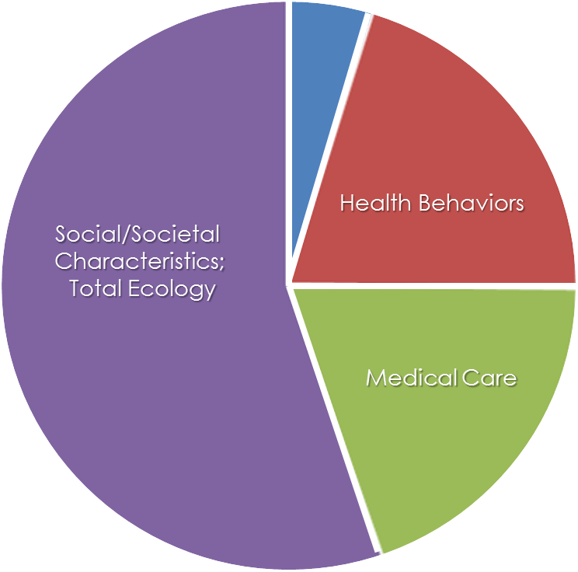
What Determines the Health of a Population?
Genes and Biology
Social/Societal
Characteristics;
Total Ecology
Health Behaviors
Medical Care
16
Centers for Disease Control and Prevention. Social determinants of health. http://www.cdc.gov/socialdeterminants/FAQ.html.
Notes:
SAY:
This chart is an estimate of how these four major determinants influence health at the population level.
Notice the portion of the chart that represents medical care. We spend trillions of dollars on health care, yet it only determines about 25% of our health. The remaining 75% of what determines our health as a population is our total environment or ecology, including the social environment in which we live, plus our health behaviors and to a lesser extent, our genes and biology.
An example of the role these determinants play in our daily lives is through nutrition and physical activity. Both are essential elements in producing optimal health and should be viewed in the context of such environmental factors as
social and cultural norms that influence food choices and physical activity,
environmental characteristics, such as availability (lack of healthy food, open space for exercise, or safety in urban neighborhoods), and
sector influences, such as the marketing of processed food.
All of these factors influence our individual choices, which in turn, influence our overall health.
GO to next slide.

Slide 17
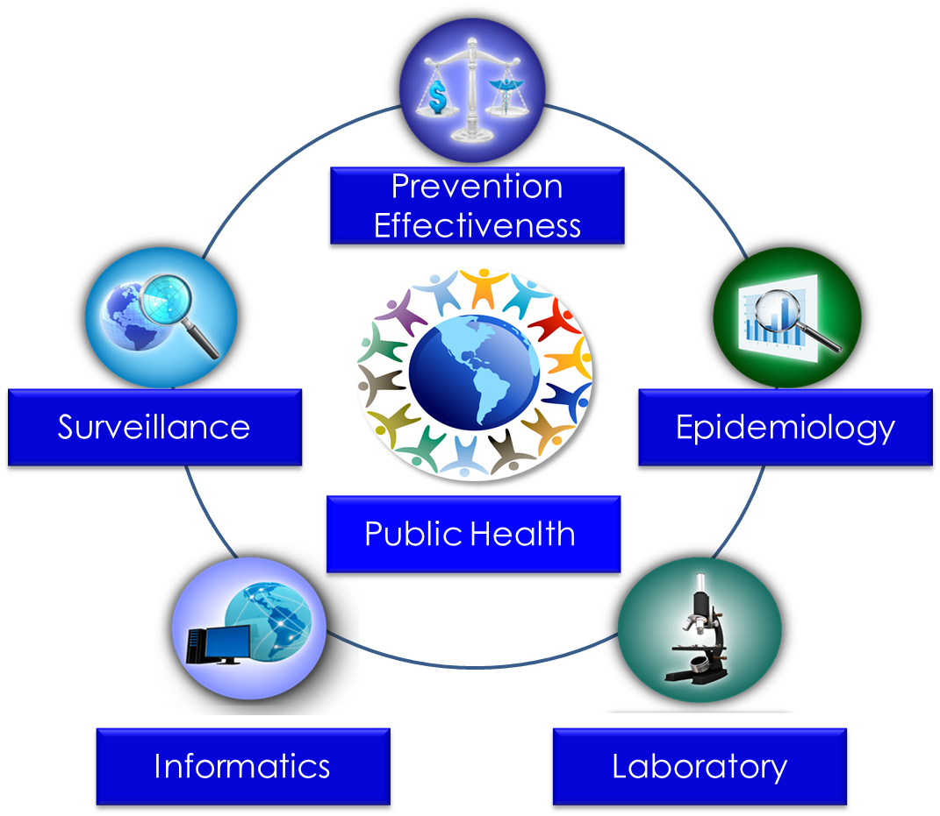
Public Health Core Sciences
17
Notes:
SAY:
To implement the public health approach, practitioners use and apply scientific methods. These methods come from a series of core sciences that provide the foundation.
These sciences include Public Health Surveillance, which we use to monitor a public health situation.
Epidemiology enables us to determine where diseases originate, how or why they move through populations, and how we can prevent them. We’ll learn more about epidemiology during today’s course.
Public Health Laboratories support public health by performing tests to confirm disease diagnoses. Laboratories also support public health by conducting research and training.
As we continue to move from the use of paper documents to electronic health records, Public Health Informatics continues to increase in importance. Informatics deals with the methods for collecting, compiling, and presenting health information. It enables us to use electronic data effectively when addressing a public health situation.
Prevention Effectiveness is closely linked to public health policy. Prevention effectiveness studies provide important economic information for decision makers to help them choose the best option available.
Together, these five core sciences can help us protect and promote the public’s health by giving public health practitioners the answers they need. Public health is better able to respond to the situation by using contributions from each of these sciences. One science alone cannot answer the questions and provide a solution; it is the application of these core sciences together.
<OPTIONAL, IF TIME PERMITS, SAY>
For example, let’s look at the public health challenge of influenza. Public health surveillance can monitor when and where cases of influenza occur each year. Professionals can use the science of epidemiology to understand why different populations choose to get vaccinated against influenza. They can use the science of informatics to receive and analyze electronic information from health care institutions (e.g., doctors’ offices and hospitals) to determine whether persons who get influenza go to see a doctor and whether they get well or die. Public health practitioners can use laboratory science to determine whether persons with fever and cough have influenza or a different infection, and they can use prevention effectiveness to show that influenza vaccination campaigns that might cost $200,000 can prevent $1 million in medical costs, lost wages, and other costs.
GO to next slide.

Slide 18
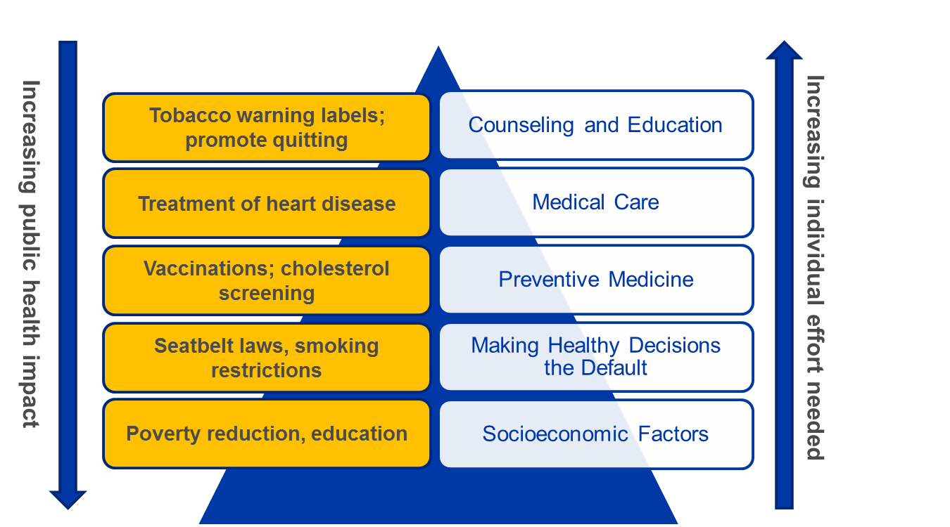
Types of Public Health Issues
Alcohol-related harms
Food safety
Healthcare-associated infections
Heart disease and stroke
HIV
Motor vehicle injury
Nutrition, physical activity and obesity
Prescription drug overdose
Teen pregnancy
Tobacco use

Slide 19
EPIDEMIOLOGY
Scientific Method – organized problem solving
Distribution and determinants of disease in human populations
Prevent and control those diseases
Health-related events:
  chronic diseases
  environmental problems
  behavioral problems
  injuries
  infectious diseases

Slide 20
Descriptive and Analytic Epidemiology
Descriptive epidemiology | Analytic epidemiology
When was the population affected? | How was the population affected?
Where was the population affected? | Why was the population affected?
Who was affected?
20
Notes:
SAY:
Time, place, and person is the mantra of the epidemiologist. Another way of comparing descriptive and analytic epidemiology is to say that, during the descriptive process, we are concerned with
when the population was affected,
where they were affected, and
who specifically was affected.
From the observations gathered during the descriptive process, a hypothesis is generated about the causes of observed patterns and the factors that increase risk for disease or injury.
To test a hypothesis, epidemiologists must use an analytic epidemiology process in which they ask how and why the population was affected.
GO to next slide.

Slide 21
Epidemiology Study Types
Experimental
Epidemiology study
types
Descriptive
Observational
Analytic
21
Notes:
SAY:
Now, let’s examine the different types of epidemiology studies.
In an experimental study, the investigators can control certain factors within the study from the beginning. An example of this type is a vaccine efficacy trial that might be conducted by the National Institutes of Health. In such a trial, the investigators randomly control who receives the test vaccine and who does not among a limited group of participants; they then observe the outcome to determine if it should to be used more widely.
In an observational study, the epidemiologist does not control the circumstances. These studies can be further subdivided into descriptive and analytic.
Descriptive epidemiology is the more basic of these categories and is fundamental to what epidemiologists do. In a descriptive study, the epidemiologist collects information that characterizes and summarizes the health event or problem.
In the analytic study, the epidemiologist relies on comparisons between different groups to determine the role of different causative conditions or risk factors.
GO to next slide.

Slide 22
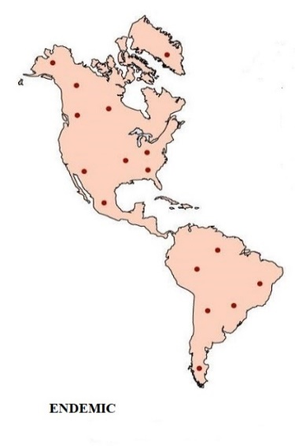
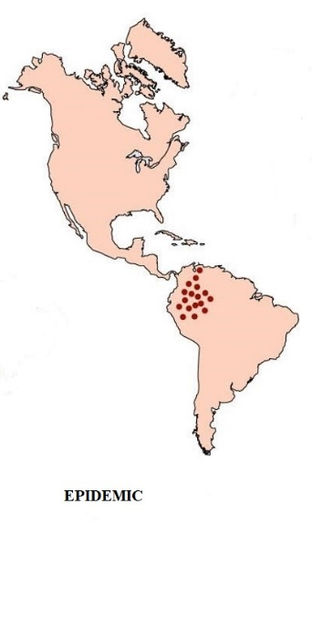
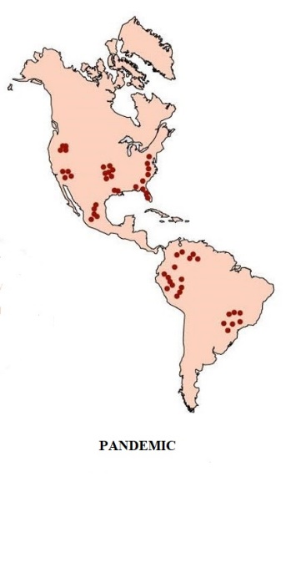
KEY TERMS
Endemic – disease or condition present among a population at all times
Outbreak – (localized epidemic) – more cases of a particular disease than expected in a given area or among a specialized group of people over a particular period of time.
Epidemic – large numbers of people over a wide geographic area affected.
Pandemic -An epidemic occurring over a very wide area (several countries or continents) and usually affecting a large proportion of the population.
Cluster –an aggregation of cases over a particular period esp. cancer & birth defects closely grouped in time and space regardless of whether the number is more than the expected number. (often the expected number of cases is not known.)
Sporadic – a disease that occurs infrequently and irregularly

Slide 23
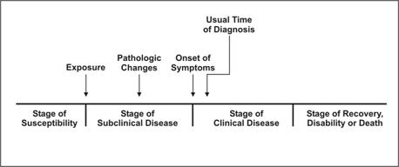
NATURAL HISTORY & SPECTRUM OF DISEASE

Slide 24
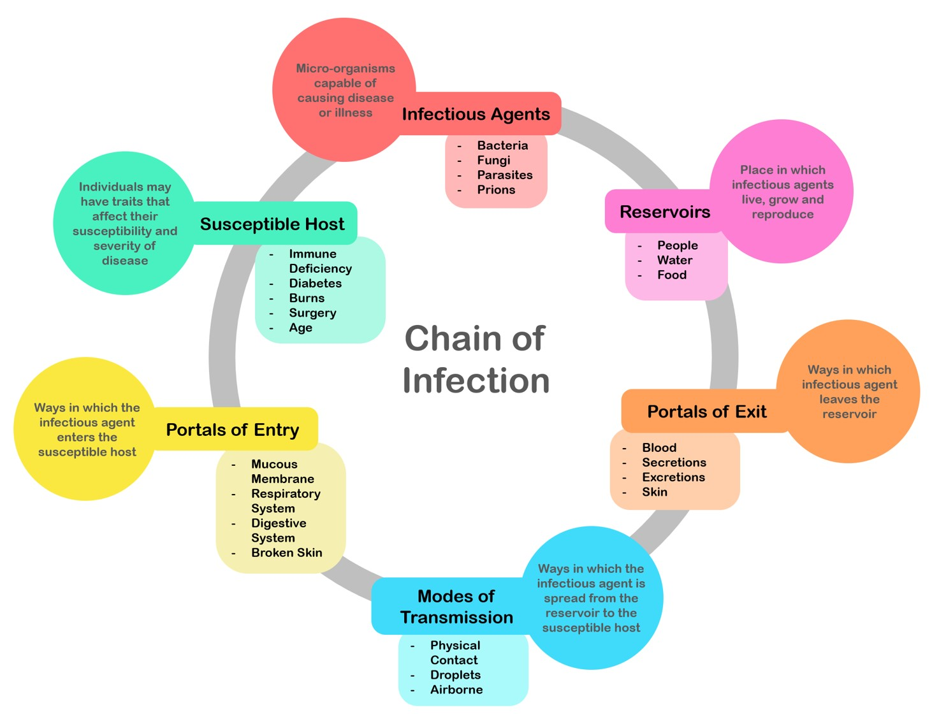

Slide 25
Objectives of Surveillance
The main objectives of surveillance are:
  to provide information about new and changing trends in the health status of a population, e.g., morbidity, mortality, nutritional status or other indicators and environmental hazards, health practices and other factors that may affect health
  to provide feed-back which may be expected to modify the policy and the system itself and lead to redefinition of objectives
  provide timely warning of public health disasters so that interventions can be mobilized

Slide 26
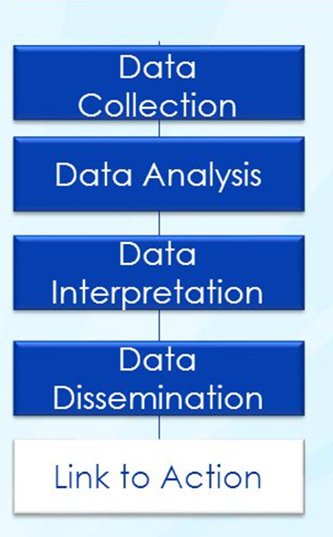
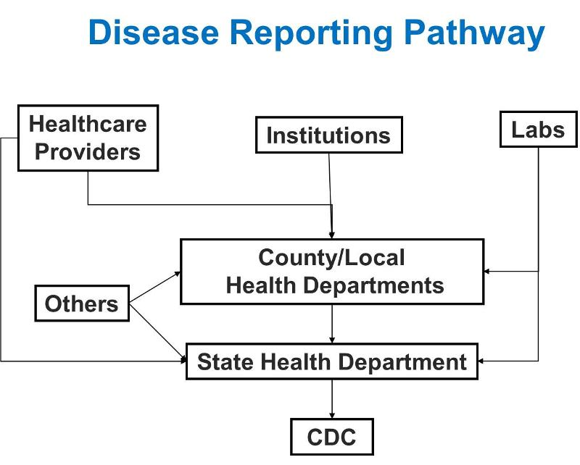
SURVEILLANCE PROCESS

Slide 27
Types of Surveillance
Passive Surveillance – diseases reported by health care professional as reporting case of measles
Active Surveillance – health agencies contact health providers seeking reports as searching for other cases of measles to identify potential outbreak
Sentinel Surveillance – involves only a limited network of carefully selected reporting sites targeting a particular disease
Syndromic Surveillance – focuses on one or more symptoms to detect or anticipate outbreaks as influenza causing symptoms and absentee increases

Slide 28
PART 2: OUTBREAK INVESTIGATION
Steps in Solving Health Problems
Step 1-Collect Data – Surveillance, determine Time/Place/Person triad
Step 2- Assessment- Inference
Step 3- Hypothesis testing – Determine how and why
Step 4- Action-Intervention
Note: Students will analyze an outbreak study.

Slide 29
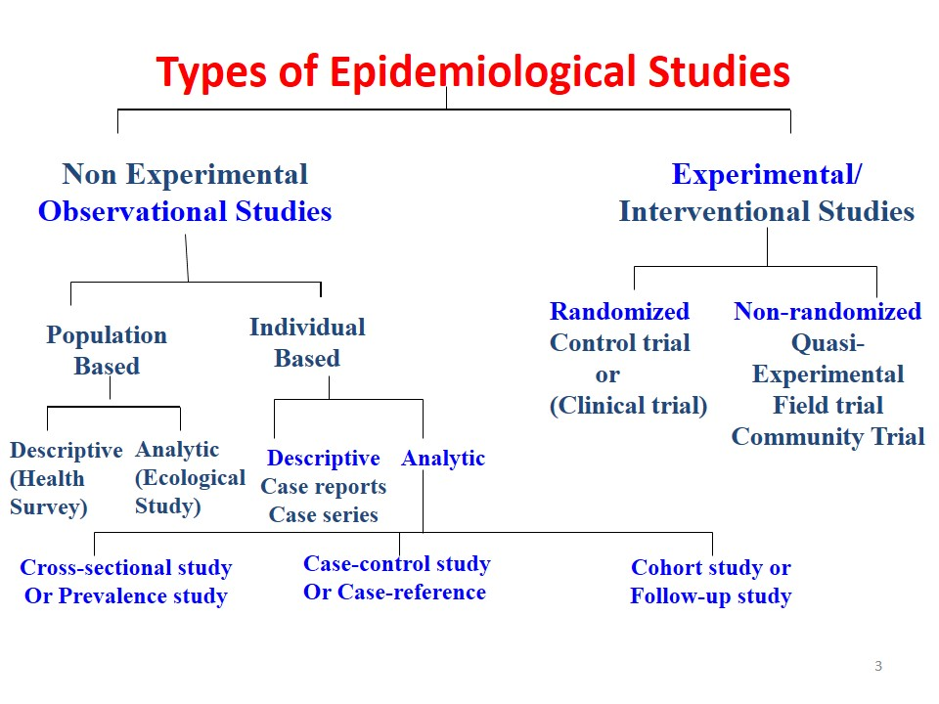
EPIDEMIOLOGICAL STUDIES

Slide 30
Scientific Method as related to Disease Detectives
Obtain Background Information
Define the Problem
Formulate Hypothesis
Develop a Study to Test the Hypothesis
Collect Data and Observations
Evaluate Results
Determine if Hypothesis is true/modify
Formulate Conclusions
Report Results
Compare these steps to 13 Steps in Outbreak Investigation

Slide 31
Step 1: Prepare for Field Work
1. Research, supplies & equipment – research
the disease or situation and gather needed
supplies & equipment to conduct the investigation
2. Administrative arrangements – make official administrative and personal travel arrangements
3. Local contacts - follow protocol

Slide 32
Step 2: Establish the Existence of an Outbreak
1. Expected # of cases for area – use records as health dept., hospital records, death records, physician records, doctor survey to determine expected # for the area in a given time
2. Other factors in play – numbers may exceed normal due to factors such as better
reporting, seasonal fluctuations, population changes

Slide 33
Step 3: Verify the Diagnosis
1. Proper diagnosis - verify the procedures used to diagnose the problem and check methods used for identifying infectious and toxic chemical agents
2. Not lab error – be sure that the increase number of cases are not due to experimental error
3. Commonality – interview several persons who became ill to gain insight concerning possible cause, source, and spread of disease or problem

Slide 34
Step 4: Construct a Case Definition
Case definition – establish with the 4 components or standard criteria for determining who has the disease or condition
a. Clinical information – about the disease or condition
b. Characteristics - of the affected people
c. Location or place - as specific as possible as restaurant, county, or several specific areas
d. Time sequence - specific time during which the outbreak or condition occurred

Slide 35
Case Definition for
Influenza-like (ILI)
A case of influenza-like illness (ILI) or influenza is defined as a person with fever of 37.8°C (100°F) or greater orally or 38.3°C (101°F) rectally PLUS cough during the influenza season (October 1 through May 31).
A person with laboratory confirmed influenza is also considered a case even if the person does not have cough and fever.

Slide 36
Identifying cases
Identification of specific cases – kind & number – count specific cases
Confirmed – have diagnosis with case definition plus lab verification
Probable – many factors point to diagnosis but may lack lab verification
Possible – some factors point to diagnosis
Note: Initial reports may be only a small sampling of the total problem. Be sure to expand search to determine the true size and extent of the problem

Slide 37
Line Listing
Line Listing – chart of specific cases including information about each case
Identifying information - ID or case # - left column + name or initials
Clinical information – diagnosis, symptoms, lab results, hospital – death?
Descriptive: time – date & time of onset + date of report
Descriptive: person – age, sex, occupation, other characteristics
Descriptive: place – street, city or county + specific site
Risk factors & possible causes – specific to situation (disease) and outbreak setting

Slide 38
Sample Line Listing
Sample Line Listing from six case report forms on a wedding reception outbreak
ID # Initials Date Diagnosis How Age Sex County Physician Wedding
of Onset Confirmed
1 KR 7/23 probable trichinosis Not done 29 M Columbia Goodman Yes
2 DM 7/27 trichinosis Biopsy 33 M Columbia Baker Yes
3 JG 8/14 probable trichinosis Not done 26 M Columbia Gibbs Yes
4 RD 7/25 trichinosis Serologia 45 M King Webster Yes
5 NT 8/4 trichinosis Not done 27 F Columbia Stanley Yes
6 AM 8/11 R/Otrichinosis Pending 54 F Clayton Mason Yes

Slide 39
Step 5: Find cases systematically and record information
Identifying information
Demographic information
Clinical information
Risk factor information
Reporter information

Slide 40
Types of Descriptive Studies
Types of Descriptive Studies – Study the distribution of a problem by cases or outcome, frequency in population, exposure, time pattern or environmental factor (Studies without a control group can be used for descriptive purposes!)
a. Case report/case series – case report = detail report of a single
patient from one or more doctors while case series =
characteristics of several patients
b. Correlative studies – correlates general characteristics of the
population with health problem frequency with several groups
during the same period of time
Time series analysis – correlate within the same population a different point in time
Ecologic relations – correlate relative to specific ecologic
factors as diet
c. Cross sectional - a survey of a population where participants are selected irrespective of exposure or disease status

Slide 41
Step 6: Describe in terms of Time, Place and Person Triad
TIME – a histogram showing the course of the disease or outbreak to identify the source of the exposure Epidemic Curve or Epi curve (Begin early & update often)
PLACE – geographic extent plus spot map of cases to identify groups specific to a location or environmental factors
PERSON – identify the affected population by type of person or by exposures as age, sex, high risk exposure as with AIDS

Slide 42
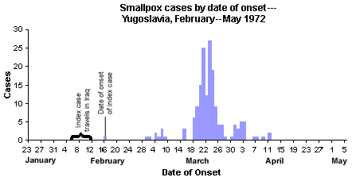
EPI Curve (Epidemic Curve)
x axis= units of time equal to 1/4 to 1/3 incubation time and y axis = # of cases
Note: a single point or source will have only one peak, a plateau will show a continuous common source, several uniform peaks will indicate a propagated outbreak spread from person to person

Slide 43
Step 7: Develop Hypothesis
(Agent/Host/Environment triad)
1. Agent /host /environment = agent capable of causing disease & its source host or persons susceptible to agent + environment allowing them to get together
Infectious Groups: viruses, bacteria, protistans (protozoa), fungi, animals (worms)
2. Testable – hypothesis must be in a form that is testable
3. Current knowledge & background – it should be based upon current knowledge and be updated or modified as new information is uncovered!!!

Slide 44
Step 8: Evaluate Hypothesis
(Analytical Studies = Control Group)
1. Compare with established fact – these are used when evidence is strong and clear cut
2. Observational Studies: (Study determinants of health problems – how & why)
Cohort – Based upon exposure status whether or not they have outcome (illness) works forward from exposure
Case-Control - Works backward from effect or illness to suspected cause.
3. Must have lab verification to validate hypothesis.

Slide 45
Cohort Study – Exposure
Both groups have a known exposure and are checked for future outcomes or illness.
retrospective: (historic cohort) starts at exposure in past & moves forward to outcome
prospective: starts a present exposure and moves forward in time to outcome

Slide 46
Sample Cohort Study using 2 X 2 table
400 people attended a special awards dinner
Some persons became ill. The suspected culprit was the potato salad. The population at the dinner was then surveyed to determine who became ill.
Disease Yes Disease No
Exposed (Ate salad) 150 (a) 30 (b)
Unexposed(no salad) 50 (c) 170 (d)

Slide 47
Calculating Attack Rate & Relative Risk
Disease Yes Disease No
Exposed (Ate salad) 150 (a) 30 (b)
Unexposed (no salad) 50 (c) 170 (d)
Attack rate – the rate that a group experienced an outcome or illness= number sick ÷ total in that group (Look for high attack rate in exposed & low rate in unexposed)
exposed = a ÷ (a+b) = 150 ÷ 180 = 80%
unexposed = c ÷ (c + d) = 50 ÷ 220 = 20%
Relative risk = [a ÷ (a+b)] / [c ÷ (c+d)] =
80% ÷ 20% = 4

Slide 48
Interpreting Results of Cohort Study
Relative risk estimates the extent of the association between an exposure and a disease. It estimates the likelihood of developing the disease in the exposed group as compared to the unexposed group.
A relative risk >1.0 indicates a positive association or an increased risk. This risk increases in strength as the magnitude of the relative risk increases.
A relative risk = 1.0 indicates that the incidence rates of disease in the exposed group is equal to the incidence rates in unexposed group. Therefore the data does not provide evidence for an
association.
Relative risk is not expressed in negative numbers.

Slide 49
Case Control - Illness
Works backward from effect or illness to suspected cause.
Control group is a selected group who has similar characteristics to the sick group but is not ill.
They are then checked for similar exposures.
It is often hard to select the control group for this type of study.
Odds Ratio is calculated to evaluate the possible agents & vehicles of transmission

Slide 50
Sample Case-Control Study
Sample:
Several patients were diagnosed with Hepatitis A.
The local Restaurant A was thought to be the source of the infection.
40 case patients and a similar disease free group or control were contacted to determine if they ate at Restaurant A.
2 X 2 table of data
Ate Case patients Controls Total
Yes a = 30 b = 36 66
No c = 10 d = 70 80
Total 40 106 146

Slide 51
Calculating Odds Ratio
2 X 2 table of data:
Ate Case patients Controls Total
Yes a = 30 b = 36 66
No c = 10 d = 70 80
Total 40 106 146
Odds Ratio =
Odds of exposure in cases = a/c = a d = 30x70 = 5.8
Odds of exposure in controls b/d b c 36x10
This means that people who ate at Restaurant A were 5.8 times more likely to develop hepatitis A than were people who did not eat there.
a = # of case patients exposed b = # of control exposed
c = # of case patients unexposed d = # of control unexposed

Slide 52
Potential Types of Error in Data Collection - Division C
False Relationships
  Random Error - the divergence due to chance alone, of an observation on sample from the true population value, leading to lack of precision in measurement of association
  Bias - systematic error in an epidemiologic study that results in an incorrect estimation of the association between exposure and health-related event

Slide 53
Potential Types of Error in Data Collection – Div. C
Non-Causal Relationships
  Confounding – occurs when the effects of two risk factors are mixed in the occurrence of the health-related event under study - when an extraneous factor is related to both disease and exposure

Slide 54
Step 9: As necessary,
Reconsider, Refine, and
Re-evaluate Hypotheses
No confirmation of hypothesis - analytical studies do not confirm hypotheses.
May need to look for a new vehicle or mode of transmission
More specific – May need to be more specific in make up of case patients & controls

Slide 55
Bradford Hill criteria for Verifying the Cause of the Health Problem
1. Temporality – cause/exposure must precede effect/outcome
2. Consistency – observation of association must be repeatable in different populations at different times
3. Coherence, 1-1 relationship – exposure is always associated with outcome/ outcome is always caused by the specific exposure
4. Strength of association – relationship is clear and risk estimate is high
5. Biological plausibility – biological explanation makes sense
6. Dose/response (biologic gradient) – increasing risk is associated with increasing exposure

Slide 56
Step 10: Compare and Reconcile with laboratory an/or environmental studies
Verify with environmental/laboratory studies
verification with control conditions is very important
Laboratory evidence can confirm the findings LAB VERIFICATION IS NEEDED TO VALIDATE A HYPOTHESIS
Environmental studies are equally important
Examination of the area of an outbreak can
provide evidence and clues used in laboratory
analysis

Slide 57
Step 11: Implement Control and Preventative Measures
1. As soon as source is known – people are sick or hurting and need he must know agent & source of agent + susceptibility of host+ chain of transmission
2. Aim at chain of agent-source-host – break the chain of transmission at any of its 3 points
3. May interrupt transmission or exposure – with
vehicles as isolation
4. May reduce susceptibility – with immunization,
legal issues and/or education

Slide 58
Step 12: Initiate or
Maintain Surveillance
Once control and prevention measures have been implemented, they must continue to be monitored
If active surveillance was initiated as part of case finding efforts, it should be continued to determine whether the prevention and control measures are working

Slide 59
Step 13: Communicate Findings
1. Oral briefing – inform local health officials or other need-to-know groups as soon as information is available
2. Written report – usually done in scientific format for future reference, legal issues, and education

Slide 60
PART 3: PATTERNS, CONTROL & PREVENTION
Interpret Tables, Charts & Graphs
Determine Measures of Disease Frequency-risk, rates, ratios, proportions – Div. C
Control Strategies
Prevention Strategies
Div. C – National Challenges

Slide 61

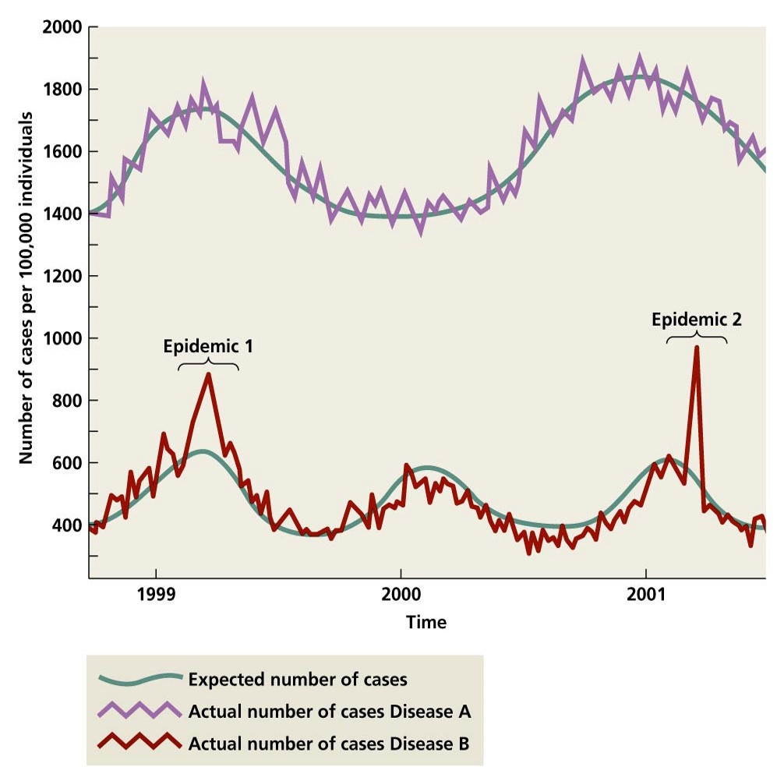
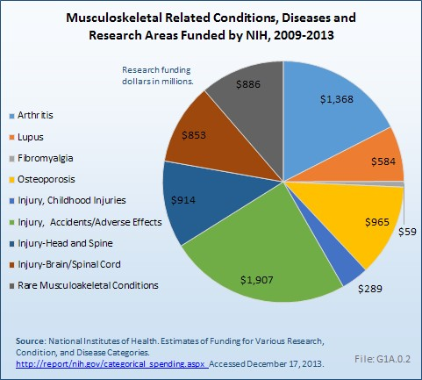
Interpreting Data Tables
Charts & Graphs

Slide 62
Determining & Interpreting Measures of Frequency

Slide 63
Disease Control
Concept of control: disease control describes ongoing operations aimed at reducing
  The incidence of disease
  The duration of disease and consequently the risk of transmission
  The effects of infection, including both the physical and psychosocial complications
  The financial burden to the community

Slide 64
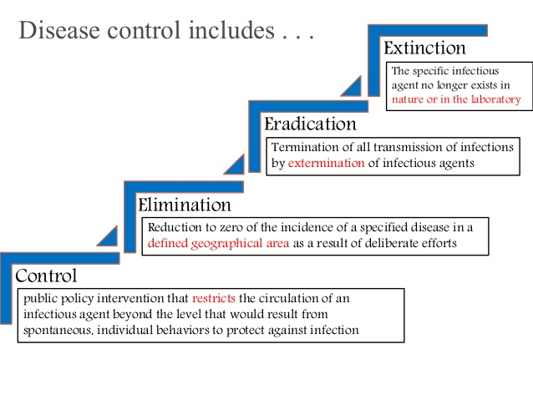
Disease Control Process

Slide 65
Preventable Causes of Disease
BEINGS
Biological factors and Behavioral Factors
Environmental factors
Immunologic factors
Nutritional factors
Genetic factors
Services, Social factors, and Spiritual factors
[JF Jekel, Epidemiology, Biostatistics, and Preventive Medicine, 1996]

Slide 66
Natural history of disease
Onset of symptoms
Usual time of diagnosis
Exposure
Pathologic
changes
Stage of subclinical disease
Stage of recovery, disability or death
Stage of
susceptibility
Stage of clinical disease
PRIMARY PREVENTION
SECONDARY PREVENTION
TERTIARY PREVENTION

Slide 67
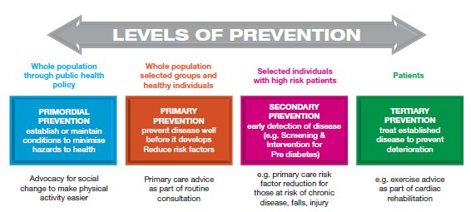

Slide 68
Strategy for Prevention
Identify
Populations
Modify Existing
at High
Disease Risk
Intervention
(based on demography /
family history,
host factors..)
Programs
Assess
Evaluate
Exposure
Intervention
Programs
Conduct
Research on
Apply
Mechanisms
Population-Based
(including the study of
genetic susceptibility)
Intervention
Programs

Slide 69
PREVENTION APPROACHES
Population-Based Approach:
• Preventive measure widely applied to an entire population (public health approach)
• Strive for small absolute change among many persons
• Must be relatively inexpensive and non-invasive

Slide 70
PREVENTION APPROACHES
High-Risk Approach:
• Target group of individual at high risk
• Strive for strong risk factor control
• Often times requires clinical action to identify the high risk group and to motivate risk factor control

Slide 71
Monitoring
The performance and analysis of routine measurements aimed at detecting changes in the environment or health status of population" (Thus we have monitoring of air pollution, water quality, growth and nutritional status, etc).
It also refers to ongoing measurement of performance of a health service or a health professional, or of the extent to which patients comply with or adhere to advice from health professionals.

