Slide 1
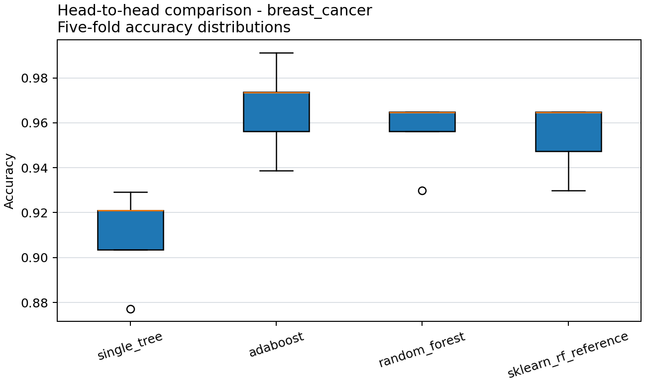
ENSEMBLE METHODS
When does boosting beat bagging?
A from-scratch study of bias, variance, label noise, imbalance, and data structure
Milana Karimova | Sharaf Feyzullayev | Nijat Agayev | Farah Feyzullayev
AI Academy | Spring 2026
Full three-dataset run | 28 phases | 81 artifacts | 6 h 52 m
1

Slide 2
The methods attack different errors
BOOSTING
BAGGING
Correct
Average
Fit a stump
Raise hard-example weight
Bootstrap
Decorrelate trees
Sequential attention can lower residual boundary bias and can chase corrupted labels.
Independent variation cancels; shared correlation remains. OOB rows provide an internal check.
2

Slide 3
Inspectable code - not a library wrapper
7
51
1
from-scratch algorithms
passing tests; 88.71% coverage
binding reproduction command
Tree | SAMME | Forest PCA | K-Means | DBSCAN Gradient Boosting
Weighted splits | OOB complements Empty clusters | noise-to-border Sequential/parallel identity
python src/experiments/run_all.py Seed 42 | manifests | raw fold/stage/replicate evidence
3

Slide 4
Three datasets isolate the conditions that should change the winner
DATA
SEVEN REQUIRED EXPERIMENTS
Breast Cancer
569 rows | 30 features | balanced binary baseline and Brier study
1 Baseline and sklearn tolerance | 2 AdaBoost stages: 1-200 | 3 Forest size and depth | 4 Identical five-fold head-to-head
Adult Income
48,842 rows | 14 raw features | mixed types, missingness, moderate imbalance
Covertype
10,000-row subset | 54 features | 7 classes | minority 0.47%
5 Nested label-noise replicates | 6 100 shared bootstrap fits | 7 PCA, K-Means, DBSCAN
Split first. Fit preprocessing and oversampling inside training only.
4

Slide 5
Custom trees stay within reference tolerance on every dataset
0.912
0.912
0.8 pp
maximum gap across datasets | required <= 2.0 pp
custom tree accuracy
sklearn tree accuracy
Why the match is credible
Why agreement is not identity
Acceptance
Sorted midpoint search | weighted impurity | deterministic ties | identical train/test split
Different tie handling can change tree shape; tests and invariants remain necessary.
PASS
5

Slide 6
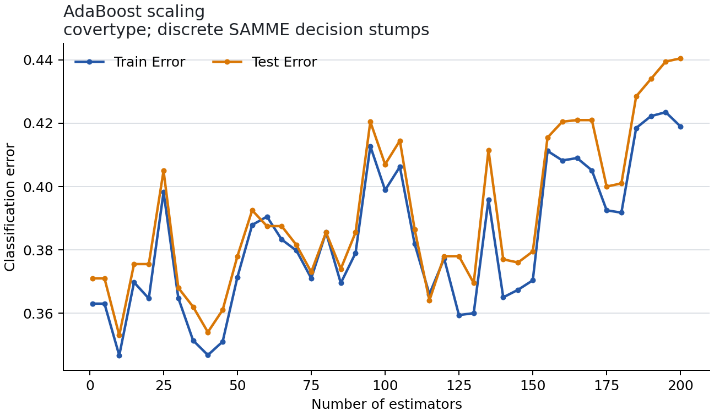
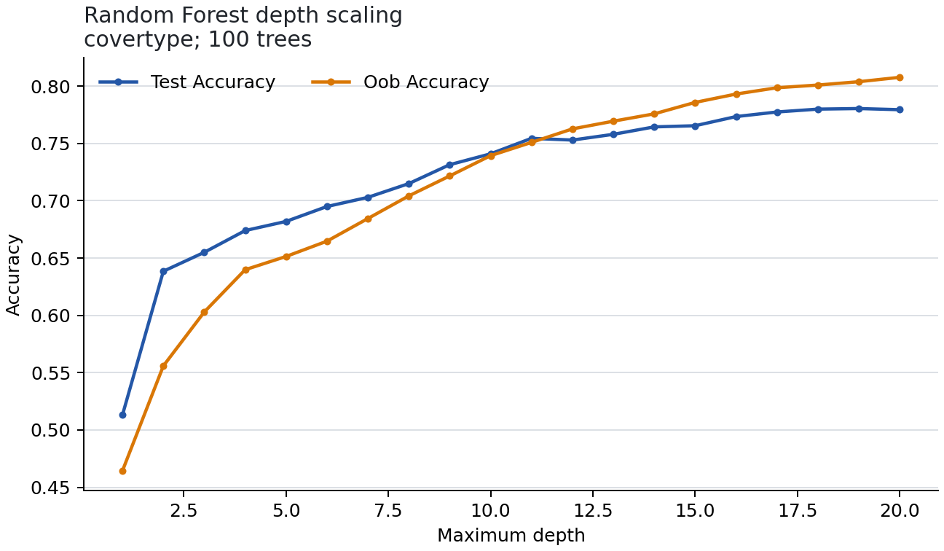
Scaling exposes different complexity needs
AdaBoost: 1-200
Forest: depth 1-20
Best error at 10; later rounds hurt
Best depth 19; flexible trees matter
6

Slide 7
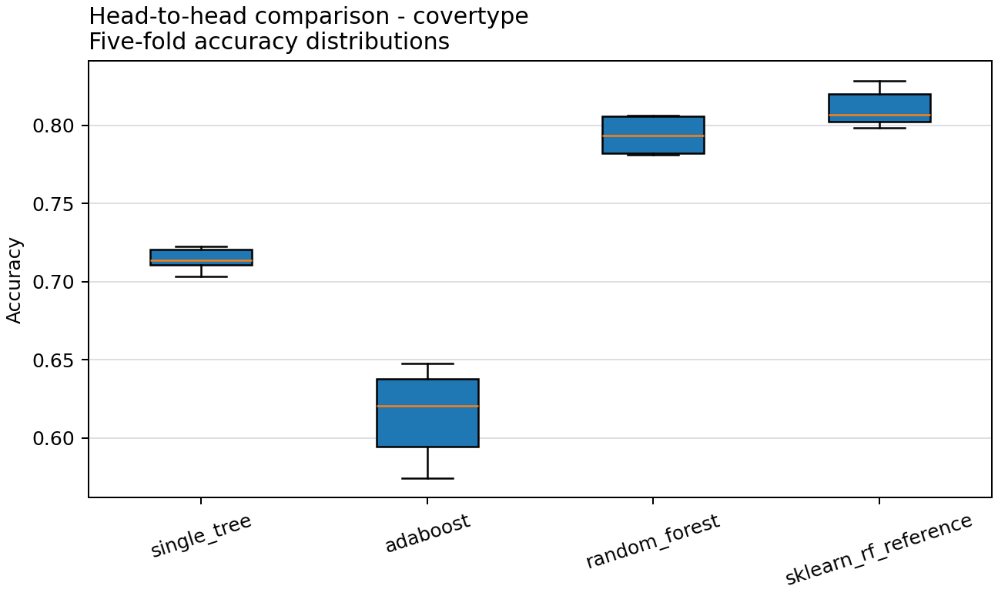
The winner changes with dataset structure
FIVE-FOLD MEAN ACCURACY
.9666
Breast Cancer Ada | RF .9561
.8649
Adult RF | Ada .8556
.7938
Covertype RF | Ada .6150
7

Slide 8
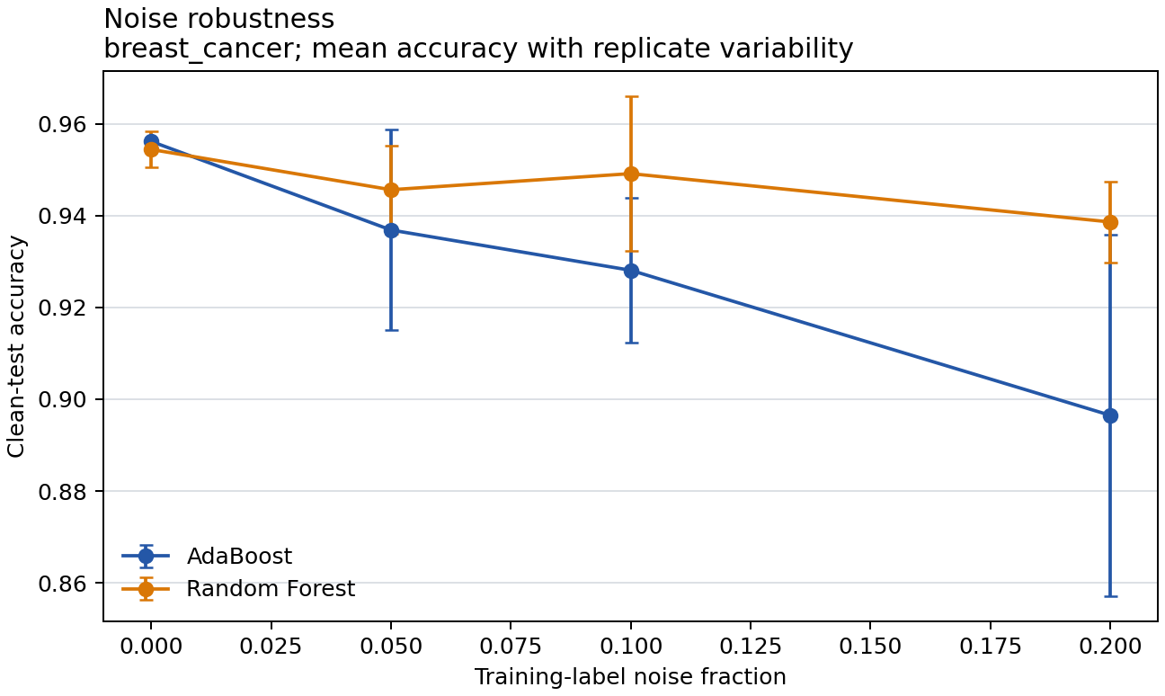
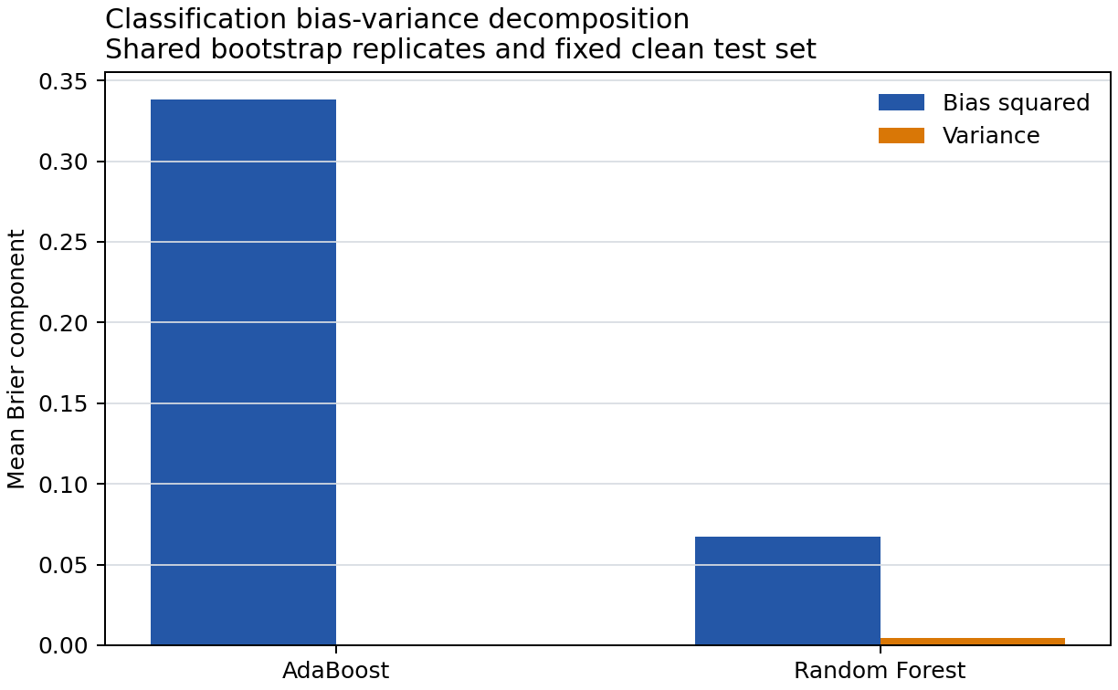
Noise robustness and probability loss tell different stories
20% LABEL NOISE | 5 REPLICATES
BRIER | 100 BOOTSTRAPS
At 20%: AdaBoost -5.96 pp; forest -1.58 pp.
Bias^2: AdaBoost .3382; forest .0675. Votes are not calibrated.
8

Slide 9
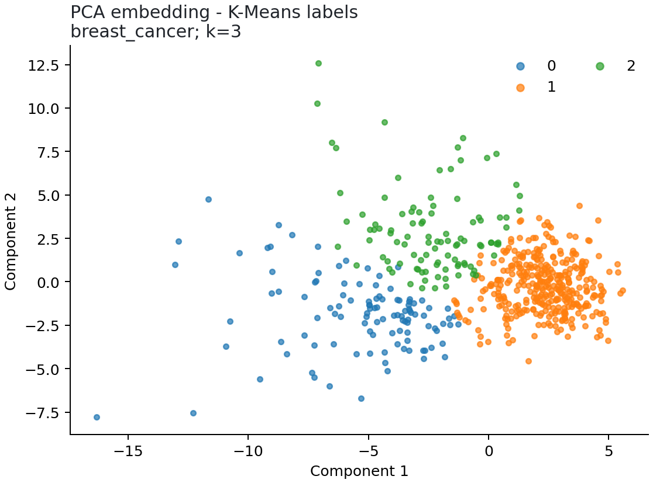
Clusters reveal geometry, not guaranteed class boundaries
7
PCs reach >= 90% variance
.515
K-Means ARI | k = 3
6.50%
DBSCAN noise | ARI = .030
Full dataset n = 569
9

Slide 10
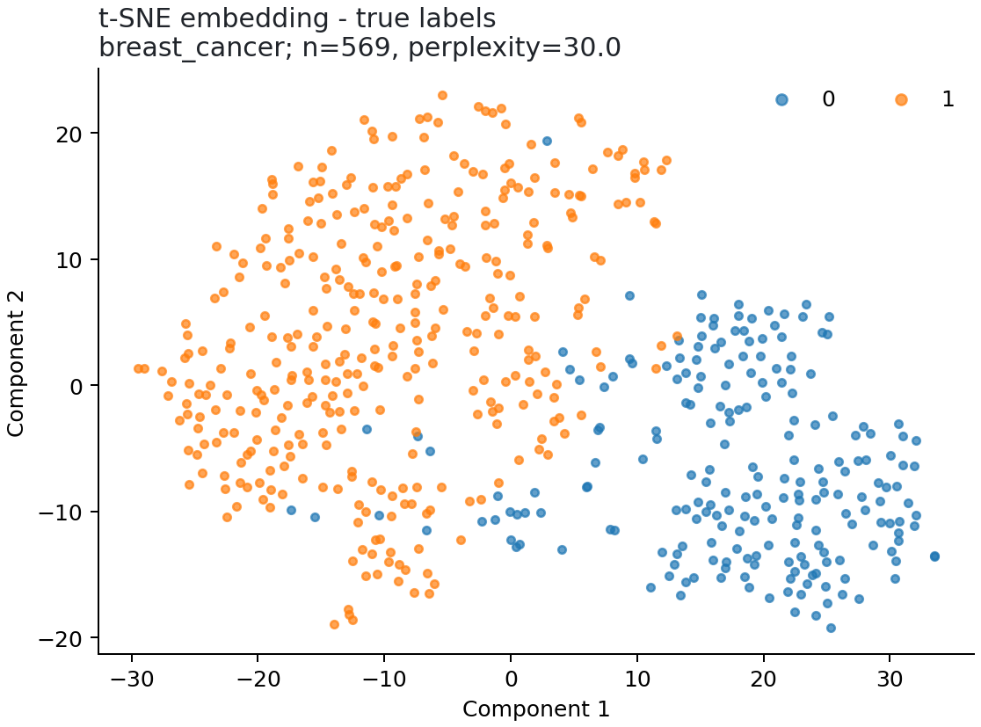
Bonuses extend the analysis without replacing it
SAMME.R
t-SNE
BC .9561 to .9649 Adult .8573 to .8687
Gradient Boosting
Binary log-loss; BC accuracy .9386, AUC .9899
Interactive notebook
Executed controls for model and cluster complexity
n=569, perplexity 30 | no global-distance claim
88.71% coverage | Ruff clean | mypy clean | AI assistance disclosed
10

Slide 11
THE ANSWER
No universal winner: let the data decide
BOOST
BAG
Breast Cancer: AdaBoost .9666. Sequential correction worked best on this structured binary task.
Adult RF .8649; Covertype RF .7938. Diverse trees handled mixed and multiclass structure better.
Release after truthful contribution approval, genuine Git history, final audit, Moodle submission, and v1.0-final.
Defense focus: weights, OOB coverage, noise, probability loss, and cluster assumptions.
11

