Slide 1

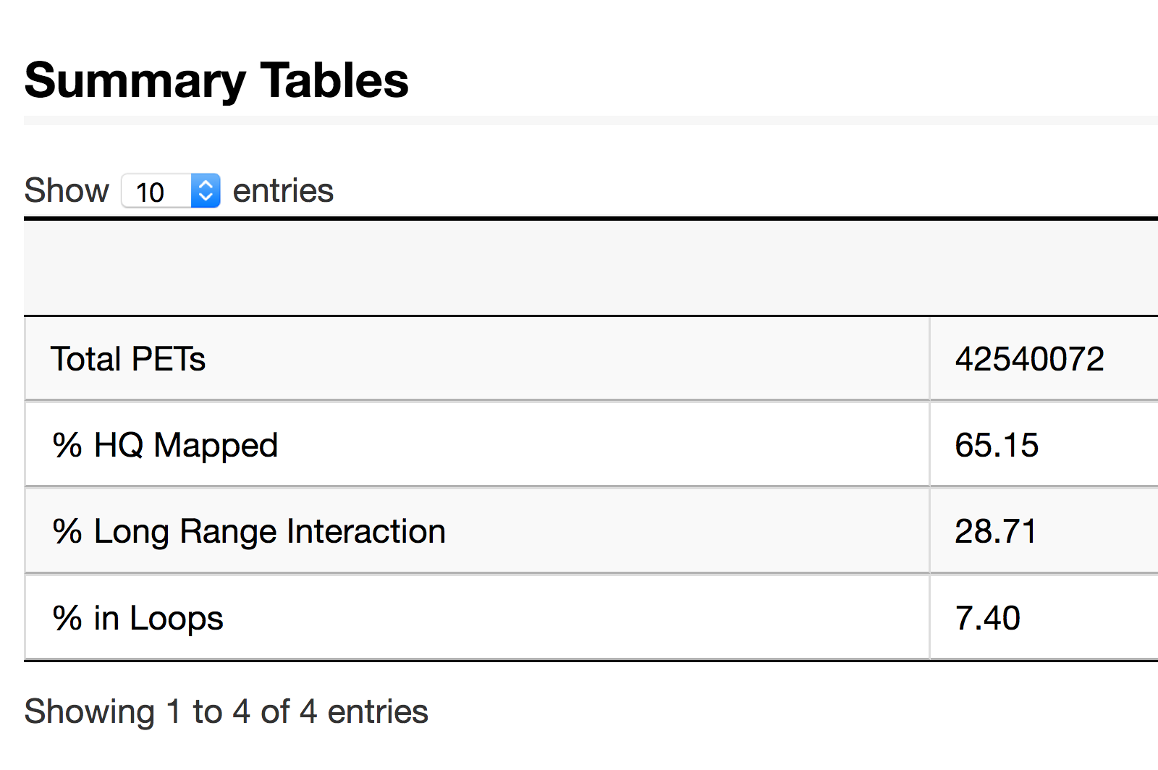
Loop 3
Loops
DNA
Anchors
Loop 1
Loop 2
HiChIP +
Alignment
Sample 1
PETs
Sample 2
PETs
Sample 1
Sample 1 loops Object
anchors interactions counts rowData colData
chrZ 4000 5200 chrZ 6500 7800 . 3
chrZ 1200 2300 chrZ 6500 7800 . 2
...
Granges Object
chr start end
[1] Z 1200 2300
[2] Z 4000 5200
[3] Z 6500 7800
[4] Z 8900 9900
…
Integer Matrix
left right
[1] 1 3
[2] 1 4
[3] 2 3
[4] 2 4
…
Integer Matrix
S1
[1] 2
[2] 6
[3] 3
[4] 7
…
data.frame
sizeFactor Group
S1 1 1
…
data.frame
loop.width
[1] 5400
[2] 7600
[3] 2650
[4] 4800
…
chrZ 1200 2300 chrZ 4000 5200 . 2
chrZ 1200 2300 chrZ 6500 7800 . 1
...
Sample 2 loops Object
anchors interactions counts rowData colData
Granges Object
chr start end
[1] Z 1200 2300
[2] Z 4000 5200
[3] Z 6500 7800
[4] Z 8900 9900
…
Integer Matrix
left right
[1] 1 2
[2] 1 3
[3] 1 4
[4] 2 4
…
Integer Matrix
S2
[1] 2
[2] 1
[3] 8
[4] 2
…
data.frame
sizeFactor Group
S1 1 1
…
data.frame
loop.width
[1] 2850
[2] 5400
[3] 7650
[4] 4800
…
Sample 2
.html
.rds
.bedpe
Report Comparison
dnalandscaper.aryeelab.org
diffloop
Library Quality Assessment
Interactive
Visualization
Differential Loop Calling

