Slide 1
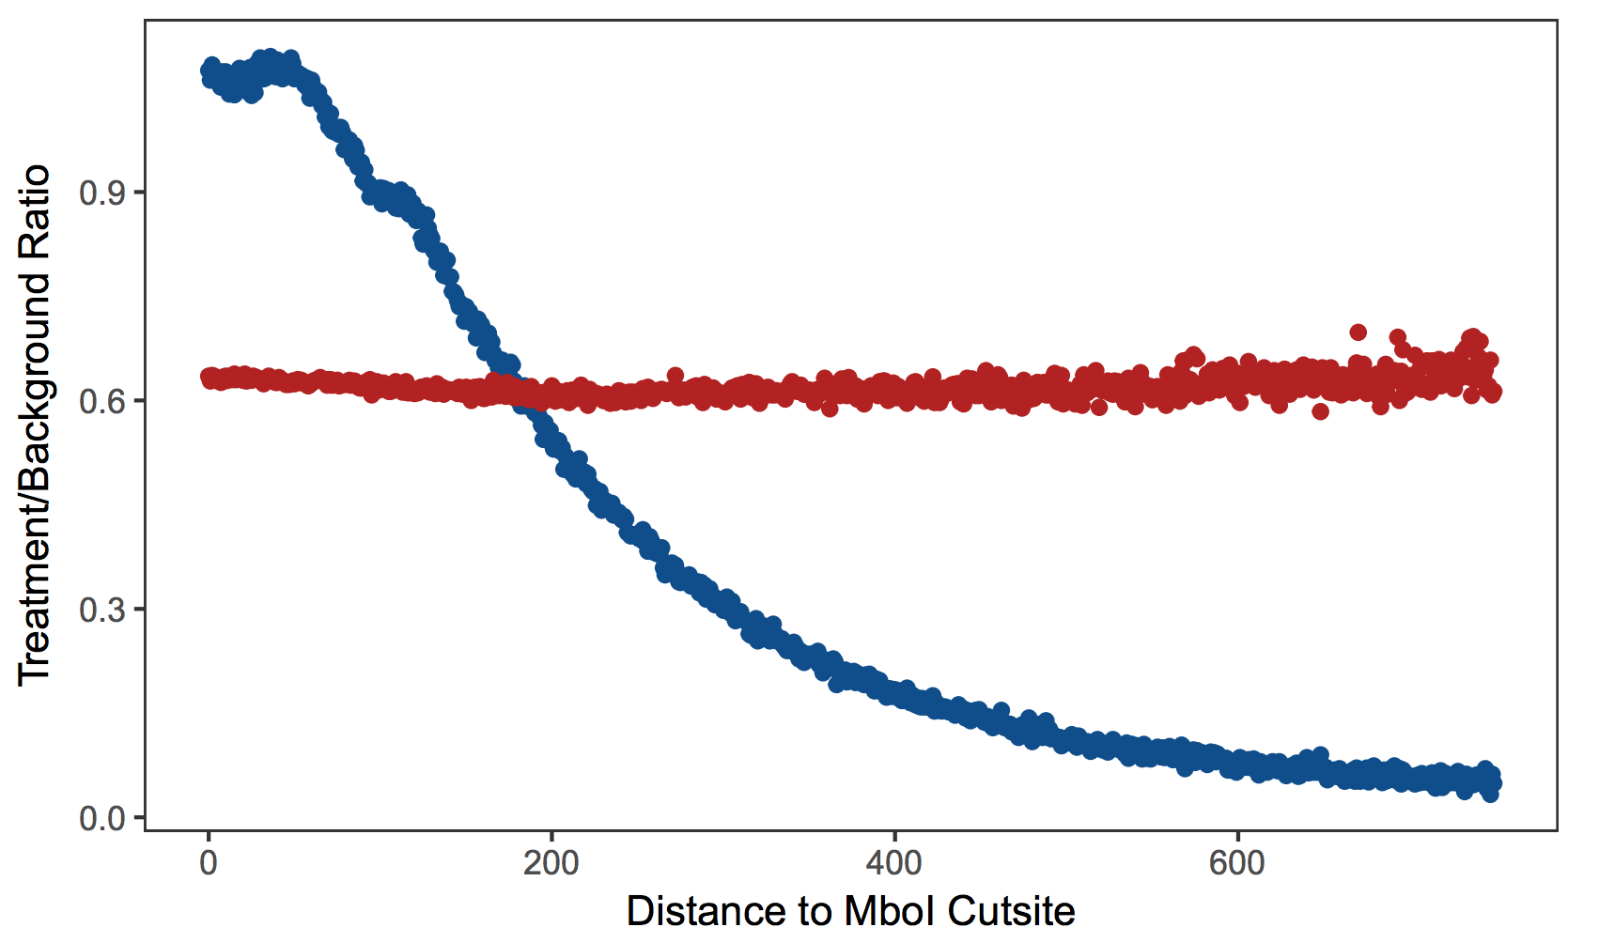
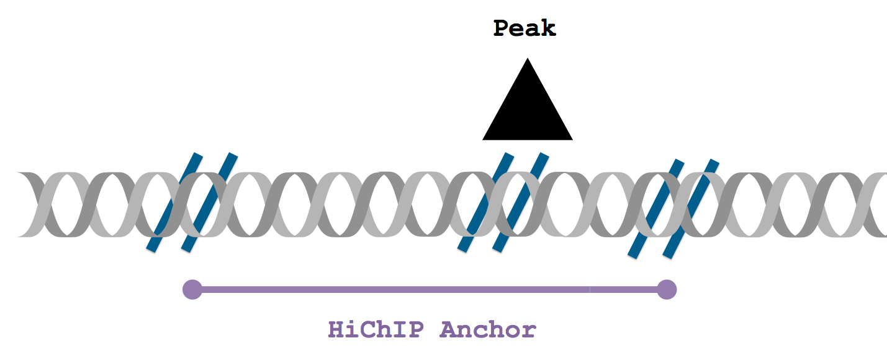

Restriction Enzyme
Cut Sites
.rds
Visualization
Restriction Motif
Aware Modeling
Available Online
.bedpe
Loops
.yaml
configuration
HiChIP
Aligned Hi-C Output
Background
Correction
Loop / Anchor
Inference
.html
Quality Control
via HiCPro

