Slide 1
+
Carestead
GEN AI ACADEMY · TEAM PROJECT
THE CAREGIVER COGNITIVE-LOAD AGENT
Less to carry.
More care to give.
A shared care picture. A clear next step.
An agent that helps while the caregiver stays in control.
Care Plan
Care Circle
Care Organizer
Care Handover
Grounded Agent
Frincy Clement · Maneetta Antony · Tejaswini Venkata Raju · Shrijan Chipalu
Carestead · GenAI Academy · September 2026 · v2
01 / 16
Notes:
Open with the product promise: reduce the mental work of coordinating care. Carestead is non-clinical and keeps consequential actions under human control.

Slide 2
+
Carestead
THE PROBLEM · MEET MAYA
ONE CAREGIVER. TOO MUCH TO REMEMBER.
Everyone has part of the story.
Maya holds it all together.
She coordinates Alex’s care around work and family, remembering every change and resolving schedule conflicts again and again.
The invisible work of care
Keep the information in her head. Spot the clash. Find cover. Update everyone.
Illustrative persona and scenario
Carestead · GenAI Academy · September 2026 · v2
02 / 16
Notes:
Maya is illustrative. The problem is coordination, not diagnosis: information, ownership, timing, and handover are fragmented across people and tools.

Slide 3
+
Carestead
THE COORDINATION GAP
THE PROBLEM
Care happens across people.
The mental checklist stays with one.
“I thought you were taking Alex tomorrow.”
Every handover costs attention
More reminders are not enough
A change in one place can leave the ride, reminder, or caregiver assignment pointing to the old plan.
The next caregiver needs current state, open risks, reliable contacts, and the exact items requiring review.
The practical need is shared context, a named owner, a safe decision, and a visible outcome.
Enable Maya to coordinate the next step without rebuilding the whole picture.
Carestead · GenAI Academy · September 2026 · v2
03 / 16
Notes:
Carestead addresses coordination failures: stale plans, ambiguous ownership, forgotten follow-ups, and costly handovers. It does not diagnose or replace clinical judgment.

Slide 4
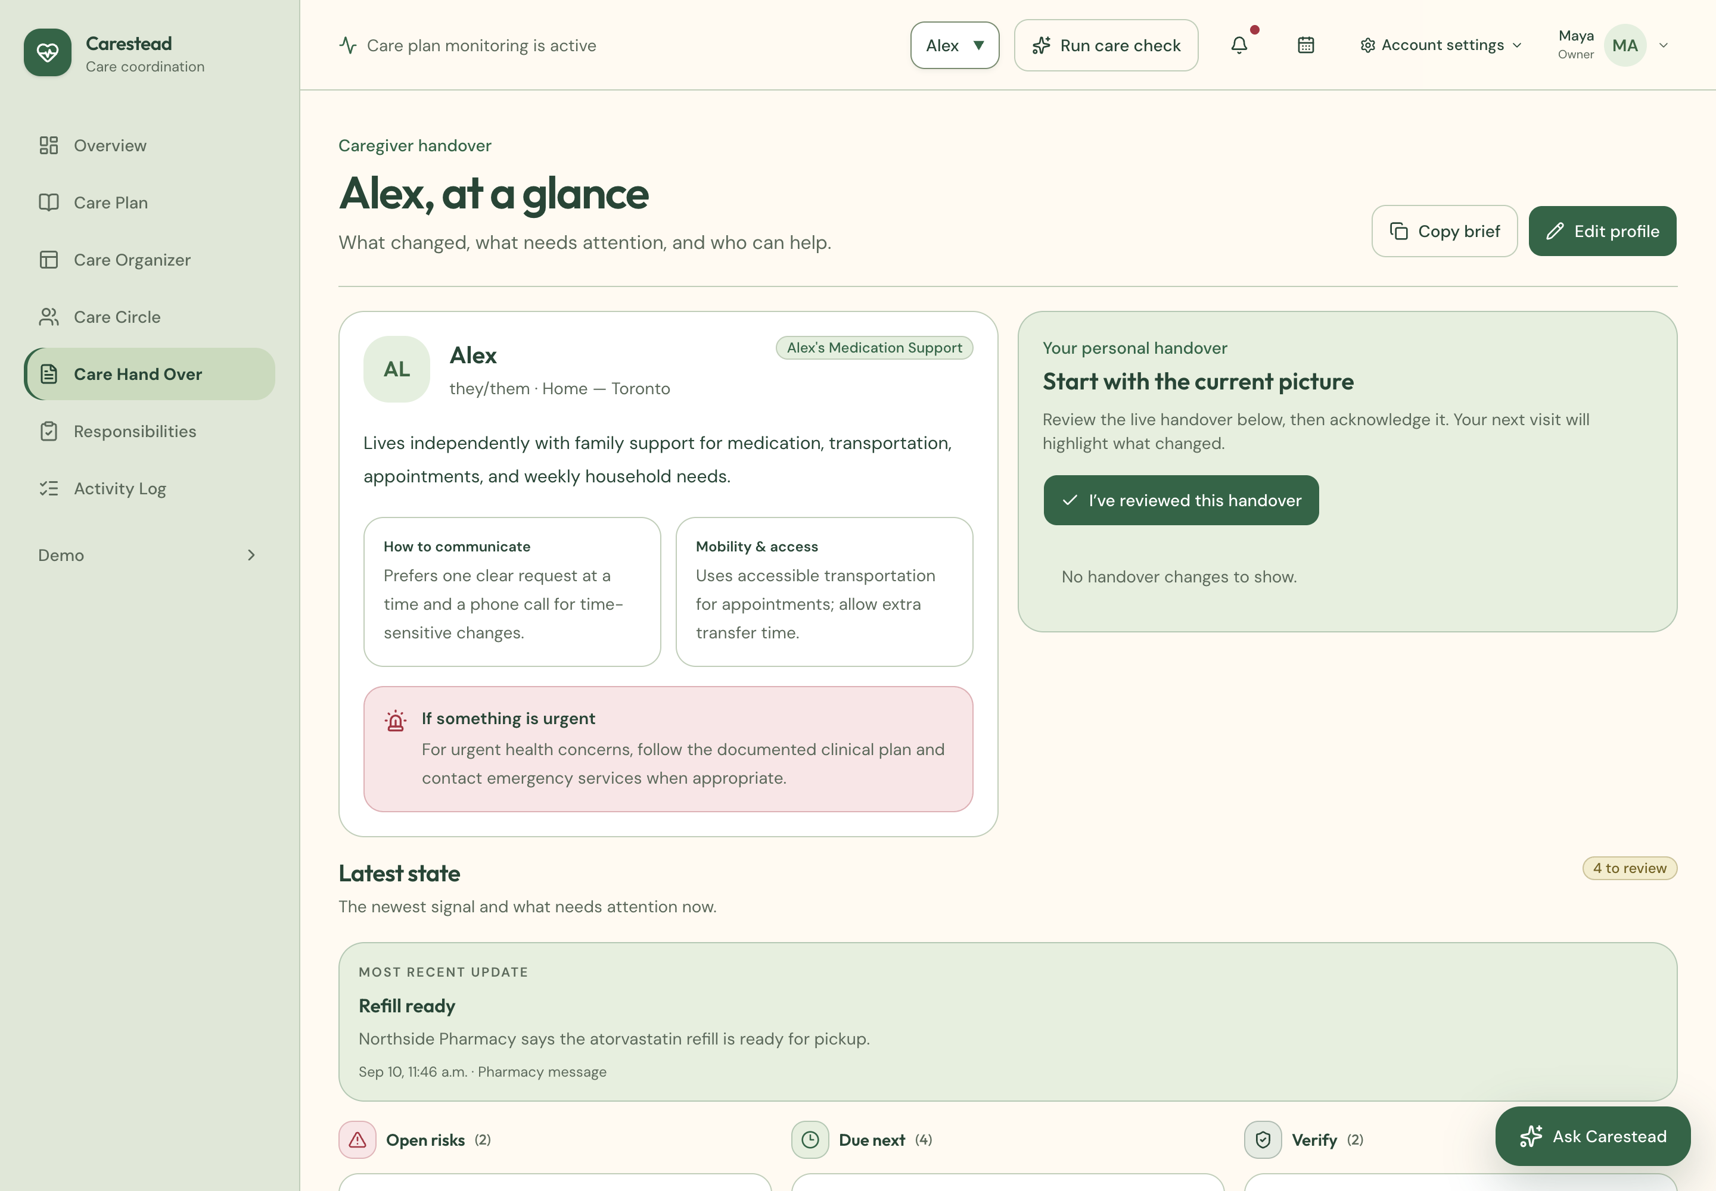
+
Carestead
MEET CARESTEAD
MEET CARESTEAD
You care. We plan.
One place for the plan, people, evidence, and next safe step.
Care Plan
Reusable templates plus person-specific preferences, routines, goals, and supports.
Care Circle
Roles, contacts, invitations, responsibility owners, and trusted support.
Care Organizer
Plan breaks, activities, coverage, transport, and dependencies in one flow.
Care Handover
A concise live brief: current state, changes, risks, contacts, and watch items.
Current product view: recipient profile, latest care state, review items, and handover context
Carestead · GenAI Academy · September 2026 · v2
04 / 16
Notes:
Introduce the four central workspace areas. The current handover view shows how Carestead consolidates a recipient profile, latest state, open review items, risks, and support context.

Slide 5
+
Carestead
CORE PRODUCT FEATURES
PRODUCT MAP
The complete Carestead workspace.
A person-centered care model connects context, coordination, people, actions, and governance.
Understand the person
Coordinate care
People + handover
Agent + governance
+
Overview + profile
+
Responsibilities
+
Care Circle + roles
+
Grounded chat + voice
✓
Care Plan + templates
✓
Care Organizer
✓
Contacts + support systems
✓
Document + image intake
✓
Preferences + routines
✓
Calendar scheduling
✓
Live Handover
✓
Integrations
✓
Memory + current risks
✓
Timeline + activity log
✓
Notifications
✓
Consent + privacy + evals
Foundation: sign-in and roles · recipient scope · export and deletion · approval history · audit trail
Carestead · GenAI Academy · September 2026 · v2
05 / 16
Notes:
Use this slide as the product inventory. Carestead combines recipient context, daily coordination, people and handover, agent interactions, integrations, and governance in one workspace.

Slide 6
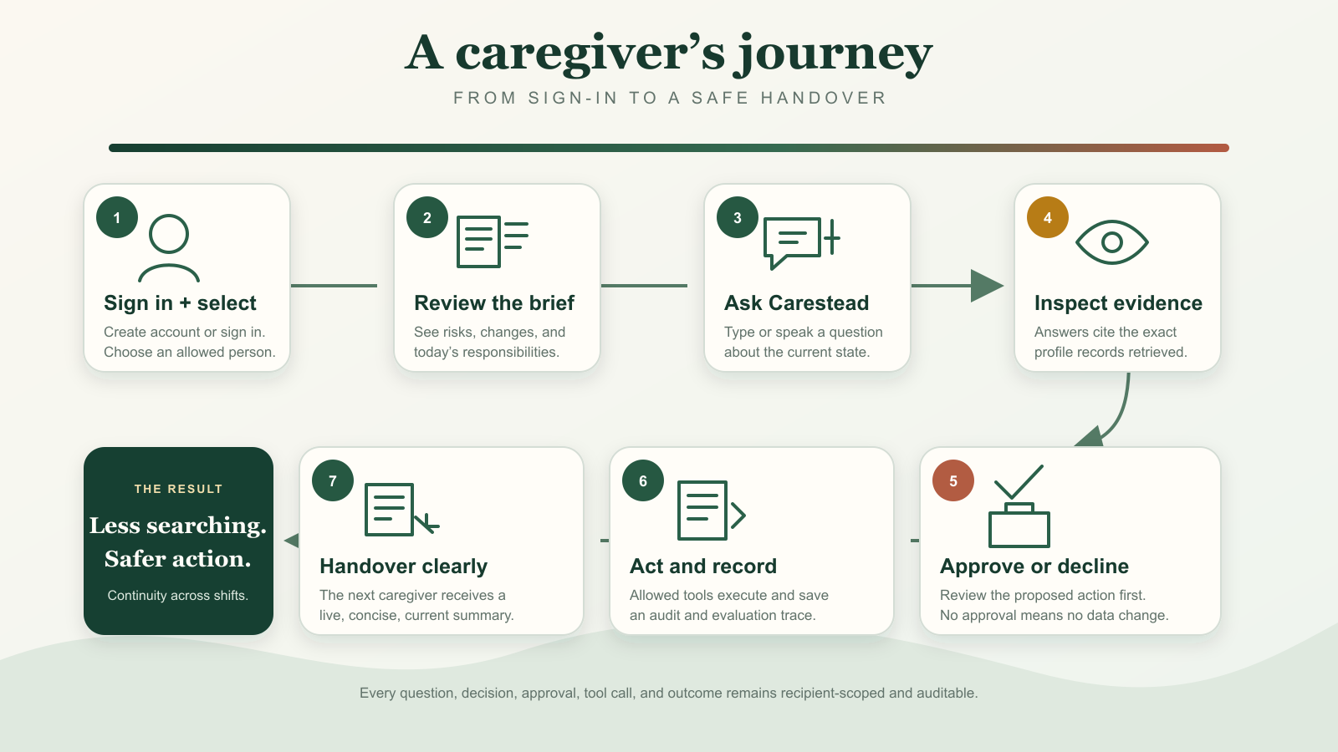
+
Carestead
PROTOTYPE JOURNEY
Carestead · GenAI Academy · September 2026 · v2
06 / 16
Notes:
This is the prototype flow: select an allowed recipient, review the brief, ask Carestead, inspect evidence, approve or decline, execute an allowed tool, record the result, and hand over clearly.

Slide 7
+
Carestead
AGENT CAPABILITY TYPES
AGENTIC DESIGN
Not every workflow uses AI the same way.
Carestead applies model intelligence selectively and keeps safety-critical control in deterministic code.
LLM-assisted workflow
Full agentic workflow
MODEL
Extracts, summarizes, ranks, or drafts.
MODEL
Interprets the goal and explains options.
CONTROL LAYER
Validates, clarifies, scopes, and saves after review.
CONTROL LAYER
Retrieves, plans, calls tools, requests approval, and verifies.
Grounded read-only
Deterministic agent
MODEL
Produces an evidence-backed answer or summary.
MODEL
Optional explanation only.
CONTROL LAYER
Retrieves recipient-scoped records and checks citations.
CONTROL LAYER
Rules detect risks, enforce policy, select tools, and trace outcomes.
Interaction modes: text · voice transcript · spoken reply · image · PDF · structured records
Carestead · GenAI Academy · September 2026 · v2
07 / 16
Notes:
Explain the taxonomy first. LLM-assisted work uses the model for language tasks. Full agentic work spans retrieval, decisions, tools, and verification. Grounded read-only work cannot change data. Deterministic agents use rules for risk and policy.

Slide 8
+
Carestead
AGENT WORKFLOWS IN THE PRODUCT
CAPABILITY MAP
Eight workflows. Four capability patterns.
Each workflow states what the model contributes and what the agent controls.
Grounded care chat
HYBRID AGENTIC
Adaptive care-plan builder
LLM PLANNING
LLM: understand and synthesize
Agent: retrieve, cite, route, approve, execute
LLM: propose plan and missing details
Agent: isolate, validate, approve, create tasks
Conflict resolution
FULL AGENTIC
Communication composer
LLM + DELIVERY
LLM: rank and explain
Agent: simulate, validate, reschedule, verify
LLM: draft and adapt tone
Agent: audience, channel, approval, receipt
Care-update extraction
LLM ASSISTED
Document and image intake
MULTIMODAL LLM
LLM: extract intent and details
Agent: clarify, validate, match, approve, save
LLM: extract fields and uncertainty
Agent: consent, validate, approve, track
Intelligent handover
GROUNDED READ ONLY
Risk checks and memory
DETERMINISTIC AGENT
LLM: evidence-backed summary
Agent: scoped retrieval and citation checks
LLM: optional explanation
Agent: rules, retrieval, policy, traces
Carestead · GenAI Academy · September 2026 · v2
08 / 16
Notes:
Walk through the eight implemented workflows. The left side of each card states the model contribution. The right side states the orchestration, policy, approval, tool, and verification responsibilities.

Slide 9
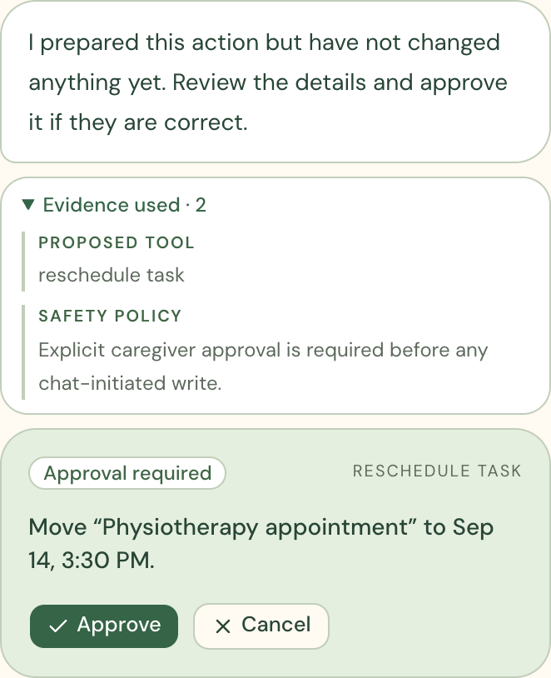
+
Carestead
GROUNDED CHAT · REVIEWABLE ACTIONS
PROTOTYPE USABILITY
Ask naturally. See the evidence.
Approve the exact next step.
1
Grounded answer
The LLM answers from the selected person’s current records and returns evidence IDs.
2
Action proposal
The orchestrator converts the request into a scoped, validated preview. It does not write immediately.
3
Approval + outcome
An authorized caregiver approves. Carestead executes once and records the result.
Carestead · GenAI Academy · September 2026 · v2
09 / 16
Notes:
Demo the chat flow: ask what needs attention, inspect the supporting evidence, request a concrete change, review the exact proposal, approve, and confirm the recorded outcome.

Slide 10
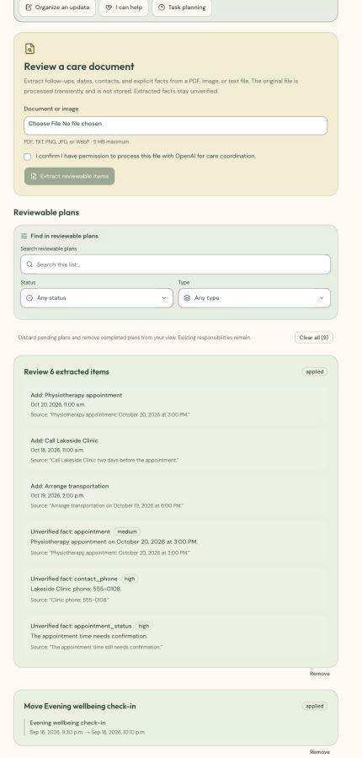
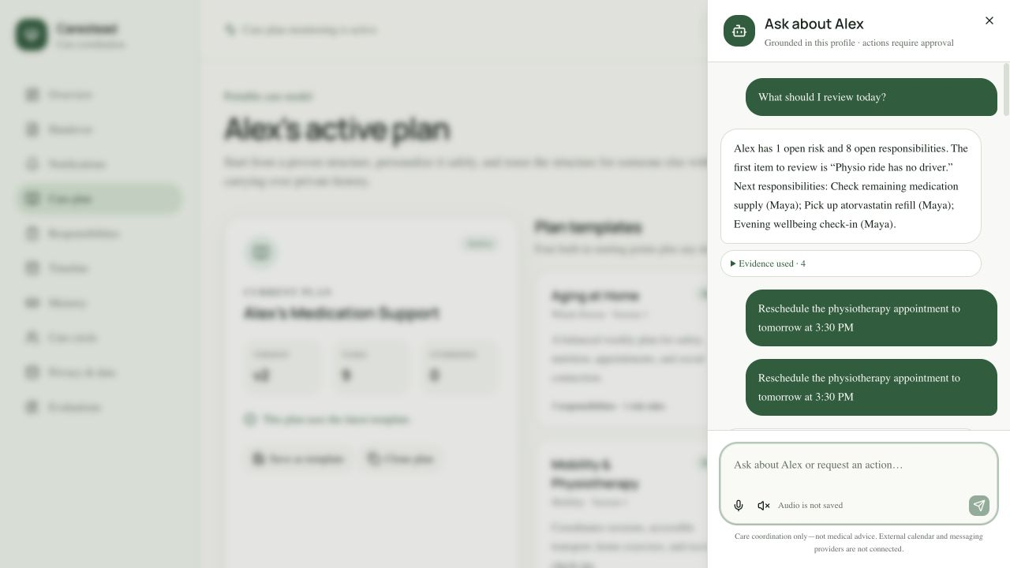
+
Carestead
VOICE · MULTIMODAL INTAKE
VOICE + MULTIMODAL
Care updates arrive in the format caregivers already have.
Speak a request, type a note, or upload an image or PDF. Review structured changes before saving.
Voice interaction
Speech-to-text starts a grounded chat. Spoken replies are optional. Carestead stores transcript text, not raw microphone audio.
Multimodal extraction
The model extracts dates, contacts, follow-ups, facts, and uncertainty. The agent validates scope and asks for approval before saving.
Carestead · GenAI Academy · September 2026 · v2
10 / 16
Notes:
Voice is an interface to the same safe workflow. Document and image intake uses multimodal extraction followed by deterministic validation and caregiver review.

Slide 11
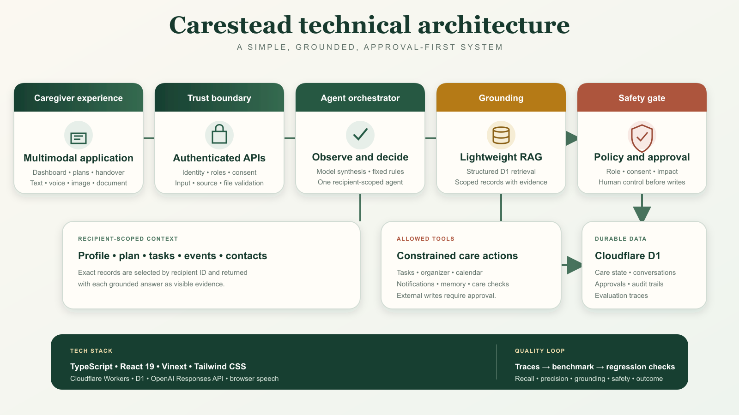
+
Carestead
TECHNICAL ARCHITECTURE
Carestead · GenAI Academy · September 2026 · v2
11 / 16
Notes:
Architecture: React and Vinext interface, authenticated APIs, TypeScript agent orchestration, recipient-scoped retrieval over D1, OpenAI Responses API, policy and approval gates, and constrained care-action tools.

Slide 12
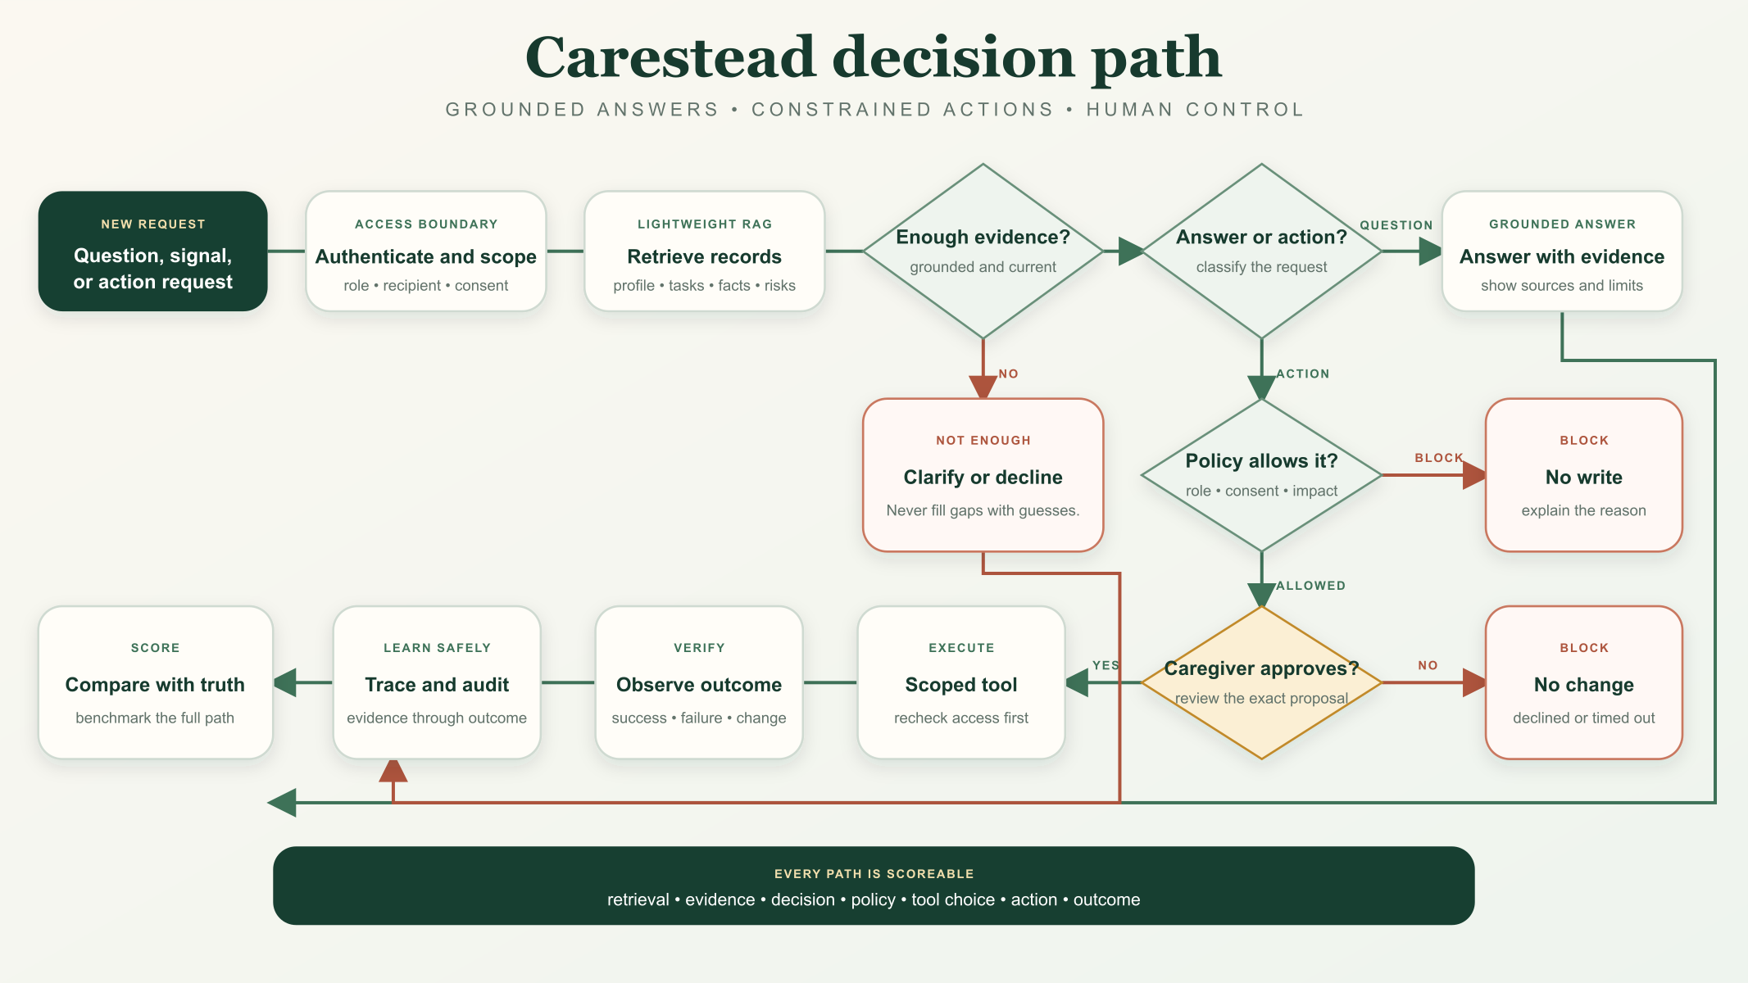
+
Carestead
DECISION PATH
Carestead · GenAI Academy · September 2026 · v2
12 / 16
Notes:
The decision path separates read-only answers from proposed actions. Missing evidence triggers clarification. Consequential changes require an authorized caregiver. Every allowed action is verified and recorded.

Slide 13
+
Carestead
BOUNDED AUTONOMY · TOOL SURFACE
BOUNDED AUTONOMY
The system can reason broadly.
It can act only through narrow, reviewable tools.
LLM contributes
Orchestrator decides
Caregiver decides
Interpret intent · extract facts · summarize evidence · draft language · rank already-feasible options
Recipient scope · tool routing · role checks · consent · risk rules · feasibility · idempotency
Approve, edit, or reject calendar changes, assignments, messages, plan changes, and other consequential writes
Profile + plan
Responsibilities
Calendar
Care Circle
Handover
Notifications
Memory
Audit + evals
Carestead · GenAI Academy · September 2026 · v2
13 / 16
Notes:
Use this slide to explain autonomy. The LLM never gets direct database or provider access. It proposes structured outputs; deterministic code validates and calls a narrow tool only after the applicable approval gate.

Slide 14
+
Carestead
EVALUATION STRATEGY
EVALUATION
Evaluate every step, not only the final answer.
Each synthetic scenario has known evidence, policy, action, and outcome expectations.
1
Scenario
→
2
Retrieve
→
3
Decide
→
4
Constrain
→
5
Act
→
6
Verify
Known input + outcome
Scoped evidence
Risk or clarification
Policy + approval
Allowed tool
Recorded outcome
EIGHT SCORED DIMENSIONS
Retrieval recall
Retrieval precision
Grounding
Decision
Find every expected recipient-scoped record.
Exclude irrelevant and other-recipient records.
Tie factual claims and decisions to evidence IDs.
Choose the correct risk, action class, or clarification.
Policy
Action + tool
Outcome
Safety
Apply roles, consent, approval, and non-clinical limits.
Select an allowed tool with valid scoped arguments.
Verify success or report tool failure honestly.
Preserve isolation, atomicity, and prohibited-action rules.
104
8 workflows · 11 conditions
104 / 104 passed
Hard gate
Synthetic regression benchmark
synthetic scenarios
16 risk + 88 trajectories
Text · chat · voice · image · tool failure · prompt injection
All eight dimensions = 100%
One policy or safety violation fails CI.
Not clinical validation or measured caregiver impact.
Carestead · GenAI Academy · September 2026 · v2
14 / 16
Notes:
Explain how evaluation follows the complete trajectory. Each scenario defines expected retrieval, evidence, decision, policy, action, and outcome. Eight dimensions are scored independently. Grounding, policy, outcome, and safety require 100 percent, and one hard-gate violation fails CI. The result remains a deterministic synthetic regression benchmark, not clinical validation.

Slide 15
+
Carestead
MOBILE DEPLOYMENT TRACK
MOBILE
The same care workspace is moving to iPhone.
A Capacitor/iOS pilot reuses the responsive Carestead UI, shared types, and the same authenticated backend APIs.
Shared application layer
Already checked
+ Carestead
Web and mobile import the same dashboard, chat, calendar, account flows, styles, and API types.
Web/mobile builds · browser integration · unsigned iOS simulator build · transport and config tests.
Plan
Chat + voice
Calendar
Handover
Approvals
→
Native adapter
Before distribution
Restricted HTTPS API bridge plus native speech recognition and synthesis, with native share support.
Signed-device sessions · native accessibility · Google OAuth return · native push · icon/store/privacy review.
iOS pilot
STATUS · Integration in progress. Pilot, not an App Store release.
Carestead · GenAI Academy · September 2026 · v2
15 / 16
Notes:
Mobile is a parallel deployment track. Be precise: the pilot builds and runs in simulator, but signed-device validation, native push, release assets, OAuth return flows, and distribution work remain.

Slide 16
+
Carestead
REAL-WORLD IMPACT · THE PROMISE
REAL-WORLD IMPACT
A scattered care story becomes
a safe, shared next step.
Before Carestead
With Carestead
Fragmented information
Repeated reconstruction
Unclear responsibility ownership
Follow-up and handover gaps
Shared recipient context
Named ownership and reviewable actions
Visible outcomes and audit history
Faster, clearer caregiver handover
PILOT MEASURES
Coordination time · unresolved responsibilities · unnecessary alerts · handover completeness · caregiver confidence
Less to carry. More care to give.
Carestead · GenAI Academy · September 2026 · v2
16 / 16
Notes:
Close on the intended impact without claiming measured outcomes. The future pilot should measure coordination time, unresolved responsibilities, unnecessary alerts, handover completeness, and caregiver confidence.

