Slide 1

OncoDetectAI
Multimodal AI Platform for Small Cell Lung Cancer (SCLC) Detection & Risk Stratification
Team Members:
Pranali Chipkar
Siddharth Pawar
Aditi Deshmukh

Slide 2
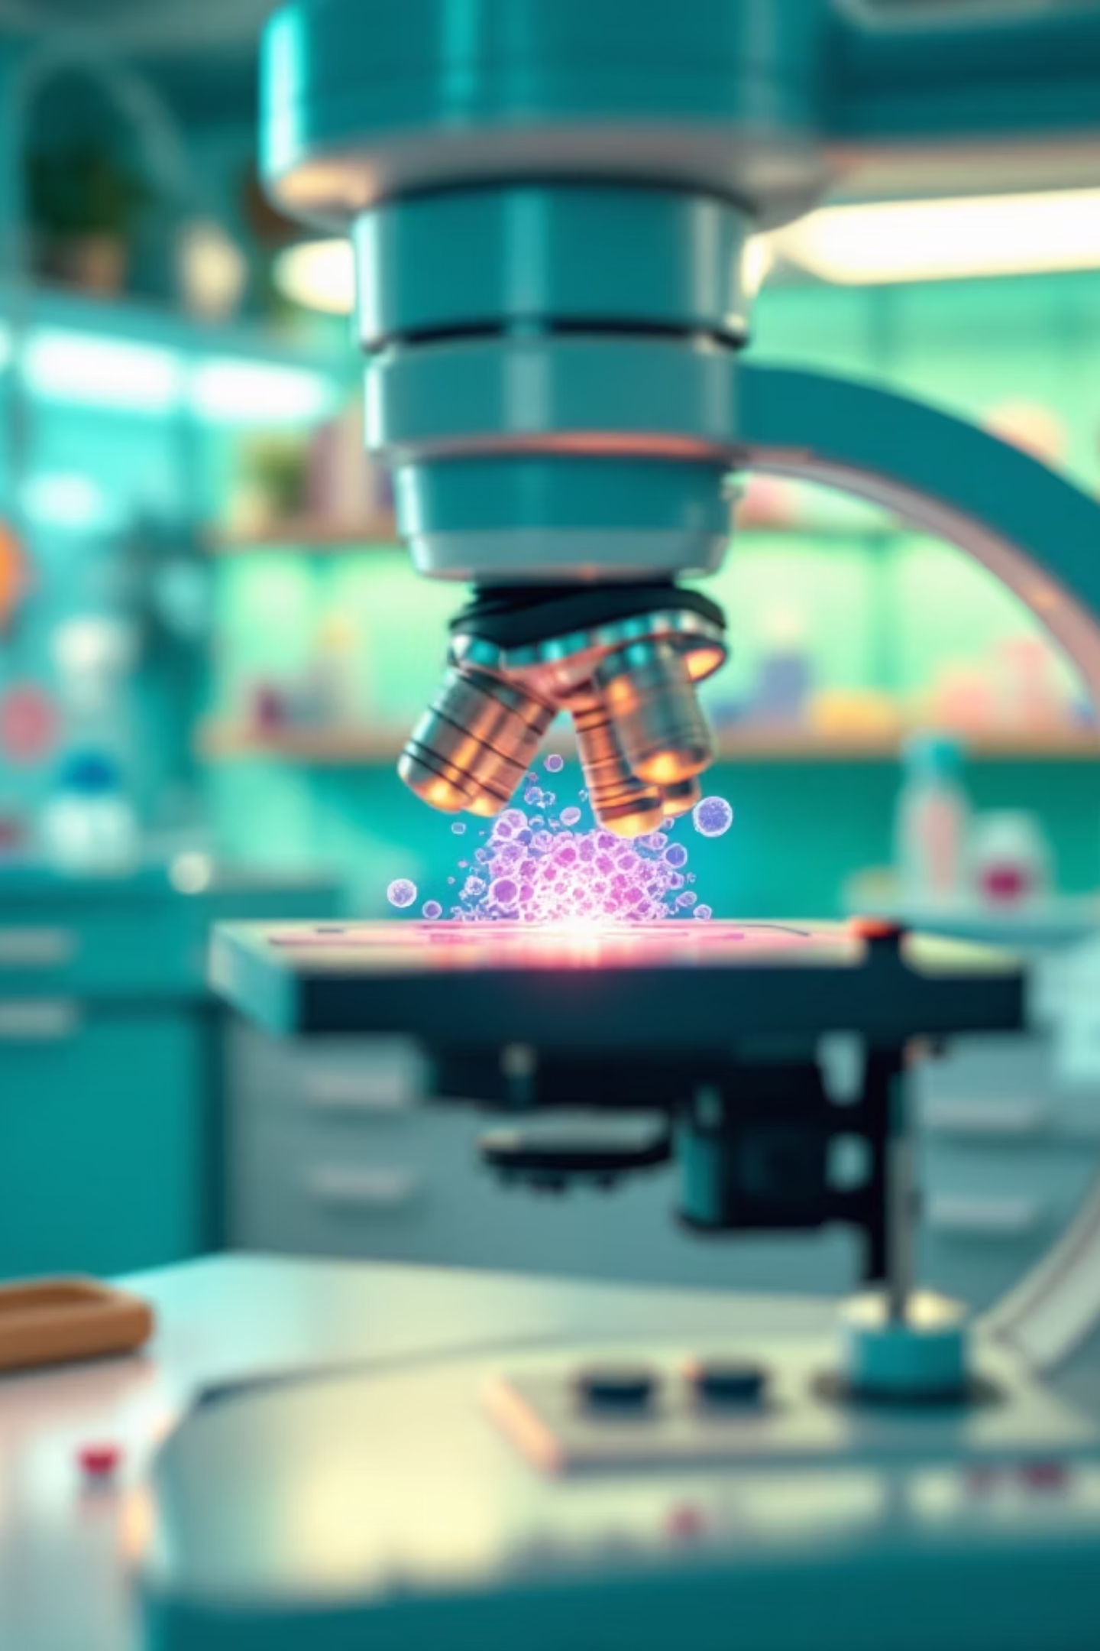
Why OncoDetectAI?
The Clinical Challenge
SCLC: 15% of lung cancers, worst prognosis
70% diagnosed at advanced stages
12–18-month average survival
Critical gap in early detection tools
The Reality for Clinicians
530+ latest research papers
Limited access to molecular subtyping
Patients lack risk assessment tools
What if AI could detect risk earlier, personalize treatment, and democratize access to cutting-edge oncology insights?

Slide 3

INTRODUCTION
A comprehensive platform combining multimodal AI, real-time research synthesis, and clinical decision support
Intelligent Research Assistant
Precision Risk Prediction
Molecular Subtype Classification
Multimodal RAG: 530+ SCLC papers
ML risk stratification engine
4 SCLC subtypes: N, P, A, Y
Text + medical image analysis
Demographics, genomics, clinical data
Biomarker-driven analysis
Real-time ArXiv & web integration
Similar patient cohort insights
Subtype-specific therapeutics
Actionable clinical insights
Geospatial treatment center mapping
Downloadable clinical reports
Technical Innovation: 7 specialized AI agents | Multimodal embeddings (Snowflake Arctic + Voyage) | Real-time data pipelines | Modern BI | Product analytics
IMPACT: Empowering clinicians and researchers with AI-assisted early detection, personalized treatment pathways, and evidence-based decision support

Slide 4
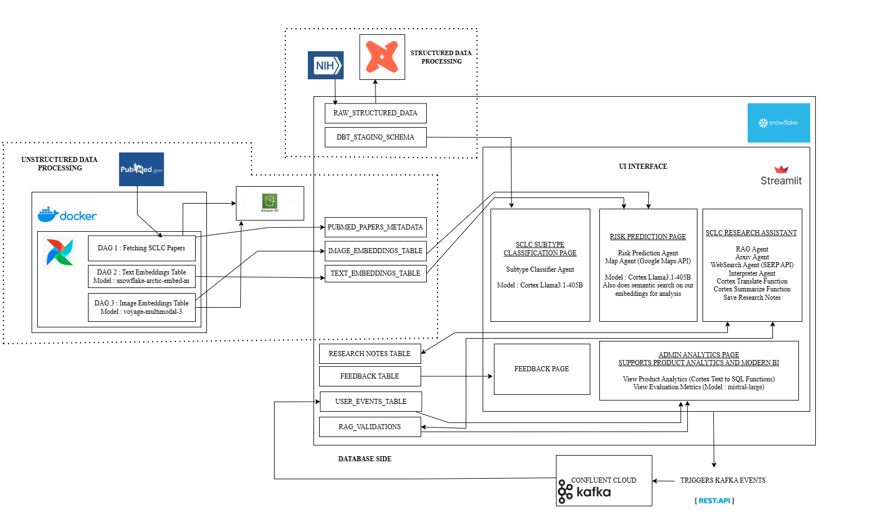
SYSTEM ARCHITECTURE

