Slide 1
ANalysis Of VAriance

Slide 2
From two samples to many
So far, we have only worked with at most two samples and the possible comparisons. Useful techniques but few applications.
What do you do when more than one samples need to be compared?
Compute all pairwise comparisons!
Yes but …

Slide 3
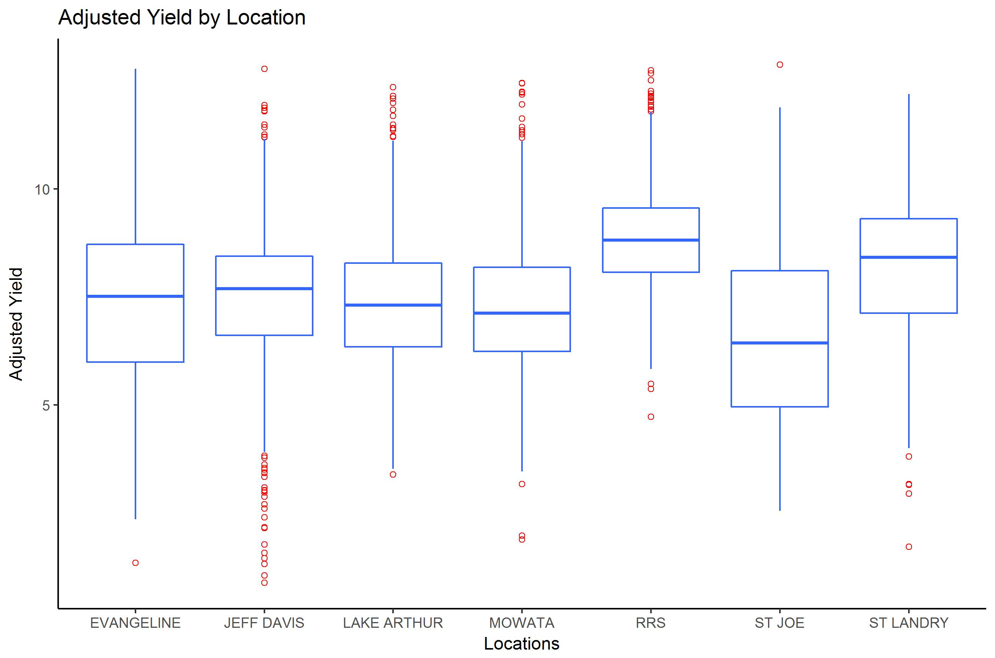
Rice Yield by location
The following boxplot shows the average yield for rice in 7 research locations in Louisiana (in thousands of pounds)

Slide 4
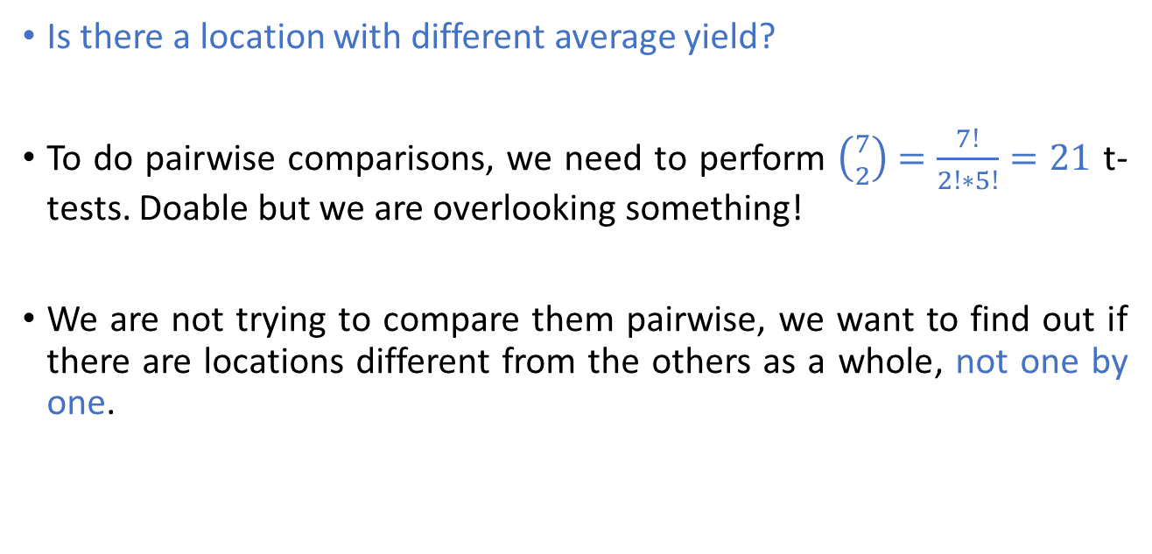
Rice Yield by location
Is there a location with different average yield?
To do pairwise comparisons, we need to perform $\left({7 \atop 2}\right)=\frac{7!}{2!∗5!}=21$ t-tests. Doable but we are overlooking something!
We are not trying to compare them pairwise, we want to find out if there are locations different from the others as a whole, not one by one.

Slide 5
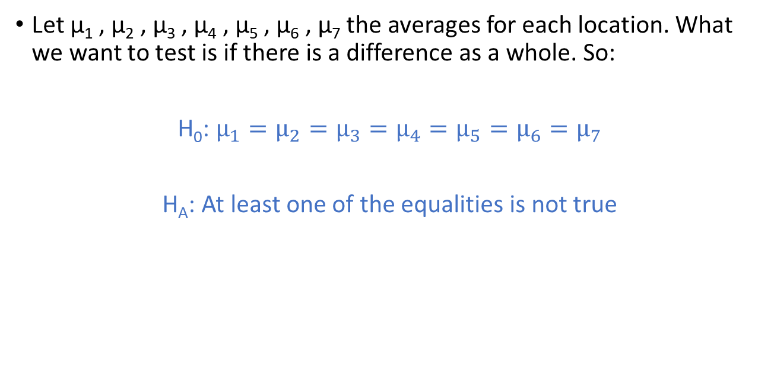
Hypothesis Testing
Let μ₁ , μ₂ , μ₃ , μ₄ , μ₅ , μ₆ , μ₇ the averages for each location. What we want to test is if there is a difference as a whole. So:
H₀: $μ_{1}=μ_{2}=μ_{3}=μ_{4}=μ_{5}=μ_{6}=μ_{7}$
H_{A}: At least one of the equalities is not true

Slide 6
Statistic
What we will be using eventually is a ratio of two computations following chi-squared distributions. Thus, the right statistic will be the F. But there is a long way to get there!
Fear not, statistical programs will do it for us!

Slide 7
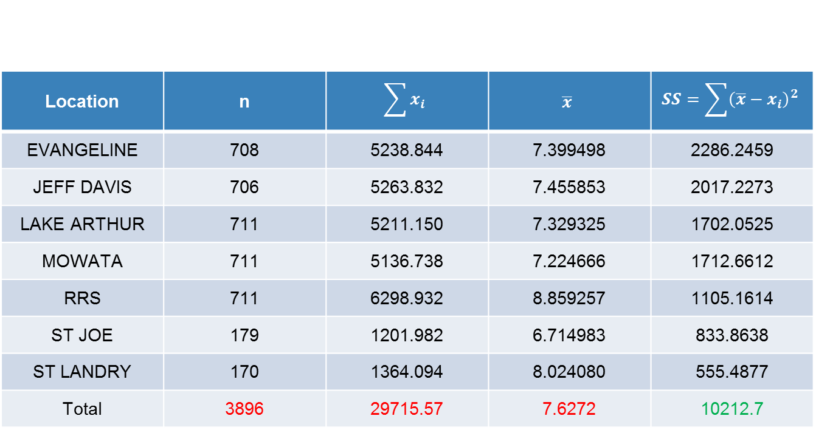
Preliminary computations
Location | n | $$\sum{x_{i}}$$ | $$\overline{x}$$ | $$SS=\sum{{\left(\overline{x}−x_{i}\right)}^{2}}$$
EVANGELINE | 708 | 5238.844 | 7.399498 | 2286.2459
JEFF DAVIS | 706 | 5263.832 | 7.455853 | 2017.2273
LAKE ARTHUR | 711 | 5211.150 | 7.329325 | 1702.0525
MOWATA | 711 | 5136.738 | 7.224666 | 1712.6612
RRS | 711 | 6298.932 | 8.859257 | 1105.1614
ST JOE | 179 | 1201.982 | 6.714983 | 833.8638
ST LANDRY | 170 | 1364.094 | 8.024080 | 555.4877
Total | 3896 | 29715.57 | 7.6272 | 10212.7
This is the pooled sum of squares

Slide 8

Pooled Sum of Squares
As we recall the variance is given by:
$$s^{2}=\frac{SS}{df}$$
In the case of two samples the pooled variance was
$$s_{p}^{2}=\frac{SS_{p}}{df_{p}}=\frac{SS_{1}+SS_{2}}{df_{1}+df_{2}}$$

Slide 9
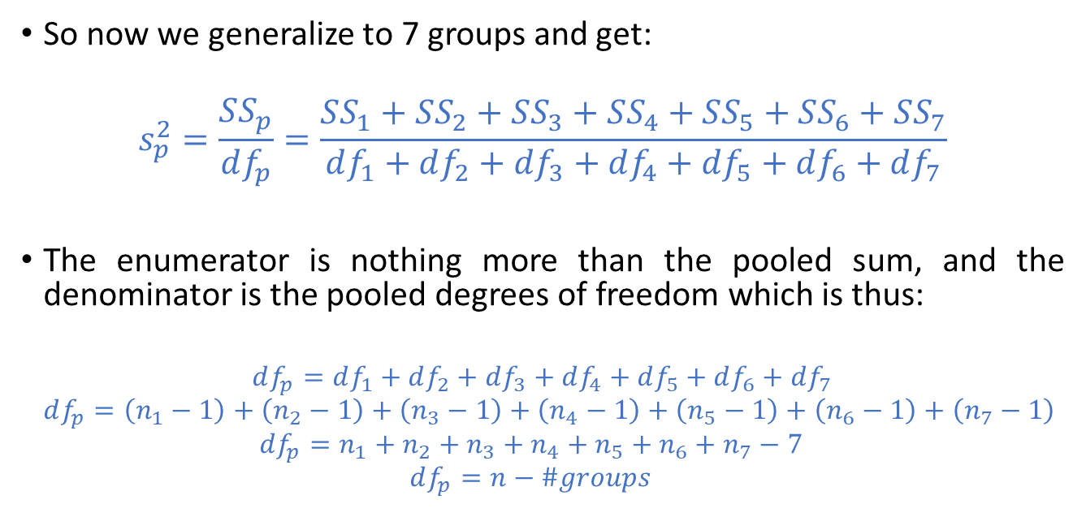
Pooled variance, degrees of freedom
So now we generalize to 7 groups and get:
$$s_{p}^{2}=\frac{SS_{p}}{df_{p}}=\frac{SS_{1}+SS_{2}+SS_{3}+SS_{4}+SS_{5}+SS_{6}+SS_{7}}{df_{1}+df_{2}+df_{3}+df_{4}+df_{5}+df_{6}+df_{7}}$$
The enumerator is nothing more than the pooled sum, and the denominator is the pooled degrees of freedom which is thus:
$$df_{p}=df_{1}+df_{2}+df_{3}+df_{4}+df_{5}+df_{6}+df_{7}$$
$$df_{p}=\left(n_{1}−1\right)+\left(n_{2}−1\right)+\left(n_{3}−1\right)+\left(n_{4}−1\right)+\left(n_{5}−1\right)+\left(n_{6}−1\right)+\left(n_{7}−1\right)$$
$$df_{p}=n_{1}+n_{2}+n_{3}+n_{4}+n_{5}+n_{6}+n_{7}−7$$
$$df_{p}=n−\#groups$$

Slide 10

Pooled variance vs individual
$$s_{p}^{2}=\frac{SS_{p}}{df_{p}}=\frac{SS_{p}}{n−\#groups}=\frac{10,212.7}{(3896−7)}$$
$$s_{p}^{2}=2.626$$
Each group also has its individual variance given by
$$s_{i}^{2}=\frac{SS_{i}}{df_{i}}$$
Location | EVANGELINE | JEFF DAVIS | LAKE ARTHUR | MOWATA | RRS | ST JOE | ST LANDRY
Variance | 3.233728 | 2.861315 | 2.397257 | 2.412199 | 1.556565 | 4.684628 | 3.286910

Slide 11
Homoscedasticity
When using pooled variances, we assume that the underlying variance of the different groups is the same. This assumption is called Homoscedasticity.
Homo (όμοιο) = same
Scedastic (σκεδαστός) = able to be scattered
More on this idea later (opposite is heteroscedasticity)

Slide 12
ANOVA Steps
We will be computing three sums of squares (between, within, total)
We will be dividing with specific degrees of freedom to get the means
We will compute the ratio of the means
We will find what is the probability of observing that ratio using an F statistic (with a one-sided test)

Slide 13
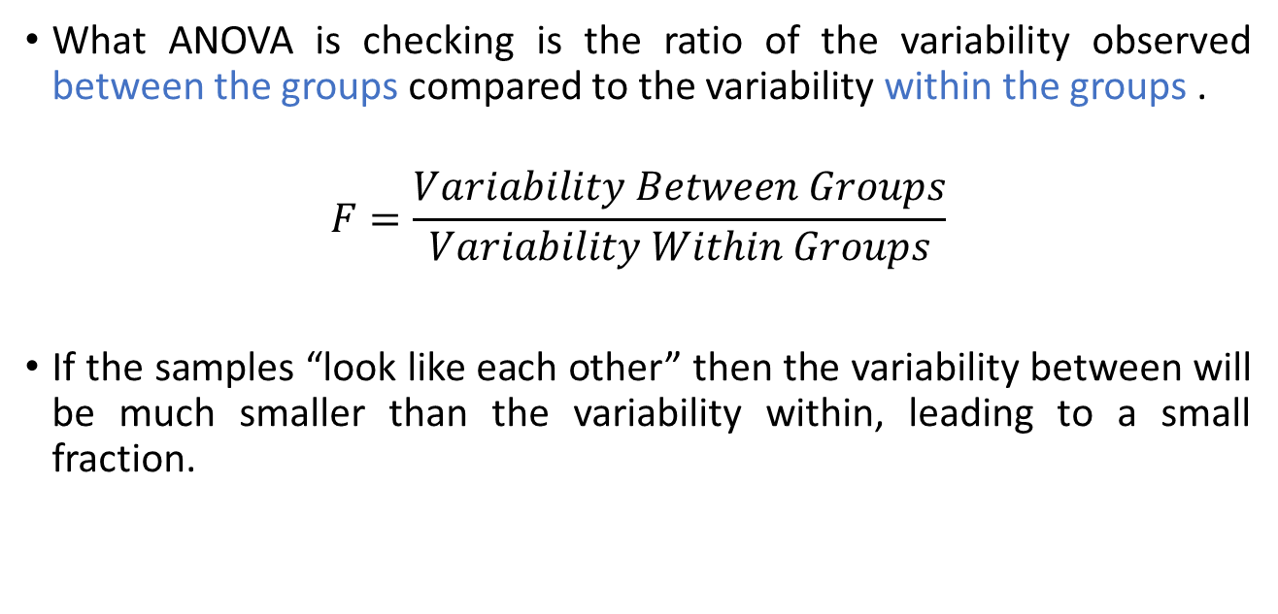
ANOVA Variability
What ANOVA is checking is the ratio of the variability observed between the groups compared to the variability within the groups .
$$F=\frac{Variability Between Groups}{Variability Within Groups}$$
If the samples “look like each other” then the variability between will be much smaller than the variability within, leading to a small fraction.

Slide 14
ANOVA TABLE
 | DF | Sum of Squares | Mean Square | F Value | Pr > F
Between | 6 | 1490.73218 | 248.45536 | 94.61 | <.0001
Within | 3889 | 10212.69974 | 2.62605
Total | 3895 | 11703.43192

Slide 15
The Between groups DF_{B}
 | DF | Sum of Squares | Mean Square | F Value | Pr > F
Between | 6 | 1490.73218 | 248.45536 | 94.61 | <.0001
Within | 3889 | 10212.69974 | 2.62605
Total | 3895 | 11703.43192

Slide 16

The Between groups DF_{B}
This basically computes the degrees of freedom for our experiment, and it is equal to the number of different groups minus one.
$$DF_{B}=\#groups−1=7−1=6$$

Slide 17
The Within groups DF_{W}
 | DF | Sum of Squares | Mean Square | F Value | Pr > F
Between | 6 | 1490.73218 | 248.45536 | 94.61 | <.0001
Within | 3889 | 10212.69974 | 2.62605
Total | 3895 | 11703.43192

Slide 18
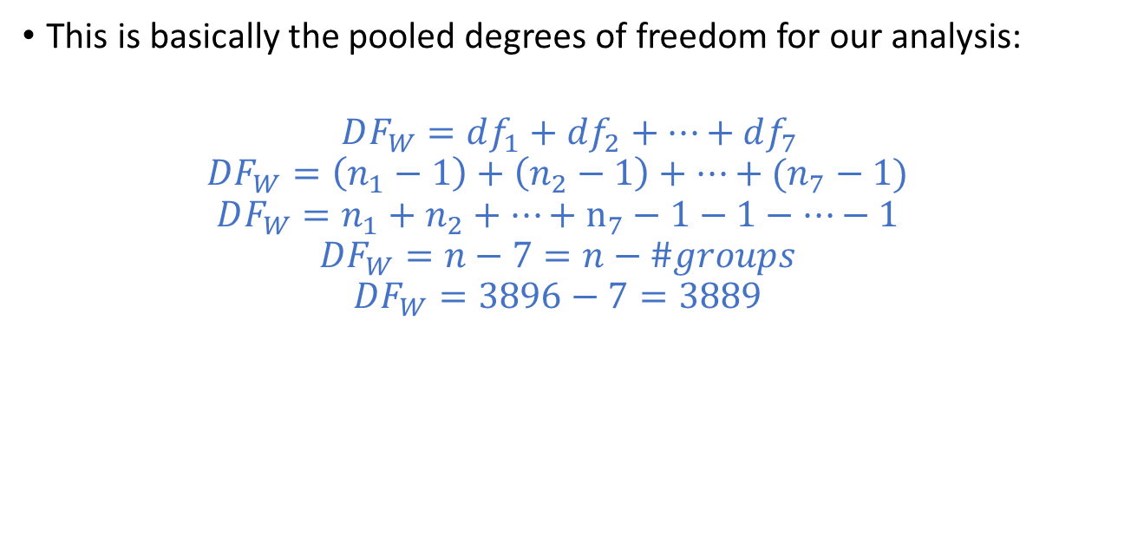
The Within groups DF_{W}
This is basically the pooled degrees of freedom for our analysis:
$$DF_{W}=df_{1}+df_{2}+…+df_{7}$$
$$DF_{W}=\left(n_{1}−1\right)+\left(n_{2}−1\right)+…+(n_{7}−1)$$
$$DF_{W}=n_{1}+n_{2}+…+n_{7}−1−1−…−1$$
$$DF_{W}=n−7=n−\#groups$$
$$DF_{W}=3896−7=3889$$

Slide 19
The Total DF_{T}
 | DF | Sum of Squares | Mean Square | F Value | Pr > F
Between | 6 | 1490.73218 | 248.45536 | 94.61 | <.0001
Within | 3889 | 10212.69974 | 2.62605
Total | 3895 | 11703.43192

Slide 20
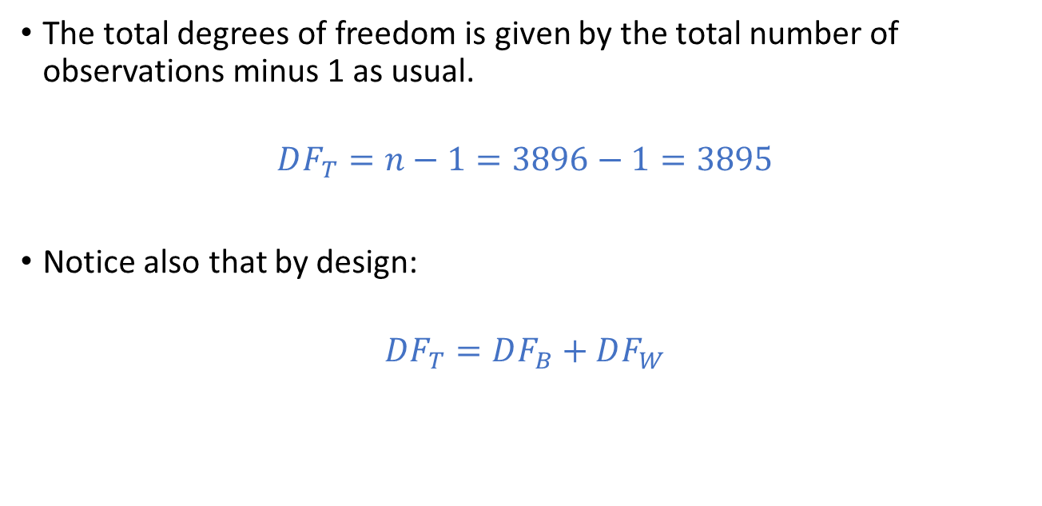
The Total DF_{T}
The total degrees of freedom is given by the total number of observations minus 1 as usual.
$$DF_{T}=n−1=3896−1=3895$$
Notice also that by design:
$$DF_{T}=DF_{B}+DF_{W}$$

Slide 21
The Between groups SS (SSB)
 | DF | Sum of Squares | Mean Square | F Value | Pr > F
Between | 6 | 1490.73218 | 248.45536 | 94.61 | <.0001
Within | 3889 | 10212.69974 | 2.62605
Total | 3895 | 11703.43192

Slide 22
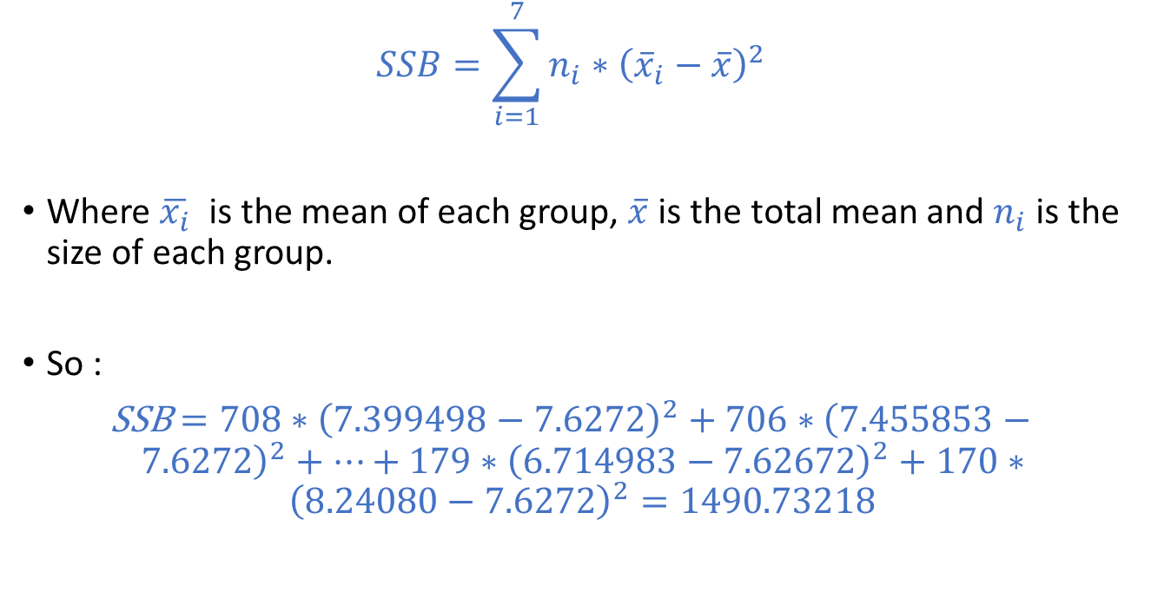
The Between groups SS (SSB)
$$SSB=\sum_{i=1}^{7}{n_{i}∗{\left({\overline{x}}_{i}−\overline{x}\right)}^{2}}$$
Where $\overline{x_{i}}$ is the mean of each group, $\overline{x}$ is the total mean and $n_{i}$ is the size of each group.
So :
SSB$=708∗{\left(7.399498−7.6272\right)}^{2}+706∗{\left(7.455853−7.6272\right)}^{2}+…+179∗{\left(6.714983−7.62672\right)}^{2}+170∗{\left(8.24080−7.6272\right)}^{2}=\text{1490.73218}$

Slide 23
The Between groups SS (SSB)
This summation represents the variability of the model which comes from the different groups.
Once again, if we believe that our samples look the same this summation should be relatively small.

Slide 24
The Total SS (SST)
 | DF | Sum of Squares | Mean Square | F Value | Pr > F
Between | 6 | 1490.73218 | 248.45536 | 94.61 | <.0001
Within | 3889 | 10212.69974 | 2.62605
Total | 3895 | 11703.43192

Slide 25
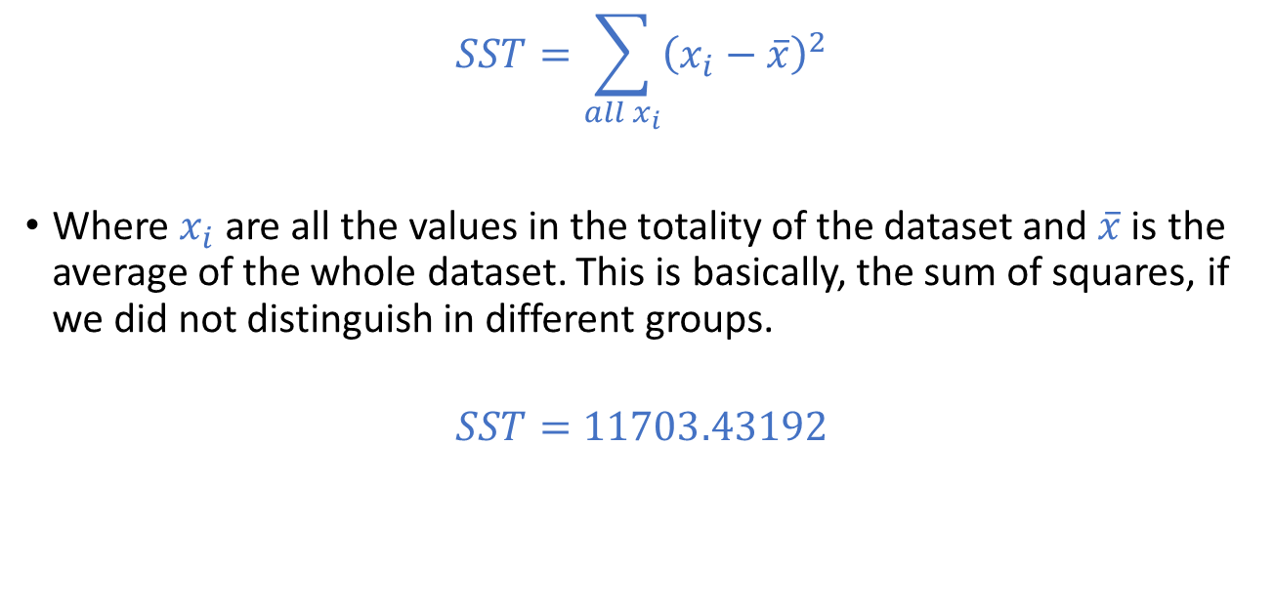
The Total SS (SST)
$$SST=\sum_{all x_{i}}{{\left(x_{i}−\overline{x}\right)}^{2}}$$
Where $x_{i}$ are all the values in the totality of the dataset and $\overline{x}$ is the average of the whole dataset. This is basically, the sum of squares, if we did not distinguish in different groups.
$$SST=11703.43192$$

Slide 26
The Within SS (SSW)
 | DF | Sum of Squares | Mean Square | F Value | Pr > F
Between | 6 | 1490.73218 | 248.45536 | 94.61 | <.0001
Within | 3889 | 10212.69974 | 2.62605
Total | 3895 | 11703.43192

Slide 27
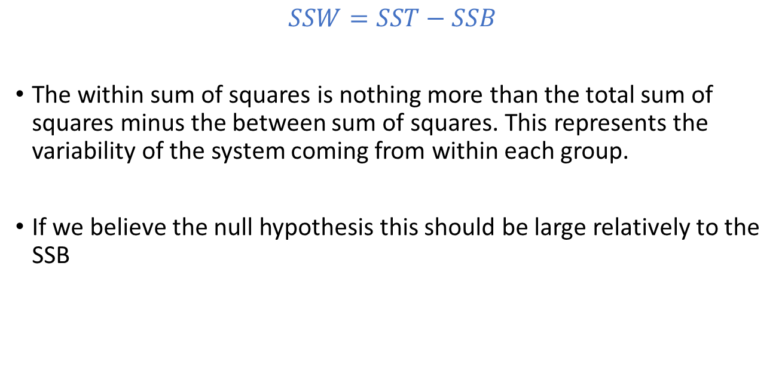
The Within SS (SSW)
$$SSW=SST−SSB$$
The within sum of squares is nothing more than the total sum of squares minus the between sum of squares. This represents the variability of the system coming from within each group.
If we believe the null hypothesis this should be large relatively to the SSB

Slide 28
Computing the means
Dividing SSB and SSW as they are will always lead to a very small ratio. This is because of the computation involved and the fact that there are many more factors in SSW than in SSB. Thus, we need to normalize by computing some sort of averages for both.

Slide 29
The Between groups mean (MSB)
Source | DF | Sum of Squares | Mean Square | F Value | Pr > F
Model | 6 | 1490.73218 | 248.45536 | 94.61 | <.0001
Error | 3889 | 10212.69974 | 2.62605
Corrected Total | 3895 | 11703.43192

Slide 30

The Between groups mean (MSB)
To find the between groups mean, we compute the ratio:
$$MSB=\frac{SSB}{DF_{B}}=\frac{1490.73218}{6}=248.45536$$

Slide 31
The Within groups mean (MSW)
 | DF | Sum of Squares | Mean Square | F Value | Pr > F
Between | 6 | 1490.73218 | 248.45536 | 94.61 | <.0001
Within | 3889 | 10212.69974 | 2.62605
Total | 3895 | 11703.43192

Slide 32

The Within groups mean (MSW)
To find the within groups mean, we compute the ratio:
$$MSW=\frac{SSW}{DF_{W}}=\frac{10212.69974}{3889}=2.62605$$

Slide 33
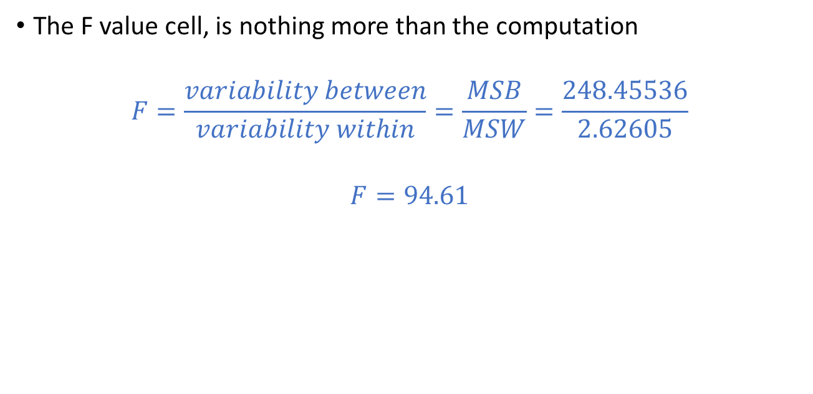
The Variability ratio F
The F value cell, is nothing more than the computation
$$F=\frac{variability between}{variability within}=\frac{MSB}{MSW}=\frac{248.45536}{2.62605}$$
$$F=94.61$$

Slide 34
The Variability ratio F
When we were talking about the analysis of variance for two proportions, we discussed that the ratio of sums of squares follows a specific F distribution, namely:
F(df of enumerator, df of denominator)
Thus, our ratio follows an F distribution with parameters F(DF_{B,} DF_{W})=F(6,3889)

Slide 35
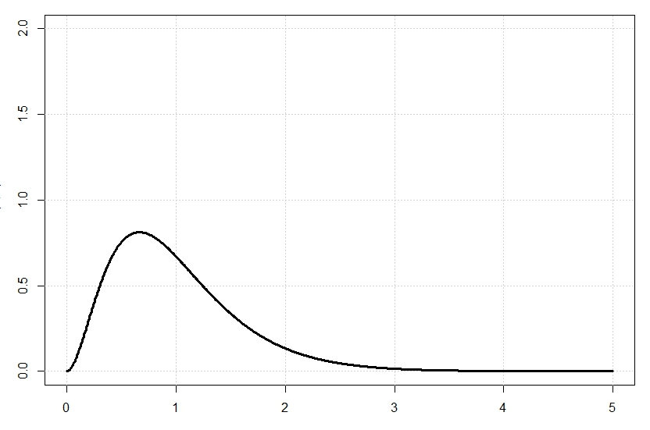

The F distribution
F(6,3889) looks like:
After 5 is practically zero, so it is no wonder that
$$P\left(F>94.61\right)<0.0001$$

Slide 36

The F distribution
Recall that if we wanted a two-sided computation, we should also compute the other ratio i.e., $F=\frac{1}{94.61}=0.01056$
And the corresponding mirror distribution
F(3889,6)

Slide 37
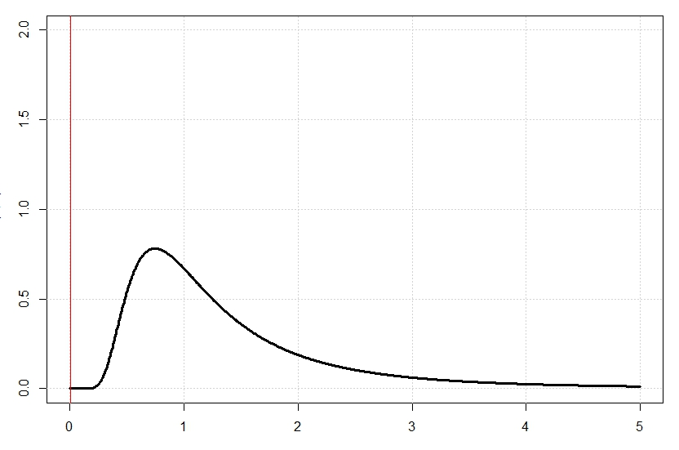

The F distribution
We are then computing $P\left(F<0.01056 \right)$which is the area under the curve to the left of the red line so again practically zero.
But this is NOT done in an ANOVA setting!

Slide 38
Verdict
 | DF | Sum of Squares | Mean Square | F Value | Pr > F
Between | 6 | 1490.73218 | 248.45536 | 94.61 | <.0001
Within | 3889 | 10212.69974 | 2.62605
Total | 3895 | 11703.43192
SAS computes the summed probabilities and outputs a p value very small utilizing a one-sided ANOVA test.

Slide 39
Verdict
As we see the p value is much smaller than 0.05 so we reject the null hypothesis. This can be translated to:
The data shows that at least one location has a different average yield from the rest.

Slide 40
Remark
Notice that the ANOVA process DOES NOT tell us which groups are different from the whole. It just tells us that at least one is.
To compute which group is different, we need to do comparisons one by one. But! We need to somehow use the totality of data to do inferences not each pair separately.

Slide 41
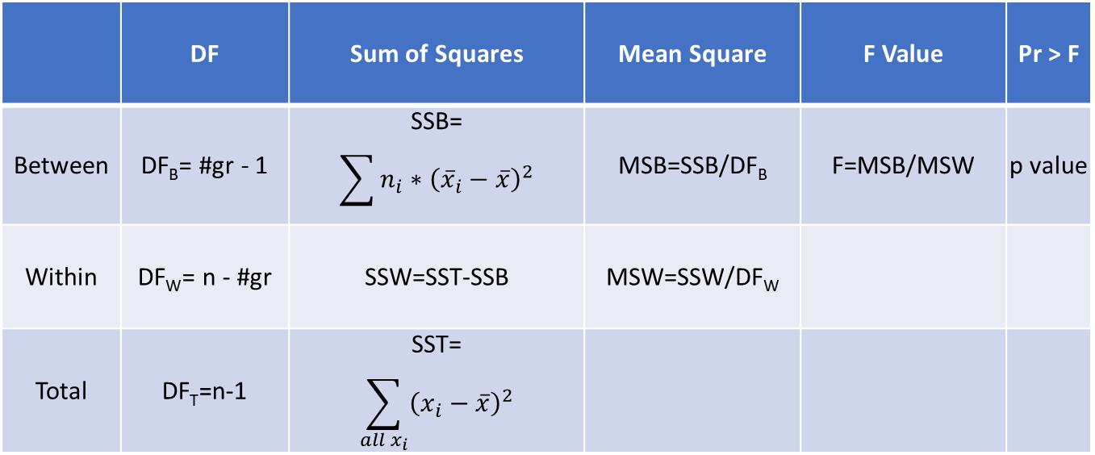
Summary table
 | DF | Sum of Squares | Mean Square | F Value | Pr > F
Between | DF_{B}= #gr - 1 | SSB= $$\sum{n_{i}∗{\left({\overline{x}}_{i}−\overline{x}\right)}^{2}}$$ | MSB=SSB/DF_{B} | F=MSB/MSW | p value
Within | DF_{W}= n - #gr | SSW=SST-SSB | MSW=SSW/DF_{W}
Total | DF_{T}=n-1 | SST= $$\sum_{all x_{i}}{{\left(x_{i}−\overline{x}\right)}^{2}}$$

