Slide 1


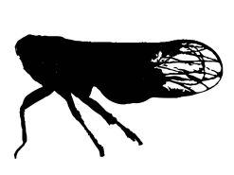
Top predator
Mesopredator
Shared prey

Slide 2
1st feeding trial
+
+

Slide 3
2nd feeding trial
+
+
+
+
+

Slide 4
Standard IGP curve
Experimental
Δ¹⁵N (‰)
Proportion of mesopredator consumed (%)

Slide 5


δ¹⁵N (‰)
Empirical
Δ¹⁵N
Experimental
Δ¹⁵N (‰)
Proportion (%)

Slide 6
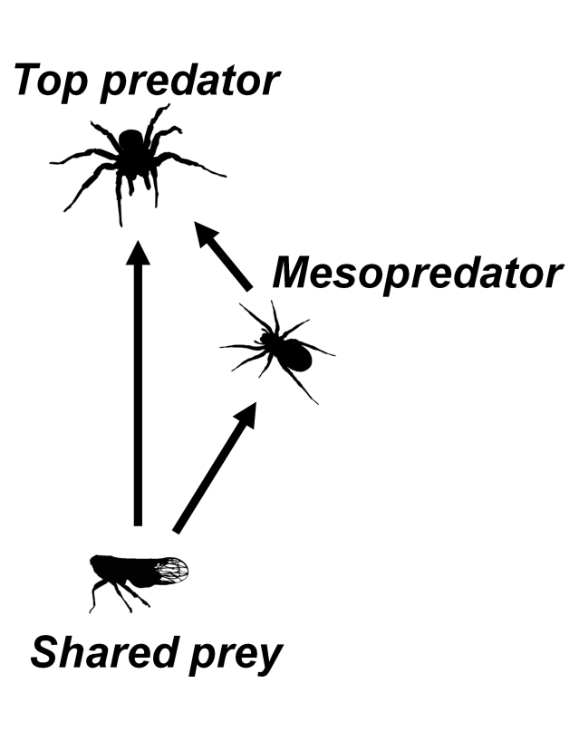
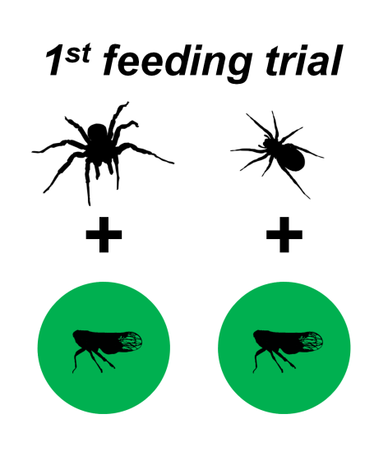
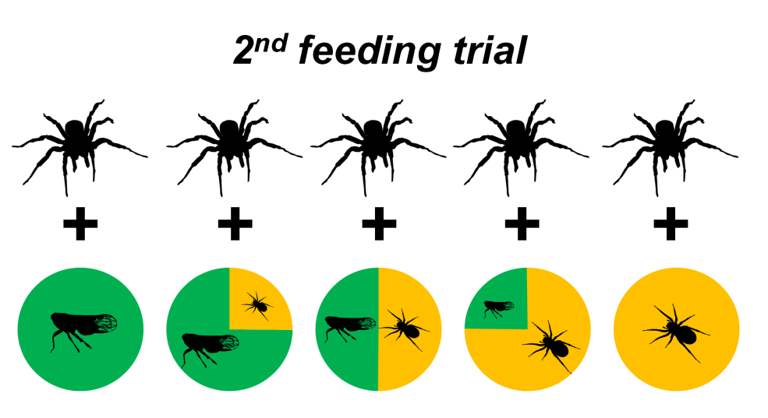
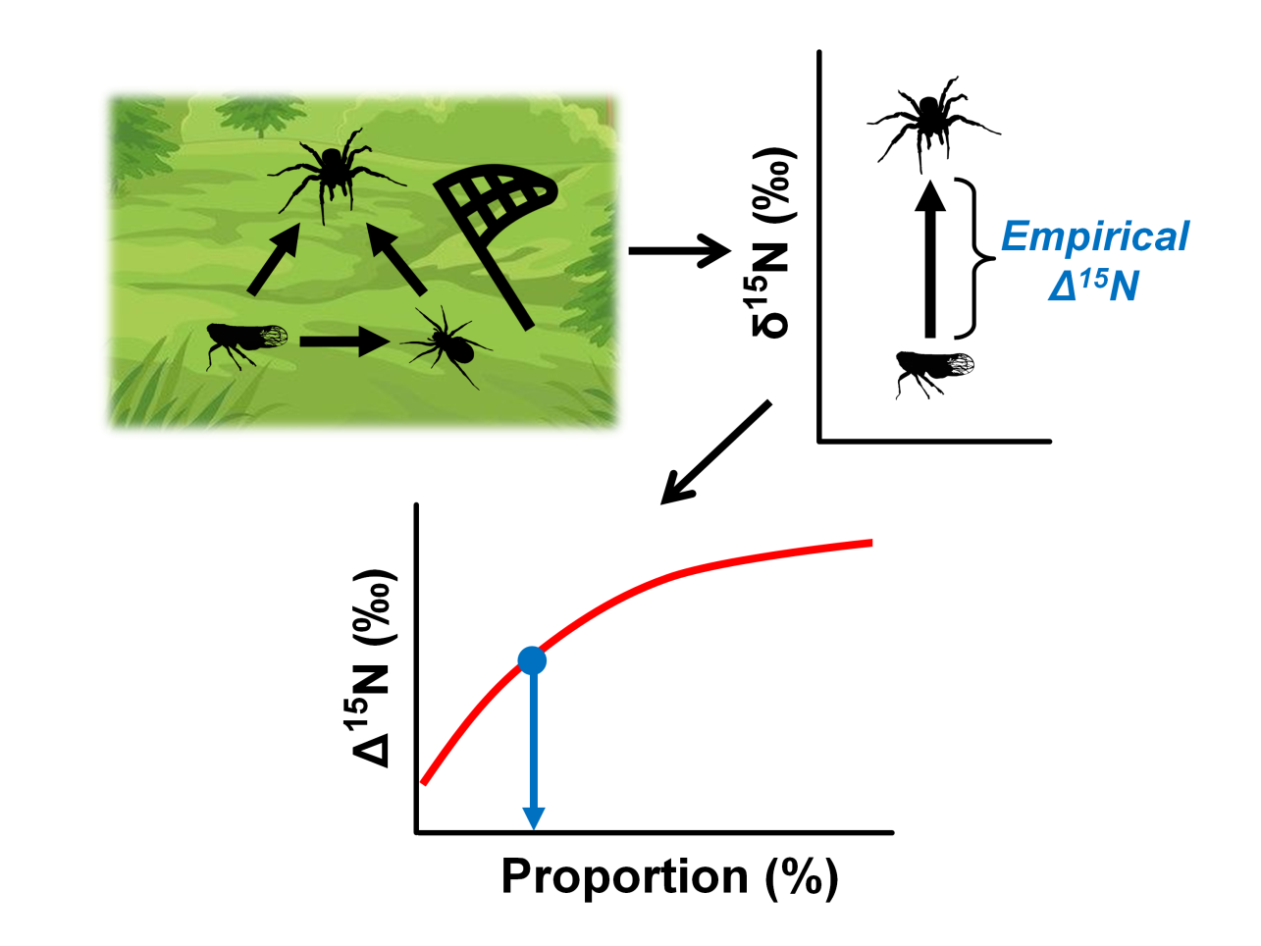
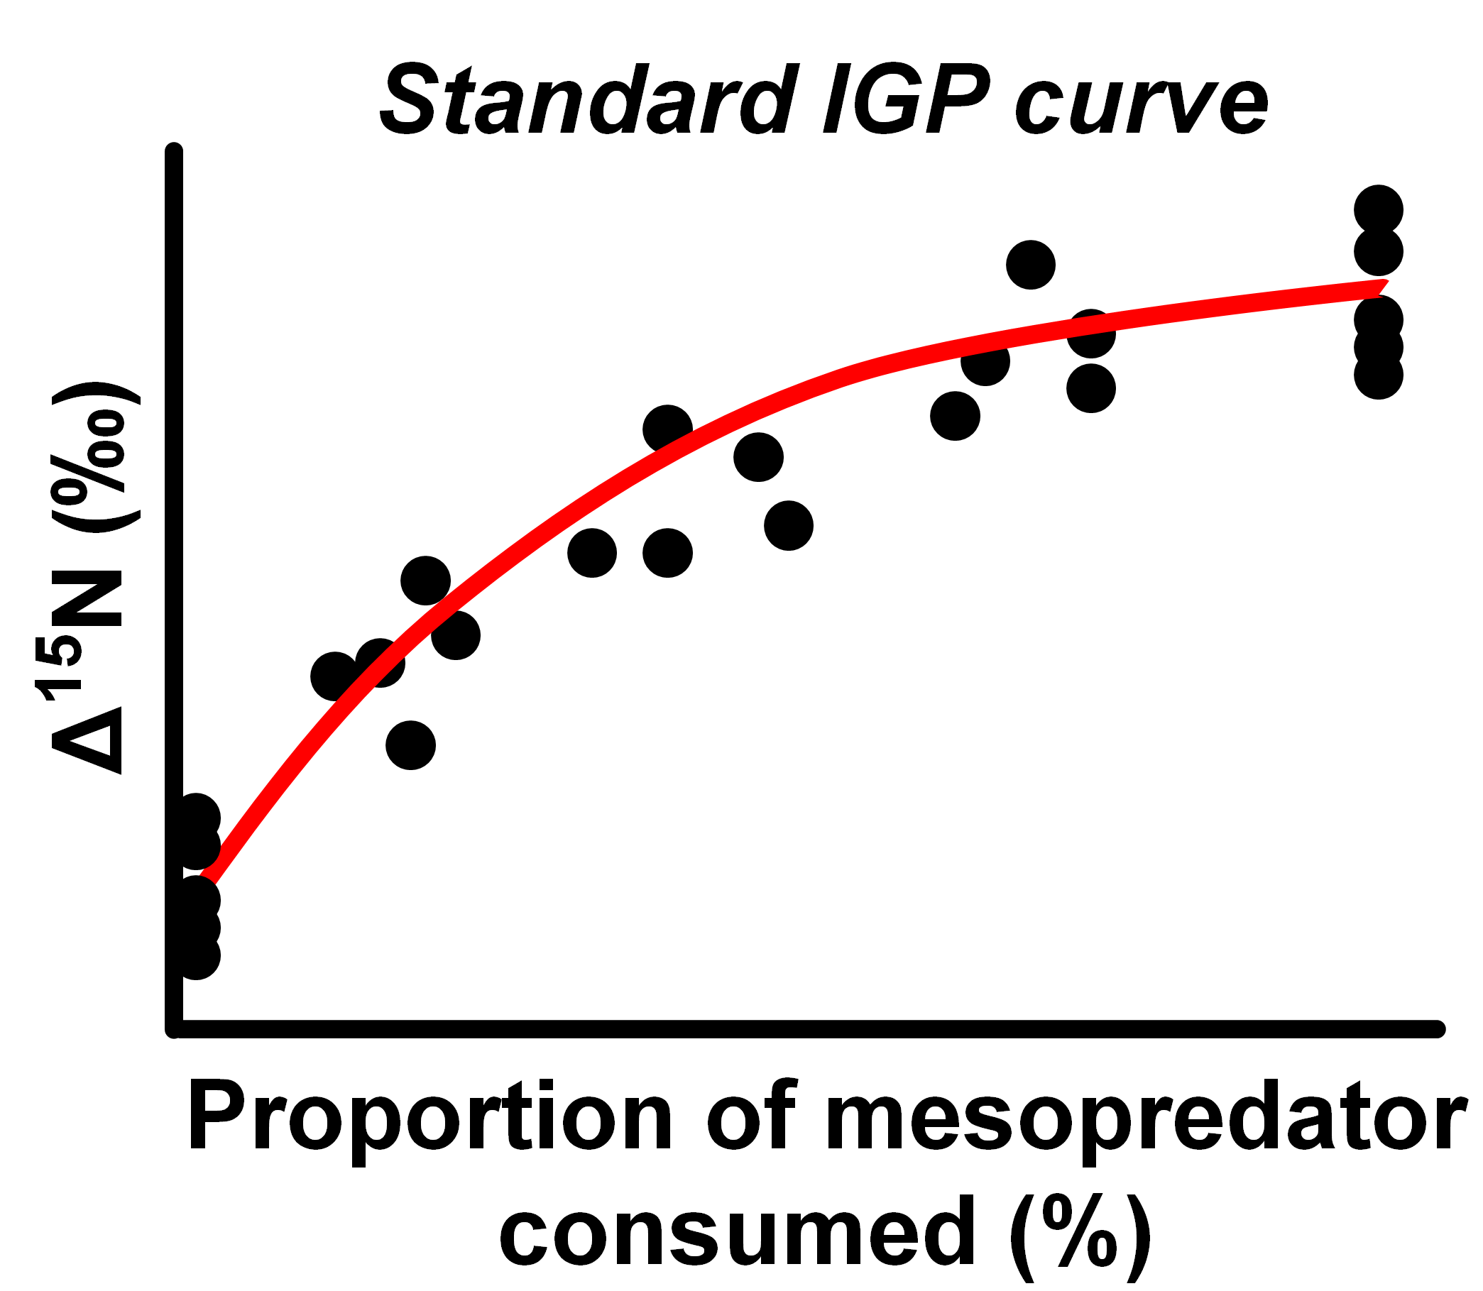
(a)
(b)
(c)
(e)
(d)
Experimental
Experimental

Slide 7
Diet treatment
N | 20/0 | 15/5 | 10/10 | 5/15 | 0/20
C | 12/0 11/0 12/0 10/0 13/0 | 8/3 7/5 9/3 8/4 7/3 | 6/5 6/4 7/4 5/5 6/4 | 3/6 3/5 4/5 2/5 3/5 | 0/4 0/5 0/5 0/3 0/6
P (%) | 0 0 0 0 0 | 27.2 41.7 25.0 33.3 30.0 | 45.5 40.0 36.3 50.0 40.0 | 66.7 62.5 55.6 71.4 62.5 | 100 100 100 100 100
Δ¹⁵N (‰) | 1.0 0.8 0.9 0.9 1.0 | 1.4 1.8 1.3 1.5 1.5 | 2.2 2.1 1.7 2.2 2.0 | 2.4 2.4 2.3 2.5 2.3 | 2.9 2.7 2.7 2.6 2.8

Slide 8
Δ¹⁵N (‰)
P

Slide 9



