Slide 1

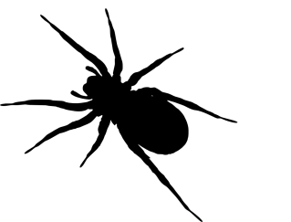
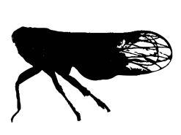
Top predator
Mesopredator
Shared prey

Slide 2
1st feeding trial
+
+

Slide 3
2nd feeding trial
+
+
+
+
+

Slide 4
Standard IGP curve
Experimental
Δ¹⁵N (‰)
Proportion of mesopredator consumed (%)

Slide 5


δ¹⁵N (‰)
Empirical
Δ¹⁵N
Experimental
Δ¹⁵N (‰)
¯
P ± SE
P₁
P₂
P₃
Proportion (%)

Slide 6
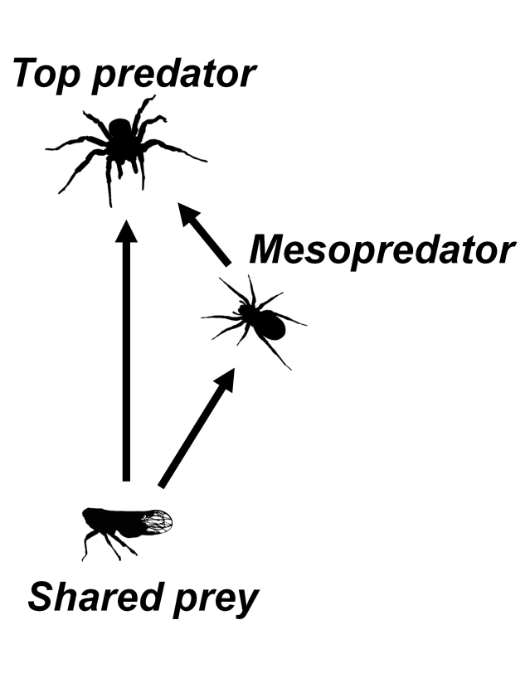
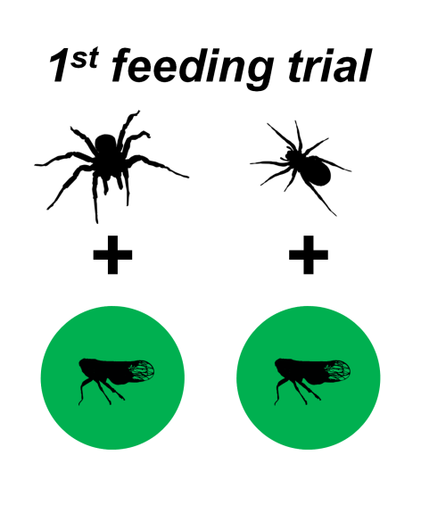
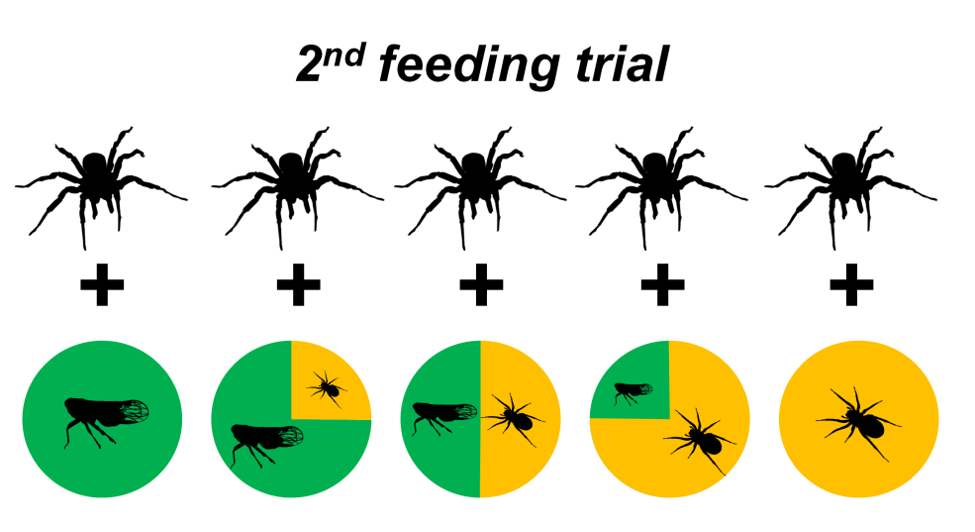
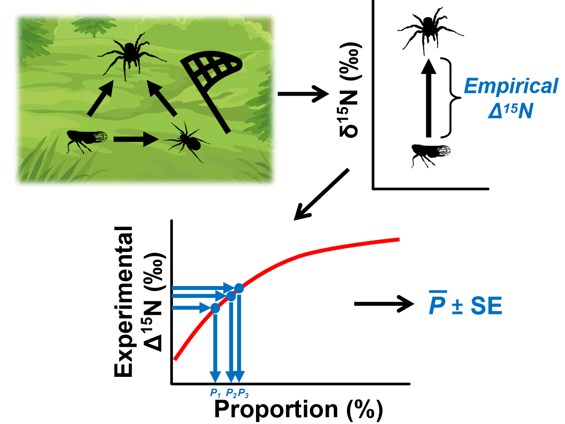
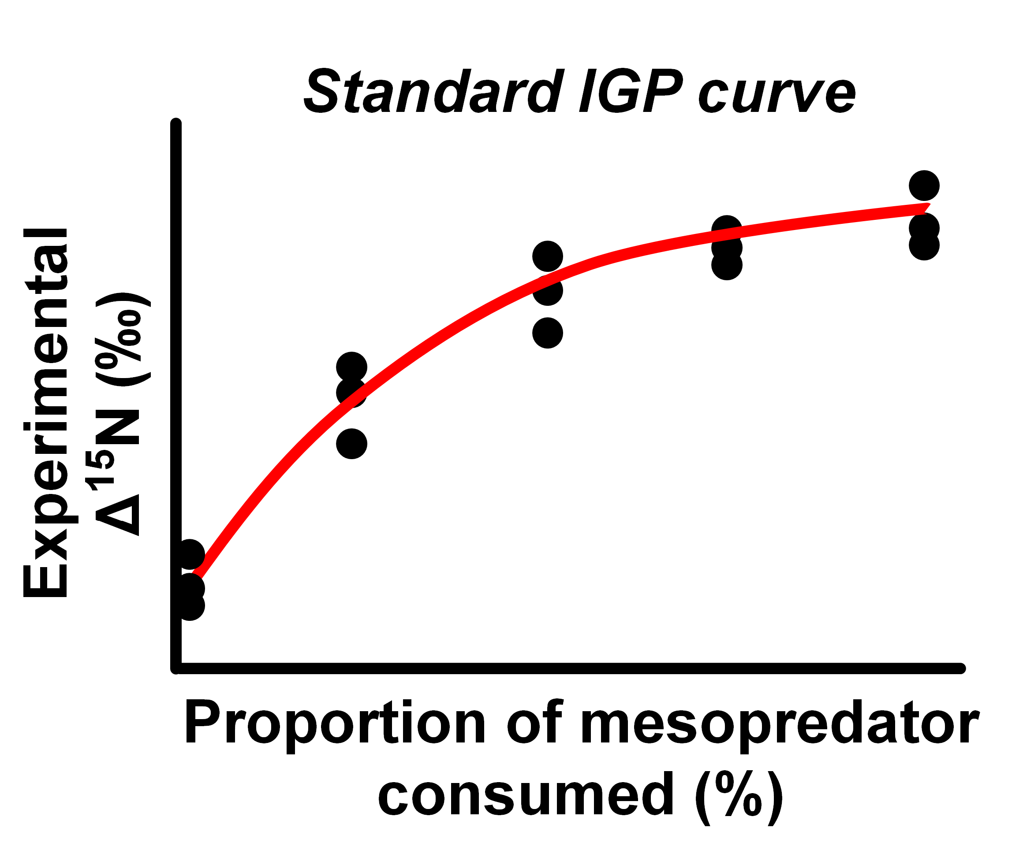
(a)
(b)
(c)
(e)
(d)

Slide 7
Diet treatment
N | 12/0 | 9/3 | 6/6 | 3/9 | 0/12
P | 0.00 | 0.25 | 0.50 | 0.75 | 1.00
Δ¹⁵N (‰) | 1.0 0.8 0.9 0.9 1.0 | 1.4 1.8 1.3 1.5 1.5 | 2.2 2.1 1.7 2.2 2.0 | 2.4 2.4 2.3 2.5 2.3 | 2.9 2.7 2.7 2.6 2.8

Slide 8
Δ¹⁵N (‰)
3
2
1
0
0
0.25
0.5
0.75
1
P

Slide 9
Predator ID | δ¹⁵N | Δ¹⁵N | P
1 | 3.5 | 1.5 | 0.24
2 | 3.2 | 1.2 | 0.15
3 | 3.3 | 1.3 | 0.21
. . .
20 | 3.3 | 1.3 | 0.21
¯
P ± SE

Slide 10
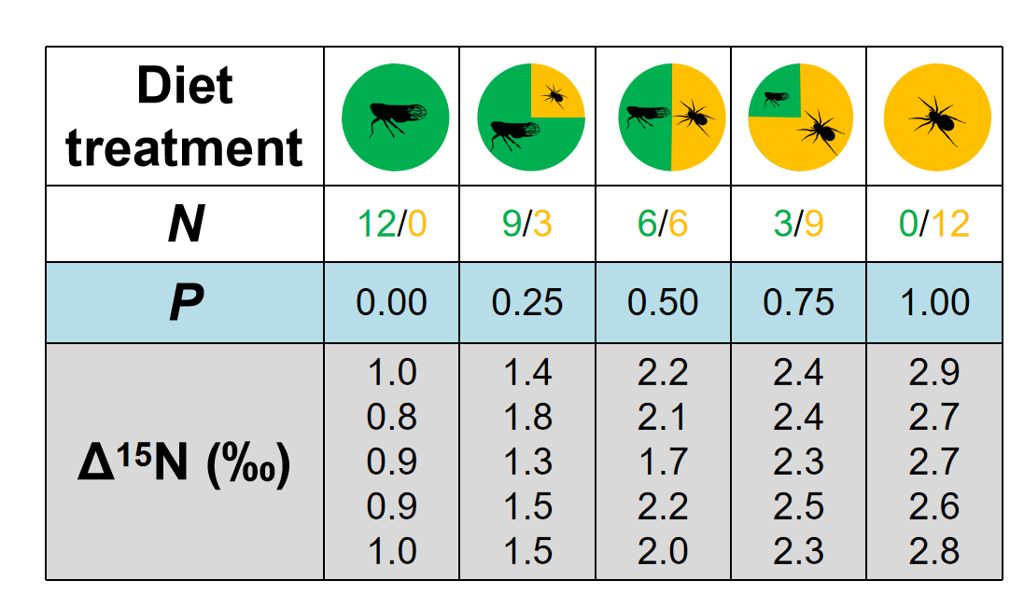
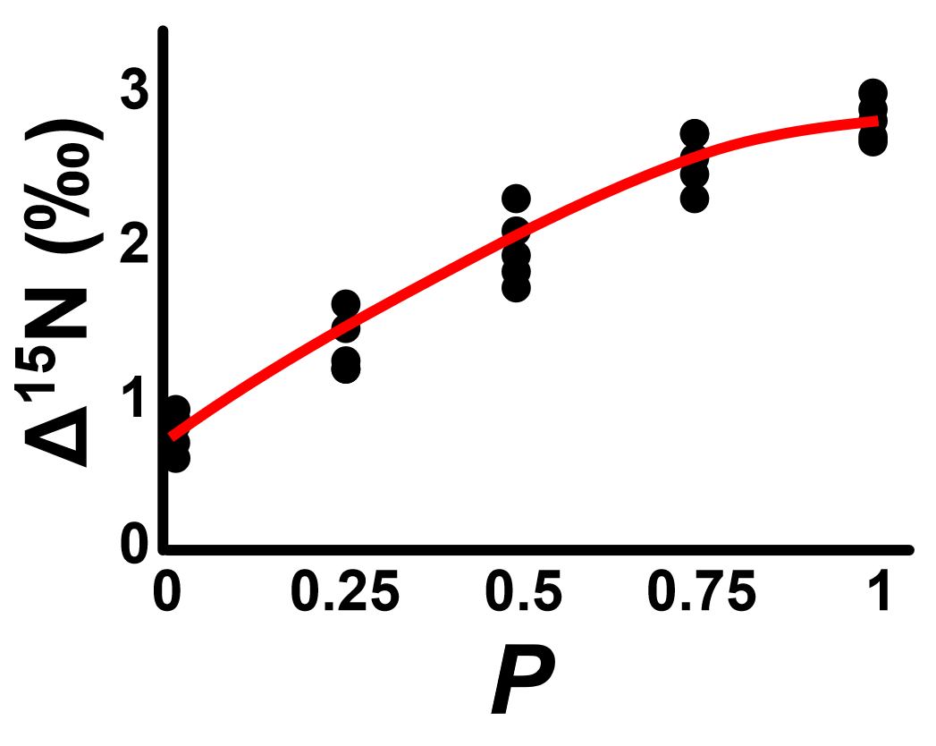
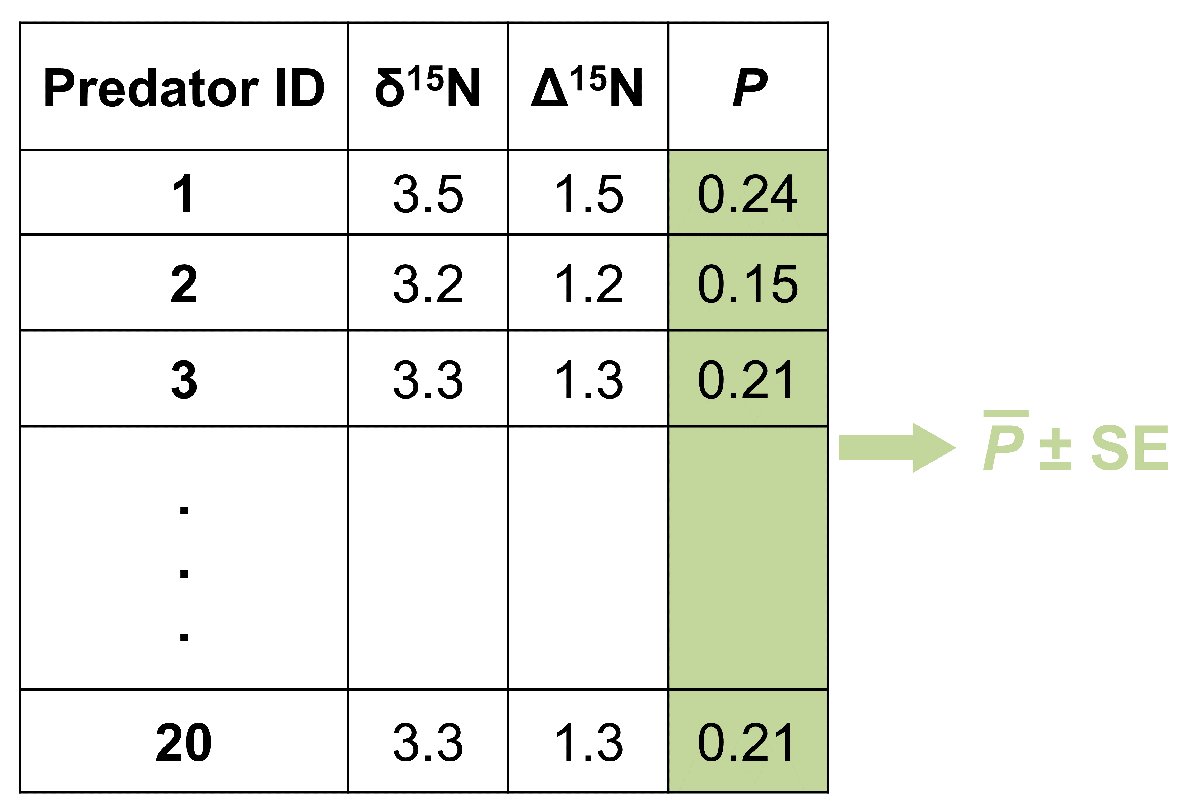
(a)
(b)
n_{predator} = 20
n_{prey} = 30
(pooled δ¹⁵N = 2.0)

