Slide 1
Farms, crop stages, sample with sweep nets, arthropod predator and prey, capsule preparation and SIMM, infer pest consumption by predators

Slide 2
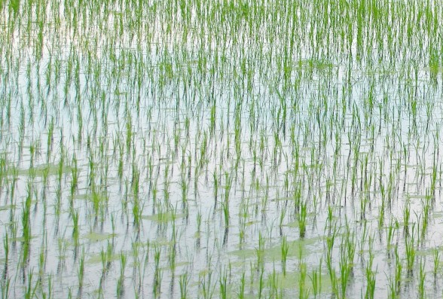
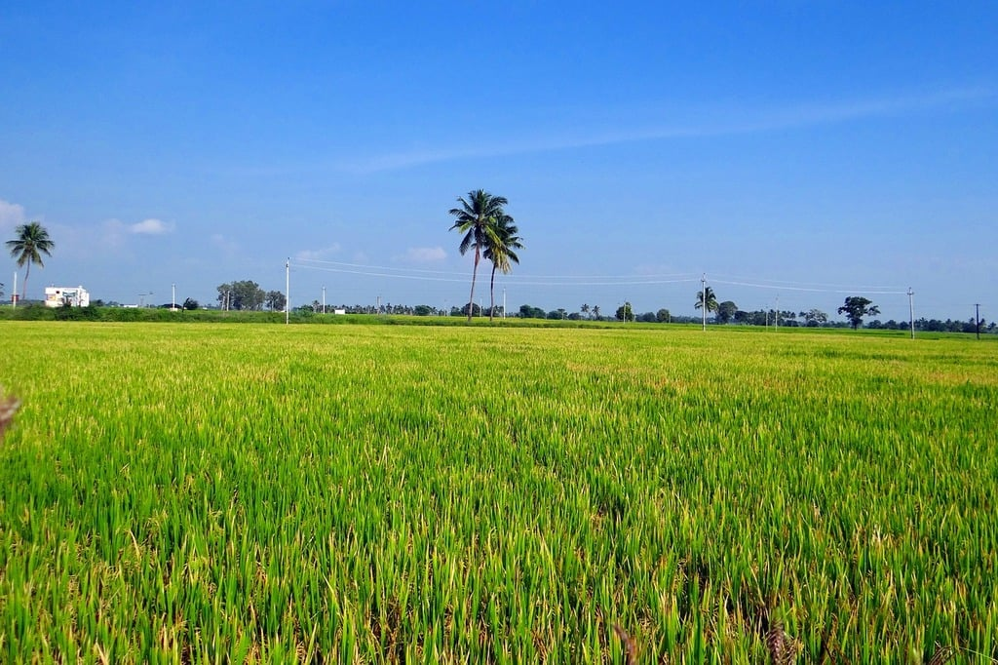
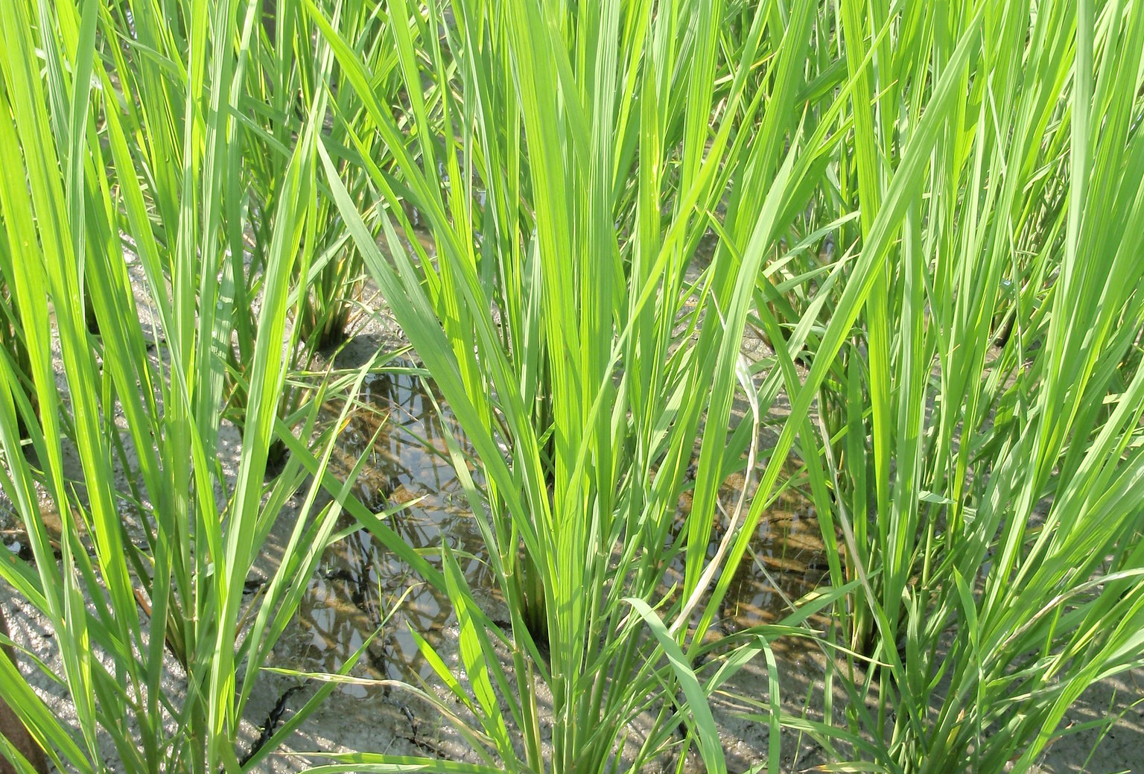
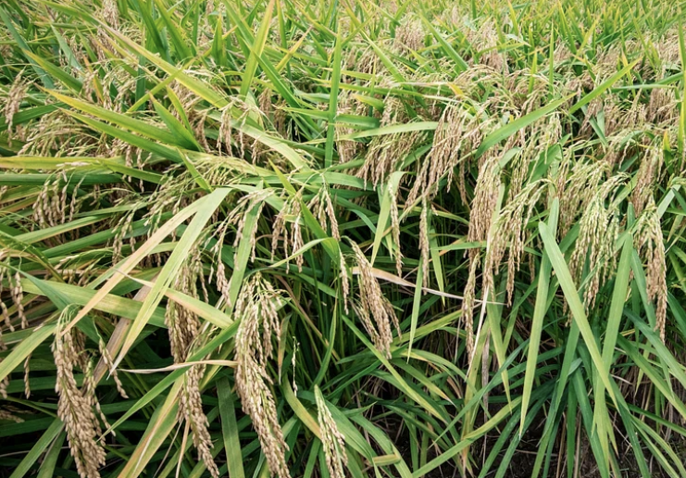

Slide 3
seedling stage: https://pxhere.com/en/photo/630261
flowering stage: https://timelessmoon.getarchive.net/amp/media/rice-fields-gangavati-karnataka-nature-landscapes-067a1a
Ripening stage: https://www.rawpixel.com/image/3260149/free-photo-image-rice-field-464-conservation-practice
tillering stage: https://www.flickr.com/photos/ricephotos/4687305339/in/photostream/

