Slide 1
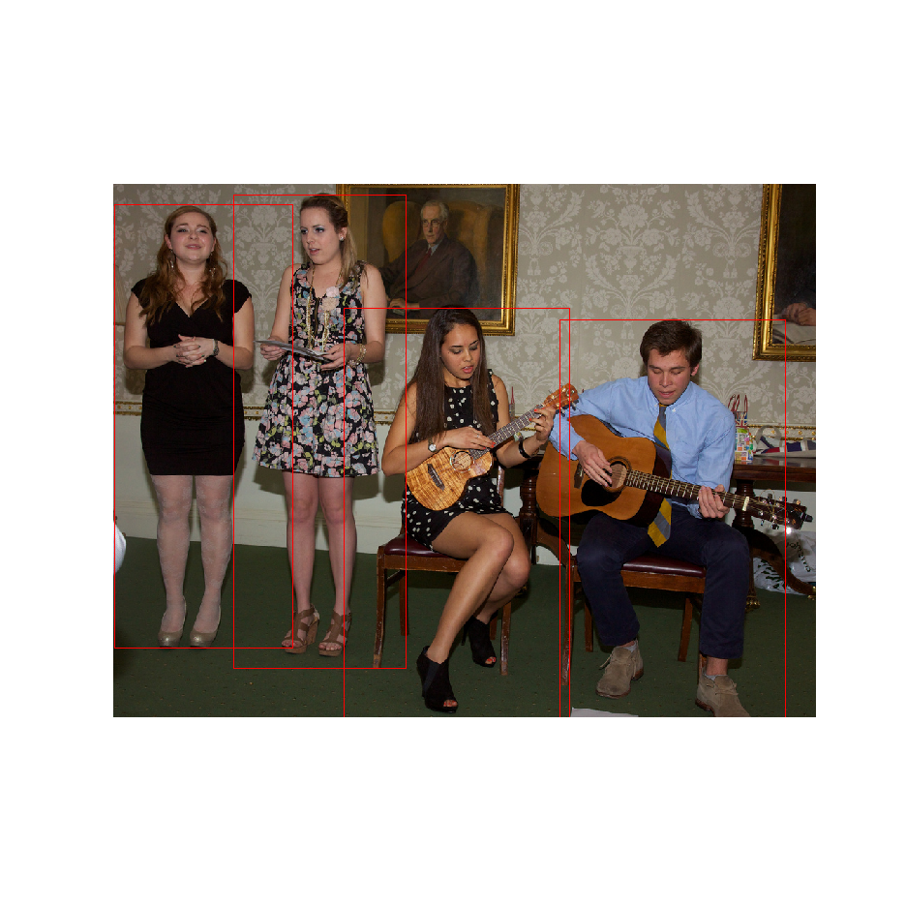
friends
friends
band members
friends

Slide 2
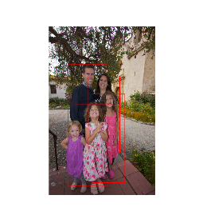
father_child
CNN
GRU
lovers/spouses
mother_child

