Slide 1
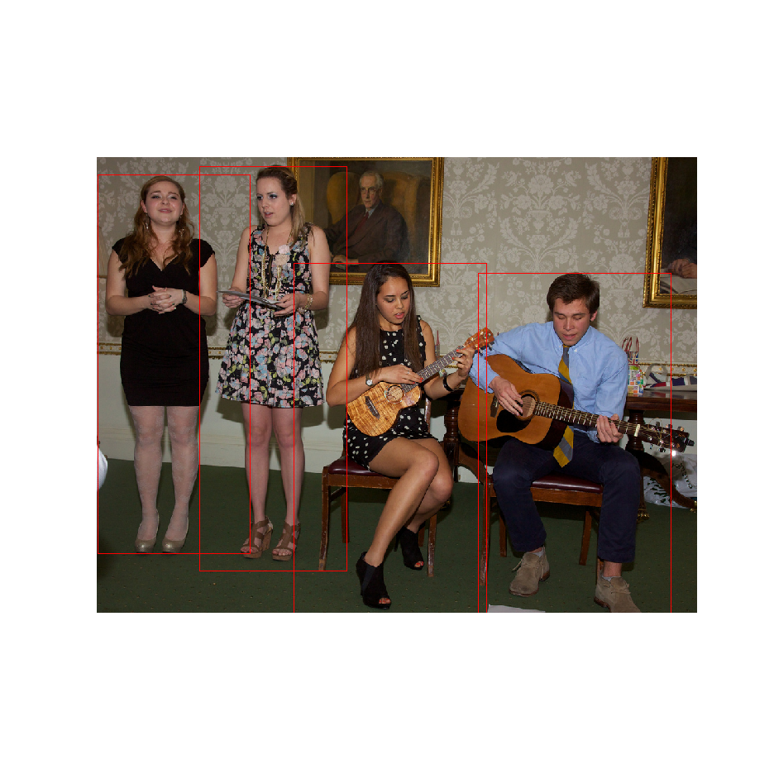
friends
friends
band members
friends

Slide 2
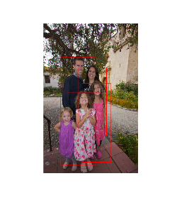
father_child
CNN
GRU
lovers/spouses
mother_child

Slide 3
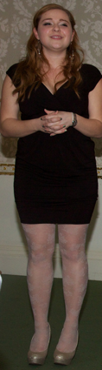
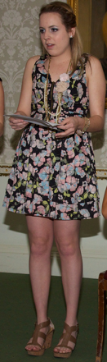
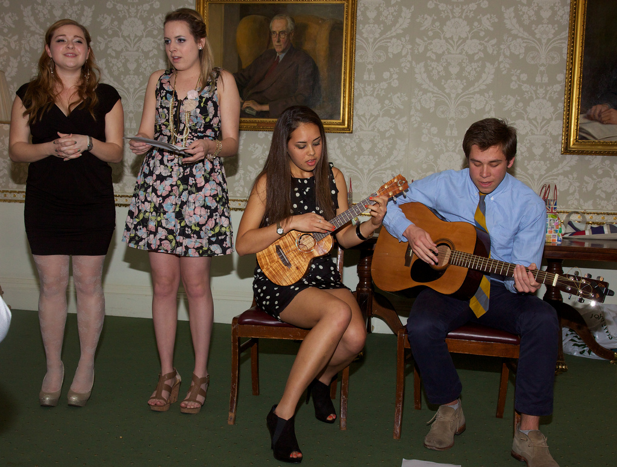
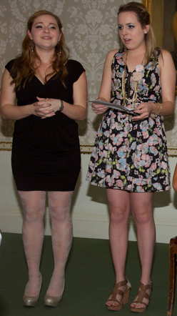
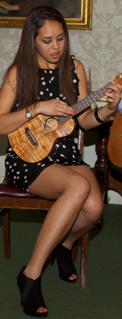
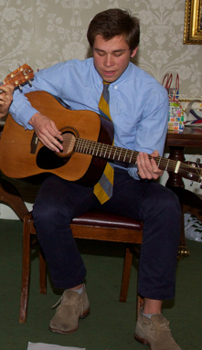
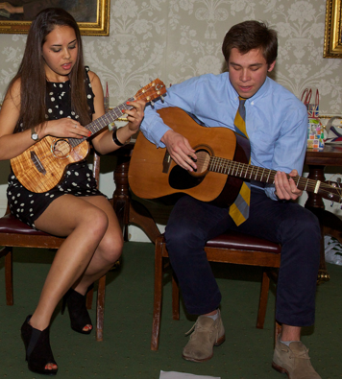
b₁
b₂
P₁
CNN
relationship message pooling
P₂
CNN
P_{u12}
CNN
T = 1
T = 2
T = N
friends
GRU
GRU
message
passing
GRU
. . .
GRU
b₃
b₄
GRU
input
band members
relationship
message
pooling
P₃
CNN
P₄
CNN
P_{u34}
CNN
Feature Extraction Module
Feature Passing Module
Feature Pooling Module
Feature Passing Module
Feature Passing Module
Results

Slide 4
b₁
b₂
P₁
CNN
Message Pooling Module
P₂
CNN
P_{u12}
T = 0
T = 1
T = 2
T = N
friends
CNN
message
passing
message
passing
GRU
GRU
GRU
. . .
GRU
b₃
b₄
band members
P₃
CNN
relationship
message
pooling
P₄
CNN
P_{u34}
CNN
relationship message pooling
Feature Extraction Module
Message Passing Module
Results

