Slide 1
Network Management Operations (nmop) WG Jointly with TEAS WG
June 04, 2024
This session is being recorded
Internet Engineering Task Force
© 2024 IETF Trust
Production by Meetecho

Slide 2
Note Well
This is a reminder of IETF policies in effect on various topics such as patents or code of conduct. It is only meant to point you in the right direction. Exceptions may apply. The IETF's patent policy and the definition of an IETF "contribution" and "participation" are set forth in BCP 79; please read it carefully.
As a reminder:
By participating in the IETF, you agree to follow IETF processes and policies.
If you are aware that any IETF contribution is covered by patents or patent applications that are owned or controlled by you or your sponsor, you must disclose that fact, or not participate in the discussion.
As a participant in or attendee to any IETF activity you acknowledge that written, audio, video, and photographic records of meetings may be made public.
Personal information that you provide to IETF will be handled in accordance with the IETF Privacy Statement.
As a participant or attendee, you agree to work respectfully with other participants; please contact the ombudsteam (https://www.ietf.org/contact/ombudsteam/) if you have questions or concerns about this.
Definitive information is in the documents listed below and other IETF BCPs. For advice, please talk to WG chairs or ADs:
BCP 9 (Internet Standards Process)
BCP 25 (Working Group processes)
BCP 25 (Anti-Harassment Procedures)
BCP 54 (Code of Conduct)
BCP 78 (Copyright)
BCP 79 (Patents, Participation)
https://www.ietf.org/privacy-policy/(Privacy Policy)

Slide 3
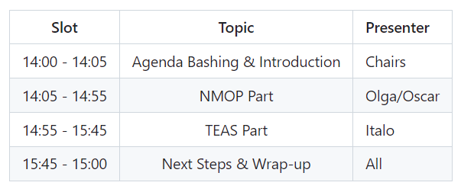
Agenda

Slide 4
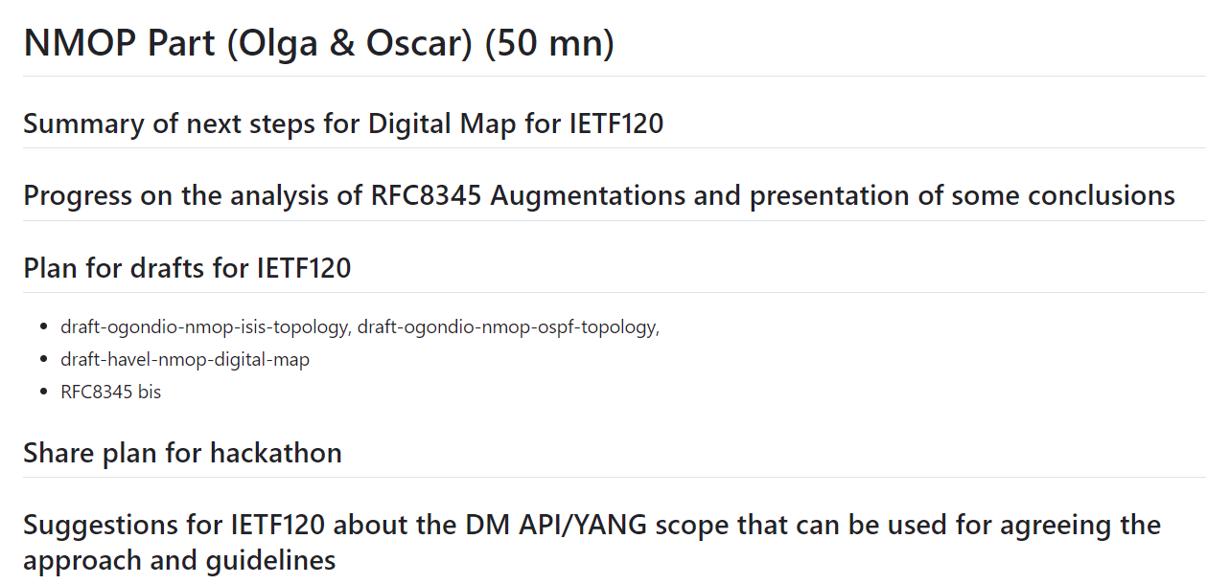
Part I

Slide 5
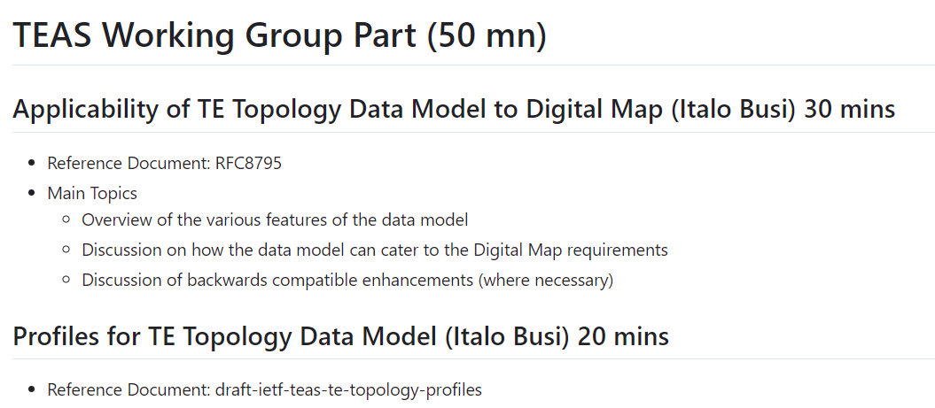
Part II

Slide 6
Spread the Word
Informed Routing ADs about this work
Original work was done in I2RS
Contacted all authors of RFC-8345 to inform them about this effort, invite them to join the discussion and indicate willingness to contribute to whatever plan will be agreed upon here in NMOP
Received positive support from Naitin (but no availability to contribute)

Slide 7
Experiments & Running Code
Bring your code
Propose hackathons
Run competing experiments
Suggest use cases
Challenge claimed issues

Slide 8
Next Steps

