Slide 1
Network Management Operations (nmop) WG
July 26, 2024
This session is being recorded
Internet Engineering Task Force
© 2024 IETF Trust
Production by Meetecho

Slide 2
Note Well
This is a reminder of IETF policies in effect on various topics such as patents or code of conduct. It is only meant to point you in the right direction. Exceptions may apply. The IETF's patent policy and the definition of an IETF "contribution" and "participation" are set forth in BCP 79; please read it carefully.
As a reminder:
By participating in the IETF, you agree to follow IETF processes and policies.
If you are aware that any IETF contribution is covered by patents or patent applications that are owned or controlled by you or your sponsor, you must disclose that fact, or not participate in the discussion.
As a participant in or attendee to any IETF activity you acknowledge that written, audio, video, and photographic records of meetings may be made public.
Personal information that you provide to IETF will be handled in accordance with the IETF Privacy Statement.
As a participant or attendee, you agree to work respectfully with other participants; please contact the ombudsteam (https://www.ietf.org/contact/ombudsteam/) if you have questions or concerns about this.
Definitive information is in the documents listed below and other IETF BCPs. For advice, please talk to WG chairs or ADs:
BCP 9 (Internet Standards Process)
BCP 25 (Working Group processes)
BCP 25 (Anti-Harassment Procedures)
BCP 54 (Code of Conduct)
BCP 78 (Copyright)
BCP 79 (Patents, Participation)
https://www.ietf.org/privacy-policy/(Privacy Policy)

Slide 3
Note Really Well
IETF meetings, virtual meetings, and mailing lists are intended for professional collaboration and networking, as defined in the IETF Guidelines for Conduct (RFC 7154), the IETF Anti-Harassment Policy, and the IETF Anti-Harassment Procedures (RFC 7776). If you have any concerns about observed behavior, please talk to the Ombudsteam, who are available if you need confidentiality to raise concerns confident about harassment or other conduct in the IETF.
The IETF strives to create and maintain an environment in which people of many different backgrounds and identities are treated with dignity, decency, and respect. Those who participate in the IETF are expected to behave according to professional standards and demonstrate appropriate workplace behavior.
IETF participants must not engage in harassment while at IETF meetings, virtual meetings, social events, or on mailing lists. Harassment is unwelcome hostile or intimidating behavior—in particular, speech or behavior that is aggressive or intimidates.
If you believe you have been harassed, notice that someone else is being harassed, or have any other concerns, you are encouraged to raise your concern in confidence with one of the Ombudspersons.

Slide 4
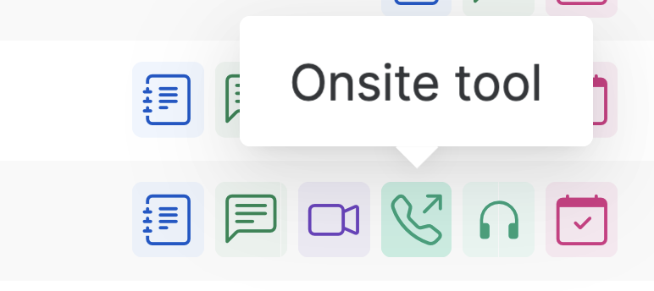
IETF 120 Meeting Tips
This session is being recorded
In-person participants
Make sure to sign into the session via Datatracker or the QR Code in this session.
Use Meetecho (usually the “Meetecho lite”) client to:
join the mic queue
participate in shows of hands
Keep audio and video off if not using the onsite version.
Remote participants
Make sure your audio and video are off unless you are chairing or presenting during a session.
Use of a headset is strongly recommended.

Slide 5
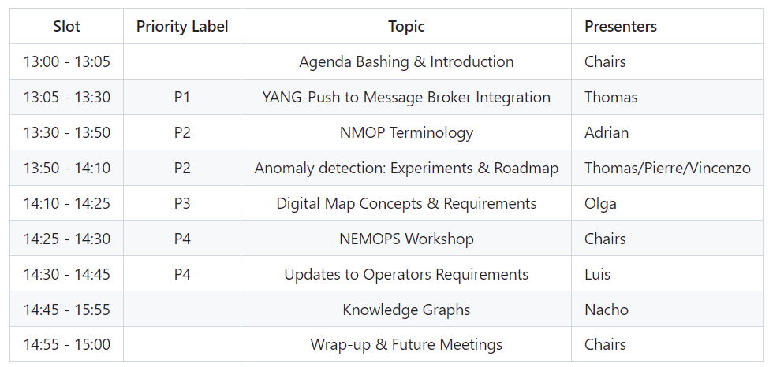
Agenda

Slide 6
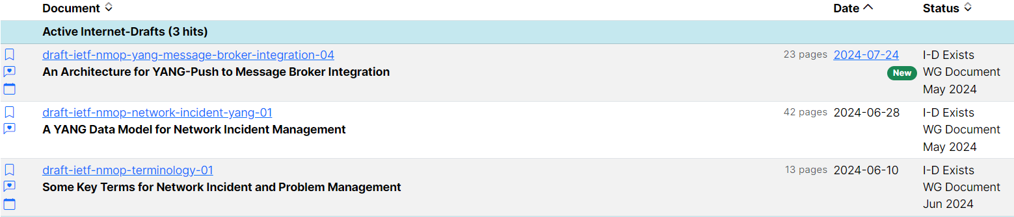
Documents Status
On the agenda

Slide 7
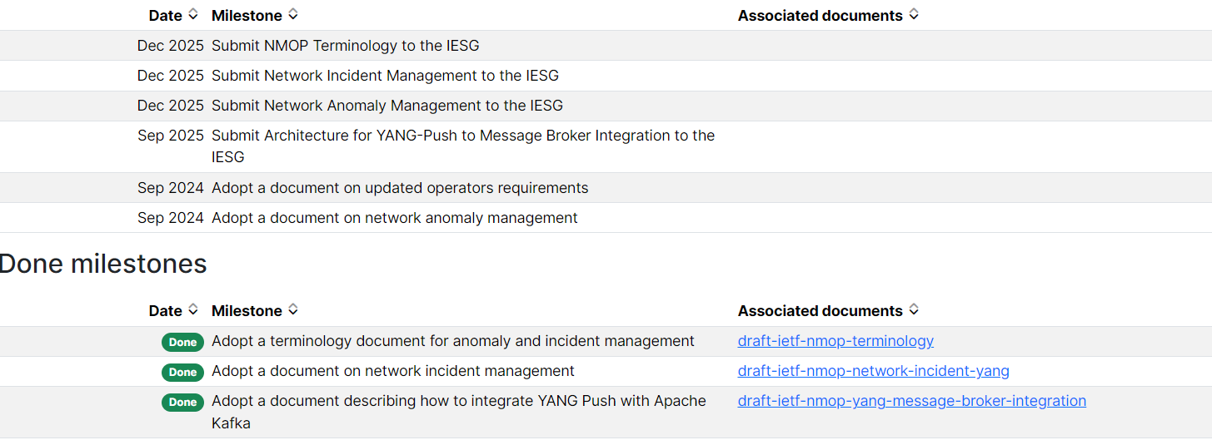
Milestones
A plan will be discussed during this session

Slide 8
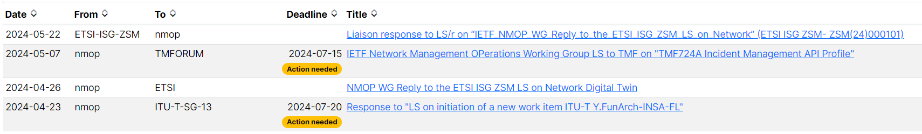
Liaison Statements
Pending APs:
Follow-up with TMF
Authors of terminology to assess/raise any terminology misalignment
Authors of incident management to check the objects mapping, in particular

Slide 9
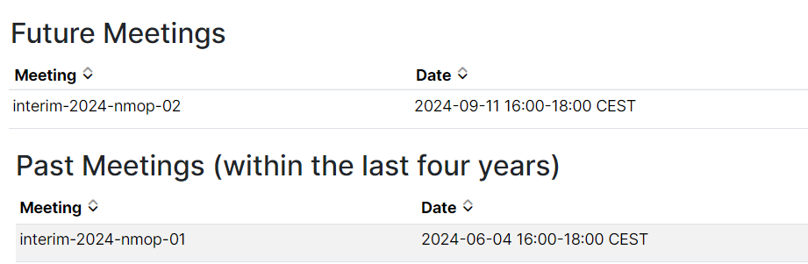
Interim Meetings: Past & Future
Anomaly detection
Digital Map
An additional interim is likely to be scheduled before IETF#121 (likely on Digital Map)
Drop us an email if you have comments/suggestions about interims

Slide 10
IETF#120 Hackathons
Validate Configured Subscription YANG-Push Publisher Implementations
Antagonist (ANomaly TAGging ON hISTorical data)
Digital Map for ISIS and OSPF
Implement find relationship solution with Augmented-by list in ietf-yang-library
Three of current WG’s priorities are covered by hackathons, with on site participants
Big thanks to all champions for their dedication and reporting to the WG!
@all: Feel free to reach out the teams or propose new experiments

Slide 11
Misc.
Open Mic (if time permits)

Slide 12
Appendix: Session Goals

Slide 13
Initial WG Priorities: Reminder
The current topics of focus for the working group are:
NETCONF/YANG Push integration with Apache Kafka & time series databases (P1)
Anomaly detection (P2.A) and incident management (P2.B)
Issues related to deployment/usage of YANG topology modules (e.g., to model a Digital Map) (P3)
Consider/plan an approach for updating RFC 3535-bis (collecting updated operator requirements for IETF network management solutions) (P4)
IETF#120:
Covered by Hackathons, with on site participants

Slide 14
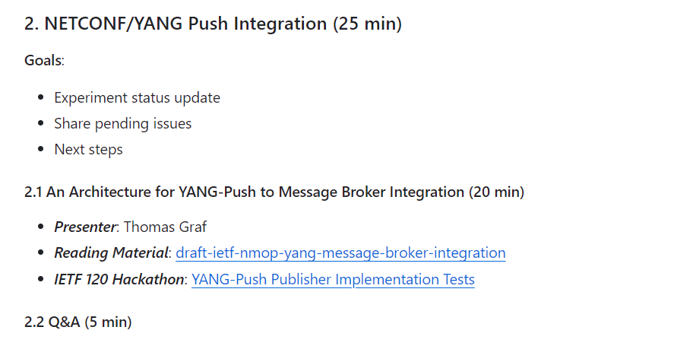
Priority I

Slide 15
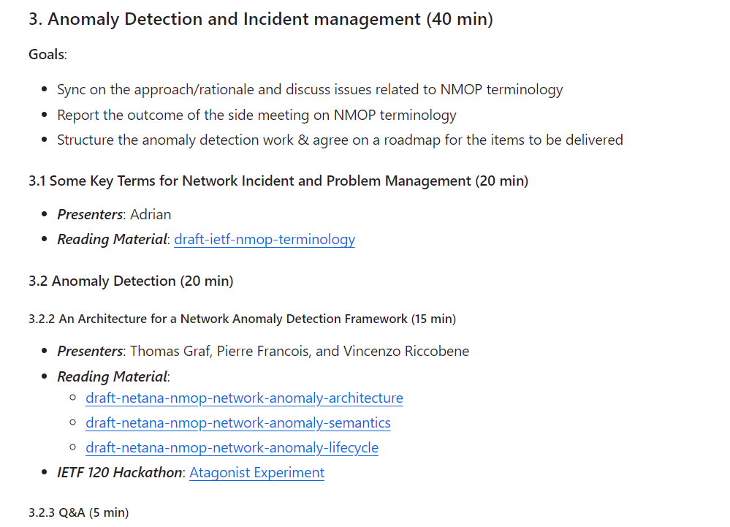
Priority II.B

Slide 16
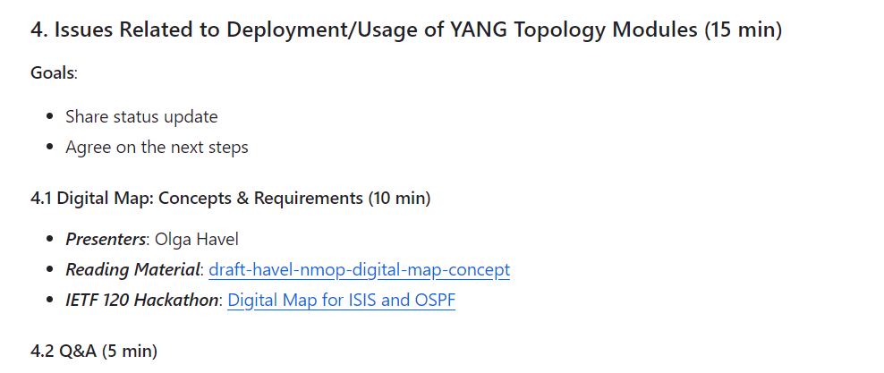
Priority III

Slide 17
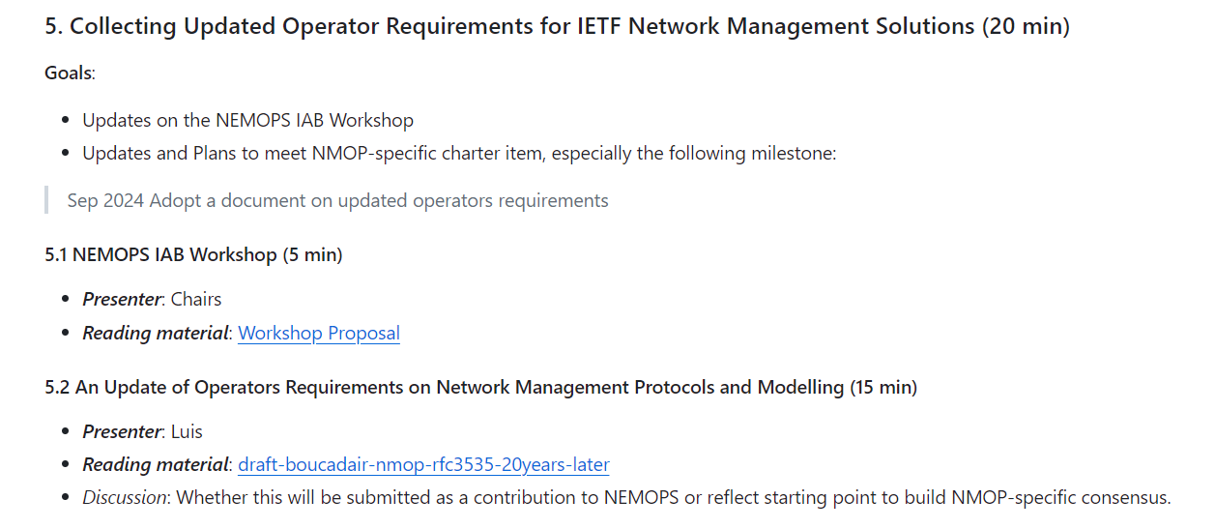
Priority IV

Slide 18
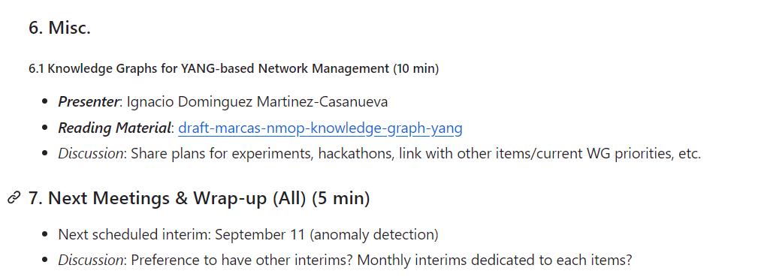
Misc.

