Slide 1
An Update of Operators Requirements on Network Management Protocols and Modelling draft-boucadair-nmop-rfc3535-20years-later
IETF#120, Brisbane
July 2024
Mohamed Boucadair (Orange), Luis M. Contreras (Telefonica),
Óscar Gonzalez de Dios (Telefonica), Thomas Graf (Swisscom),
Reshad Rahman (Equinix)

Slide 2
Why This I-D? (A Reminder)
RFC 3535 was instrumental in structuring and guiding network management effort within the IETF
Catalyst for NETCONF/YANG
More than 20 years after RFC 3535
Despite
Many protocols were specified (NETCONF/RESTCONF/COMI)
YANG is more and more perceived as a transport independent modeling language
Network automation is a trivial enabler in operations
There is a need for
Deployment reality check
Refreshing the deployment assumptions
Checking whether new requirements on network management operations are emerging from the operators
Assessing whether there are blocking points

Slide 3
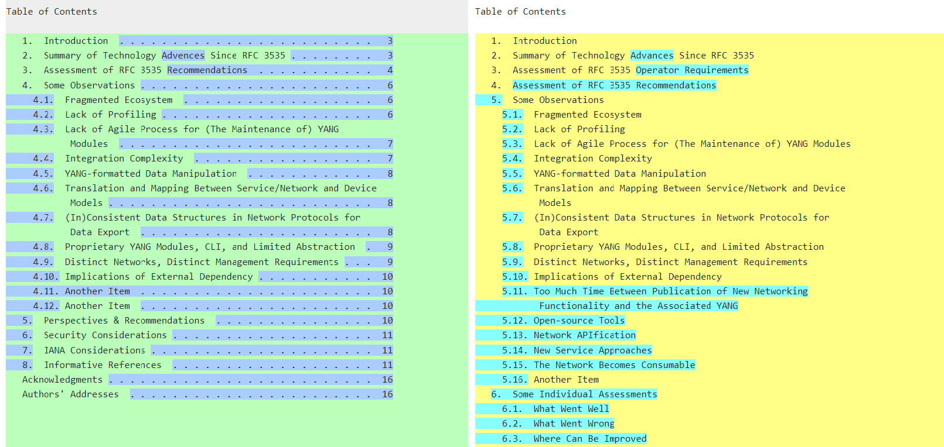
Main Changes Since IETF#119
NEW

Slide 4
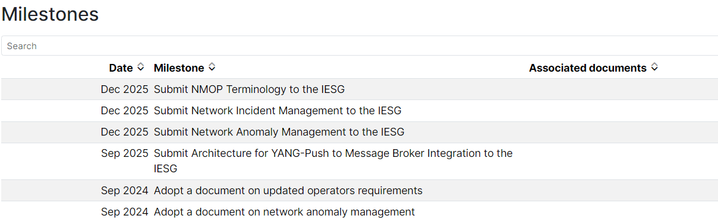
Work Item/Milestone
The current topics of focus for the working group are:
NETCONF/YANG Push integration with Apache Kafka & time series databases
Anomaly detection and incident management
Issues related to deployment/usage of YANG topology modules (e.g., to model a Digital Map)
Consider/plan an approach for updating RFC 3535-bis (collecting updated operator requirements for IETF network management solutions)
Excerpt from the NMOP Charter

Slide 5
What’s Next?
The WG coordinates with the IAB to organize NEMOPS Workshop with the hope to collect inputs from a wider operators’ community (noy only those participating to the IETF)
A workshop report will be published by the IAB
That report does not reflect IETF consensus
Options for discussion
#1: Submit draft-boucadair-nmop-rfc3535-20years-later as an individual contribution to NEMOPS
#2: Maintain an NMOP document that reflects the WG consensus
#1 seems reasonable for the long-term transformations
However, #2 seems more appropriate for IETF-specific adjustments (e.g., new YANG publication process)
How should we proceed? #1, #2, or both?

Slide 6
Appendix

Slide 7
Sample Observations
The current YANG device models ecosystem is fragmented
IETF, OpenConfig, ONF, etc.
Unlike service and network models, IETF-defined device models are not widely implemented
It is takes too long to produce device models in the IETF; with many functions not even available: many specs were abandoned
The rule seems even to be the prevalence of proprietary YANG Modules, CLI, and limited abstraction
Many NETCONF-related tools are (being) specified by the IETF, but these tools are not widely supported (e.g., Push vs. gNMI)
Lack of agile process for (the maintenance of) YANG modules
Integration complexity
YANG-formatted data manipulation
Some networks have specific network management requirements such as the need for asynchronous operations or constraints on data compactness
Translation and mapping between service/network and device models
Inconsistent data structures in network protocols for data export
Etc.

Slide 8
Candidate Direction of Work
Rationalize device models space and avoid redundant efforts
Clear guidance for the development of device models in the IETF
More agile process for developing YANG modules
More Profiling
E.g., A profile with a set of recommendations about core/key NETCONF/RESTCONF features with the appropriate justification will help the emergence of more implementations that meet the operators’ needs
YANG profiles
Reassess the value of some IETF proposals vs. competing/emerging solutions would be useful (e.g., gRPC vs. YANG-Push)

