Slide 1
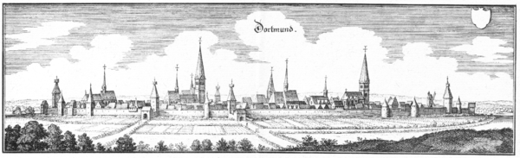



Grid – Introduction
ATLAS-D Physics Meeting Dortmund 2017
Dr. Gen Kawamura
II.Physikalisches Institut, Universität Göttingen

Slide 2
Overview (30mins)
Introduction to ATLAS Grid computing
  Concepts
  Certificate Authorities and VOMS
  ATLAS Grid computing & WLCG Resources
  Grid job and data
  Grid user interface (CLI) and CVMFS
PanDA (ATLAS job management system)
ATLAS Metadata Interface (AMI)
Rucio (ATLAS data management system)
  Rucio basic concept
  RSE expressions
Links ad references
Bakckup
  ATLAS Resources
  Job allocation (a tip)

Slide 3
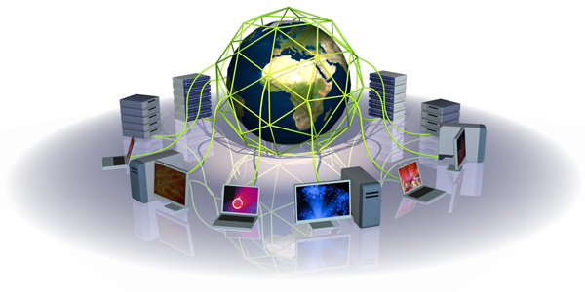
Introduction to ATLAS Grid Computing

Slide 4
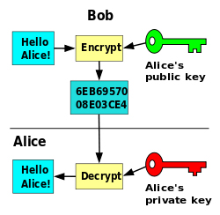
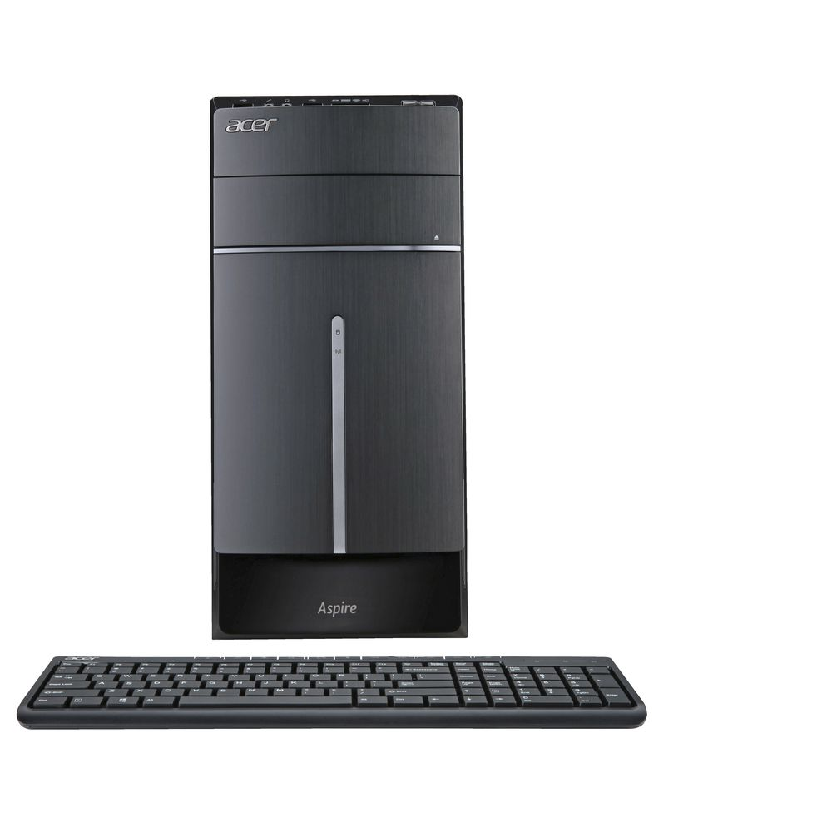
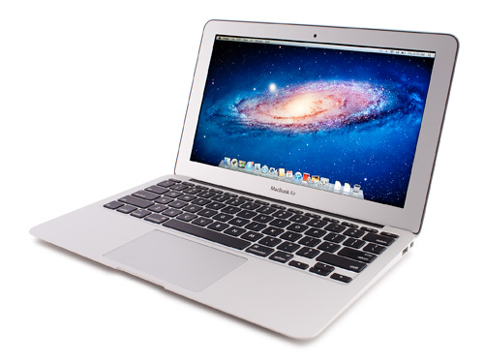
Concepts - 1
How it works (if without Grid)
  A simplest way → Only PKI by openssl
$ scp my_analysis.exe computer01:~/
$ ssh computer01 “~/myprogram.exe run 01”
$ scp computer01:output01.tgz ./output01.tgz
$ scp output01.tgz storage02:output01.tgz
Computation
Storage
my_analysis.exe
1. COPY
2. RUN
3. DOWNLOAD
output01.tgz
4. STORE

Slide 5
Concepts - 2
How it works (with Grid)
  Need of basic stuffs
    Security policy based on PKI
    Working with many users (physicists)
    Recognition of users in affiliation, organization and experiment
    Control of Job allocation
    Control of storage space allocation and data replication
    Control among geographically distributed computers
    Interface of local computing infrastructures
    Tree-like information search for computing clusters
      E.g. like Domain Name Server
    End user tools to make life easy

Slide 6
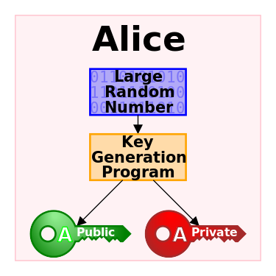

Concepts - 3
Then, hierarchical signatures
CA1
Sign
CA2
Sign
My X509 Certificate
= Grid user certificate

Slide 7
Concepts - 4
Generating a new certificate = proxy certificate
Proxy certificate (with limited validity)
Verifiable
CA1
Sign
Generating primary numbers + Signed by you + PK
CA2
Sign
My X509 Certificate
= Grid user certificate

Slide 8

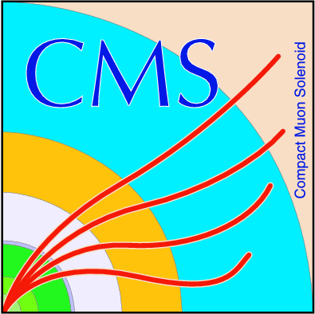
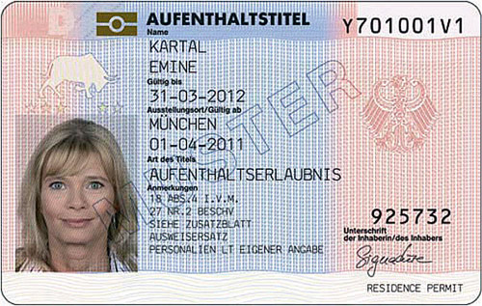


Concepts - 5
Virtual Organization (VO), VOMS
  VOMS extends a certificate with a VO
VOs
Certificate Authority
VOMS server
Requesting VO
voms-proy-init
Sign
ATLAS VOMS
CMS VOMS
LHCb VOMS
User certificate
Sign
Obtaining VO extension
Proxy certificate
= a limited copy of your certificate

Slide 9

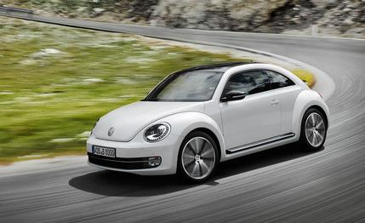
Concepts - 6
A similar analogy
  Authenticated and authorized for your tasks
Certificate Authority
Controlled
Sign
User certificate
Authentication
= who you are?
Authorization
= can enter a new land (Grid)
Sign
Proxy certificate
= a limited copy of your certificate

Slide 10
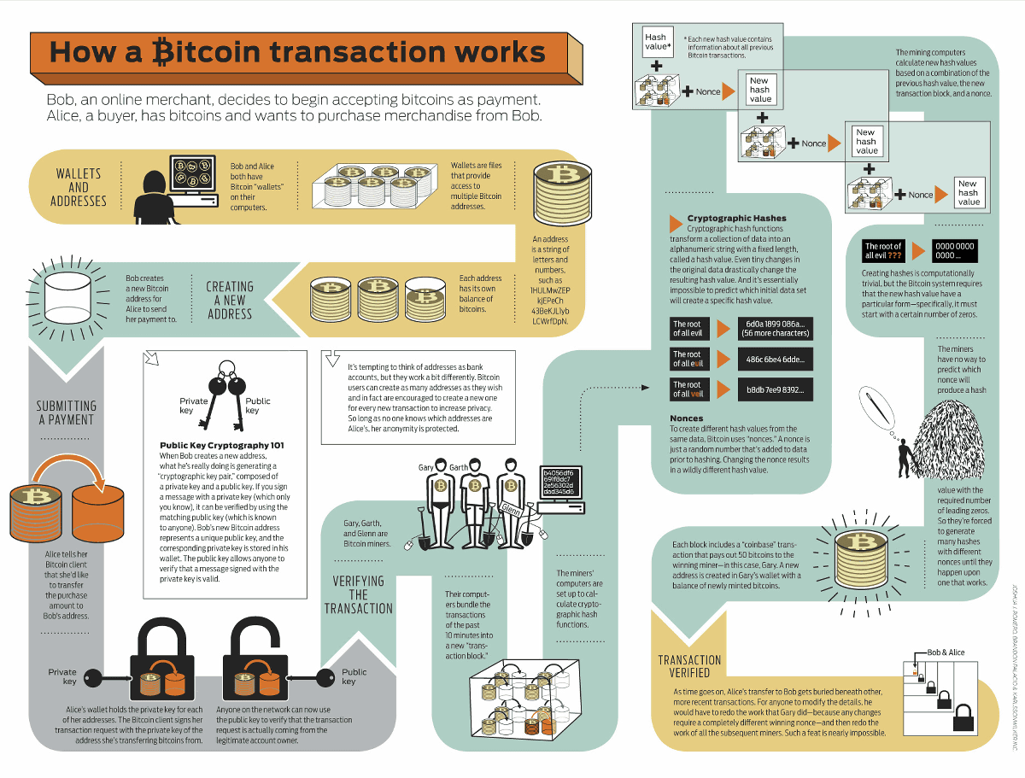
A hint
No CA, but an infinite chain of signatures
  Global digital currency = digital certificates

Slide 11
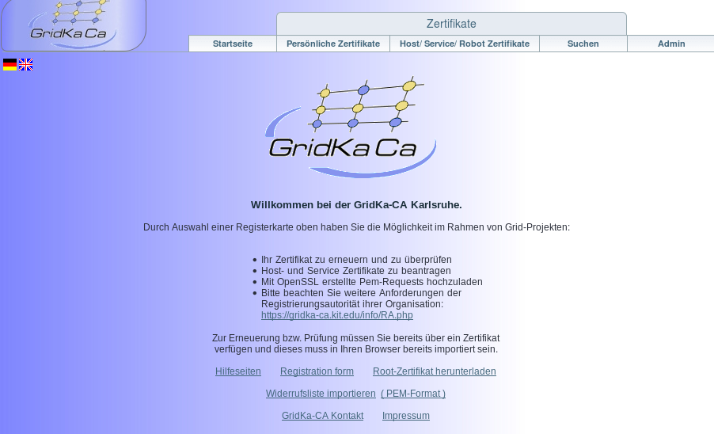
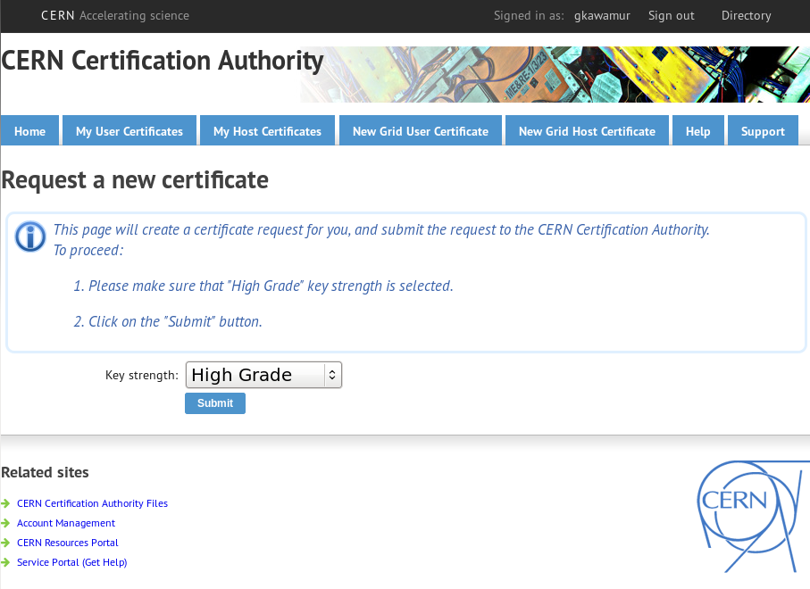
Certificate Authorities and VOMS
Germany (FZK)
  https://gridka-ca.kit.edu/
CERN
  https://ca.cern.ch/ca/user/Request.aspx?template=EE2User

Slide 12

Certificate Authorities and VOMS
VOMS top page
  https://voms2.cern.ch:8443/
VOMS ATLAS (request your ATLAS VO)
  https://voms2.cern.ch:8443/voms/atlas
VOMS ATLAS users in Germany
  https://voms2.cern.ch:8443/voms/atlas/services/VOMSCompatibility?method=getGridmapUsers&container=/atlas/de

Slide 13


ATLAS Grid job - 1
LHC multi-tier structure
      WLCG = Worldwide LHC Computing Grid
Tier-0
RAL UK
Tier-1
Tier-0: Raw data, Data store (in tape), Pre-processing, Reconstruction
FZK DE
Tier-1
Tier-1: National LCG-Centre, faster network connections and lager storage spaces (e.g. Tape), MC production, user analysis, etc.
BNL USA
Tier-1
Goe DE
Tier-2
DESY-HH DE
Tier-2
Tier-2: University or Facility level computing sites. MC production, user analysis, etc.

Slide 14
ATLAS Grid computing and WLCG resources - 1
LHC multi-tier structure
      WLCG = Worldwide LHC Computing Grid
Tier-0
RAL UK
Tier-1
Tier-0: Raw data, Data store (in tape), Pre-processing, Reconstruction
FZK DE
Tier-1
VO attribute: /atlas/de
Tier-1: National LCG-Centre, faster network connections and lager storage spaces (e.g. Tape), MC production, user analysis, etc.
BNL USA
Tier-1
Goe DE
Tier-2
DESY-HH DE
Tier-2
Tier-2: University or Facility level computing sites. MC production, user analysis, etc.
If one is from DESY-HH, can use local storage

Slide 15
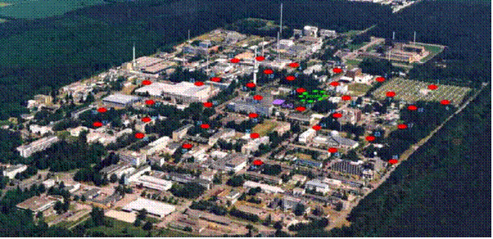


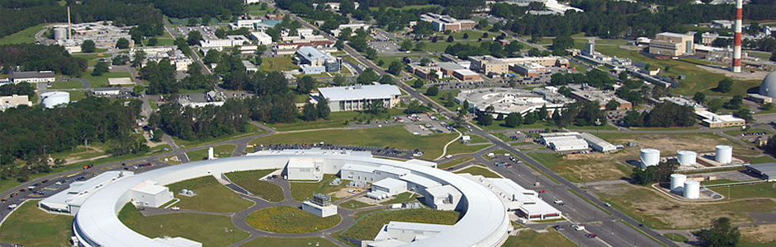

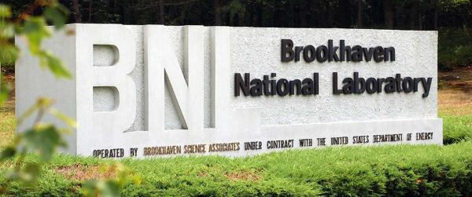
ATLAS Grid job - 1
FZK Tier-1
BNL Tier-1

Slide 16
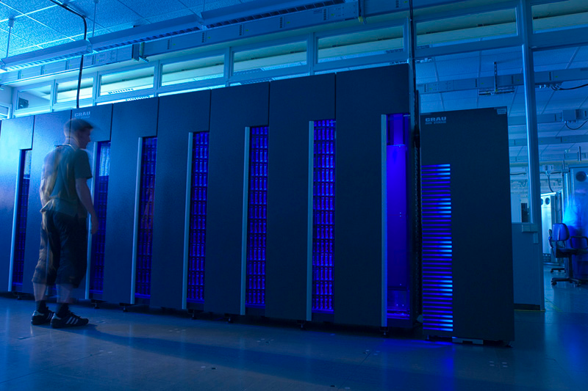
ATLAS Grid job - 1
FZK Tier-1
Job queue endpoint
Computing resources
FZK Computing centre
Storage spaces
DDM endpoint
Protocols: srm, gridftp, https, xroot
DDM = Distributed Data Management

Slide 17
ATLAS Grid job - 1
Some technical terms you may often need (however not in Physics)
  User certificate, proxy certificate, CA, Virtual Organization (VO), VOMS, authentication, authorization, Computing Element, Storage Element, Worker nodes, Workload Management System, data management system, Job, data replica, information provider, site

Slide 18
ATLAS Grid job - 1
Computing Element, Storage Element, Worker nodes, Batch system, Workload Management System, data management system, Job, data replica, information provider, site
    Job = Computing task of which users run program in Grid system
    Site = a minimum boundary or facility at which provides computing power and storage space
    Components of a Grid site
      UI = User Interface
      CE = Computing Element (= Managing CPU + memory)
      SE = Storage Element (= Disk or storage space)
      WN = Worker Node (= Providing actual CPU + memory)
    Distribution service
      DDM = Distributed Data Management System
      WMS = Workload Management System

Slide 19
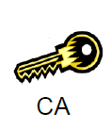


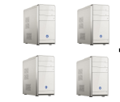
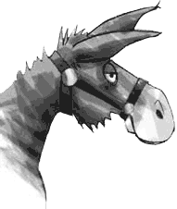
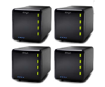
ATLAS Grid job - 2
How do they work?
Job Status
Site A
Information Provider
ATLAS PanDA
Panda Queue A
UI
Distributed job
management
CE
Rucio DDM
SE
Panda Queue B
Site B

Slide 20
ATLAS Grid job - 3
How do they work?
Job Status
Site A
Information Provider
ATLAS PanDA
Panda Queue A
Pilots
UI
Distributed job
management
CE
Rucio DDM
SE
Pilots
Panda Queue B
Site B

Slide 21
ATLAS Grid job - 4
How do they work?
Job Status
Site A
Registered
Defined
voms-proxy
Information Provider
ATLAS PanDA
Waiting when site & system is ready
Pilots
UI
Job submission
+ input sandbox
CE
Rucio DDM
SE
Pilots
Site B

Slide 22
ATLAS Grid job - 5
How do they work?
Job Status
Site A
Registered
Defined
Ready
Information Provider
Scheduled
ATLAS PanDA
Panda Queue A
Pilots
UI
Distributed job
management
CE
DDM SE endpoint A
Rucio DDM
Distributed data
management
SE
Data transfers
Pilots
Panda Queue B
Site B
DDM SE endpoint B

Slide 23


ATLAS Grid job - 6
How do they work?
Job Status
Site A
Registered
Defined
Ready
Information Provider
Scheduled
Running
ATLAS PanDA
Panda Queue A
Running!
UI
Distributed job
management
CE
DDM SE endpoint A
Analysis data
Rucio DDM
Distributed data
management
SE
Panda Queue B
Site B
DDM SE endpoint B

Slide 24
ATLAS Grid job - 7
How do they work?
Job Status
Site A
Registered
Defined
Ready
Information Provider
Scheduled
Running
ATLAS PanDA
Panda Queue A
UI
Distributed job
management
CE
Prepared
DDM SE endpoint A
Output data
Rucio DDM
Registration
Distributed data
management
SE
Panda Queue B
Site B
DDM SE endpoint B

Slide 25
ATLAS Grid job - 8
How do they work?
Job Status
Site A
Registered
Defined
Ready
Information Provider
Scheduled
Running
ATLAS PanDA
Panda Queue A
Done!
UI
Distributed job
management
CE
Prepared
DDM SE endpoint A
Done
Rucio DDM
Distributed data
management
SE
Panda Queue B
Site B
DDM SE endpoint B

Slide 26

Grid User Interface and CVMFS
Grid client software originally supported by European Middleware Initiative (EMI)
CVMFS is a remote repository using FUSE file system
  e.g. /cvmfs/atlas.cern.ch → A repository of all client software we need
  Internally using HTTP → Need of network access
Panda client using ATLAS PanDA server is a tool to manage jobs
  BigPanda monitoring system provides a Web interface
Rucio client is a tool to interact with data
ATLAS Athena physics framework
Just try it out!
Data management
Rucio client
Job management
Panda client
Grid client software
EMI LCG tools

Slide 27
PanDA (ATLAS Job Management System)

Slide 28
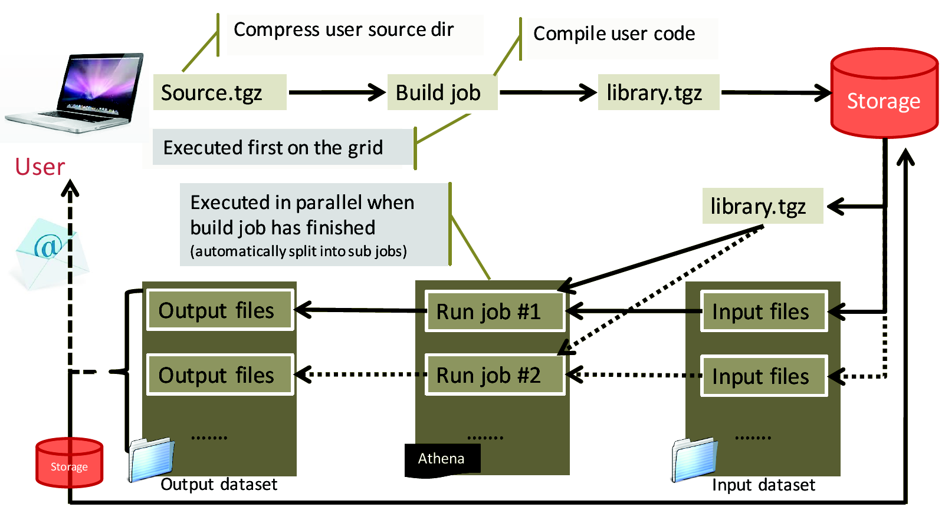
Build job & Run job

Slide 29
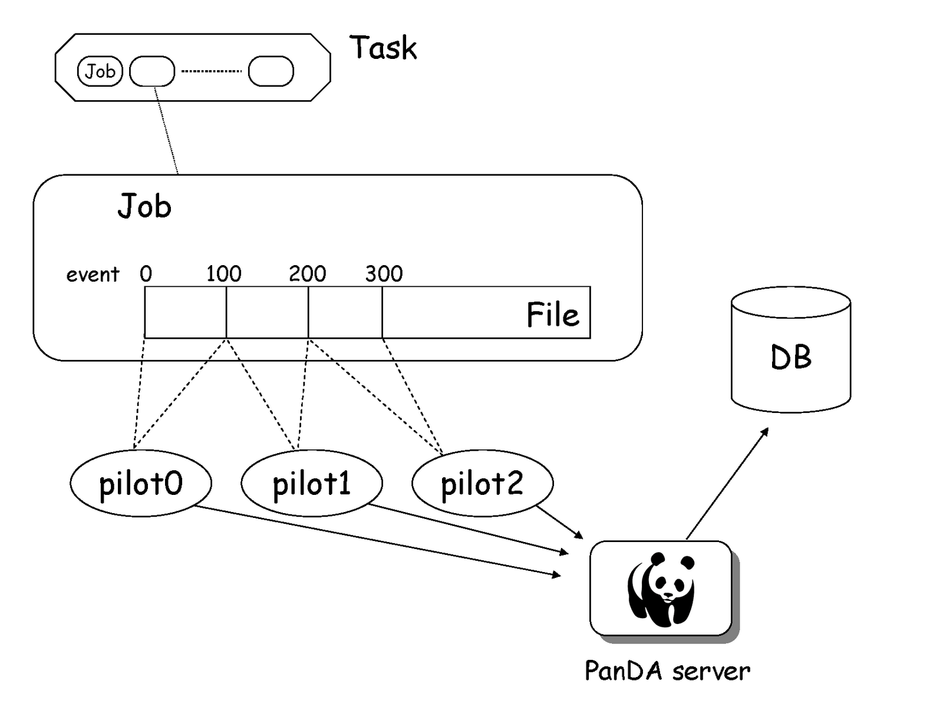
Event level processing
  Task (calculation) can be split by evenl level handler
    Event Level Handler can generate basic pilot jobs according to events in given file(s)

Slide 30
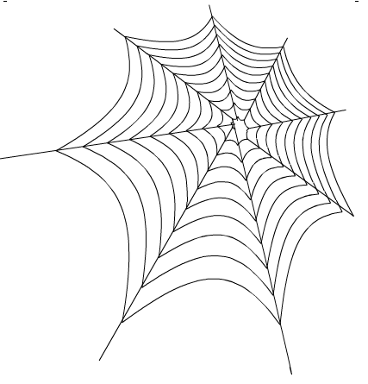
ATLAS Metadata Interface (AMI)

Slide 31
AMI (ATLAS Metadata Interface)
Metadata = Data of Data (Description of data)
Key of ATLAS Data Life Cycle Management
On each step of data reconstruction in ATLAS, AMI Tags are generated
  ATLAS data set, metadata link
    Size and origin of dataset
    File, number of events
    Software parameter (AMI Tags)
    MC parameter (PDF, generator, cross section, etc)
    Lost files and Lumi blocks
    Link to other applications (COMA, Rucio)
    Data period
      Luminosity, Trigger, Data of RAW data creation etc
  Special Interface
    AMI-Tags
      Software Configuration Parameters
    AMI-Glance
      Data + Publication
    Definition of data periods
    Definition of physics containers
    Reprocessing campaigns
    Event count comparator

Slide 32
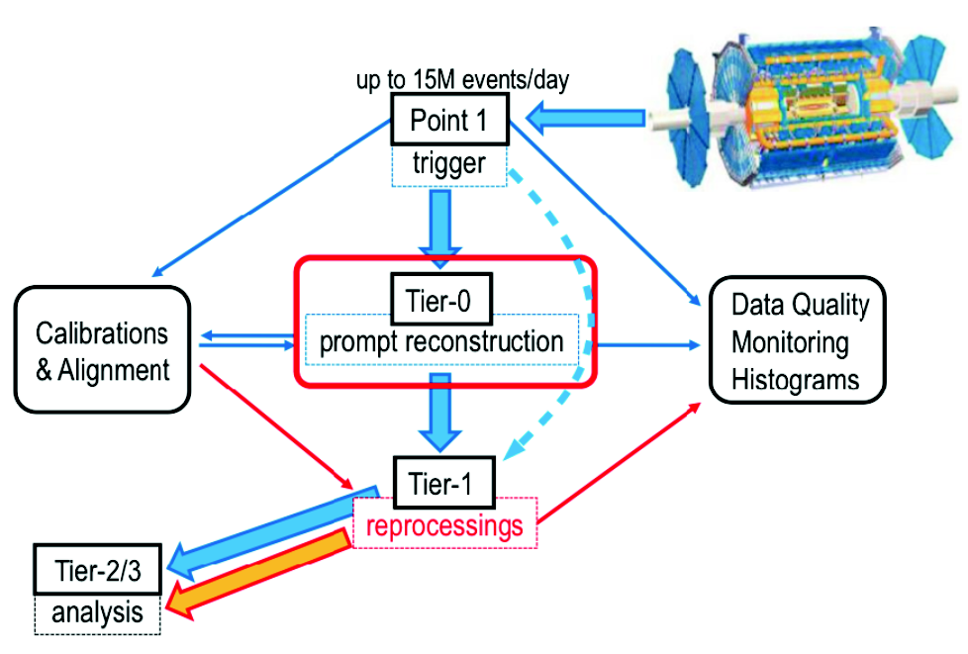
ATLAS Dataset - 2
Tier-0
  RAW is produced
  Prompt data reconstruction
ProdSys2
  MC + Reprocessing
  PanDA, JEDI, DEFT
Distribution of dataset
  Rucio

Slide 33
ATLAS Dataset - 3
Data reconstruction → Example：x353 = AMI tag
  Reco_tf.py —AMI=x353 --inputBSFile=tier0_RawData.data
Reprocessing Campaign
  After improvement of ATLAS software or framework, often huge reconstruction jobs can run
    The campaign require many computing resources
    As a result, many different versions of AOD (Analysis Object Data)
      Derivation framework: AOD → Derived AOD
      About 1% size of ogirinal AOD
      Selection of particular event, parameter etc
      Different configurations, software and conditions

Slide 34
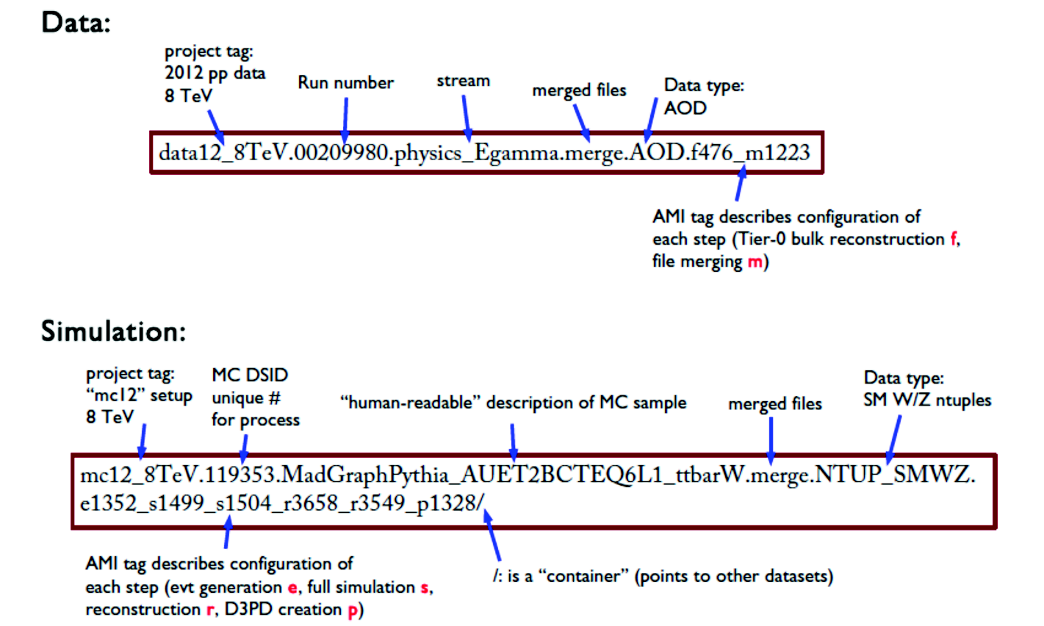
ATLAS Dataset - 4
Dataset = Collection of files
  Collision data (data) and Monte Carlo (mc)

Slide 35
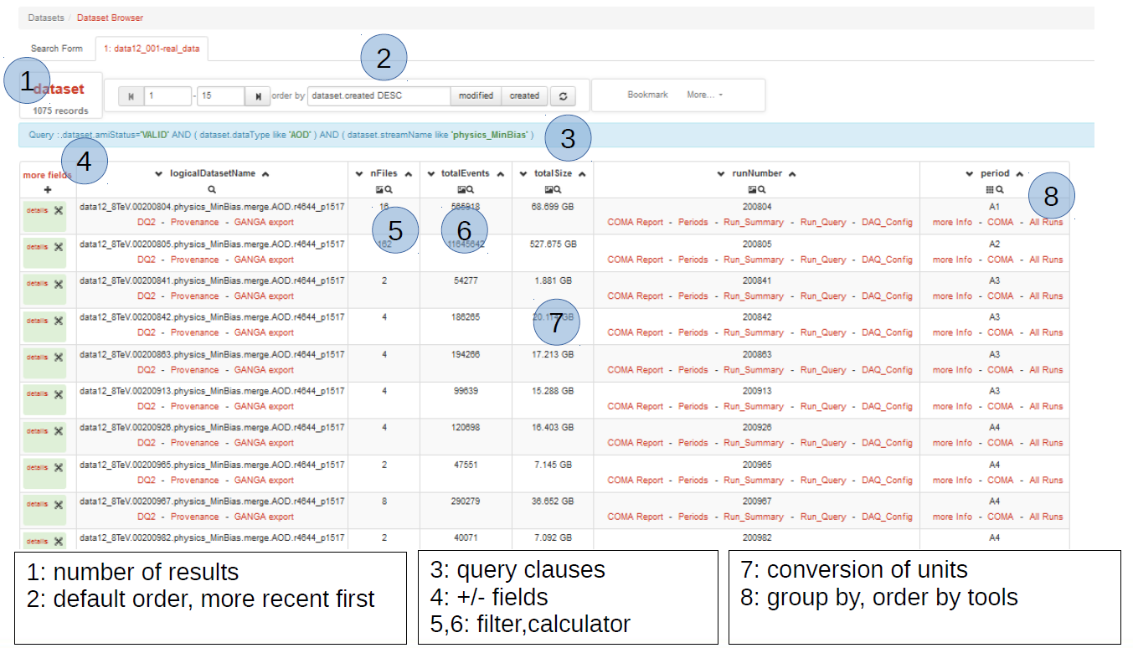
AMI WebUI - 1

Slide 36
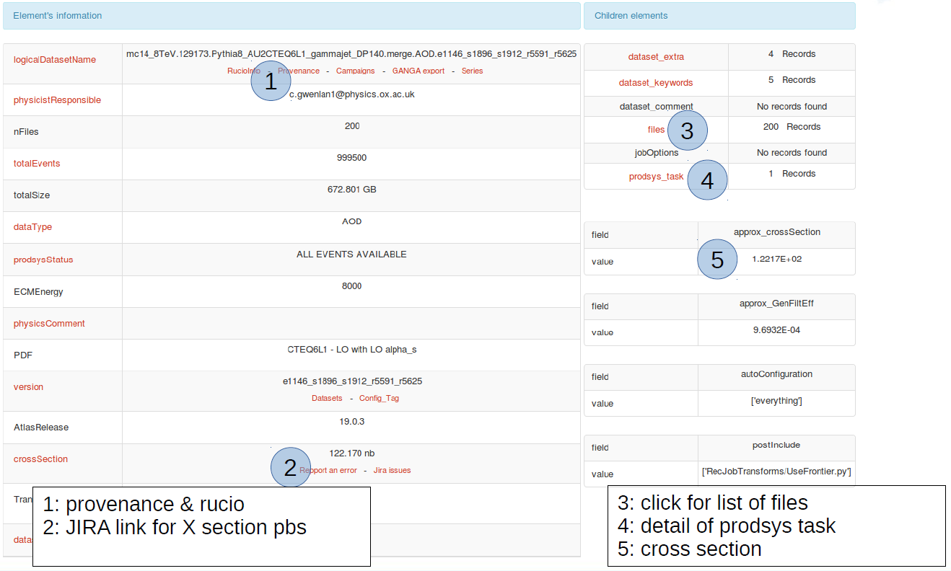
AMI WebUI - 2

Slide 37
Rucio (ATLAS data management system)

Slide 38
Rucio basic concepts - 1
Data Management System for Run-2 in ATLAS distributed computing system
  Used to download outputs of Grid jobs, moving data and searching for them
Rucio CLI tools from CVMFS
  Web interface provides similar functionality

Slide 39
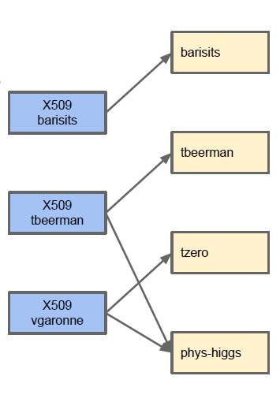
Rucio basic concepts - 2
Accounts
  A Rucio Account can represent users, groups (phys-susy) or activities (panda, tzero)
  Quota and permissions are associated to an account
  One can connect to a Rucio account using X509 certificates/proxies, Kerberos
  One credential can be used to map to different accounts.

Slide 40
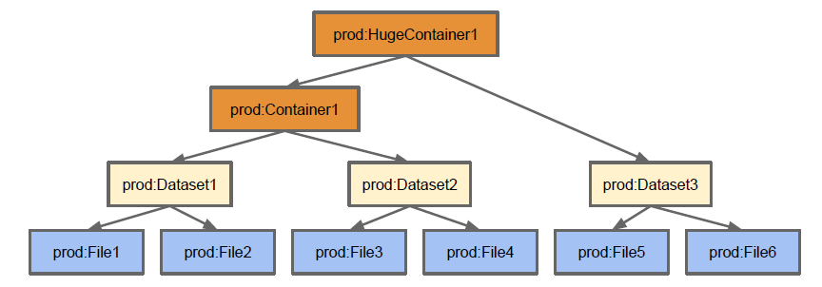
Rucio basic concepts - 3
Rucio namespace
  3 types of Data Identifiers (DIDs): File, Datasets, Containers.
    Dataset: Collection of Files
    Containers: Collection of Datasets or Containers
  The namespace is divided using scopes. A name is unique within a scope but can be used in other scopes. A DID is identified by a scope and a name

Slide 41
Rucio basic concepts - 4
Rucio Storage Elements (RSEs)
  Name for a storage endpoint in Rucio, e.g.: GOEGRID_ LOCALGROUPDISK or CERN-PROD_DATADISK
  Can be grouped using tags (e.g. tier=2, cloud=DE)
Replication Rules
  Define how to replicate Data Identifiers to Rucio Storage Elements
  E.g.: Make one replica of dataset user.gen:my.dataset on DESY-HH_ LOCALGROUPDISK
  Using RSE expression: 2 replicas at cloud=DE&type=LOCALGROUPDISK (any German LOCALGROUPDISK)
  Will create the minimum number of replicas to optimise storage space and minimise transfers

Slide 42
RSE expressions
Rules can be created either with an exact RSE name or by using tags that are defined on an RSE, this is then called an RSE expression
  Examples:
    RSEs in German cloud: cloud=DE
    LOCALGROUPDISKs in UK: country=UK&type=LOCALGROUPDISK
    Any T2 in Italy but not INFN-NAPOLI: cloud=FR&tier=2\INFN-NAPOLI
  More about this can be found in the Rucio documentation:
    http://rucio.cern.ch/replication_rules_examples.html
When using RSE expressions you can define a replication factor, so you can create multiple replicas for one datasets with on rule
Also you can define the grouping of the data:
  ALL: Rucio selects an RSE and all files will be copied to this RSE
  DATASET: If there are multiple datasets Rucio will pick an RSE for each one and will copy all files in the same dataset to the same RSE
  NONE: Rucio will pick a new RSE for every file, so that they spread over all available RSEs

Slide 43
Links and references
RucioUI
  https://rucio-ui.cern.ch/
Rucio Documentation
  http://rucio.cern.ch/index.html
Software twiki tutorial
  https://twiki.cern.ch/twiki/bin/viewauth/AtlasComputing/SoftwareTutorialGettingDatasets
Athena Docker setup
  https://twiki.cern.ch/twiki/bin/viewauth/AtlasComputing/AthenaMacDockerSetup
Docker container for CVMFS
  https://github.com/sbinet/docker-containers/tree/master/cvmfs-atlas
Binet, Sébastien, and Ben Couturier. "docker & HEP: Containerization of applications for development, distribution and preservation." Journal of Physics: Conference Series. Vol. 664. No. 2. IOP Publishing, 2015.
  http://iopscience.iop.org/article/10.1088/1742-6596/664/2/022007/meta
ATLAS-D meeting 2015 Rucio Tutorial, Thomas Beermann
Monitoring Your Grid Jobs, Andrew Washbrook University of Edinburgh, ATLAS Software & Computing Tutorials 14th January 2015 PUC, Chile
Athena Mac Docker
  https://twiki.cern.ch/twiki/bin/viewauth/AtlasComputing/AthenaMacDockerSetup
Software tutorial using Grid
  https://twiki.cern.ch/twiki/bin/viewauth/AtlasComputing/SoftwareTutorialUsingTheGrid

Slide 44
Enjoy your hands-on exercise!

Slide 45
Backup

Slide 46
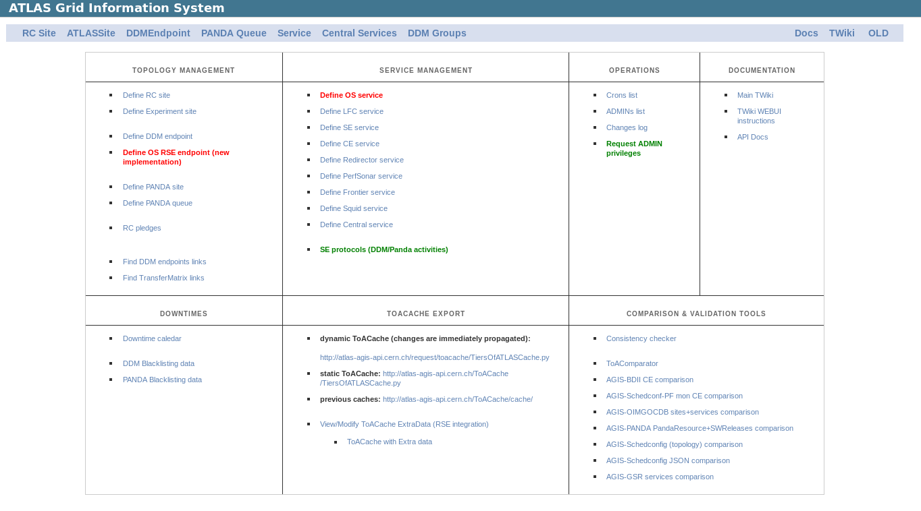
ATLAS Resources - 1
AGIS (ATLAS Grid Information Sysgtem)
  http://atlas-agis.cern.ch/agis/

Slide 47
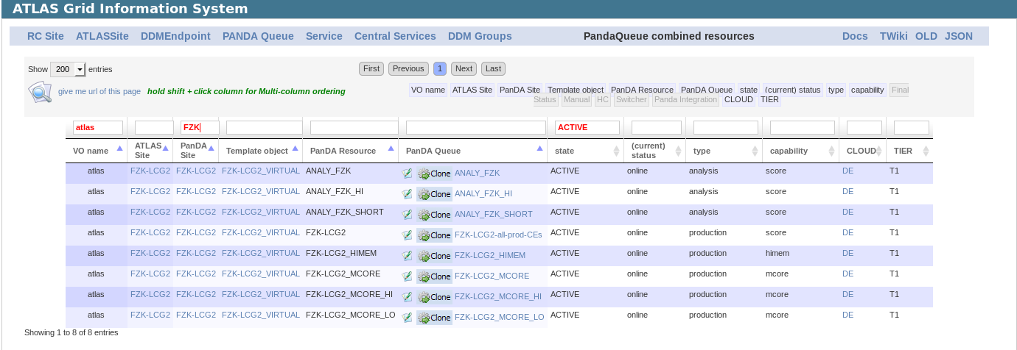
ATLAS Resources - 2
PanDA queue end points
FZK
Active PanDA (job) queues
ANALY_ …. = Analysis queue

Slide 48
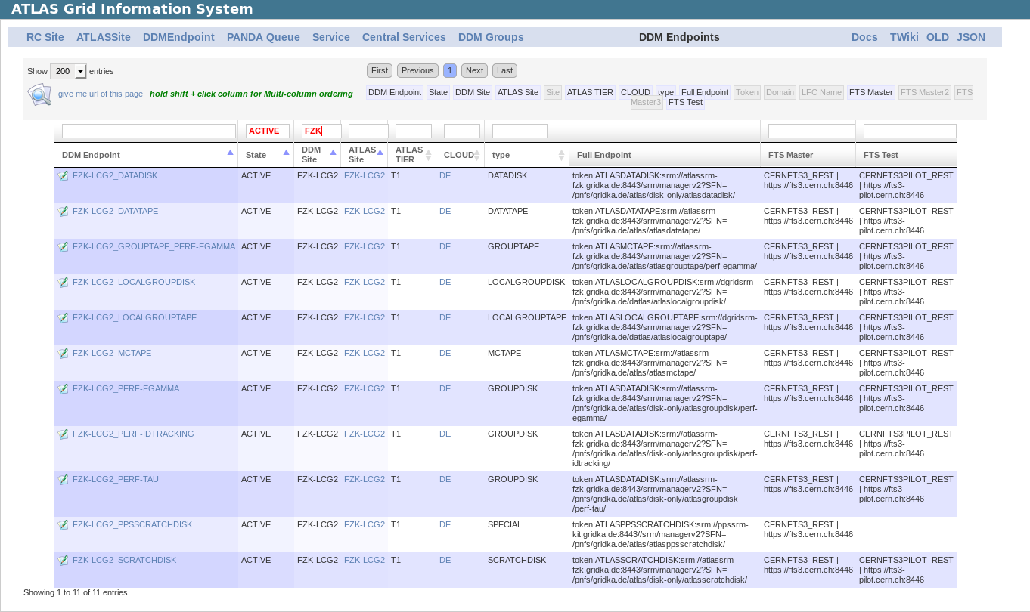
ATLAS Resources - 3
DDM end points
FZK
Active DDM storage
end points

Slide 49
ATLAS Resources - 4
SCRATCHDISK (Tier1 + Tier2s in Germany)
  FZK-LCG2_SCRATCHDISK
  DESY-HH_SCRATCHDISK
  DESY-ZN_SCRATCHDISK
  LRZ-LMU_SCRATCHDISK
  WUPPERTALPROD_SCRATCHDISK
  UNI-FREIBURG_SCRATCHDISK
  GOEGRID_SCRATCHDISK
LOCALGROUPDISK (e.g. DESY-HH and UniGoettingen)
  DESY-HH_LOCALGROUPDISK
  GOEGRID_LOCALGROUPDISK
  …... _LOCALGROUPDISK

Slide 50
ATLAS Resources - 4
SCRATCHDISK (Tier1 + Tier2s in Germany)
  FZK-LCG2_SCRATCHDISK
  DESY-HH_SCRATCHDISK
  DESY-ZN_SCRATCHDISK
  LRZ-LMU_SCRATCHDISK
  WUPPERTALPROD_SCRATCHDISK
  UNI-FREIBURG_SCRATCHDISK
  GOEGRID_SCRATCHDISK
LOCALGROUPDISK (e.g. DESY-HH and UniGoettingen)
  DESY-HH_LOCALGROUPDISK
  GOEGRID_LOCALGROUPDISK
  …... _LOCALGROUPDISK
Storages for temporary data of PanDA jobs. Would be automatically REMOVED!
Permanently KEPT. Generally speaking, in total a few hundred TB in each site

Slide 51

Job allocation (a tip) - 1
A tip: User job allocation policy among sites
  Rule: Grid jobs (should) go to their data locations
DESY-HH
Tier-2
ATLAS PanDA
Goe DE
Tier-2
Job submission
Preferred site
Your input data

Slide 52
Job allocation (a tip) - 2
A tip: User job allocation policy among sites
  Rule: Grid jobs (should) go to their data locations
DESY-HH
Tier-2
ATLAS PanDA
Your input data in scratchdisk
Goe DE
Tier-2
DDM replication
Replication request
Rucio DDM
Your input data

Slide 53
Job allocation (a tip) - 3
A tip: User job allocation policy among sites
  Rule: Grid jobs (should) go to their data locations
DESY-HH
Tier-2
ATLAS PanDA
Your input data in scratchdisk
Goe DE
Tier-2
Job submission
Preferred sites
Your input data

Slide 54
Job allocation (a tip) - 4
A tip: User job allocation policy among sites
  Rule: Grid jobs (should) go to their data locations
DESY-HH
Tier-2
ATLAS PanDA
Your input data in scratchdisk
Goe DE
Tier-2
Job submission
Preferred sites
Local access is better than remote access
(or to avoid an error in PanDA, “local data does not exist”)
Your input data

