Slide 1
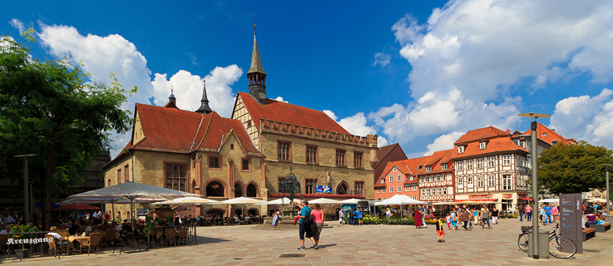



S44: High Energy Physics Big Data and the ATLAS experiment with a hands-on tutorial - 1
Data Science School Göttingen on 21.07.2017
Gen Kawamura
II.Physikalisches Institut, Universität Göttingen

Slide 2
Overview of Introduction (45 mins)
Introduction to ATLAS data analysis model
  What are the LHC experiments?
  The ATLAS detector
  Inner Detector
  Basic Physics
  ATLAS Grid computing and WLCG resources
  Data flow in ATLAS
  Basis of data analysis in high energy physics
  Event Data Model (EDM) in ATLAS
  Basis of data analysis
  Basic tools: ATLAS CLI and CVMFS
ATLAS Metadata Interface (AMI)
Rucio (ATLAS Data Management System)
Introduction to World LHC Computing Grid (WLCG)
PanDA (ATLAS Job Management System)

Slide 3
Overview of Hands-on (30-40 mins)
Let's start Hands-on
  Your Grid environments
  Hello World AMI (ATLAS Metadata Interface)
  Hello World Athena job
  Hello World PyRoot
    Plot of electron Pt distribution
  Hello World prun Grid job
  Hello World PyRoot Grid job

Slide 4
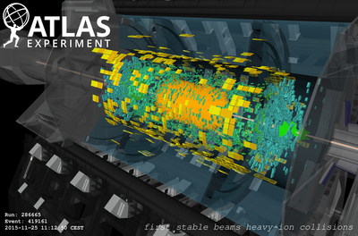
Introduction to ATLAS data analysis model

Slide 5
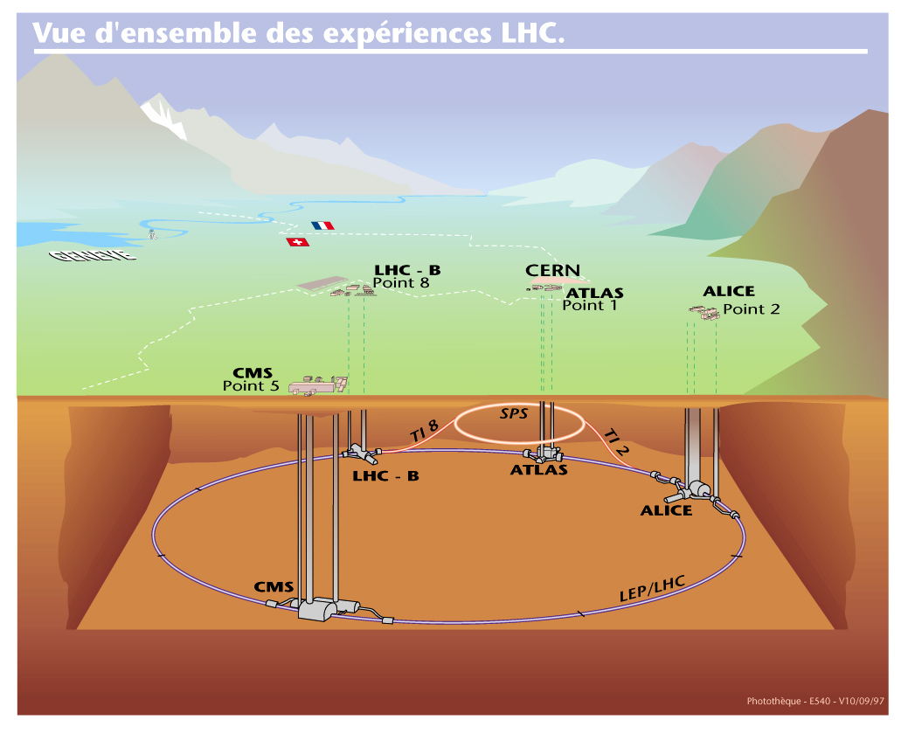
What are the LHC experiments? - 1
The biggest hadron collier on this planet
  Hadron-Hadron collisions in TeV scale (14TeV in 2018)
  100m below ground
  27km circular ring
  The world largest distributed computing platform across 36 countries
  4 main experiments (ATLAS, CMS, Alice and LHCb)
  Already not super easy!
Expectations
  New physics
  Understanding of early universe and fundamental laws
    Validation of many theoretical models

Slide 6
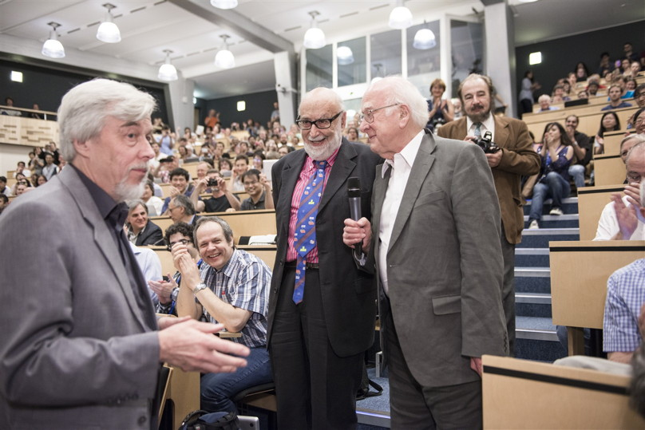
What are the LHC experiments? - 2
New discovery was announced by ATLAS and CMS in 2012
  Higgs boson (was expected by Standard Model)
  Nobel prize 2013

Slide 7
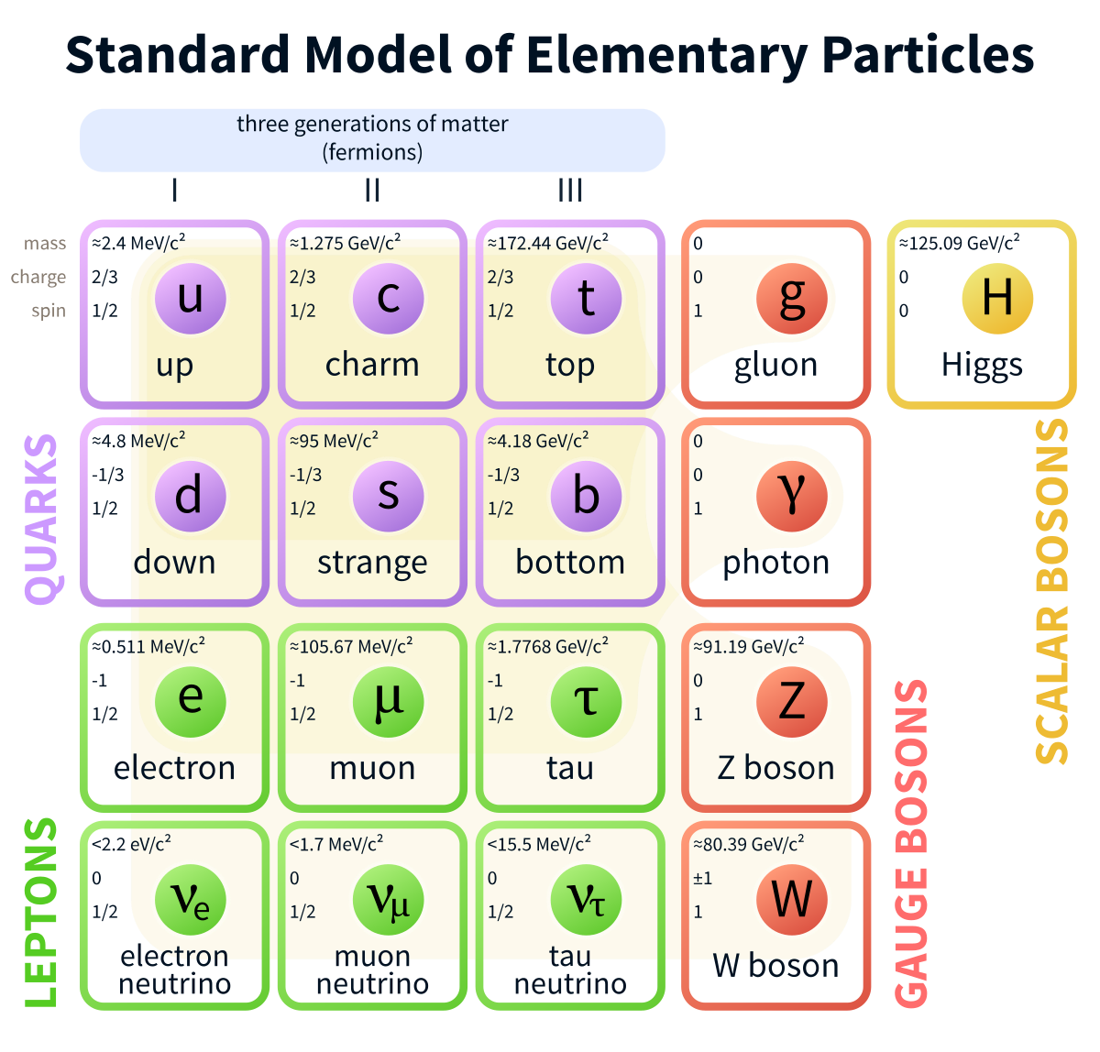
What are the LHC experiments? - 3
This

Slide 8
What are the LHC experiments? - 4
Has continued since 1992
1992
1997
2002
2007
2012
2017
2022
2027
Machine Learning?
AI?
BigData?
WWW
Linux on HPC
Multi-core
GP-GPU
Virtualization
Cloud computing
Container tech

Slide 9

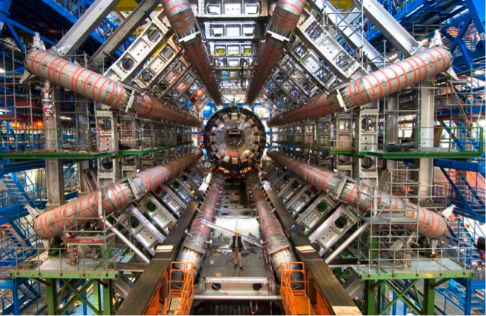
What are the LHC experiments? - 4
Has continued since 1992
1992
1997
2002
2007
2012
2017
2022
2027
Machine Learning?
AI?
BigData?
WWW
Linux on HPC
Multi-core
GP-GPU
Virtualization
Cloud computing
Container tech
TDR (1994)
gLite (β)
Run-1
Run-2
Run-3
ATLAS
HL-LHC
Discovery of Higgs Particle

Slide 10
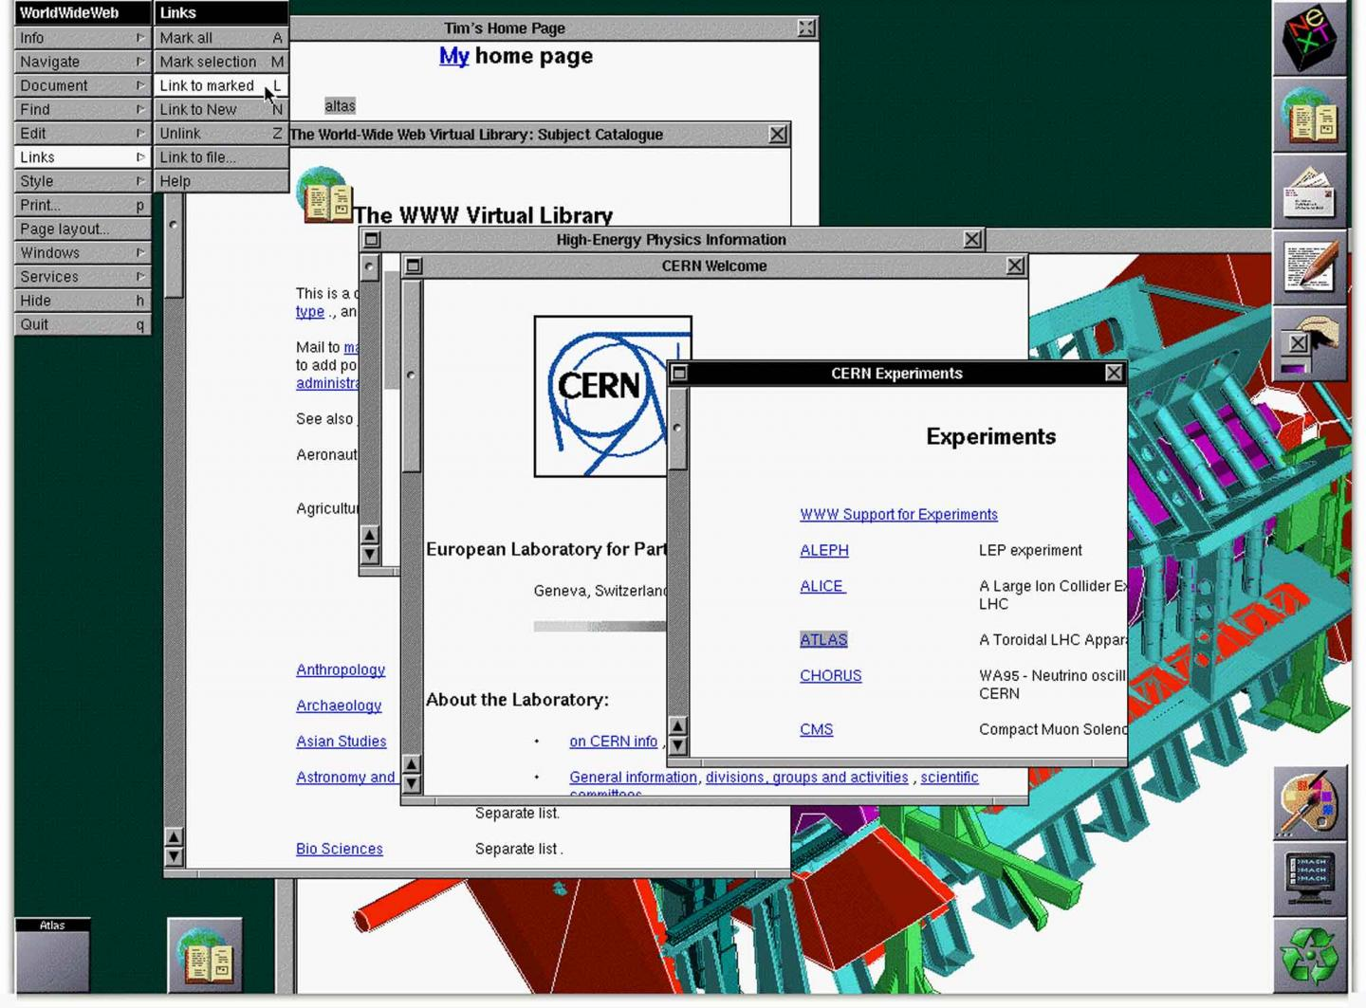
What are the LHC experiments? - 4
Has continued since 1992
Screenshot of the original NeXT web browser in 1993 (Image: Berners-Lee/CERN)

Slide 11
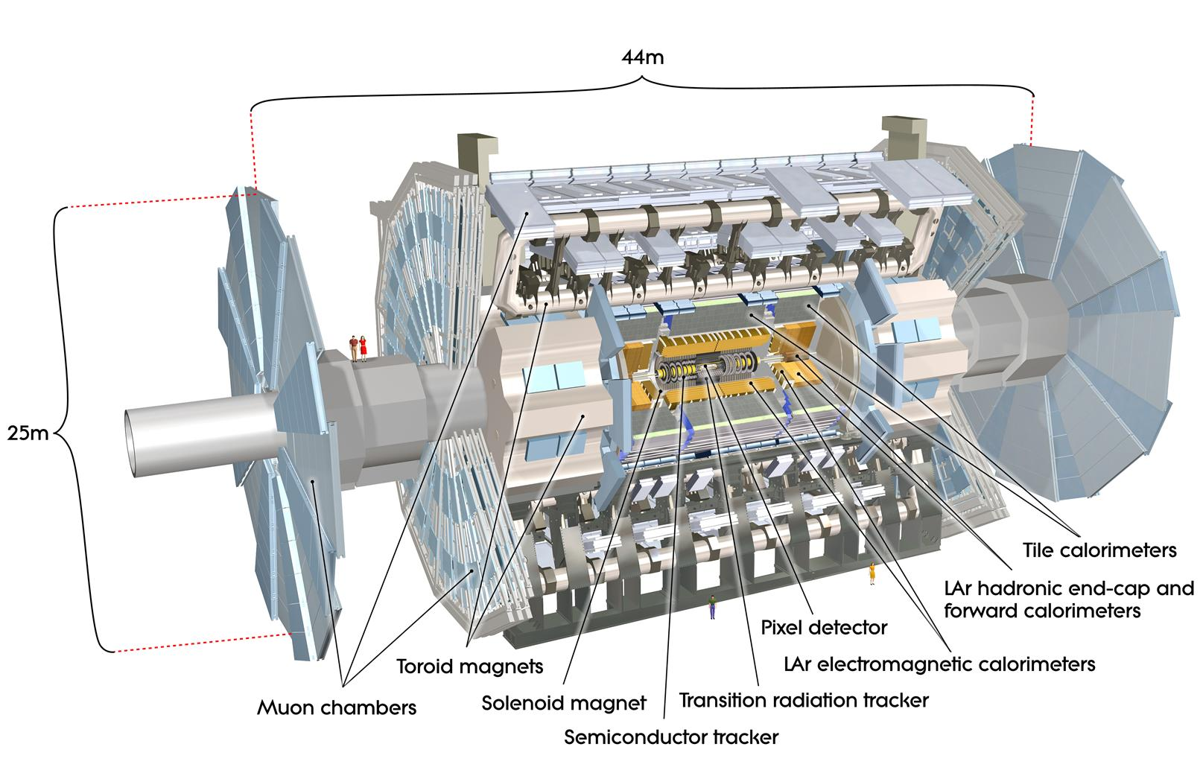
The ATLAS detector
General-purpose HEP experiment
  Reconstruction of outgoing particles from proton-proton collisions at 13TeV
  pp-rate: 40MHz
  Length: 46m, Height 25m, Weight 7kt, B-field 4T

Slide 12
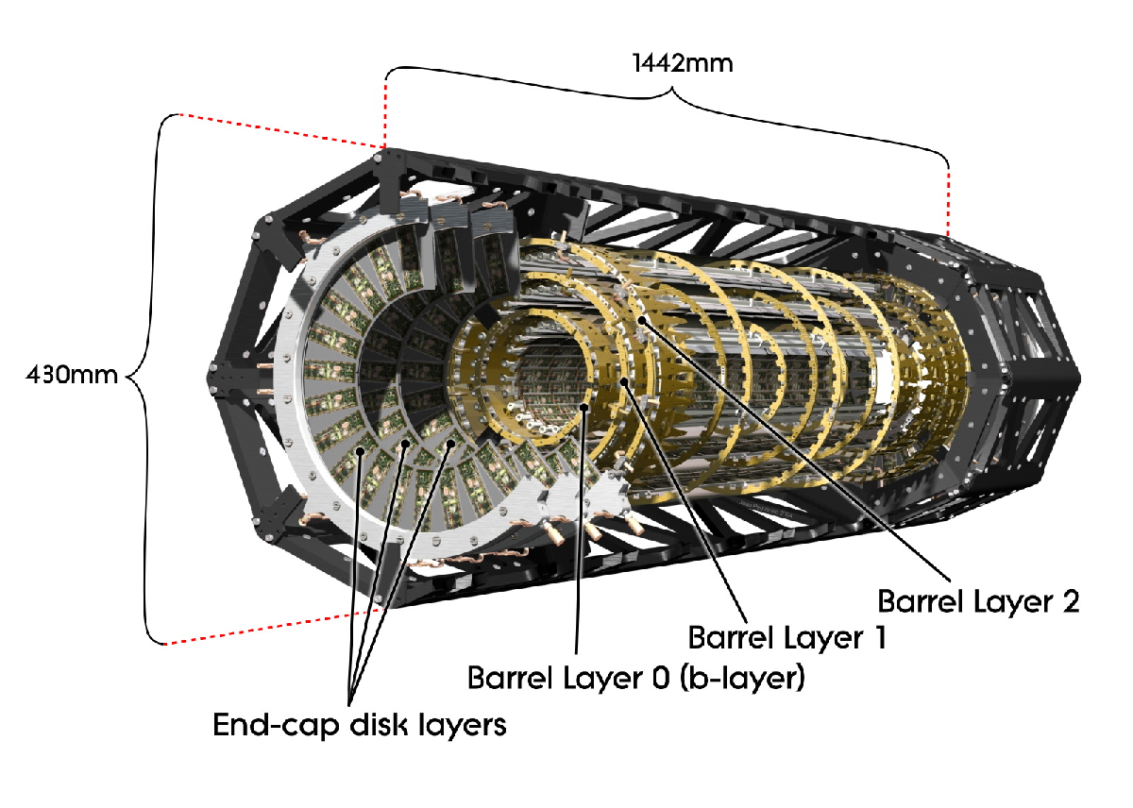
Inner Pixel Detector - 1
  80 million pixels (80 million channels). Area 1.7m^2. 15 kW power consumption
  Barrel has 1,744 modules (10cm^2) with 46,080 readout channels per module
  Pixel size 50 x 400μm^2 . Resolution 14 x 115μm^2
  Three Pixel disks (in each endcap) have 6.6 million channels
  3 barrel layers: 1,456 modules
  3 disks in each end-cap: 288 modules

Slide 13
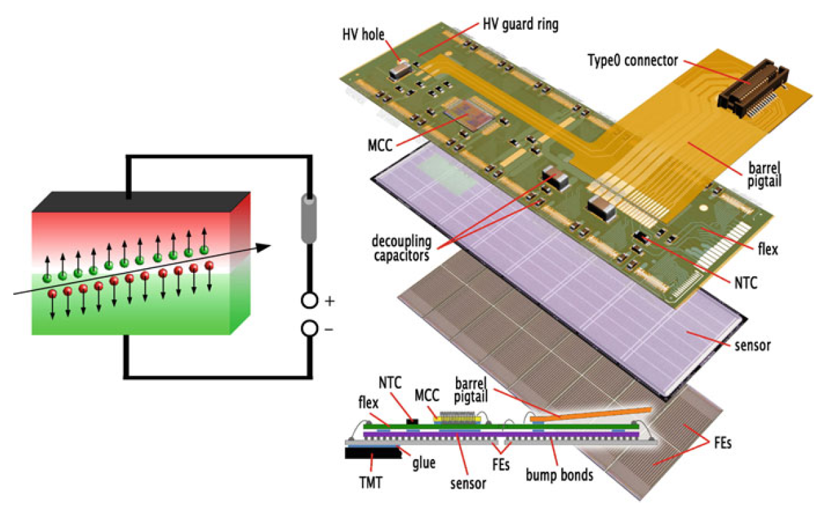
Inner pixel detector - 2
Works like (very complicated) CCD camera

Slide 14
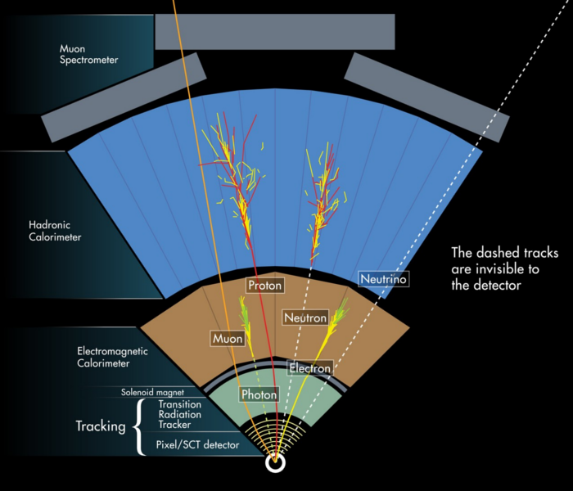
Silicon Tracker & Trigger - 2

Slide 15
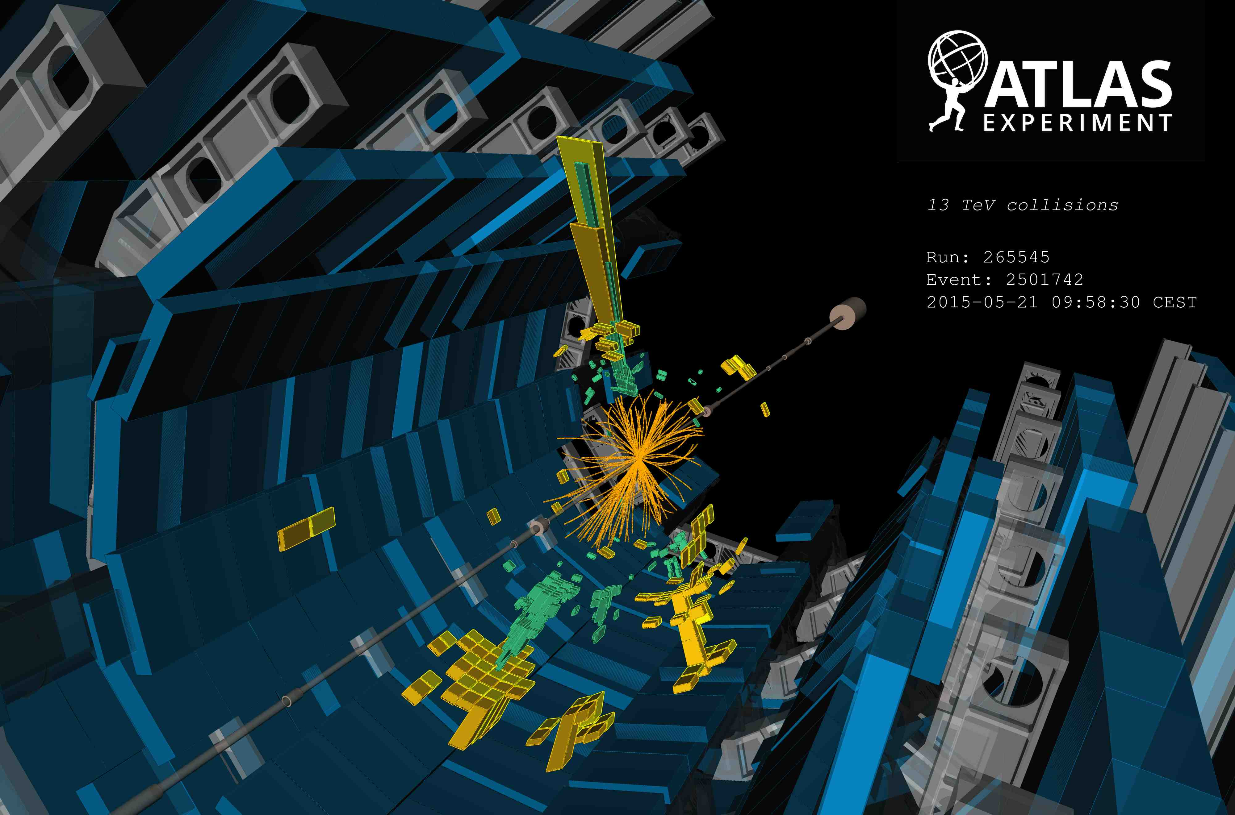
One event

Slide 16
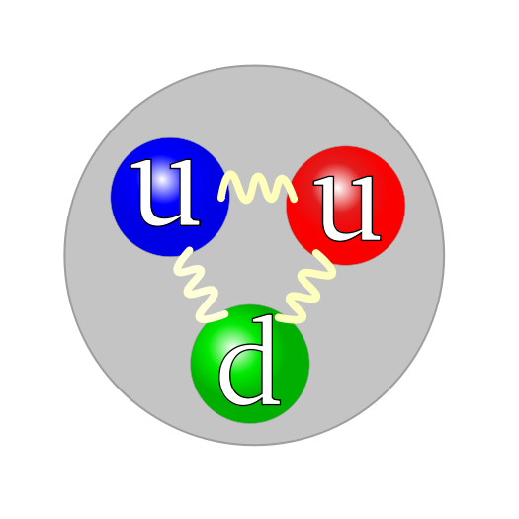
Basic Physics - 1
Proton-Proton (Hadron-Hadron) Collisions
  Proton = 2 Up quarks, 1 Down quark bound by Gluons (strong force)
proton
proton
Centre of mass energy = 13TeV
Productions of elementary particles
even unknown particles and unknown mechanisms (expectation!)

Slide 17
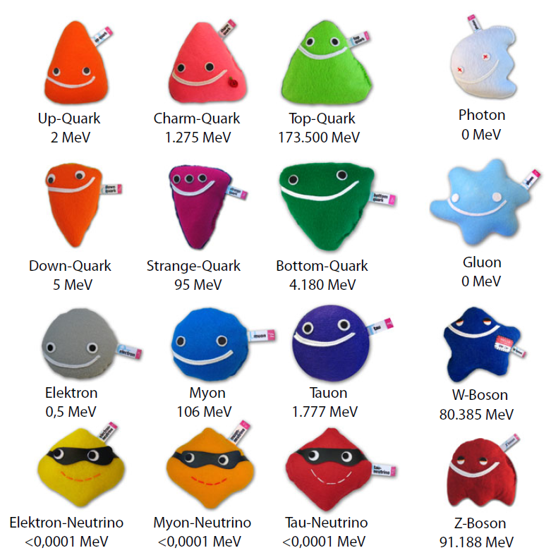
Basic Physics - 2
Production of Teilchenzoo (particle zoo)

Slide 18
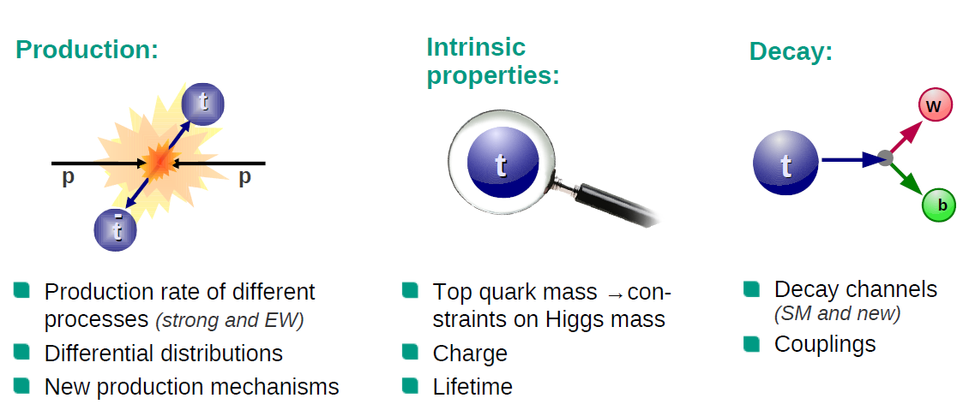
Basic Physics - 3
For example, Top-Quark production

Slide 19
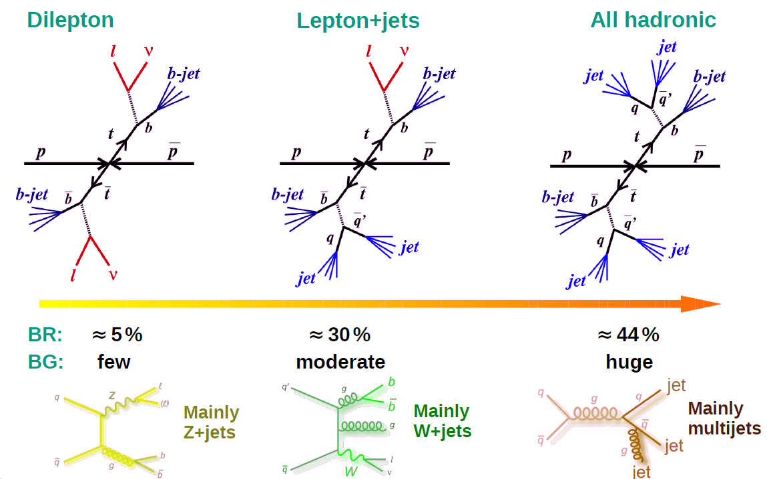
Basic Physics - 4
For example, Top-Quark production
  Event signatures

Slide 20
Basic Physics - 5
For example, Top-Quark production
  Event signatures
Decay Products
Decay Products

Slide 21
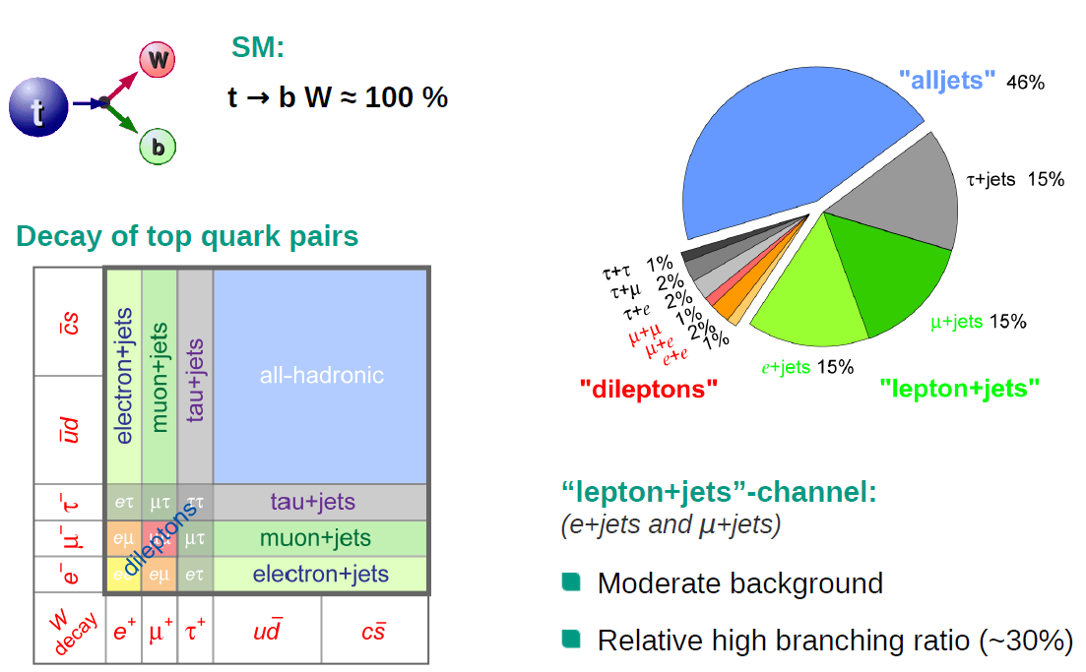
Basic Physics - 6
For example, Top-Quark production
  Decay products

Slide 22
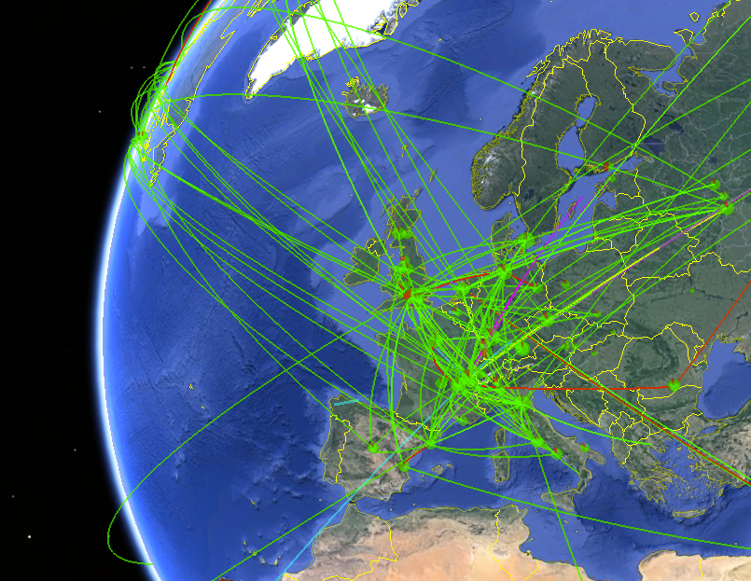
ATLAS Grid computing and WLCG resources - 1
World LHC Computing Grid (WLCG)
  The most sophisticated data-taking & analysis system ever built for science, providing near real-time access to LHC data
  2 million computing jobs per day
  42 countries
  170 computing centres

Slide 23


ATLAS Grid computing and WLCG resources - 2
LHC multi-tier structure
      WLCG = Worldwide LHC Computing Grid
Tier-0
RAL UK
Tier-1
Tier-0: Raw data, Data store (in tape), Pre-processing, Reconstruction
FZK DE
Tier-1
Tier-1: National LCG-Centre, faster network connections and lager storage spaces (e.g. Tape), MC production, user analysis, etc.
BNL USA
Tier-1
Goe DE
Tier-2
DESY-HH DE
Tier-2
Tier-2: University or Facility level computing sites. MC production, user analysis, etc.

Slide 24
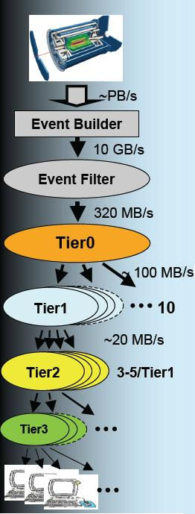
Data flow in ATLAS
RAW = about 2 MB/event
  Original data at Tier-0 (ATLAS detector)
  Complete replica distributed among all Tier-1s
ESD (Event Summary Data) = 1 MB/event
  ESDs produced by primary at Tier-1s
  Globally 2 copies on disk
AOD (Analysis Object Data) = 0.2 MB/event
  Completely replicated at each Tier-1
  Partially replicated to Tier-2s so as to have a complete set in the Tier-2s associated to each national Tier-1
  Every Tier-2 specifies which datasets are most interesting for their reference community; the rest are distributed according to capacity
TAG (Event Level Metadata Tags) = 1 kB/event
  TAG files or databases are replicated to all Tier-1s (Root/Oracle)
  Partial replicas of the TAG are distributed to Tier-2s as Root files
  Each Tier-2 have all TAGs that correspond to the AODs storead

Slide 25
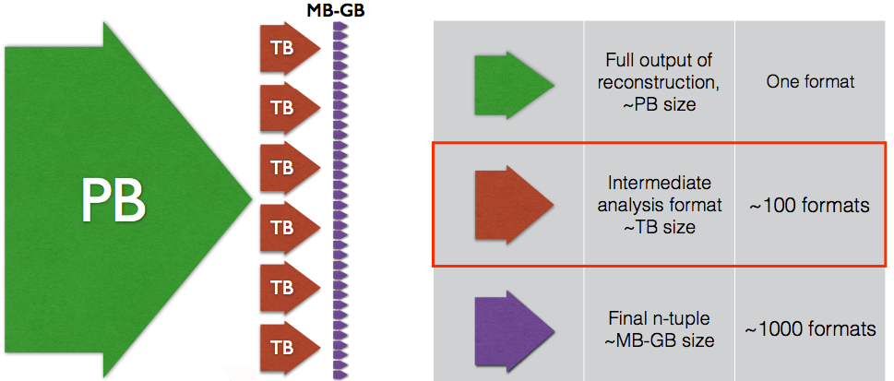
Event Data Model (EDM) in ATLAS
AODs are still huge, so need to have manageable size of data → Derived AOD (DAOD)
Derivation framework in Athena (ATLAS software framework)
Each analysis group use own derivation framework

Slide 26
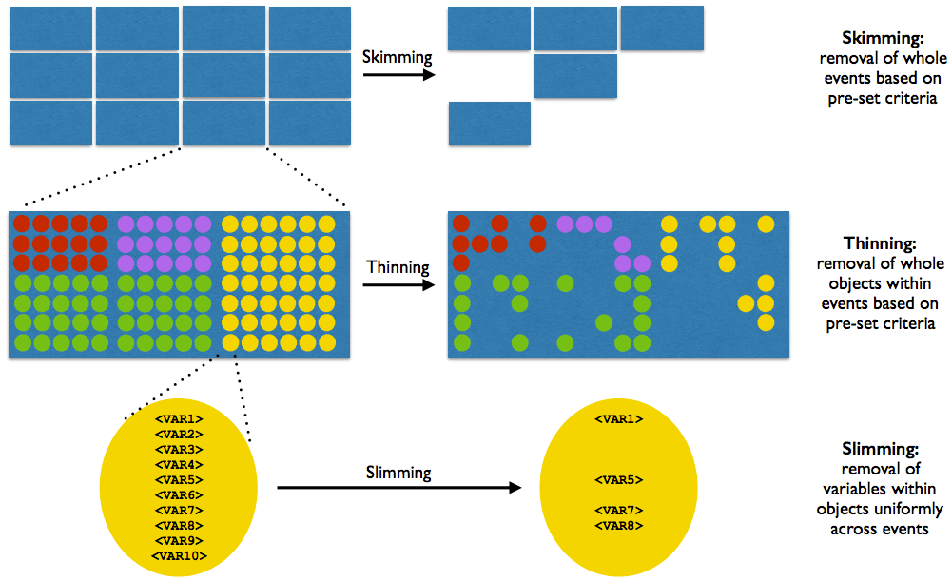
Event Data Model (EDM) in ATLAS
Size reduction (= selection of events, particles and parameters)

Slide 27
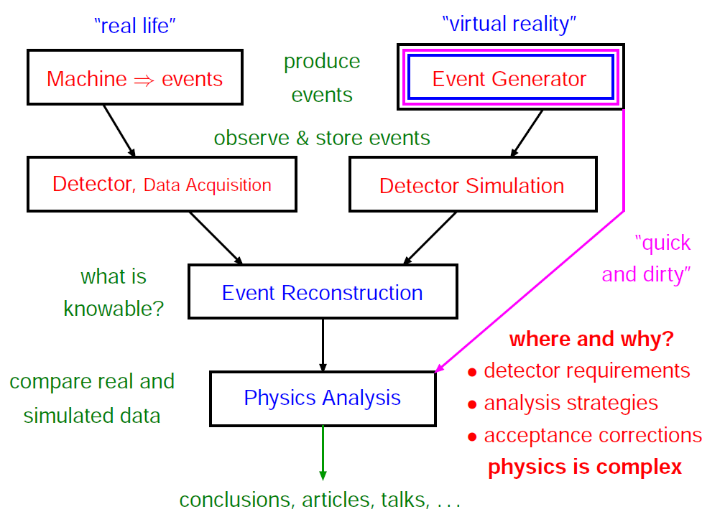
Basis of data analysis - 1

Slide 28
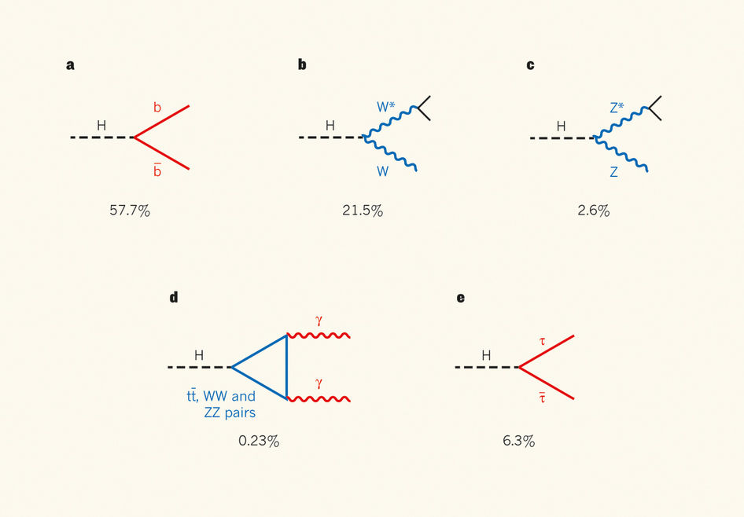
Basis of data analysis - 2
Higgs decay channel
  1 EUR → 50 + 50 cent
  1 EUR → 50 + 20 + 10 cent
  1 EUR → 20 + 20 + 20 + 20 + 20 cent
  1 EUR → 50 + 20 + 10 + 10 + 10 cent

Slide 29
Basis of data analysis - 2
Higgs decay channel
  1 EUR → 50 + 50 cent
  1 EUR → 50 + 20 + 10 cent
  1 EUR → 20 + 20 + 20 + 20 + 20 cent
  1 EUR → 50 + 20 + 10 + 10 + 10 cent

Slide 30
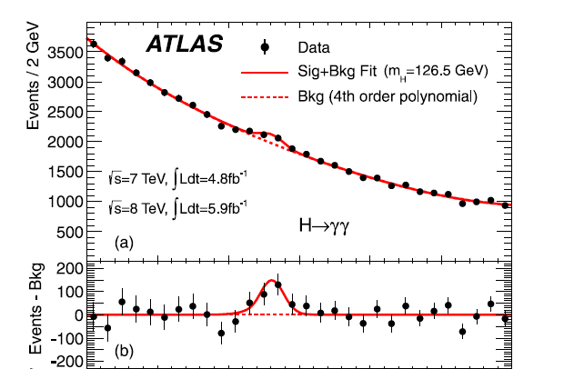
Basis of data analysis - 3
Atlas Collaboration. "Observation of a new particle in the search for the Standard Model Higgs boson with the ATLAS detector at the LHC." arXiv preprint arXiv:1207.7214 (2012).

Slide 31
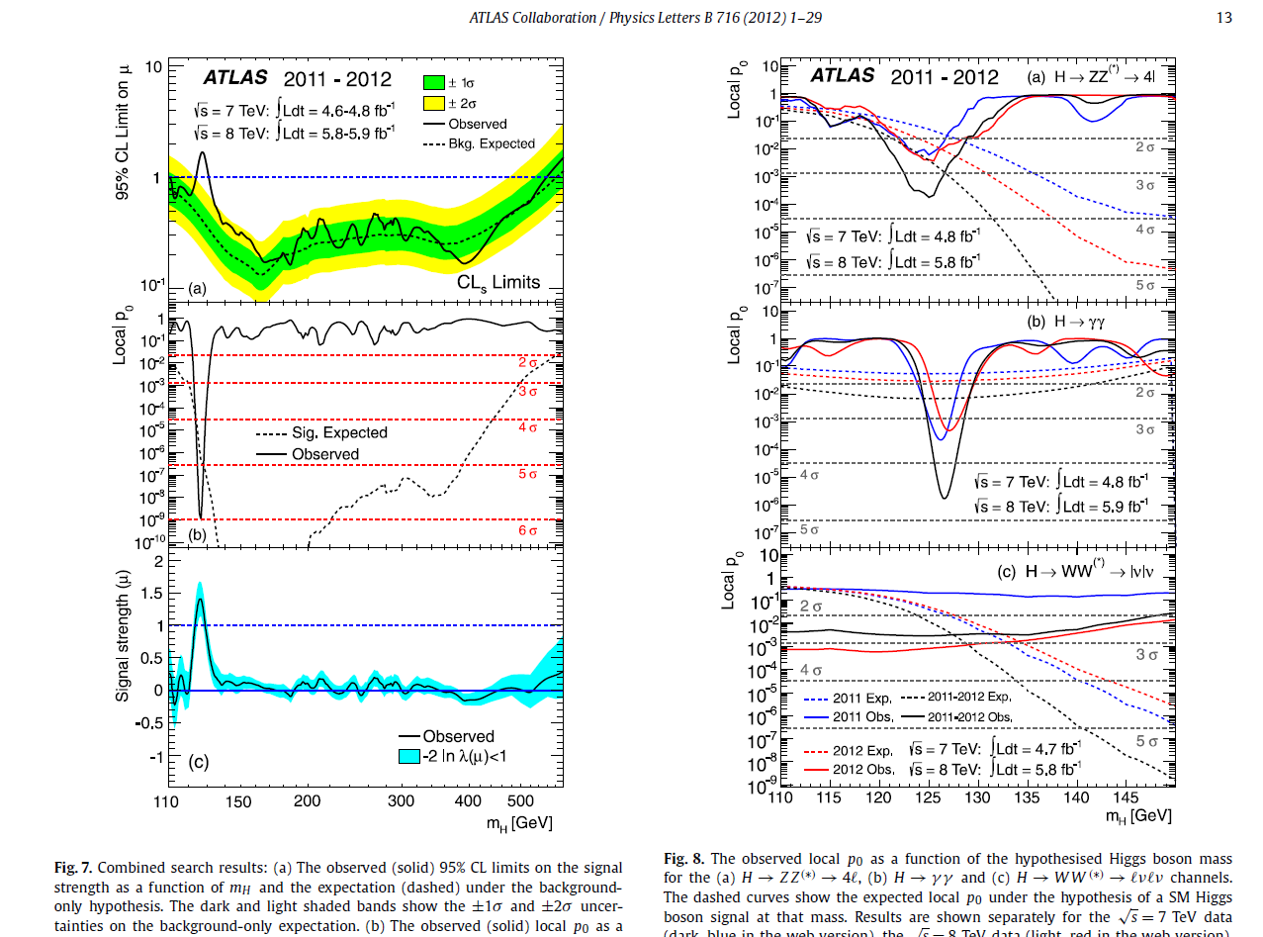
Basis of data analysis - 4

Slide 32

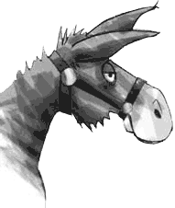

Basic Tools: ATLAS CLI and CVMFS
Grid client software originally supported by European Middleware Initiative (EMI)
CVMFS is a remote repository using FUSE file system
  e.g. /cvmfs/atlas.cern.ch → A repository of all client software we need
  Internally using HTTP → Need of network access
PanDA client using ATLAS PanDA server is a tool to manage jobs
  BigPanda monitoring system provides a Web interface
Rucio client is a tool to interact with data
ATLAS framework (Athena)
ROOT (c++ HEP framework)
ATLAS Athena physics framework
Data management
Rucio client
Job management
Panda client
Grid client software
EMI LCG tools

Slide 33
CVMFS (CERN VM File-System)
Before CVMFS
  Problems of distribution of common High Energy Physics software environments
  Needed to build every software release in every university/facility
After CVMFS
  Everything is centrally managed/updated
  Nightly build is also available
  Nothing to do (e.g. build of every update) in local PCs / Clusters
  Using general http proxy system like Squid → less network access and robust

Slide 34
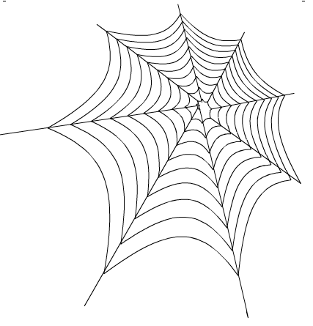
ATLAS Metadata Interface (AMI)

Slide 35
AMI (ATLAS Metadata Interface)
Metadata = Data of Data (Description of data)
Key of ATLAS Data Life Cycle Management
On each step of data reconstruction in ATLAS, AMI Tags are generated
  ATLAS data set, metadata link
    Size and origin of dataset
    File, number of events
    Software parameter (AMI Tags)
    MC parameter (PDF, generator, cross section, etc)
    Lost files and Lumi blocks
    Link to other applications (COMA, Rucio)
    Data period
      Luminosity, Trigger, Data of RAW data creation etc
  Special Interface
    AMI-Tags
      Software Configuration Parameters
    AMI-Glance
      Data + Publication
    Definition of data periods
    Definition of physics containers
    Reprocessing campaigns
    Event count comparator

Slide 36
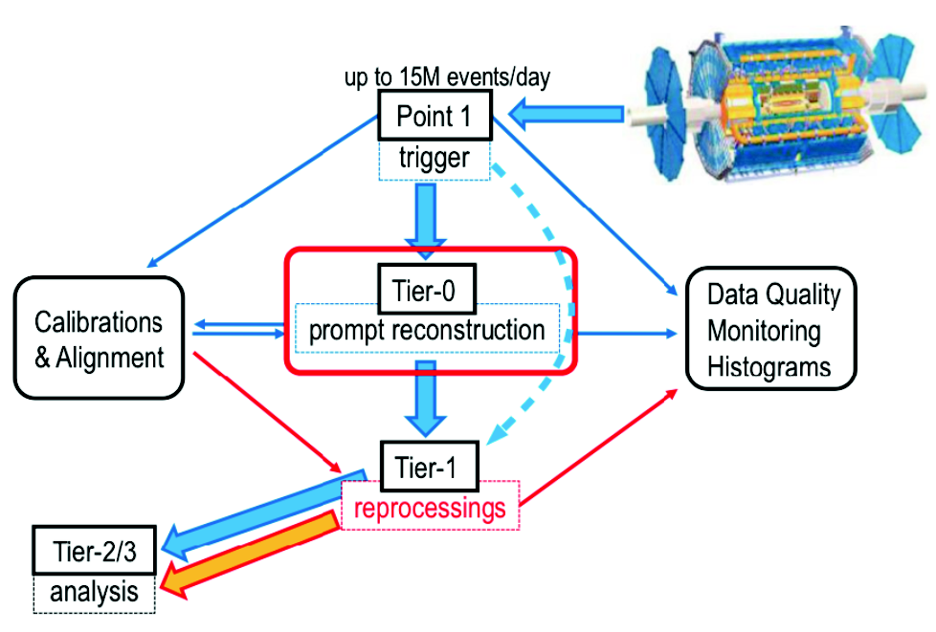
ATLAS Dataset - 2
Tier-0
  RAW is produced
  Prompt data reconstruction
ProdSys2
  MC + Reprocessing
  PanDA, JEDI, DEFT
Distribution of dataset
  Rucio

Slide 37
ATLAS Dataset - 3
Data reconstruction → Example：x353 = AMI tag
  Reco_tf.py —AMI=x353 --inputBSFile=tier0_RawData.data
Reprocessing Campaign
  After improvement of ATLAS software or framework, often huge reconstruction jobs can run
    The campaign require many computing resources
    As a result, many different versions of AOD (Analysis Object Data)
      Derivation framework: AOD → Derived AOD
      About 1% size of ogirinal AOD
      Selection of particular event, parameter etc
      Different configurations, software and conditions

Slide 38
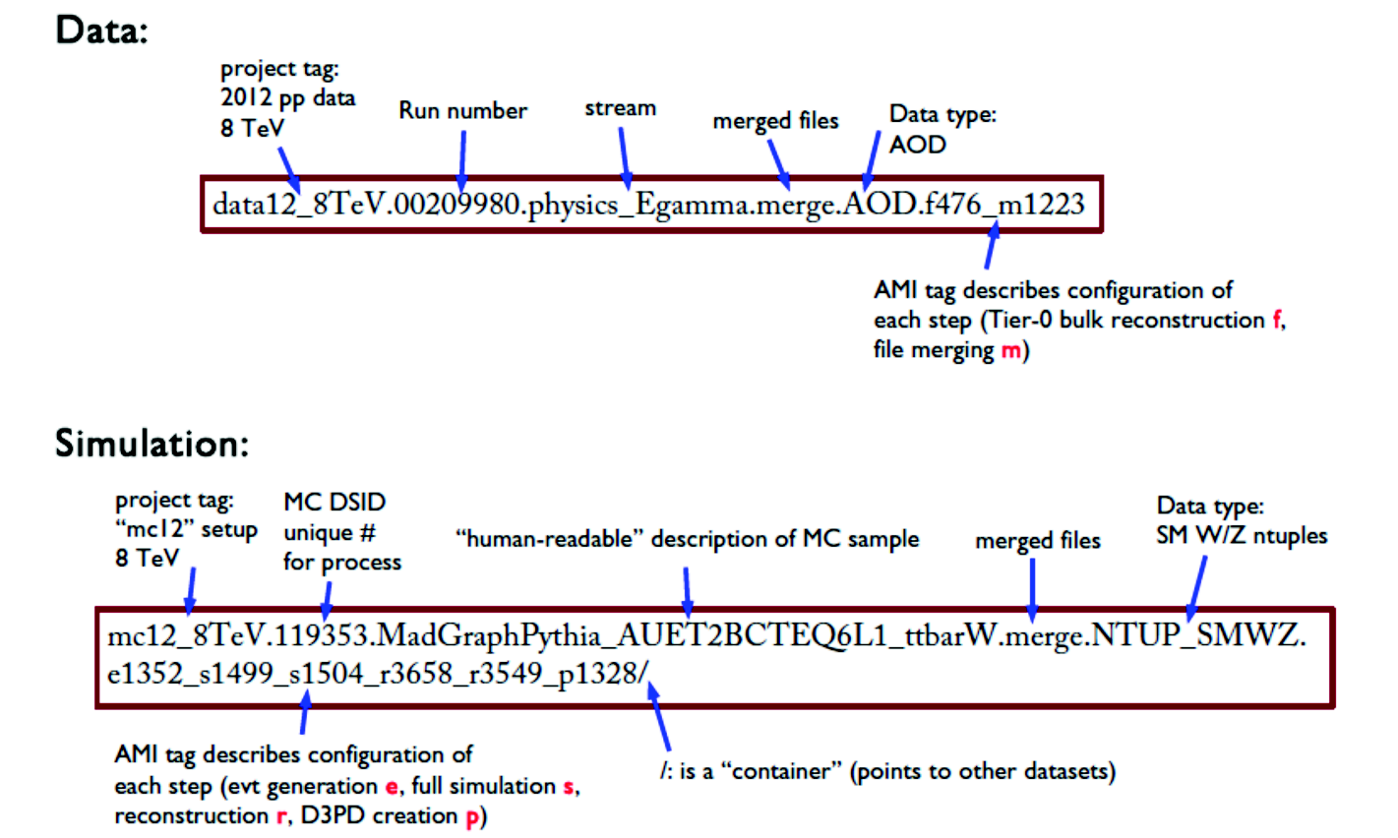
ATLAS Dataset - 4
Dataset = Collection of files
  Collision data (data) and Monte Carlo (mc)

Slide 39
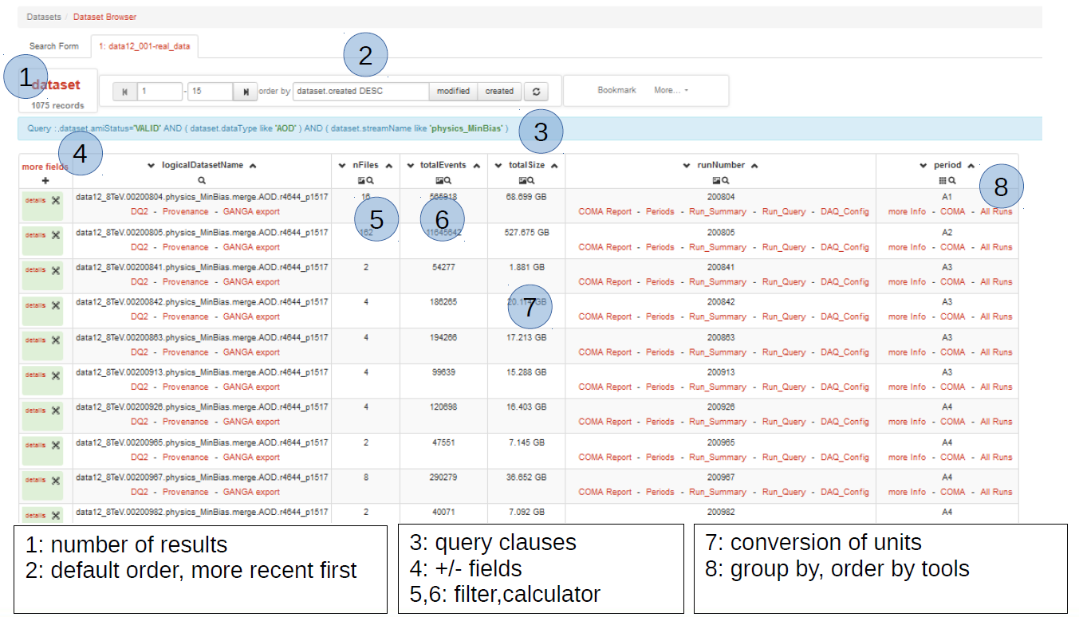
AMI WebUI - 1

Slide 40
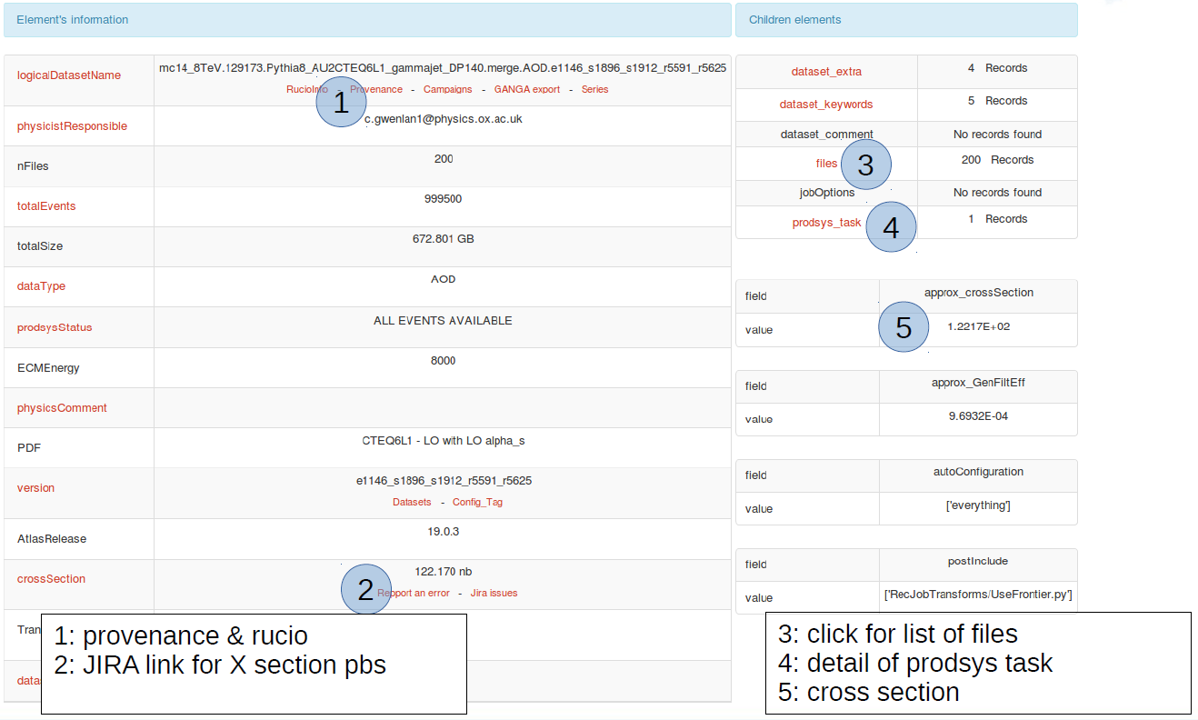
AMI WebUI - 2

Slide 41
Rucio (ATLAS Data Management System)

Slide 42
Basic concepts - 1
Data Management System for Run-2 in ATLAS distributed computing system
  Used to download outputs of Grid jobs, moving data and searching for them
Rucio CLI tools from CVMFS
  Web interface provides similar functionality

Slide 43
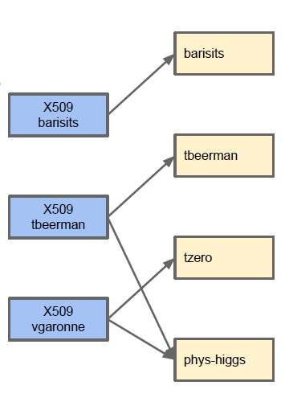
Basic concepts - 2
Accounts
  A Rucio Account can represent users, groups (phys-susy) or activities (panda, tzero)
  Quota and permissions are associated to an account
  One can connect to a Rucio account using X509 certificates/proxies, Kerberos
  One credential can be used to map to different accounts.

Slide 44
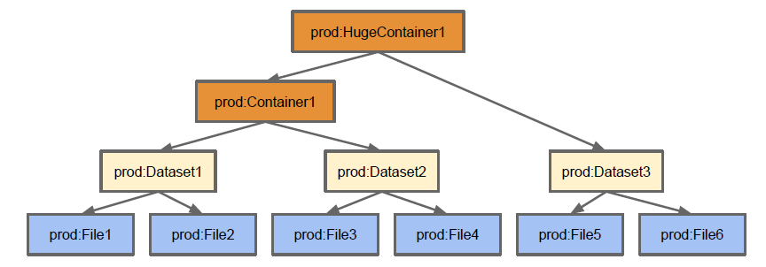
Basic concepts - 3
Rucio namespace
  3 types of Data Identifiers (DIDs): File, Datasets, Containers.
    Dataset: Collection of Files
    Containers: Collection of Datasets or Containers
  The namespace is divided using scopes. A name is unique within a scope but can be used in other scopes. A DID is identified by a scope and a name

Slide 45
Hands-on exercise list DIDs
A data Identifier is found by name and scope
## To list all DIDs within a scope
rucio list-dids user.gkawamur:*
+------------------------------------------------------------+--------------+
| SCOPE:NAME | [DID TYPE] |
|------------------------------------------------------------+--------------|
| user.gkawamur:user.gkawamur.pruntest_7168.log | CONTAINER |
| user.gkawamur:user.gkawamur.tut.helloworldathena.test.log | CONTAINER |
| user.gkawamur:user.gkawamur.20160323144306.1.log | CONTAINER |
| user.gkawamur:user.gkawamur.tutorial.grid.deriv.test1.log | CONTAINER |
| user.gkawamur:user.gkawamur.pruntest_14222.log | CONTAINER |
## Using filters (search)
rucio list-dids data16_13TeV:* --filter type=DATASET,datatype=AOD
+-----------------------------------------------------------------------------------------------------------------+--------------+
| SCOPE:NAME | [DID TYPE] |
|-----------------------------------------------------------------------------------------------------------------+--------------|
| data16_13TeV:data16_13TeV.00293572.physics_CosmicCalo.merge.AOD.x387_m1554 | DATASET |
| data16_13TeV:data16_13TeV.00297447.physics_Standby.merge.AOD.x416_m1583 | DATASET |
| data16_13TeV:data16_13TeV.00297041.physics_Main.merge.AOD.f686_m1583 | DATASET |
| data16_13TeV:data16_13TeV.00297041.physics_CosmicCalo.merge.AOD.f686_m1583 | DATASET |
| data16_13TeV:data16_13TeV.00297041.physics_ZeroBias.merge.AOD.f686_m1583 | DATASET |

Slide 46
Hands-on exercise show metadata
## Showing metadata of a dataset
rucio get-metadata data16_13TeV:data16_13TeV.00303819.physics_Main.merge.AOD.f716_m1620
purge_replicas: None
campaign: None
is_new: None
is_open: False
closed_at: 2016-07-18 07:39:44
deleted_at: None
availability: AVAILABLE
eol_at: None
guid: None
panda_id: None
provenance: None
accessed_at: 2016-09-19 22:00:22
version: f716_m1620
scope: data16_13TeV
hidden: False
md5: None
events: 25475721
adler32: None
complete: None
lumiblocknr: None
monotonic: False
updated_at: 2016-09-19 22:00:42
obsolete: False
transient: None
did_type: DATASET
suppressed: True
expired_at: None
stream_name: physics_Main
account: tzero
run_number: 303819
name: data16_13TeV.00303819.physics_Main.merge.AOD.f716_m1620
task_id: None
datatype: AOD
created_at: 2016-07-17 04:17:53
bytes: 6462688464808
project: data16_13TeV
length: 2595
prod_step: merge
phys_group: None

Slide 47
Hands-on exercise list replicas
## Listing dataset replicas
rucio list-dataset-replicas data16_13TeV:data16_13TeV.00303819.physics_Main.merge.AOD.f716_m1620
DATASET: data16_13TeV:data16_13TeV.00303819.physics_Main.merge.AOD.f716_m1620
+---------------------+---------+---------+
| RSE | FOUND | TOTAL |
|---------------------+---------+---------|
| CERN-PROD_TZDISK | 2567 | 2595 |
| GRIF-LPNHE_DATADISK | 2595 | 2595 |
| IN2P3-CC_DATADISK | 2595 | 2595 |
| CERN-PROD_DERIVED | 2595 | 2595 |
+---------------------+---------+---------+

Slide 48
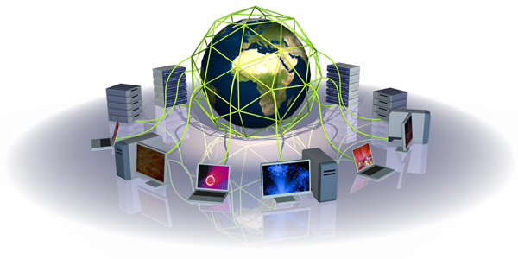
Introduction to World LHC Computing Grid

Slide 49
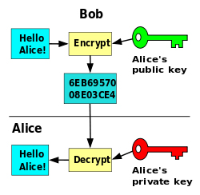
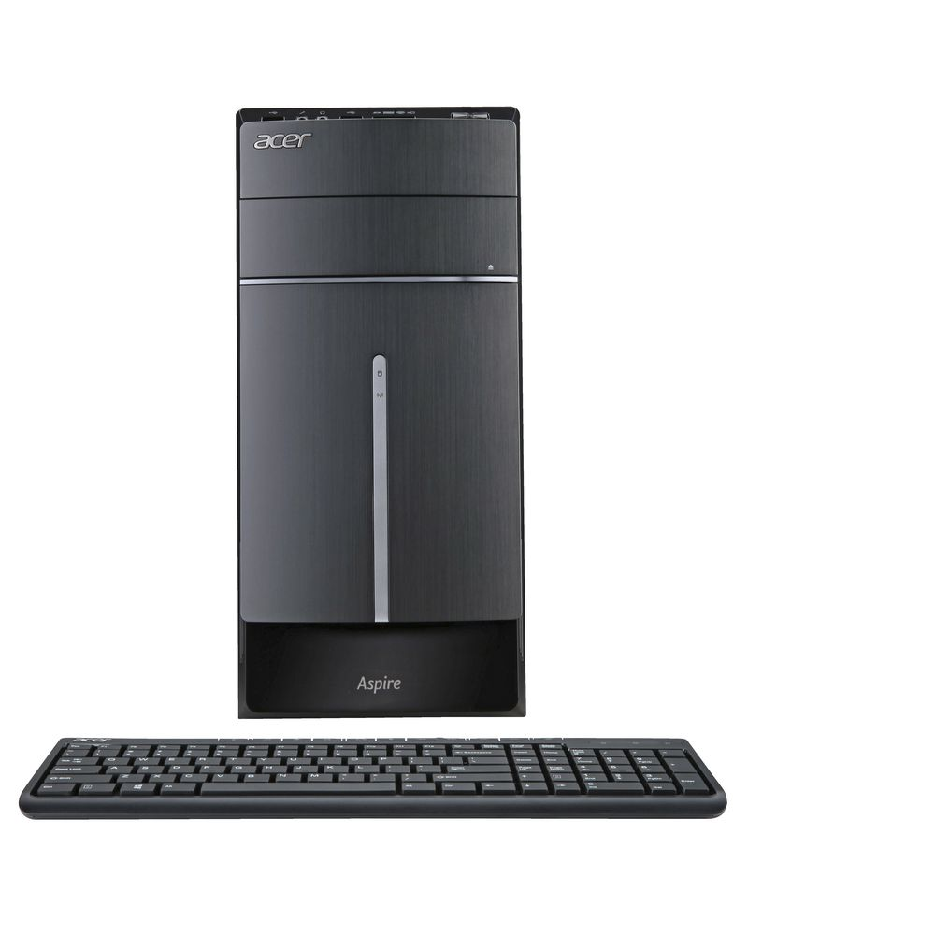
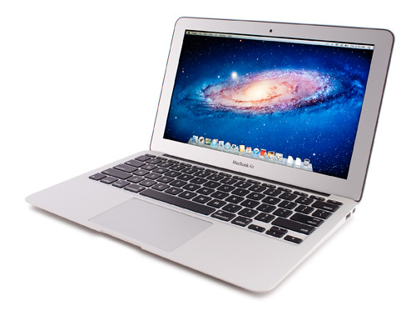
Concepts - 1
How it works (without Grid)
  Only PKI by openssl -> a simplest way
$ scp my_analysis.exe computer01:~/
$ ssh computer01 “~/myprogram.exe run 01”
$ scp computer01:output01.tgz ./output01.tgz
$ scp output01.tgz storage02:output01.tgz
Computation
Storage
my_analysis.exe
1. COPY
2. RUN
3. DOWNLOAD
output01.tgz
4. STORE

Slide 50
Concepts - 2
How it works (with Grid)
  Need of basic stuffs
    Security policy based on PKI
    Working with many users (physicists)
    Recognition of users in affiliation, organization and experiment
    Control of Job allocation
    Control of storage space allocation and data replication
    Control among geographically distributed computers
    Interface of local computing infrastructures
    Tree-like information search for computing clusters
      E.g. like Domain Name Server
    End user tools to make life easy

Slide 51
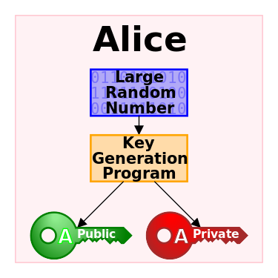

Concepts - 3
Then, hierarchical signatures
CA1
Sign
CA2
Sign
My X509 Certificate
= Grid user certificate

Slide 52
Concepts - 4
Generating a new certificate = proxy certificate
Proxy certificate (with limited validity)
Verifiable
CA1
Sign
Generating primary numbers + Signed by you + PK
CA2
Sign
My X509 Certificate
= Grid user certificate

Slide 53

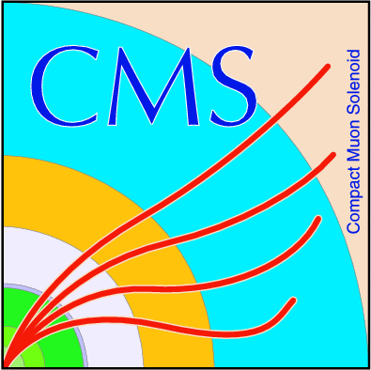
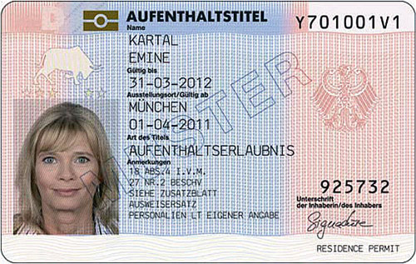


Concepts - 5
Virtual Organization (VO), VOMS
  VOMS extends a certificate with a VO
VOs
Certificate Authority
VOMS server
Requesting VO
voms-proy-init
Sign
ATLAS VOMS
CMS VOMS
LHCb VOMS
User certificate
Sign
Obtaining VO extension
Proxy certificate
= a limited copy of your certificate

Slide 54

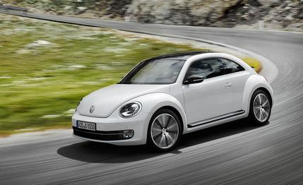
Concepts - 6
A similar analogy
  Authenticated and authorized for your tasks
Certificate Authority
Controlled
Sign
User certificate
Authentication
= who you are?
Authorization
= can enter a new land (Grid)
Sign
Proxy certificate
= a limited copy of your certificate

Slide 55
ATLAS Grid job - 1
LHC multi-tier structure
      WLCG = Worldwide LHC Computing Grid
Tier-0
RAL UK
Tier-1
Tier-0: Raw data, Data store (in tape), Pre-processing, Reconstruction
FZK DE
Tier-1
Tier-1: National LCG-Centre, faster network connections and lager storage spaces (e.g. Tape), MC production, user analysis, etc.
BNL USA
Tier-1
Goe DE
Tier-2
DESY-HH DE
Tier-2
Tier-2: University or Facility level computing sites. MC production, user analysis, etc.

Slide 56
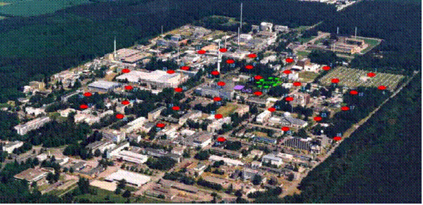


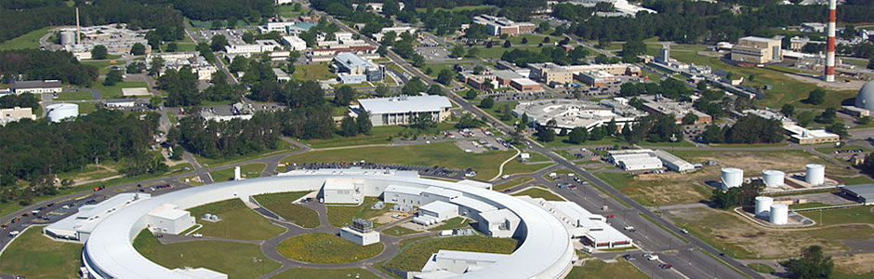

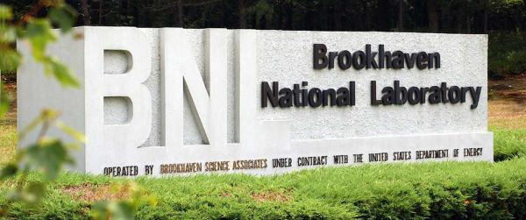
ATLAS Grid job - 1
FZK Tier-1
BNL Tier-1

Slide 57
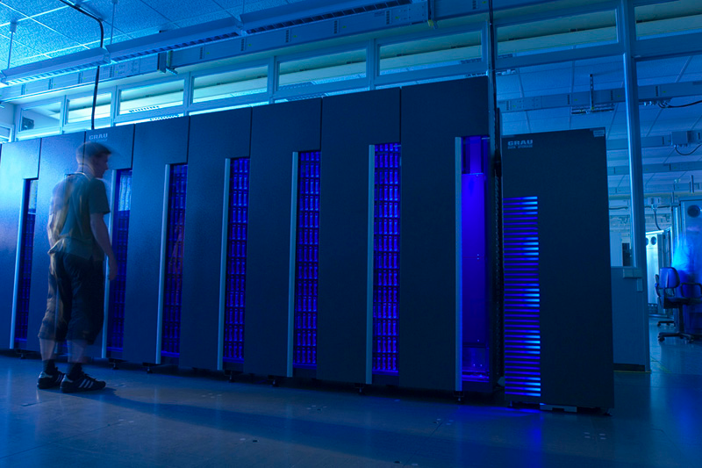
ATLAS Grid job - 1
FZK Tier-1
Job queue endpoint
Computing resources
FZK Computing centre
Storage spaces
DDM endpoint
Protocols: srm, gridftp, https, xroot
DDM = Distributed Data Management

Slide 58
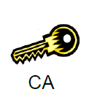

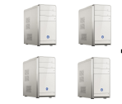
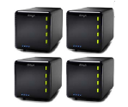
ATLAS Grid job - 2
How do they work?
Job Status
Site A
Information Provider
ATLAS PanDA
Panda Queue A
UI
Distributed job
management
CE
Rucio DDM
SE
Panda Queue B
Site B

Slide 59
ATLAS Grid job - 3
How do they work?
Job Status
Site A
Information Provider
ATLAS PanDA
Panda Queue A
Pilots
UI
Distributed job
management
CE
Rucio DDM
SE
Pilots
Panda Queue B
Site B

Slide 60
ATLAS Grid job - 4
How do they work?
Job Status
Site A
Registered
Defined
voms-proxy
Information Provider
ATLAS PanDA
Waiting when site & system is ready
Pilots
UI
Job submission
+ input sandbox
CE
Rucio DDM
SE
Pilots
Site B

Slide 61
ATLAS Grid job - 5
How do they work?
Job Status
Site A
Registered
Defined
Ready
Information Provider
Scheduled
ATLAS PanDA
Panda Queue A
Pilots
UI
Distributed job
management
CE
DDM SE endpoint A
Rucio DDM
Distributed data
management
SE
Data transfers
Pilots
Panda Queue B
Site B
DDM SE endpoint B

Slide 62


ATLAS Grid job - 6
How do they work?
Job Status
Site A
Registered
Defined
Ready
Information Provider
Scheduled
Running
ATLAS PanDA
Panda Queue A
Running!
UI
Distributed job
management
CE
DDM SE endpoint A
Analysis data
Rucio DDM
Distributed data
management
SE
Panda Queue B
Site B
DDM SE endpoint B

Slide 63
ATLAS Grid job - 7
How do they work?
Job Status
Site A
Registered
Defined
Ready
Information Provider
Scheduled
Running
ATLAS PanDA
Panda Queue A
UI
Distributed job
management
CE
Prepared
DDM SE endpoint A
Output data
Rucio DDM
Registration
Distributed data
management
SE
Panda Queue B
Site B
DDM SE endpoint B

Slide 64
ATLAS Grid job - 8
How do they work?
Job Status
Site A
Registered
Defined
Ready
Information Provider
Scheduled
Running
ATLAS PanDA
Panda Queue A
Done!
UI
Distributed job
management
CE
Prepared
DDM SE endpoint A
Done
Rucio DDM
Distributed data
management
SE
Panda Queue B
Site B
DDM SE endpoint B

Slide 65
PanDA (ATLAS Job Management System)

Slide 66
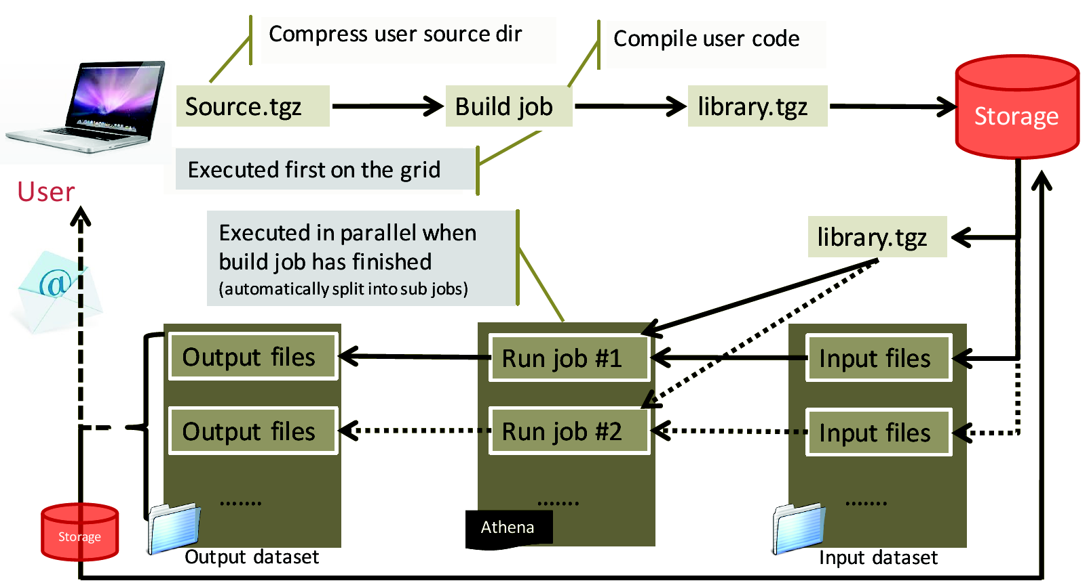
Build job & Run job

Slide 67
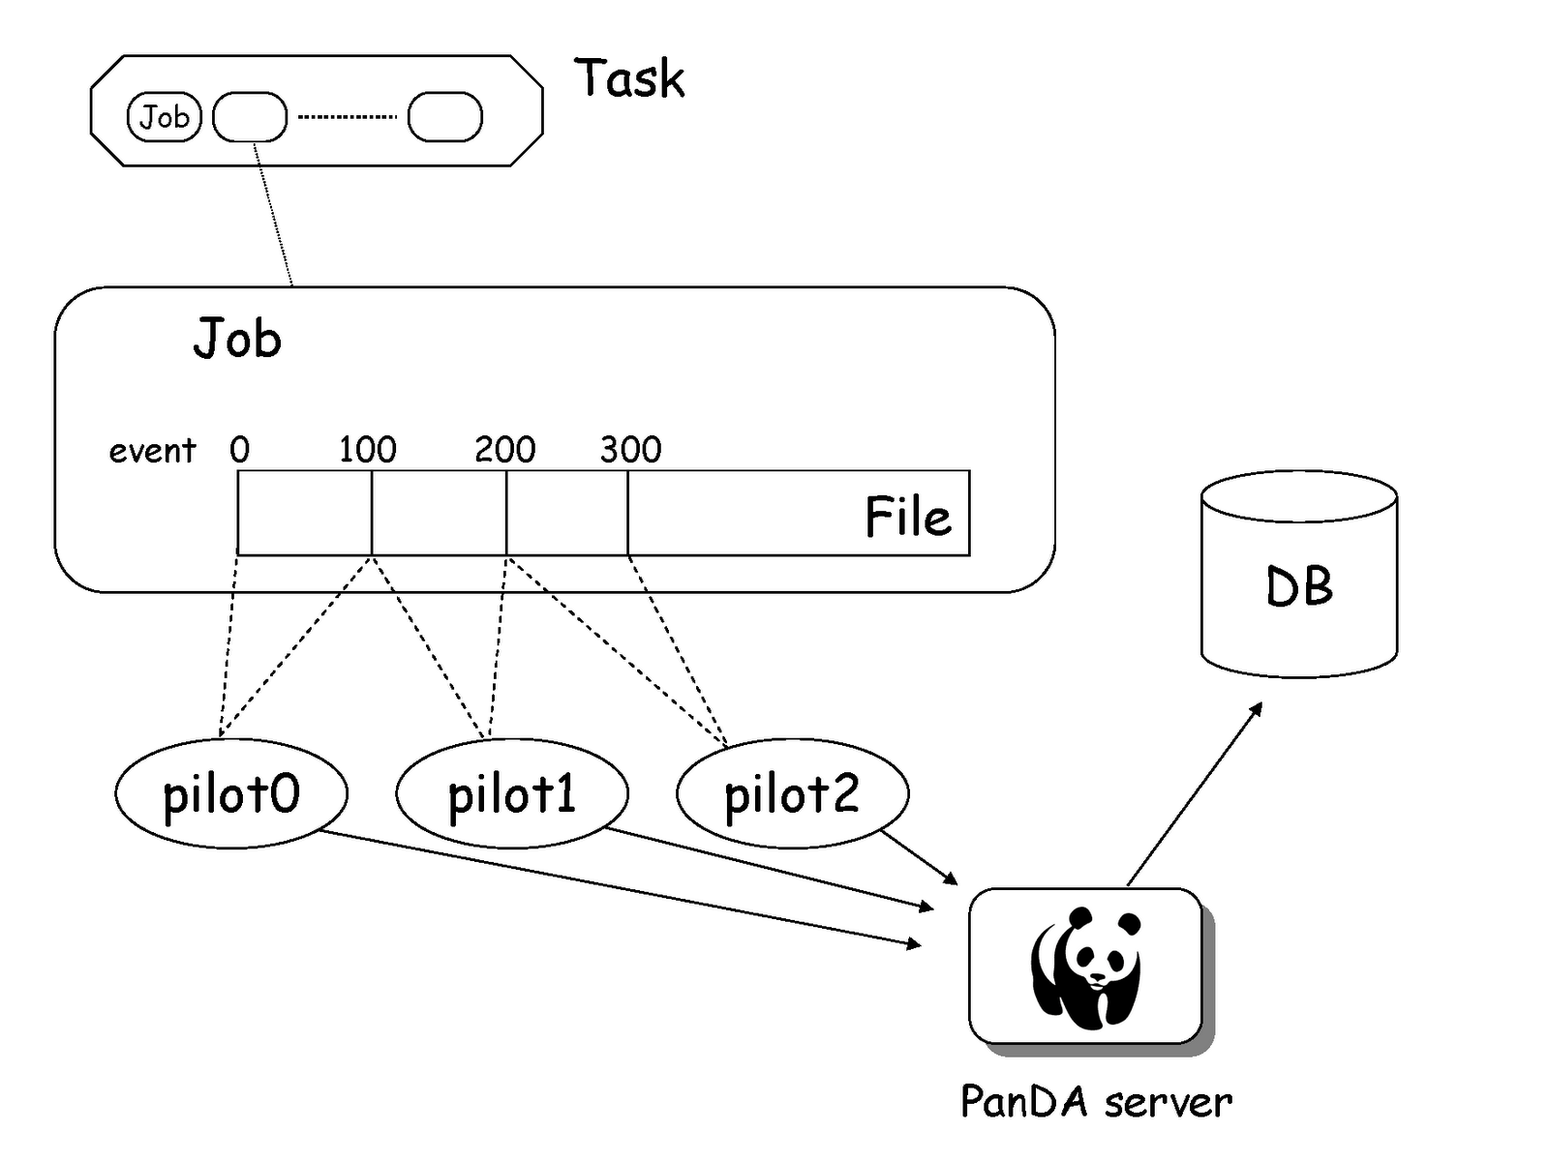
Event level processing
  Task (calculation) can be split by evenl level handler
    Event Level Handler can generate basic pilot jobs according to events in given file(s)

Slide 68
Let's start your hands-on exercise!
To be continued...

Slide 69
Backup

Slide 70

RucioUI (WebUI R2D2)

Slide 71

RucioUI
Move data between RSEs, use Rucio replication rules
Such request can be generated by CLI and UI
The UI tool is the Rucio Rule Definition Droid (R2D2) https://rucio-ui.cern.ch/r2d2
Basic need: X509 certificate in your browse

Slide 72

RucioUI: Select DIDs - 1
Data transfers (R2D2) → Request new rule
Enter if you have a dataset list
Wild card query by Rucio expression

Slide 73

RucioUI: Select DIDs - 2
E.g. a wild card pattern
  “data15_13TeV.*.physics_Main.merge.DAOD_SUSY1.*”
metadata
Select the DIDs you want to replicate

Slide 74

RucioUI: Select DIDs - 3
Metadata

Slide 75

RucioUI: select a RSE - 1
Find your destination space

Slide 76

RucioUI: select a RSE - 2
SCRATCHDISKs in Germany
  cloud=DE&type=SCRATCHDISK
RSE expression
RSE expression (e.g. to Göttingen)
List of RSEs

Slide 77

RucioUI: select options
A grouping definition of how the replica will be distributed
Use if you select files randomly

Slide 78

Rucio UI: Transfer status
Go to top page and see your transfer activity
  https://rucio-ui.cern.ch/r2d2

