Slide 1
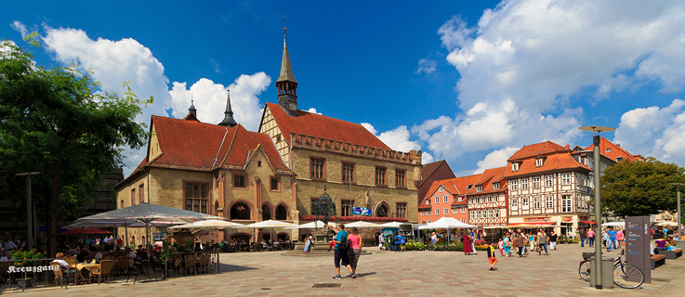



S44: High Energy Physics Big Data and the ATLAS experiment with a hands-on tutorial - 2
Data Science School Göttingen on 21.07.2017
Gen Kawamura
II.Physikalisches Institut, Universität Göttingen

Slide 2
Overview of Hands-on (30-40 mins)
Let's start Hands-on
  Your Grid environments
  Hello World AMI (ATLAS Metadata Interface)
  Hello World Athena job
  Hello World PyRoot
    Plot of electron Pt distribution
  Hello World prun Grid job
  Hello World PyRoot Grid job

Slide 3




Your Grid environments

Slide 4
VMs at Göttingen University
Loging in your VM
## USE your user account
ssh ...@...VM

Slide 5
Prepare your environments
Reading ATLAS environments from CVMFS
## Cloning materials
$ cd
$ git clone https://github.com/GenKawamura/DataScienceSummerSchool_ATLAS_2017
$ cd DataScienceSummerSchool_ATLAS_2017

Slide 6
Setup CVMFS
Reading ATLAS environments from CVMFS
## Alias to setupCVMFS
setupCVMFS(){
export LCG_LOCATION=
export ATLAS_LOCAL_ROOT_BASE=/cvmfs/atlas.cern.ch/repo/ATLASLocalRootBase
source $ATLAS_LOCAL_ROOT_BASE/user/atlasLocalSetup.sh ""
## Using EMI LCG package
source ${ATLAS_LOCAL_ROOT_BASE}/packageSetups/atlasLocalEmiSetup.sh --emiVersion ${emiVersionVal}
}
## Or, use a script
. setupATLASHandsOn.sh
## Using CVMFS (with EMI LCG client tools)
setupCVMFS

Slide 7
Hands-on exercise grid certificate
Checking your certificate and VO
## Copying a proxy certificate
export X509_USER_PROXY=/tmp/x509_cert_$UID
cp -v grid_proxy $X509_USER_PROXY
chmod 600 $X509_USER_PROXY
## Check your VOMS proxy
voms-proxy-info -all
## Read X509 attributes if you are interested
openssl x509 -in $X509_USER_PROXY -text | less

Slide 8

How it works
You get a temporary key of a door now

Slide 9
Hello World AMI (ATLAS Metadata Interface)

Slide 10
Hands-on exercise pyAMI Interface
AMI CLI interface
## Loading the pyAMI environment
$ lsetup pyami
## Search data of 2016 and period A1
$ ami list datasets data16_13TeV%periodA1.%
data16_13TeV.periodA1.physics_Main.PhysCont.AOD.t0pro20_v01
data16_13TeV.periodA1.physics_Main.PhysCont.DAOD_STDM2.grp16_v01_p2623
data16_13TeV.periodA1.physics_Main.PhysCont.DAOD_STDM4.grp16_v01_p2623
data16_13TeV.periodA1.physics_Main.PhysCont.DAOD_STDM5.grp16_v01_p2623
data16_13TeV.periodA1.physics_Main.PhysCont.DAOD_STDM7.grp16_v01_p2623

Slide 11
Hands-on exercise check metadata by pyAMI
## Show metadata of a dataset
$ ami show dataset info data16_13TeV.00284285.physics_Main.merge.AOD.f662_m1453_r8067_p2645
logicalDatasetName : data16_13TeV.00284285.physics_Main.merge.AOD.f662_m1453_r8067_p2645
nFiles : 0
totalEvents : 0
totalSize : NULL
runNumber : 284285
period : J6
prodsysStatus : NO EVENTS YET
dataType : AOD
beamType : NULL
conditionsTag : NULL
geometryVersion : NULL
streamName : physics_Main
version : f662_m1453_r8067_p2645
lastModified : 2016-06-09 18:35:05
amiStatus : VALID
created : 2016-06-09 18:35:04
inContainer : 0
added_comment : NULL
keyword : NULL
prodsysIdentifier_0: 8650873
taskStatus_0 : UNKNOWN:METADATA ERROR
TIDState_0 : added
task_lastModified_0: 2016-06-10 09:24:25

Slide 12
Hands-on exercise check metadata by pyAMI
## Show RAWs
$ ami show dataset prov data16_13TeV.00284285.physics_Main.merge.AOD.f662_m1453_r8067_p2645
...

Slide 13
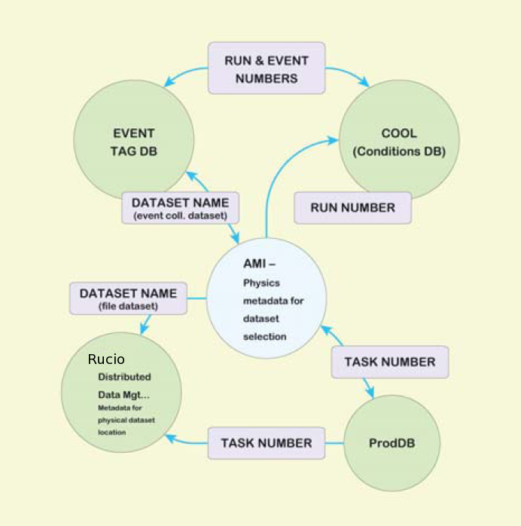
How it works
Applications
  The Monte-Carlo Dataset Number Broker
  The ATLAS Metadata directory
  Tag collector
ProdDB
  For Monte-Carlo simulation
S. Albrand, T. Doherty, J. Fulachier, F. Lambert. The ATLAS Metadata Interface. Interna-tional Conference on Computing in High Energy and Nuclear Physics (CHEP-07), Sep 2007, Victoria, Canada. IOP Publishing, 120, pp.072003, 2008, <10.1088/1742-6596/120/7/072003>. <in2p3-00192624>

Slide 14
Hello World Athena Job

Slide 15
Hands-on exercise simple Athena job
Only 5 events by Pythia MC generator
## Setup an Athena release
$ asetup 17.2.4,here,setup
## Run Pythia MC event generator
$ athena ajob_options/jobOptions.pythia16.py

Slide 16
Do not need this exercise, but it works on Grid as well
Athena job by PanDA client
  pathena
## Loading PanDA client
$ lsetup panda
## For example, you can seamlessly run Athena code on Grid
$ pathena ajob_options/jobOptions.pythia16.py --outDS=user.gkawamur.evgen.pool.pythia.v1.$$ --split 5

Slide 17
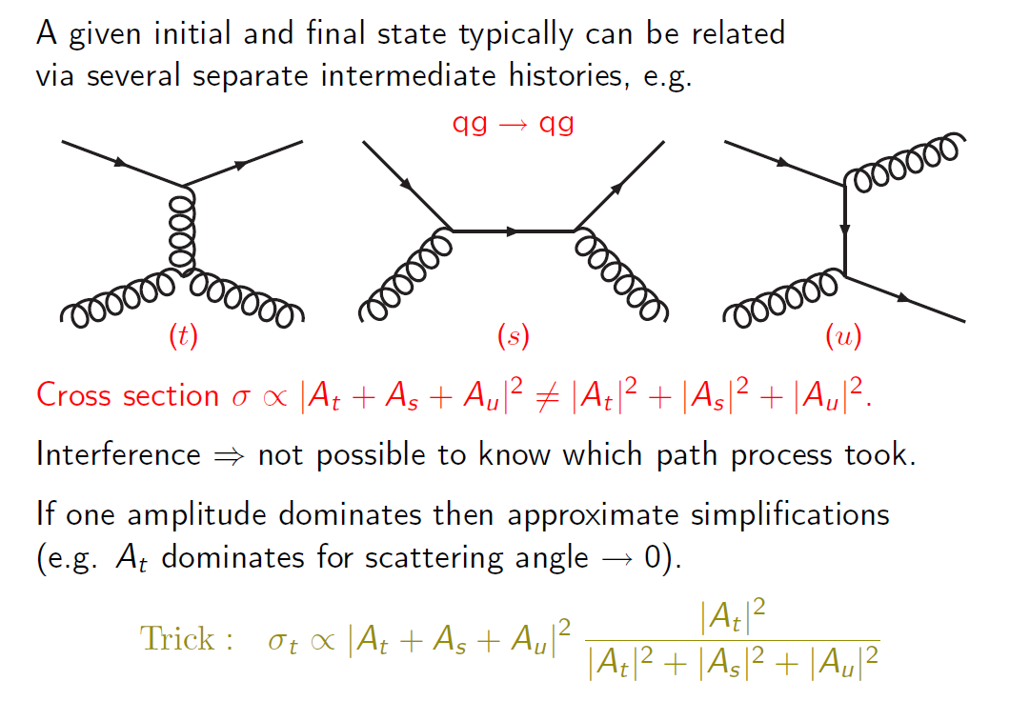
How it works - 1
Quantum mechanics
  Each event is depending on event probability

Slide 18
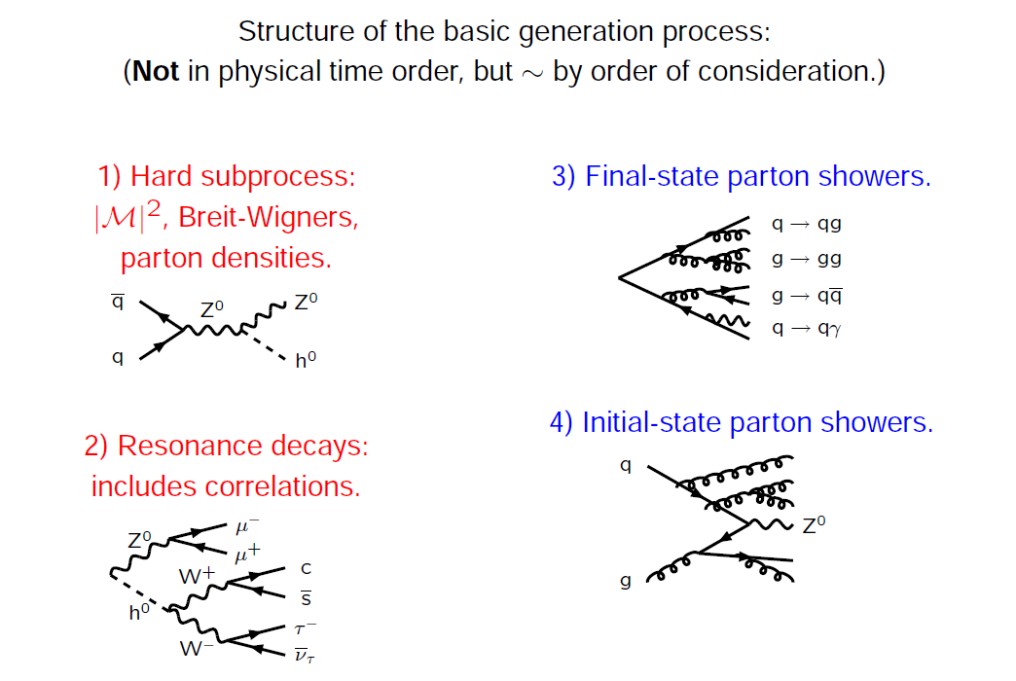
How it works - 2
The main physics components

Slide 19
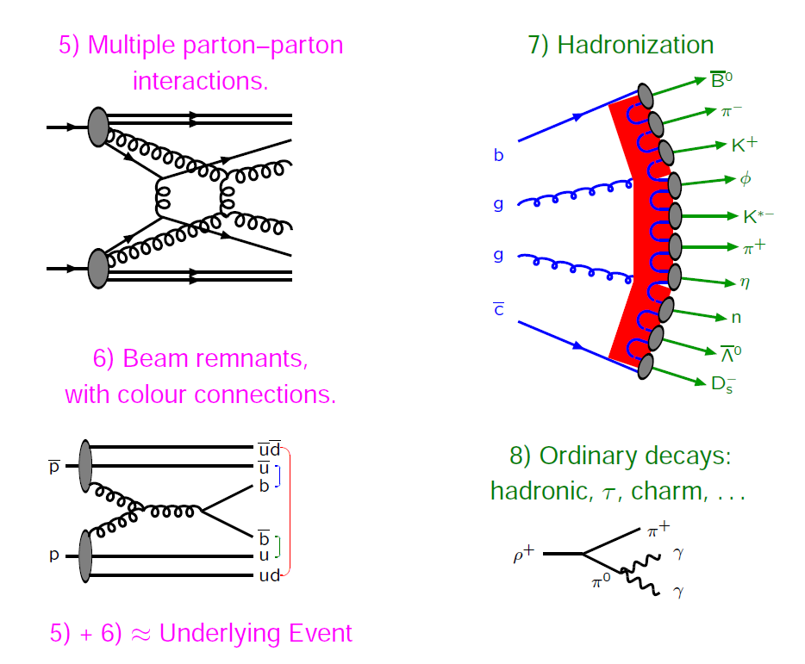
How it works - 3
The main physics components

Slide 20
Hello World PyRoot

Slide 21
Hands-on exercise
PyRoot example
## Making PyRoot environments
$ cd pyroot
$ source pyroot_env.sh
## Getting a sample
$ ./get-sample-files.sh -n 1
$ ls valid2.117050.PowhegPythia_P2011C_ttbar.digit.AOD.e2657_s1933_s1964_r5534/* > input.txt
## Extracting and counting electron energy
$ less xAOD_electron_hist_example.py
$ ./xAOD_electron_hist_example.py -i input.txt -o hist.root
## Plotting electron energy distribution. (this may not work in VMs)
$ root hist.root
root [1] TBrowser t

Slide 22
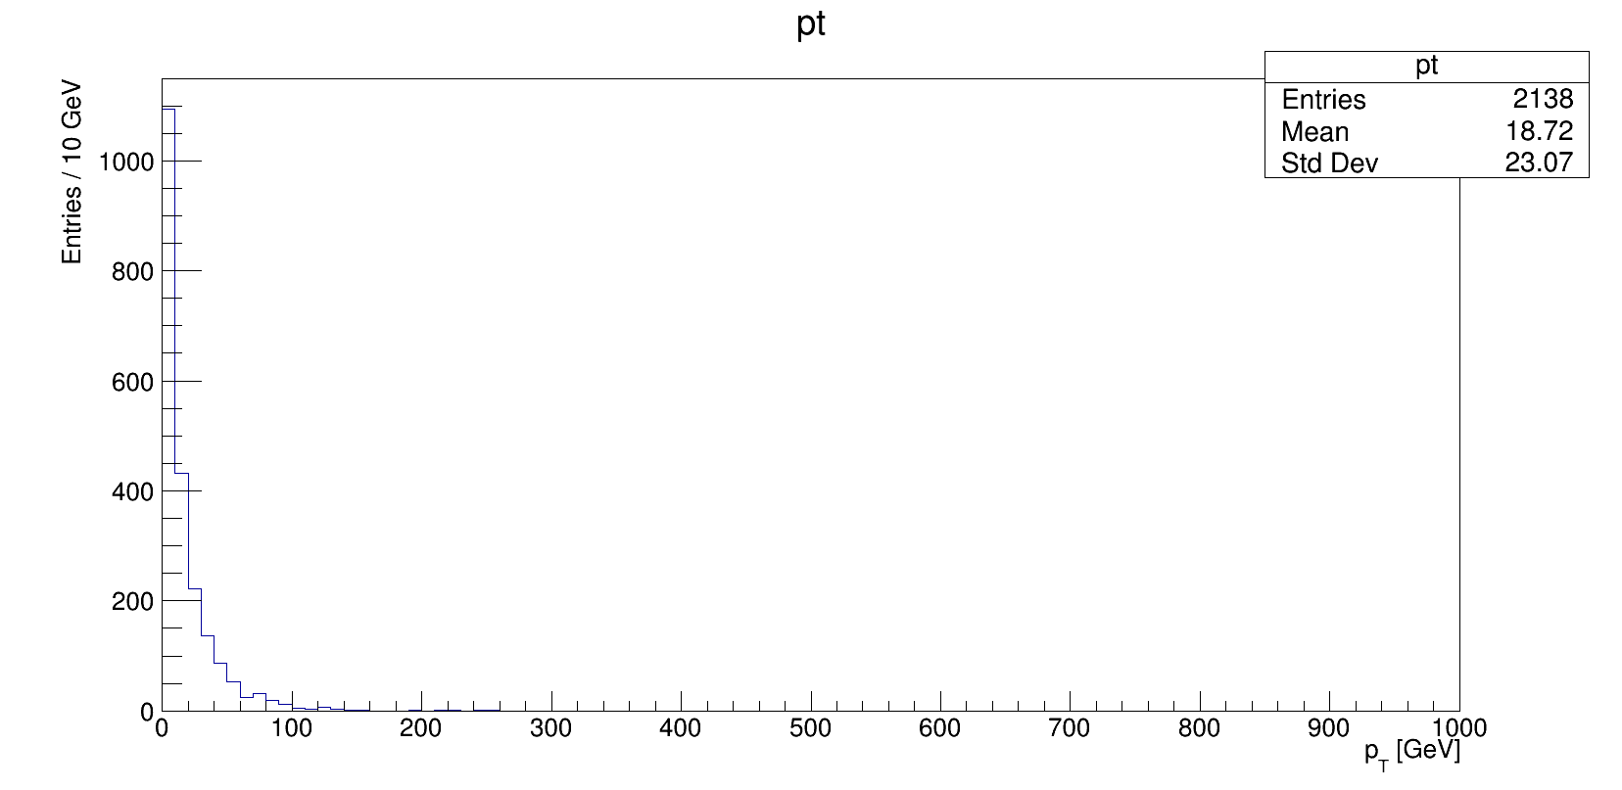
Plot of electron Pt distribution

Slide 23
How it works
Just looping entries (events) in a Root tree and counting electron Pt in histogram object
* xAOD_electron_hist_example.py
# Make the "transient tree":
t = ROOT.xAOD.MakeTransientTree( f, treeName)
print( "Number of input events: %s" % t.GetEntries() )
for entry in xrange( t.GetEntries() ):
t.GetEntry( entry )
print( "Processing run #%i, event #%i" % ( t.EventInfo.runNumber(), t.EventInfo.eventNumber() ) )
print( "Number of electrons: %i" % len( t.ElectronCollection ) )
# loop over electron collection
for el in t.ElectronCollection:
pthist.Fill(el.pt()/1000.)
pass # end for loop over electron collection
pass # end loop over entries
f.Close()
pass

Slide 24
Hello World prun Grid Job

Slide 25
Hands-on exercise
Using ATLAS client tools
First “Hello world” job by PanDA client
## PanDA client
lsetup panda
## Make a Python script
cat hello_world.py
#!/usr/bin/python
print "Hello world!"
chmod 755 hello_world.py
./hello_world.py
Hello world!
## Submitting a prun job
prun --outDS user.gkawamur.pruntest.$$ --exec hello_world.py
INFO : gathering files under /home/gen/tmp/for_new_comer
INFO : upload source files
INFO : submit
INFO : succeeded. new jediTaskID=5107461
## Submitting 5 prun jobs
prun --outDS user.gkawamur.pruntest.$$ --exec hello_world.py –nJobs=5

Slide 26
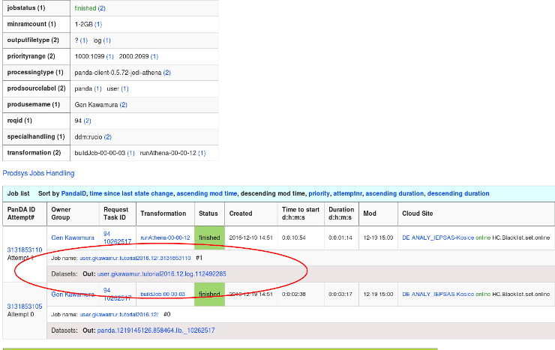
What will happen?
On PanDA web interface, we can find the jobs

Slide 27
Hello World PyRoot Grid Job

Slide 28
Hands-on exercise
PyRoot with Grid
First “Hello world” PyRoot job by PanDA client
## Making PyRoot environments
$ inDS="valid2.117050.PowhegPythia_P2011C_ttbar.digit.AOD.e2657_s1933_s1964_r5534"
$ outDS="user.gkawamur.DStutorial.pyroot.xAOD.v0.1_$$"
$ infile="input.txt"
$ outfile="hist.root"
$ prun --useRootCore --inDS=$inDS --forceStaged \
--outDS=$outDS --outputs=$outfile --nFiles=100 --nFilesPerJob=1 \
--exec="echo %IN > $infile; xAOD_electron_hist_example.py -i $infile -o $outfile"

Slide 29
How it works
Executing a task processing processing events per job (per file)
--inDS (input Dataset)
valid2.117050.PowhegPythia_P2011C_ttbar.digit.AOD.e2657_s1933_s1964_r5534
Task
Job 1
Job 2
Job 3
Job 100
…....
hist.root
--outDS (output Dataset)

