Slide 1
dCache configuration in the WLCG Tier-2, in practice
(for v2.2.4 on SL6.5 64bit, for the ATLAS experiment)
Gen Kawamura
II. Physikalisches Institut, Georg-August-Universität Göttingen
Info

Slide 2
Summary
This slide shows you minimum configuration of workable dCache in the ATLAS WLCG
Important points
  VO role configuration
  Space reservation token (for ATLAS)
  Information provider
  Tuning of PostgreSQL server
  Tuning of RAID devices in disk pool

Slide 3
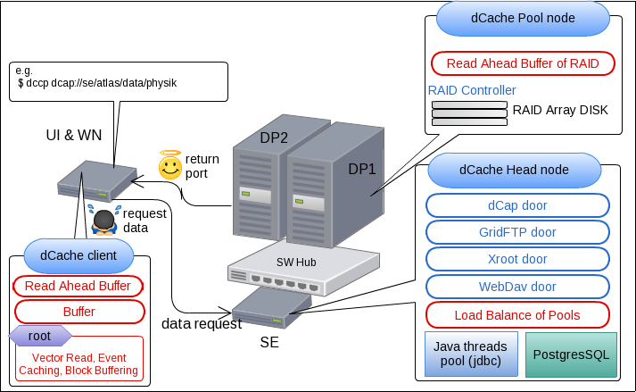
Structure of minimum SE and Pool
Example: 1 SE + 2 Disk pools
  SE = head + doors, Pools = Physical RAID disk nodes

Slide 4
Table of contents
Installing dCache
Postgresql configuration
Information provider in WLCG
ATLAS VO role configuration
dCache disk pool and pool configuration
Space reservation takens in ATLAS
Performance tuning of RAID cards and etc.

Slide 5
Before installing dCache
Disabling YUM, to avoid unnecessary corruption or dependency problems in the future
Installing UMD-2
Installing LCG CA certificate authority files

Slide 6
Disabling YUM and installing UMD2
Run “disable_yum.sh” (download from here)
Deleting dag, Installing epel and UMD2
  EPEL_RPM=epel-release-6-8.noarch.rpm
  UMD_RPM=umd-release-2.0.0-2.el6.noarch.rpm
  [ -e /etc/yum.repos.d/dag.repo ] && rm -v /etc/yum.repos.d/dag.repo
  rpm -e epel-release umd-release
  wget http://dl.fedoraproject.org/pub/epel/6/x86_64/$EPEL_VERSION -O $HOME/$EPEL_RPM
  yum -y install $HOME/$EPEL_RPM
  wget http://repository.egi.eu/sw/production/umd/2/sl6/x86_64/updates/$UMD_VERSION -O $HOME/$UMD_RPM
  yum -y install $HOME/$UMD_RPM
  yum clean all

Slide 7
Installing CA
Activate certificate authority public keys
# Installing EGI CA
yum -y install yum-protectbase ca-policy-egi-core fetch-crl
# activate periodic CRL update
chkconfig fetch-crl-boot on
chkconfig fetch-crl-cron on

Slide 8
Installing dCache on head node
Installing required packages and dCache
  yum -y install java-1.6.0-openjdk-devel ruby
  yum -y install postgresql-server postgresql
  yum -y install bdii glue-schema
  yum -y install dcache-server
Make standard environments with dCache book
  Samples for this slide can be found
    /etc/dcache/dcache.conf
    /etc/dcache/layouts/$(hostname).conf
    /var/lib/dcache/config/poolmanger.conf

Slide 9
PostgreSQL configuration
Basic configurations
  Tuning on auto vacuum
    In /var/lib/pgsql/data/postgresql.conf
      autovacuum = on
  Configuring access right for localhost
    Add following lines to /var/lib/pgsql/pg_hba.conf
      # configuration for dCache chimera and SRM database
      local all all trust
      host all all 127.0.0.1/32 trust
      host all all ::1/128 trust

Slide 10
Information provider
An example of “info-provider.xml” is here
  Add Grid site name and host name to dcache.conf
      SITE_NAME=DE-ATLAS-T2
      echo “info-provider.site-unique-id=$SITE_NAME
      info-provider.se-unique-id=$(hostname -f)
      info-provider.se-name=dcache@$(hostname -f)" >> /etc/dcache/dcache.conf
      ln -s /usr/sbin/dcache-info-provider /var/lib/bdii/gip/provider/dcache-info-provider

Slide 11
ATLAS VO configuration
Creating a proper gplasma.conf in /etc/dcache
  Activate voroemap
  Generate /etc/grid-security/grid-vorolemap
      /usr/sbin/dcacheVoms2Gplasma.py -r -a -c /etc/dcache/dcacheVoms2Gplasma.conf
    An example of dcacheVoms2Gplasma.conf for ATLAS is here
  Appendix: how to generate grid-mapfile
      yum -y install edg-mkgridmap
      edg-mkgridmap --output=/etc/grid-security/grid-mapfile --safe

Slide 12
dCache pool and pool configuration
  Has mounted a physical pool in /pool1 and generating a 100GB pool
    pool_dir=/pool1
    pool_name=dp1.dcache.german-t2.de__dpool1_atlas
    pool_domain=$(hosnname)Domain
    pool_size=100
    /usr/bin/dcache pool create --lfs=precious --size=${pool_size}000000000 ${pool_dir}/${pool_name} $pool_name $pool_domain
  The pool information needs to be defined in head node
    /var/lib/dcache/conf/poolmanager.conf
    psu create pool dp1.dcache.german-t2.de__dpool1_atlas
    psu addto pgroup atlas dp1.dcache.german-t2.de__dpool1_atlas

Slide 13
dCache pool and pool configuration
Making a minimum dCache pool node
  yum -y install java-1.6.0-openjdk-devel ruby
  yum -y install dcache-server
  Edit following files
    /etc/dcache/dcache.conf
    /etc/dcache/layouts/$(hostname).conf

Slide 14
Space reservation token in ATLAS
Creating a directory structure. The typical structure is the followings
    domain=german-t2.de
    vo=atlas, or vo=ops
    dir=/pnfs/${domain}/data/$vo
  Generating atlas dir by chimera-cli
      vo=atlas
      chimera-cli Mkdir $dir
      chimera-cli Chown $dir atlas001
      chimera-cli Chgrp $dir atlas
      chimera-cli Chgrp $dir 775

Slide 15
Space reservation token in ATLAS
Generating tag for pnfs directoy
    echo "STATIC" | chimera-cli Writetag $dir sGroup
    echo "StoreName $vo" | chimera-cli Writetag $dir OSMTemplate
    echo "ONLINE" | chimera-cli Writetag $dir AccessLatency
    echo "REPLICA" | chimera-cli Writetag $dir RetentionPolicy
Making 100GB of a spacetoken “ATLASLOCALGROUPDISK” in admin interface
    ssh -c blowfish -p 22223 admin@localhost <<EOF
    cd SrmSpaceManager
    reserve -vog=$vog -vor=* -acclat=ONLINE -retpol=REPLICA -lg=atlas-link-group -desc=ATLASLOCALGROUPDISK 100GB "-1"

Slide 16
Space reservation token in ATLAS
Generating tag for pnfs directory
    echo "STATIC" | chimera-cli Writetag $dir/atlasgroupdisk sGroup
    echo "StoreName $vo" | chimera-cli Writetag $dir/atlasgroupdisk OSMTemplate
    echo "ONLINE" | chimera-cli Writetag $dir/atlasgroupdisk AccessLatency
    echo "REPLICA" | chimera-cli Writetag $dir/atlasgroupdisk RetentionPolicy
  Adding an explicit spacetoken ID to spacetoken directory
    echo "$spacetoken_id" | chimera-cli Writetag $dir/atlaslocalgroupdisk WriteToken
In head node, a SRM configuration is applied to /etc/dcache/LinkGroupAuthorization.conf
Sample scripts can be found here

Slide 17
Tuning of RAID card in disk pool
One important parameter is “read ahead buffer size” for block devices. This tuning is effective when number of parallel requests is >20.
  e.g. (/dev/dm-0 is a logical RAID disk)
    blockdev –getra /dev/dm-0
    64 MByte (512 Byte * 131072 Blocks) is sufficient
    blockdev –setra 131072 /dev/dm-0

Slide 18
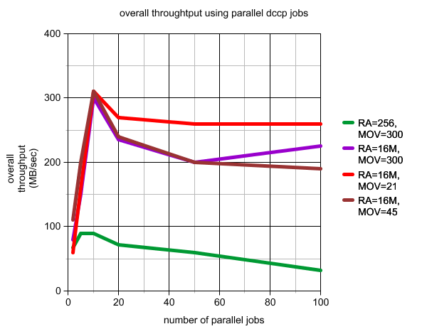
Example of performance tuning
Example: performance with parallel copy jobs

Slide 19
Additional standard tuning
Do not forget to optimize jvm memory
  in /etc/dcache/dcache.conf
    dcache.java.memory.heap=2048m
    dcache.java.memory.direct=2048m
Making performance of PostgreSQL better
  Very typical tuning parameters
    in /var/lib/pgsql/data/postgresql.conf
      max_connections = more than 1000
      shared_buffer = 25% of memory
      effective_cache_size = 50% of memory

