Slide 1
C++ & GDB & Emacs exercise

Slide 2

Debugger
Cheat_GDB.txt
GDB cheatsheet

Slide 3
Short exercise of GDB
Exercise Repository→ cpp_debug
  Clone the code
  Use the above codes and compile them
  Open Emacs
  M-x gdb
  Set a break point
  Run GDB commands

Slide 4
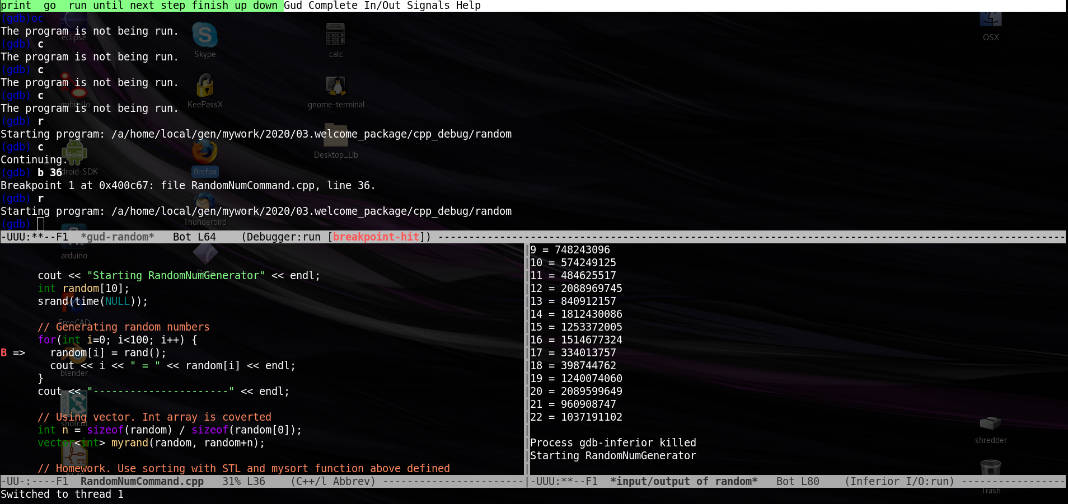

Slide 5
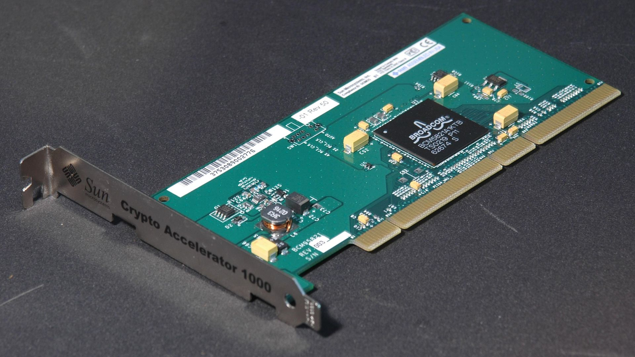
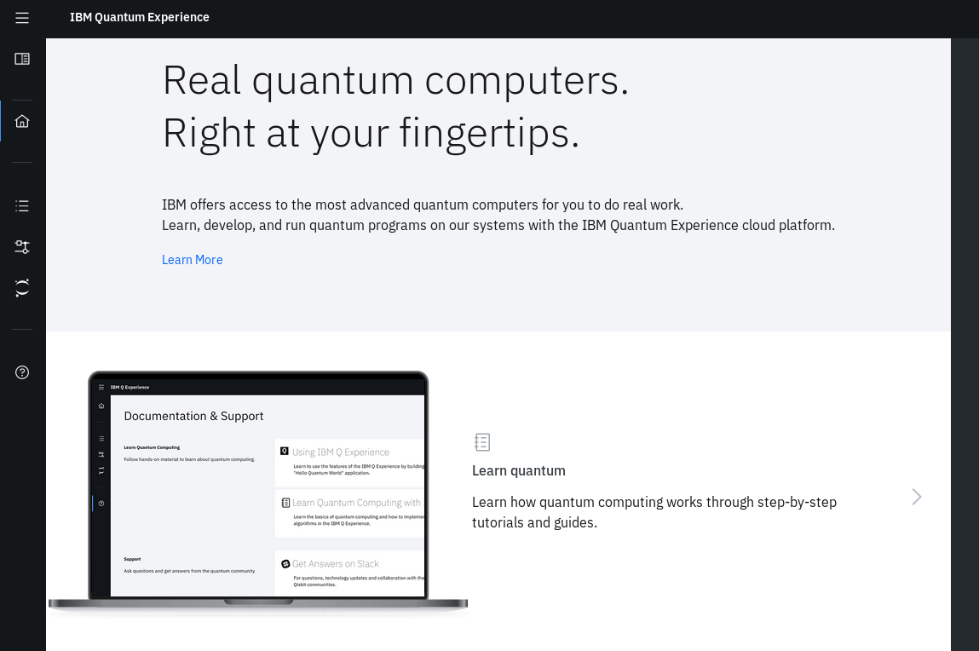
Use-case?
Assessing hardware random number generator
  Pseudo RN is a software
Command receiver
Cloud Quantum Computing thread reader
Command receiver
Thread pool

