Slide 1


Final Demo Day

Slide 2
Team - SoloGen
Member: Gen, Li, Technical University of Munich

Slide 3
Advanced Energy Management System for Utility-Scale Battery Storage
Team SoloGen

Slide 4
OBJECTIVE
Develop an intelligent EMS for a 4.5 MWh BESS to maximize profitability across European electricity markets while managing battery degradation

Slide 5
AGENDA
1. Model and Implementation: 2. Results and Performance: 3. Business Impact: 4. Discussion, Outlook and Conclusion:

Slide 6
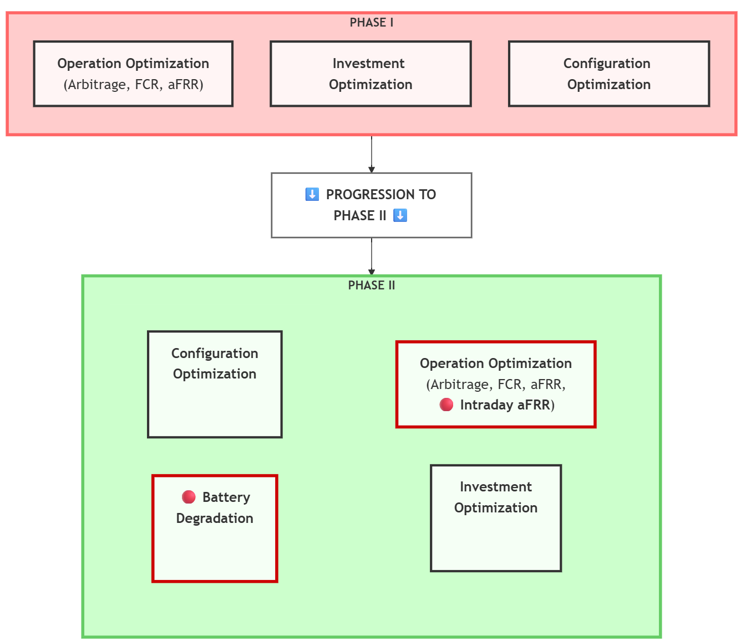
Phase II Deliveries
1. Four-market optimization - Day-ahead energy - FCR capacity - aFRR capacity - aFRR energy 2. Battery degradation modeling - Cyclic aging costs - Calendar aging costs 3. 10-year investment analysis
Battery Specifications
- Capacity: 4,472 kWh
- Efficiency: 95% round-trip
- C-rates: 0.25, 0.33, 0.50
- Daily cycles: 1.0, 1.5, 2.0

Slide 7



Model and Implementation Three-Stage Model Architecture
Model I: Phase I Model + aFRR Energy $$\max{Revenue=P_{DA}+P_{ANCI}+P_{aFRR_{E}}}$$
s.t.
Model II: Model I + Cyclic Aging $$\max{Revenue−αC_{cyclic}}$$
s.t.
Model III: Model II + Calendar Aging $$\max{Revenue}−α(C_{cyclic}+C_{cal}\text{)}$$
s.t.
BESS Physical Rules
Market Rules
Energy Balance
Model I constraints
Cyclic Aging Constraints
BESS Physical Rules
Market Rules
Energy Balance
Model II constraints
Calender Aging Constraints

Slide 8
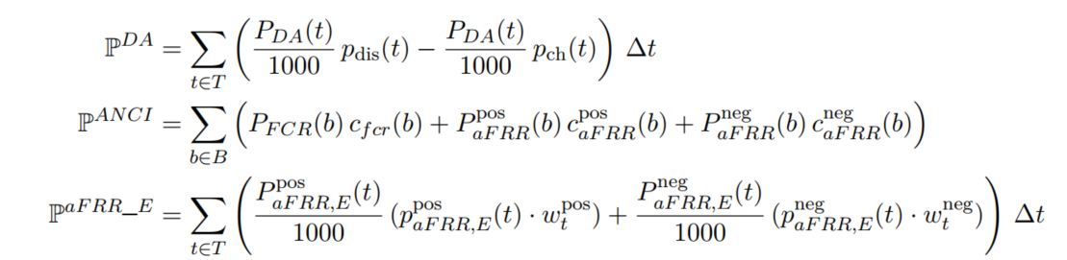
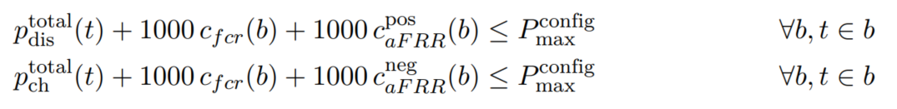

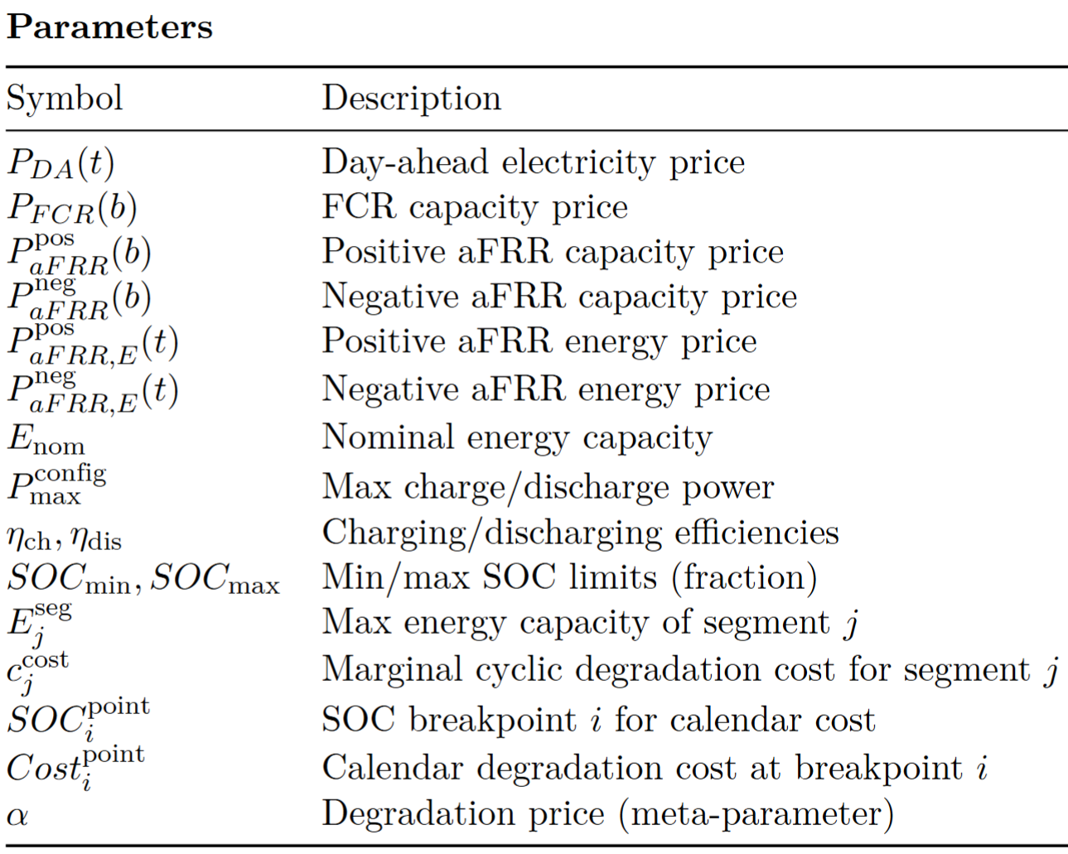
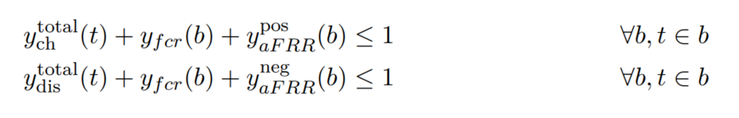
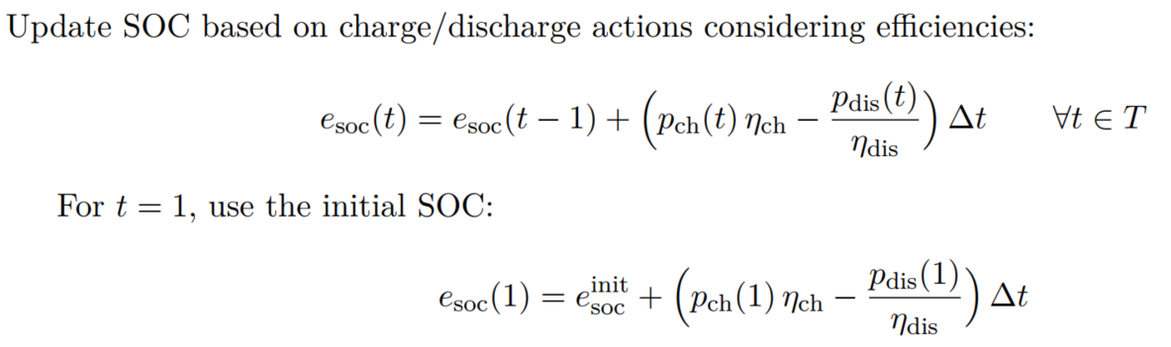
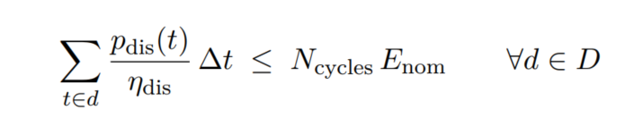
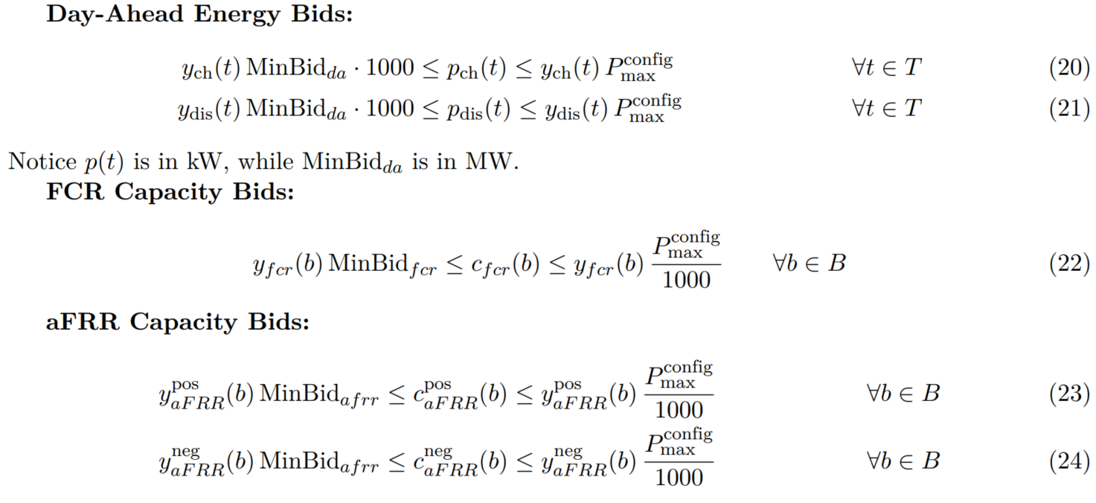
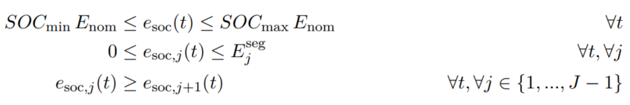
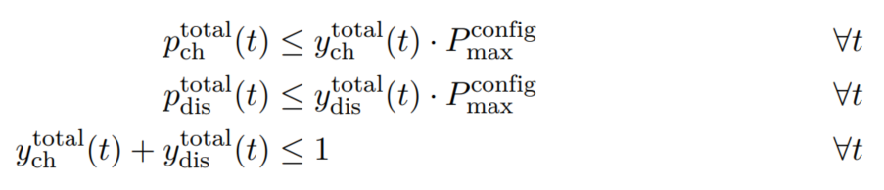
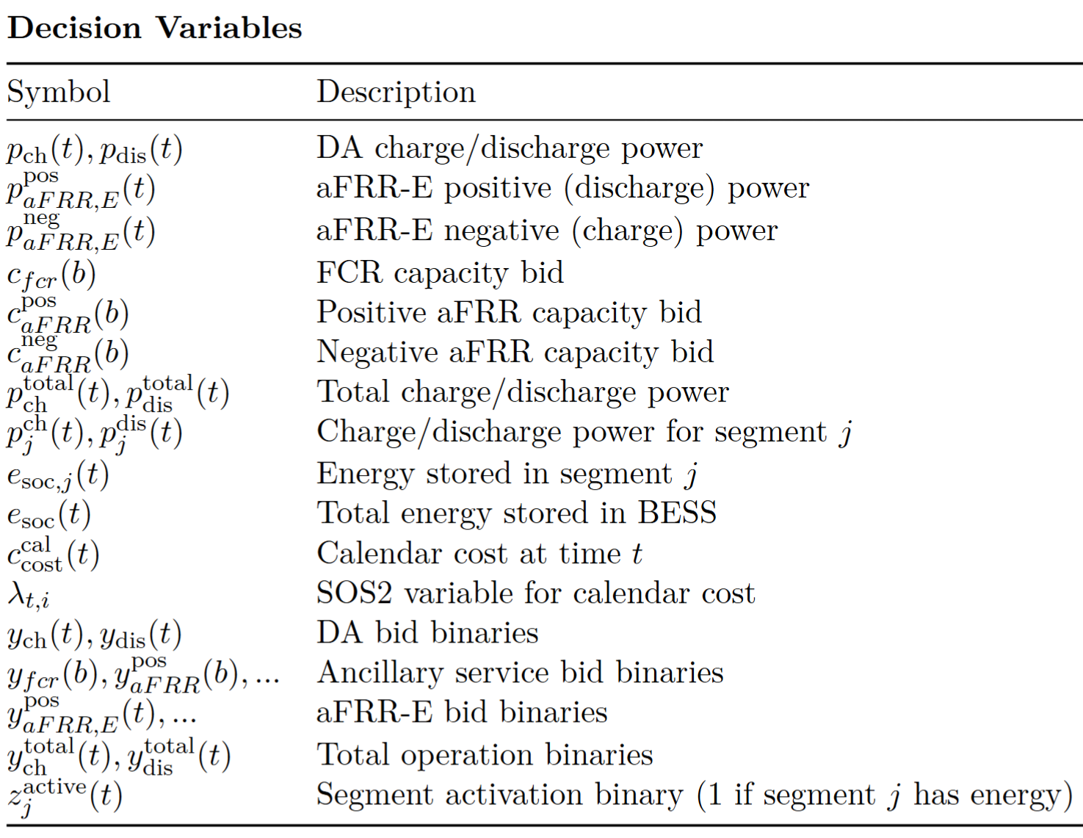
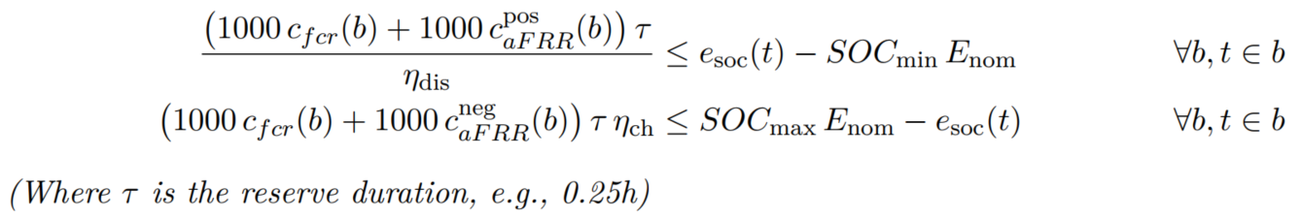

Model and Implementation Three-Stage Model Architecture
Model I: Phase I Model + aFRR Energy $$\max{Revenue=P_{DA}+P_{ANCI}+P_{aFRR_{E}}}$$
Model Components:
(CST-5) Market Co-optimization Power Limits
Objective Function
Components
(CST-6) Cross-Markets Mutual Exclusivity
(CST-7) Daily Cycle Limits
(CST-1) SOC Dynamics (Energy Balance)
(CST-2) SOC Limits
(CST-8) Max/Min Bounds
(CST-3) Prevent Simultaneous Operation
(CST-4) Ancillary Service Energy Reserve

Slide 9

Model and Implementation Three-Stage Model Architecture
Model I: Phase I Model + aFRR Energy $$\max{Revenue=P_{DA}+P_{ANCI}+P_{aFRR_{E}}}$$
s.t.
Model II: Model I + Cyclic Aging $$\max{Revenue−αC_{cyclic}}$$
BESS Physical Rules
Market Rules
Energy Balance
BESS Physical Rules
Market Rules
Energy Balance

Slide 10
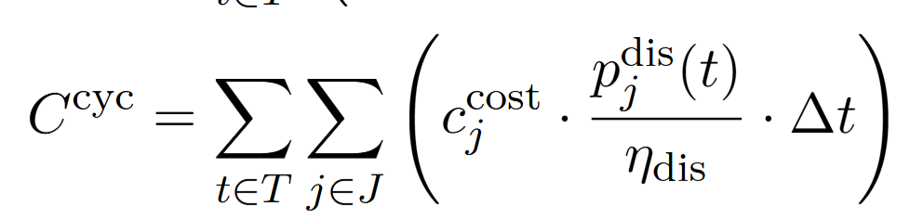
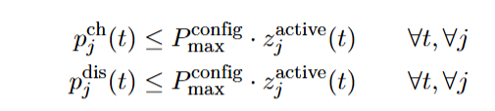
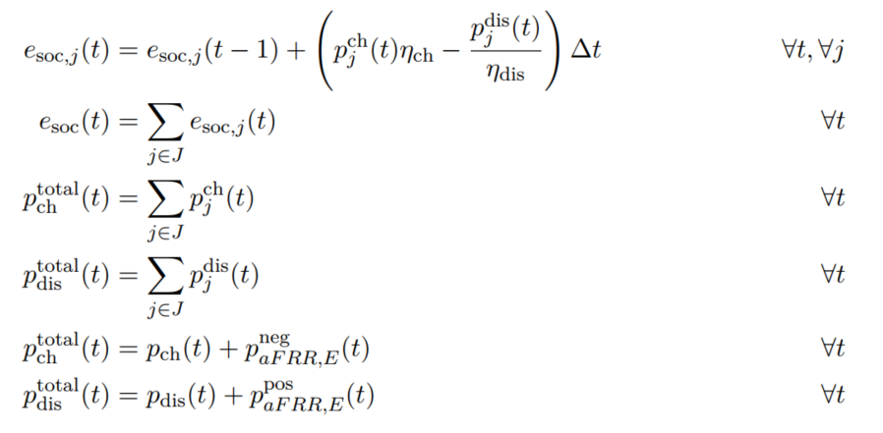
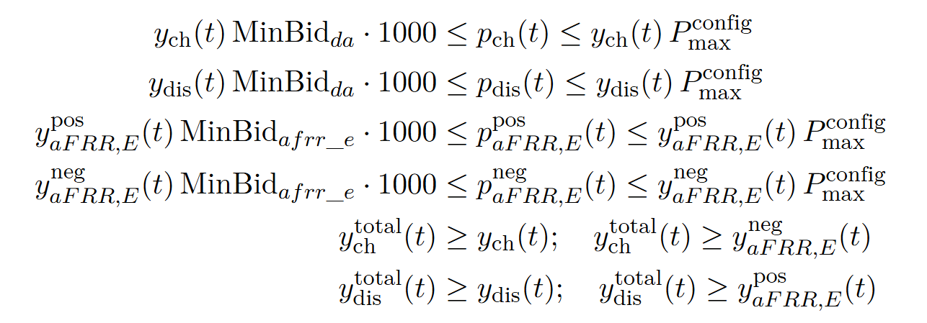
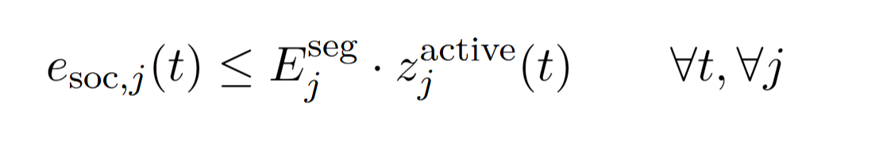
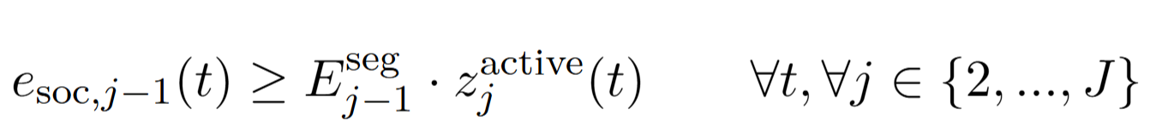
Model and Implementation Three-Stage Model Architecture
Model II: Model I + Cyclic Aging $$\max{Revenue−αC_{cyclic}}$$
(CST-ii-1) Cyclic Aging Cost
(CST-ii-4)
Require BESS energy (dis-)charge sequentially to BESS segments.
(CST-ii-1) Degradation-Aware SOC Dynamics
(CST-ii-5) Min/Max Bounds
BESS Physical Rules
Market Rules
Energy Balance
(CST-ii-2) SOC & Segment Limits
(CST-ii-3)
Require BESS energy is stored sequentially

Slide 11
Model and Implementation Three-Stage Model Architecture
Model II: Model I + Cyclic Aging $$\max{Revenue−αC_{cyclic}}$$
s.t.
Model III: Model II + Calendar Aging $$\max{Revenue}−α(C_{cyclic}+C_{cal}\text{)}$$
s.t.
Model I constraints
Cyclic Aging Constraints
BESS Physical Rules
Market Rules
Energy Balance
Model II constraints
Calender Aging Constraints

Slide 12
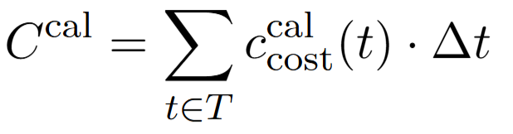
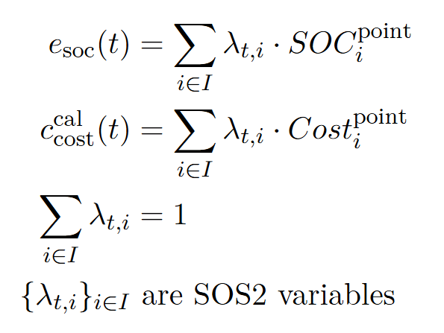

Model and Implementation Three-Stage Model Architecture
Model Components:
Model III: Model II + Calendar Aging $$\max{Revenue}−α(C_{cyclic}+C_{cal}\text{)}$$
Calendar Aging Cost
(CST-7) Calendar Aging PWL Constraints

Slide 13
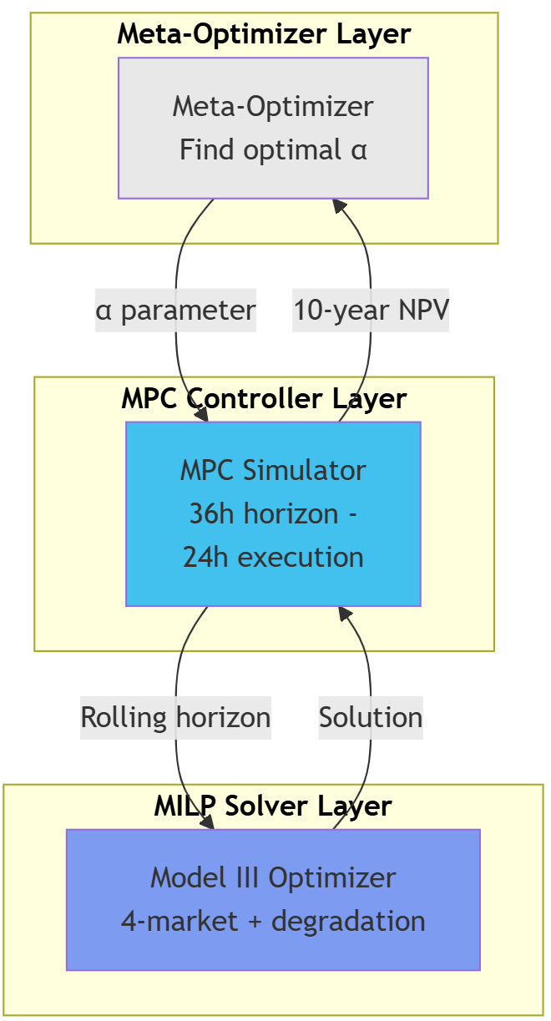
Model and Implementation MPC Framework Architecture

Slide 14
Results and Performance Optimizer Case Study: CZ
Technical Achivements ⚙️
✅ Three-layer optimization architecture
✅ Cyclic Aging enforcement (Xu 2017)
✅ SOS2 calendar aging (Collath 2023)
✅ Production MPC with checkpointing
✅ 100% scenario completion rate

Slide 15
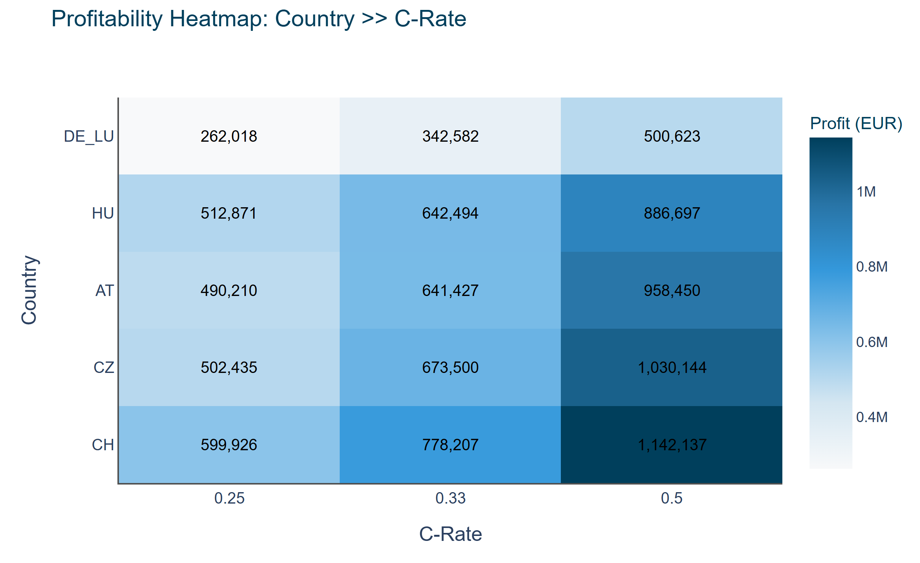
Results and Performance MPC Total Profit Analysis
Strategic Investment Recommendations
1. Priority Markets
- 🇨🇭 Switzerland: Highest absolute returns
- 🇨🇿 Czech Republic: Strong risk-adjusted returns
2. Configuration Strategy
- Always select C-rate 0.50
- Optimize daily cycles via MPC
3. Risk Considerations
- Market saturation in Germany
- Regulatory changes in CEE markets

Slide 16
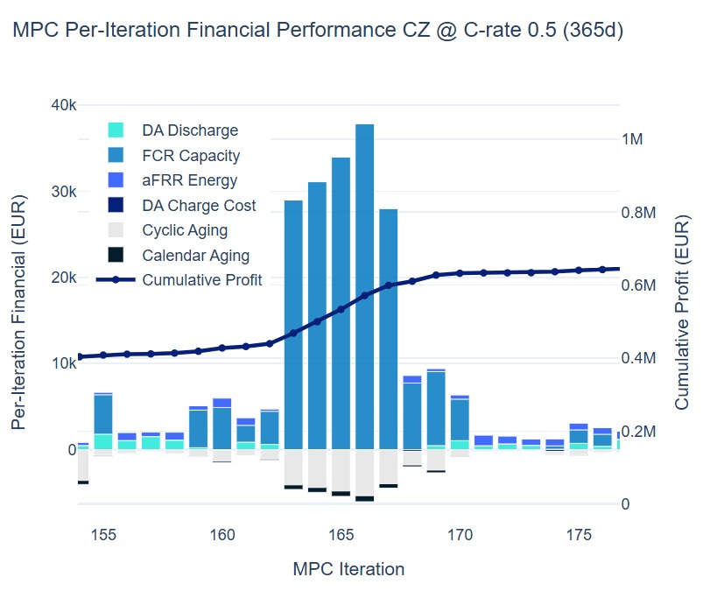
Results and Performance MPC Total Profit Analysis
Strategic Investment Recommendations
1. Priority Markets
- 🇨🇭 Switzerland: Highest absolute returns
- 🇨🇿 Czech Republic: Strong risk-adjusted returns
2. Configuration Strategy
- Always select C-rate 0.50
- Optimize daily cycles via MPC
3. Risk Considerations
- Market saturation in Germany
- Regulatory changes in CEE markets

Slide 17
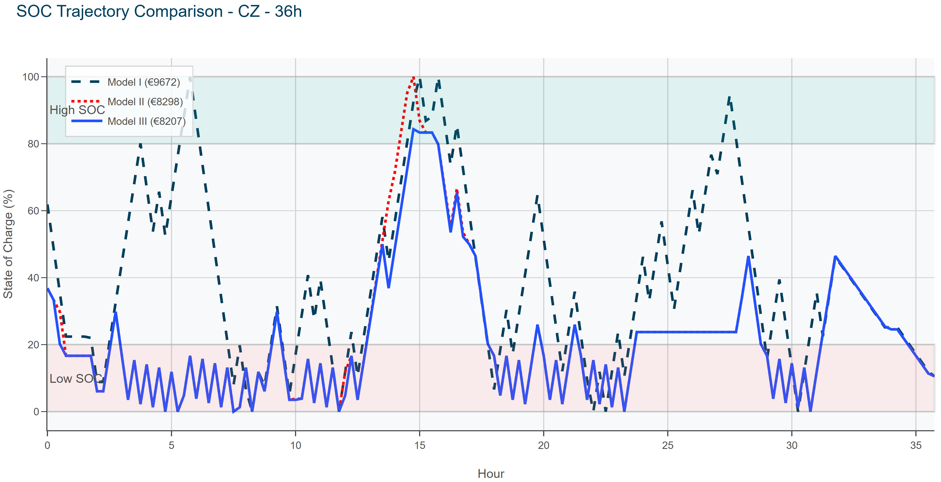
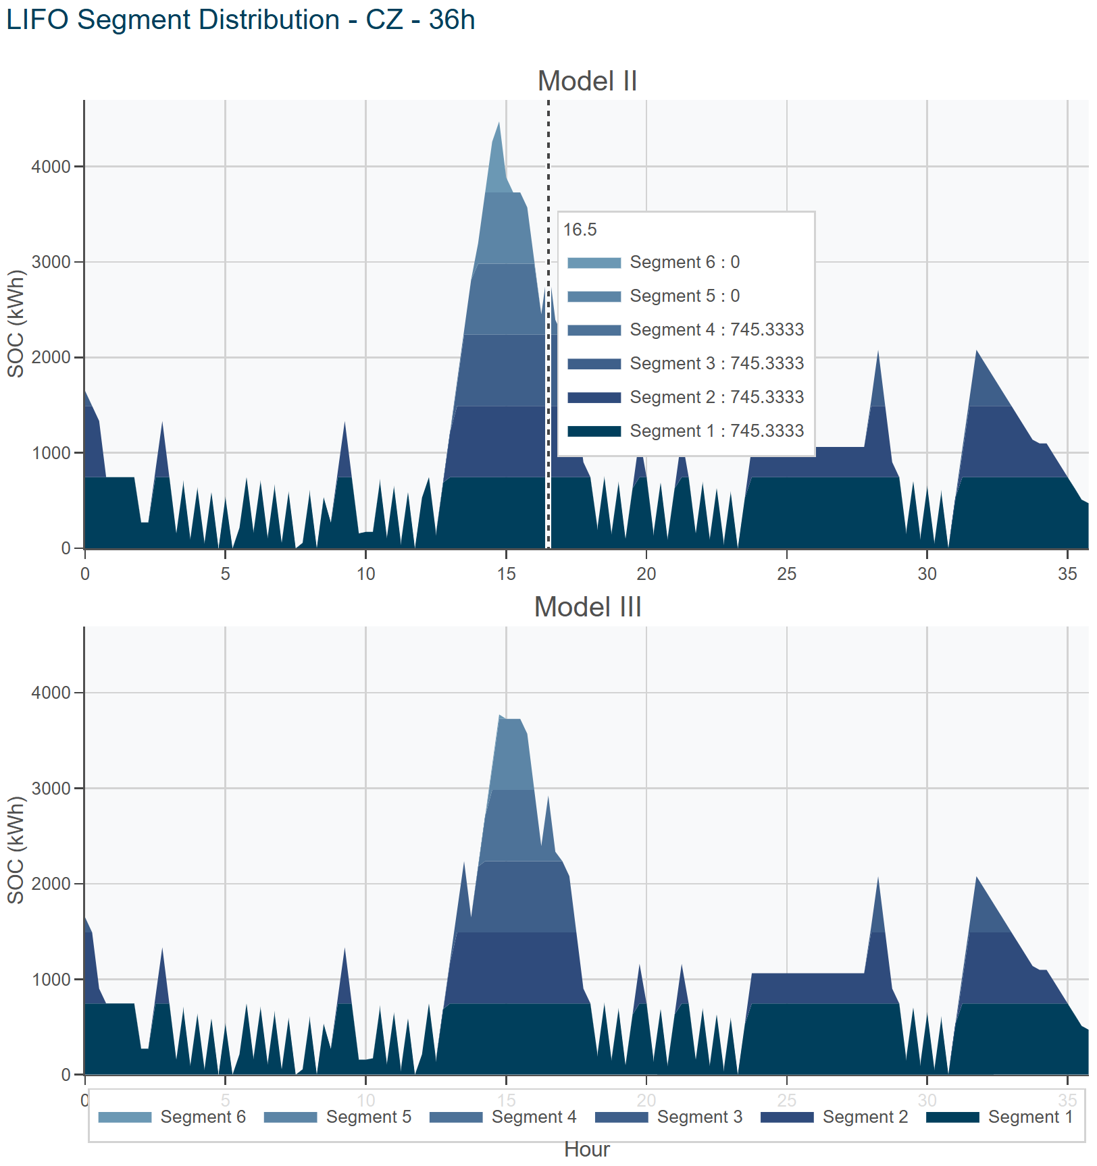
Results and Performance Optimizer Case Study: CZ – May 12th 2024
The SOC check of three models

Slide 18
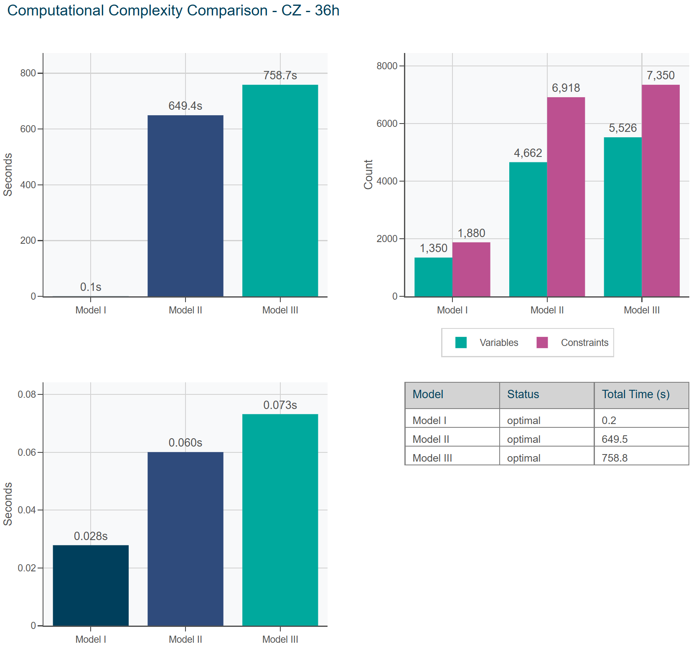
Results and Performance Optimizer Case Study: CZ – May 12th
Solver: Gurobi 13.0.0
Hardware: Intel i9-12900K (16 cores, 24 threads) | RAM: 64 GB

Slide 19
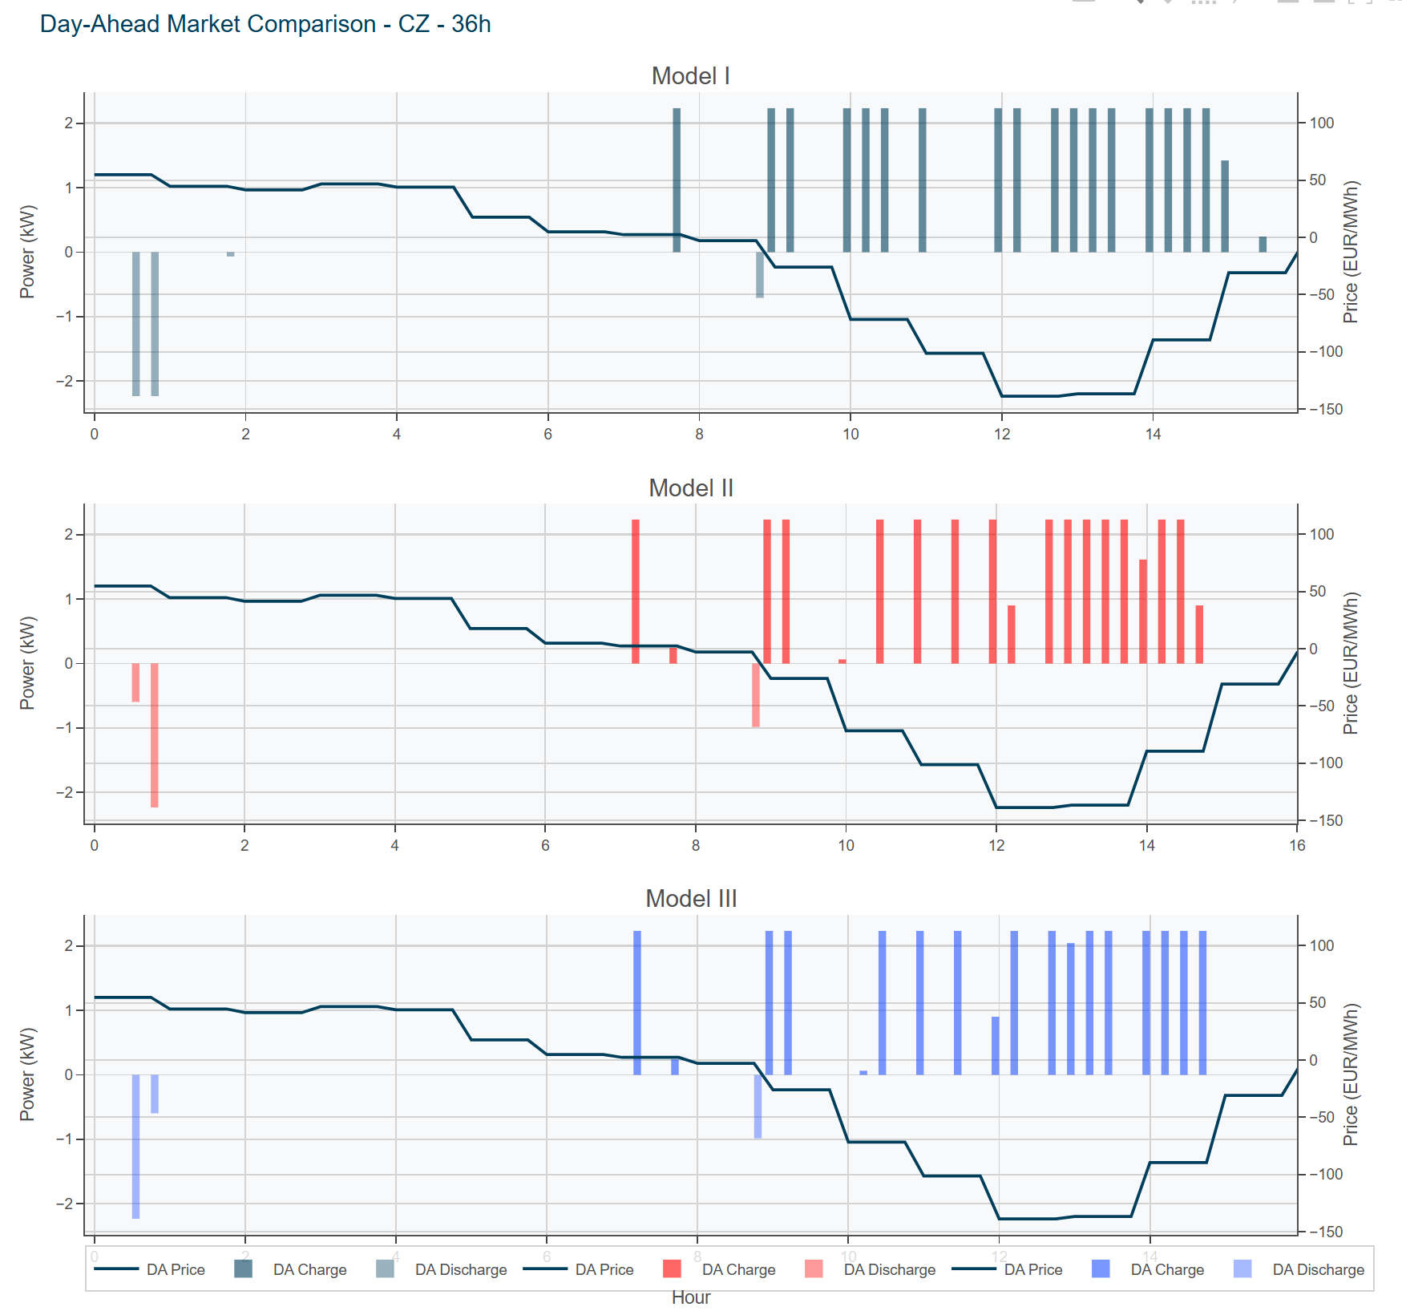
Results and Performance Optimizer Case Study: CZ

Slide 20
Conclusion
We delivered a BESS optimizer that:
Maximizes profitability across four European electricity markets
Manages degradation through advanced aging models
Scales efficiently to full-year horizons Provides actionable insights for investment decisions
Ready for Deployment
Professional codebase with comprehensive documentation @ https://github.com/GenLI3202/TechArena2025_EMS
Extensible architecture for future enhancements

Slide 21
Thank You
Contact:
gen.li@tum.de

