Slide 1
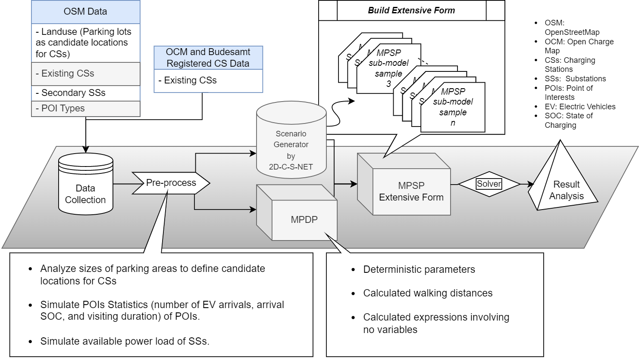
Structure introduction

Slide 2
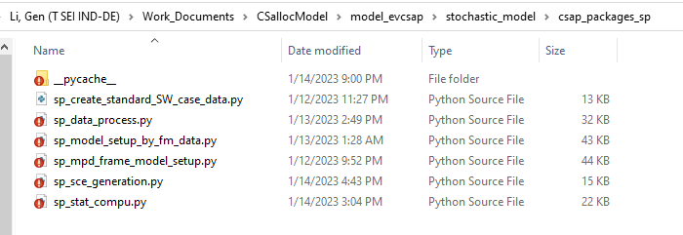




Structure introduction

Slide 3
Structure introduction

Slide 4
Structure introduction

Slide 5
Structure introduction

Slide 6
Structure introduction

Slide 7
Structure introduction

