Slide 1
Method of Morris Algo
9/26/21

Slide 2
Concept

Slide 3

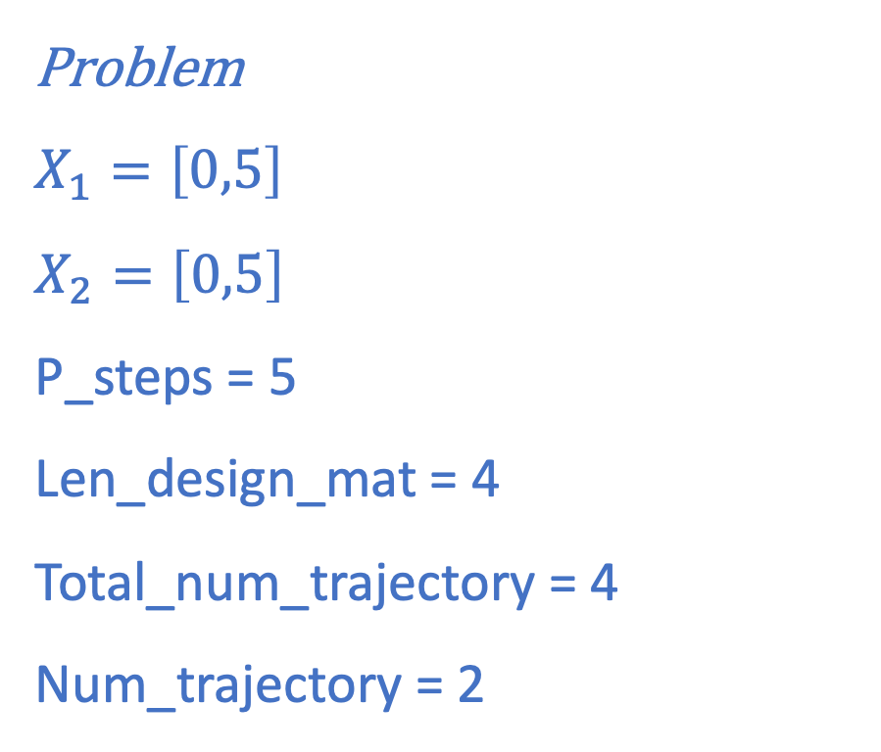

$$X_{2}$$
2
(5,5)
Problem
$$X_{1}=\left[0,5\right]$$
$$X_{2}=\left[0,5\right]$$
P_steps = 5
Len_design_mat = 4
Total_num_trajectory = 4
Num_trajectory = 2
3
4
1
(0,0)
$$X_{1}$$

Slide 4
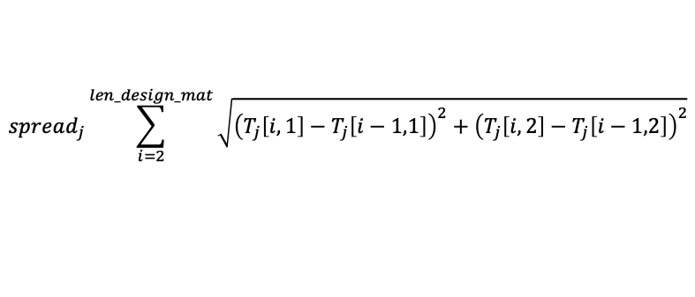
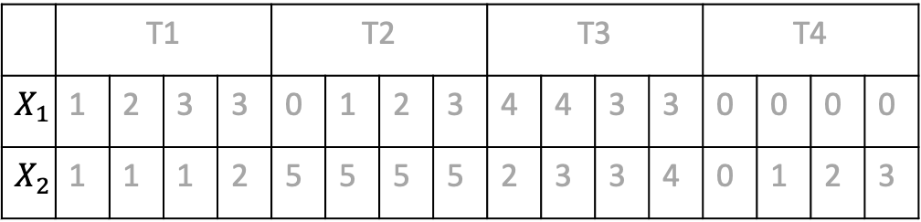

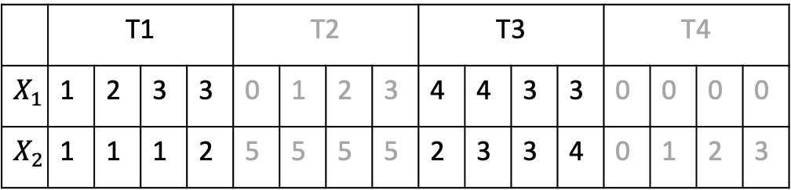
 | T1 |  |  |  | T2 |  |  |  | T3 |  |  |  | T4
$$X_{1}$$ | 1 | 2 | 3 | 3 | 0 | 1 | 2 | 3 | 4 | 4 | 3 | 3 | 0 | 0 | 0 | 0
$$X_{2}$$ | 1 | 1 | 1 | 2 | 5 | 5 | 5 | 5 | 2 | 3 | 3 | 4 | 0 | 1 | 2 | 3
Calculate spread of each trajectory
$$spread_{j}\sum_{i=2}^{len_design_mat}{\sqrt{{\left(T_{j}\left[i,1\right]−T_{j}\left[i−1,1\right]\right)}^{2}+{\left(T_{j}\left[i,2\right]−T_{j}\left[i−1,2\right]\right)}^{2}}}$$
Select Num_trajectory matrices with highest spread
Then solve the model for each set of input parameters, calculate elementary effect for the design matrix
 | T1 |  |  |  | T2 |  |  |  | T3 |  |  |  | T4
$$X_{1}$$ | 1 | 2 | 3 | 3 | 0 | 1 | 2 | 3 | 4 | 4 | 3 | 3 | 0 | 0 | 0 | 0
$$X_{2}$$ | 1 | 1 | 1 | 2 | 5 | 5 | 5 | 5 | 2 | 3 | 3 | 4 | 0 | 1 | 2 | 3
$$ElemEffect_{j}=\frac{Obj_{i+1}−Obj_{i}}{p_{j,i+1}−p_{j},i} ∀i<NewLenDesignMat$$
Calculate mean, variance from elementary effect and allocate ranking

Slide 5
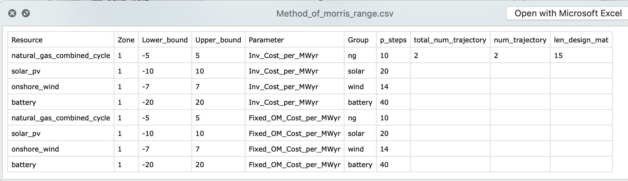
Parameter specification

Slide 6
Notes
Upper and lower bounds are specified in terms of percentage deviation from the nominal value
Percentage variation for uncertain parameters in a given group is identical. For example, if solar cluster 1 and solar cluster 2 both belong to the ‘solar’ group, their Lower_bound and Upper_bound must be identical
P_steps should at least be = 1%, i.e., Upper_bound – Lower_bound < p_steps
P_steps for parameters in one group must be identical
Total_num_trajectory should be around 3 to 4 times the total number of uncertain parameters
Num_trajectory should be approximately equal to the total number of uncertain parameters
Len_design_mat should be 1.5 to 2 times the total number of uncertain parameters
Higher number of Num_trajectory and len_design_mat would lead to higher accuracy

Slide 7
Sample results
With CO2 Cap

Slide 8
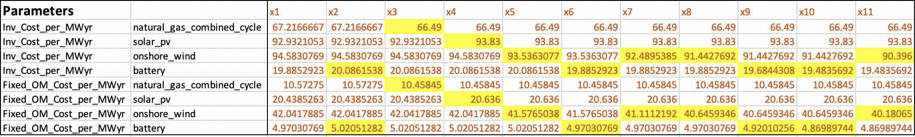
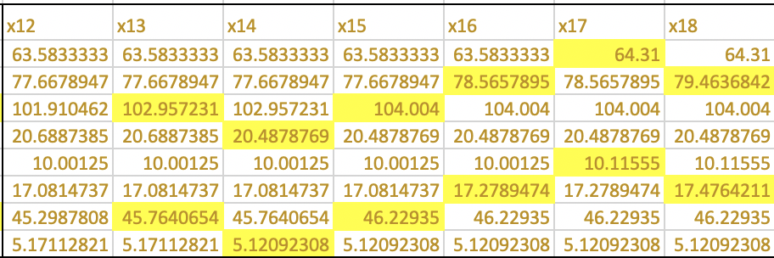
2 sample trajectories
Trajectory 1: NewLenDesignMat = 11
Trajectory 2: NewLenDesignMat = 7

Slide 9
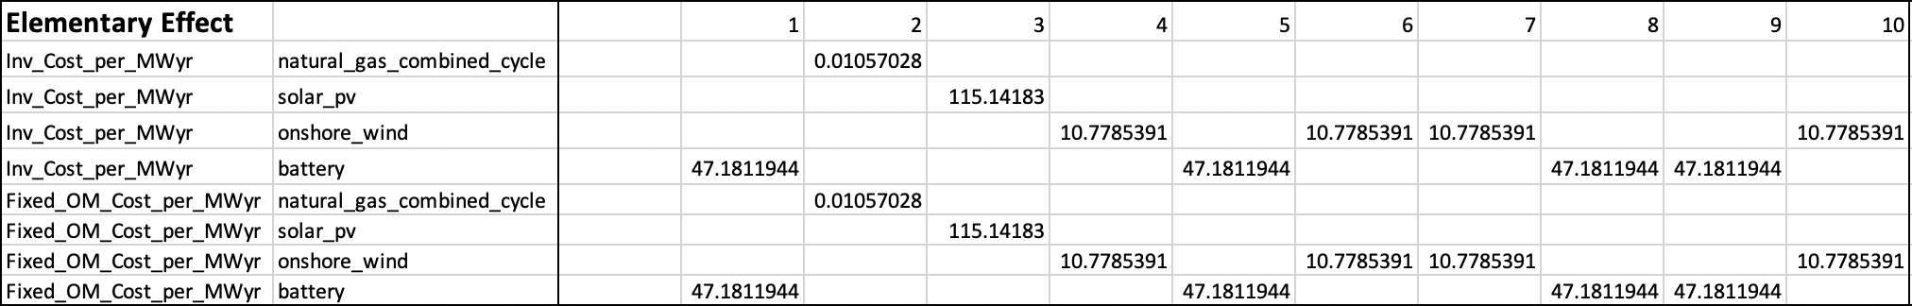
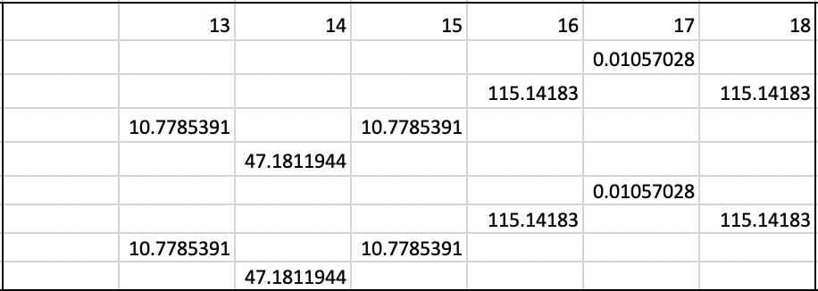

$$ElemEffect_{j}=\frac{Obj_{i+1}−Obj_{i}}{p_{j,i+1}−p_{j},i} ∀i<NewLenDesignMat$$
Trajectory 1
Trajectory 2

Slide 10
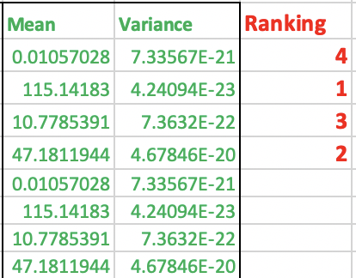
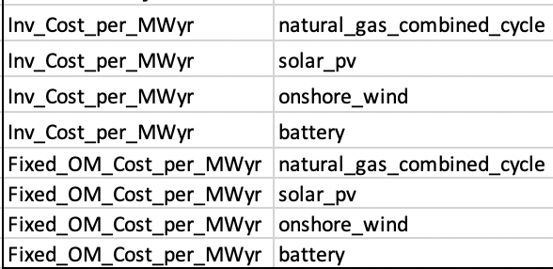
Mean, Variance and Ranking of each uncertain parameter group

Slide 11
Sample results
Without CO2 Cap

Slide 12
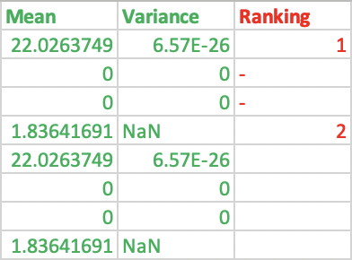
Mean, Variance and Ranking of each uncertain parameter group

