Slide 1
#00 Hello World

Slide 2
Who Am I
Geoff
Lifelong nerd and gamer
Over 20 years of experience in IT across multiple technologies
Technology is fun, cool, fascinating
More about me...
  https://geoffreylamb.000webhostapp.com/
  https://github.com/Genadeb
  https://www.linkedin.com/in/geoffrey-lamb-2547a18/
  https://www.youtube.com/@geofflamb9867

Slide 3
What is this Chanel?
A place to...
Share my experience working on projects
Share my knowledge
Dispel the fear and ignorance around tech
Share my love of tech with you
A reason to try something new

Slide 4
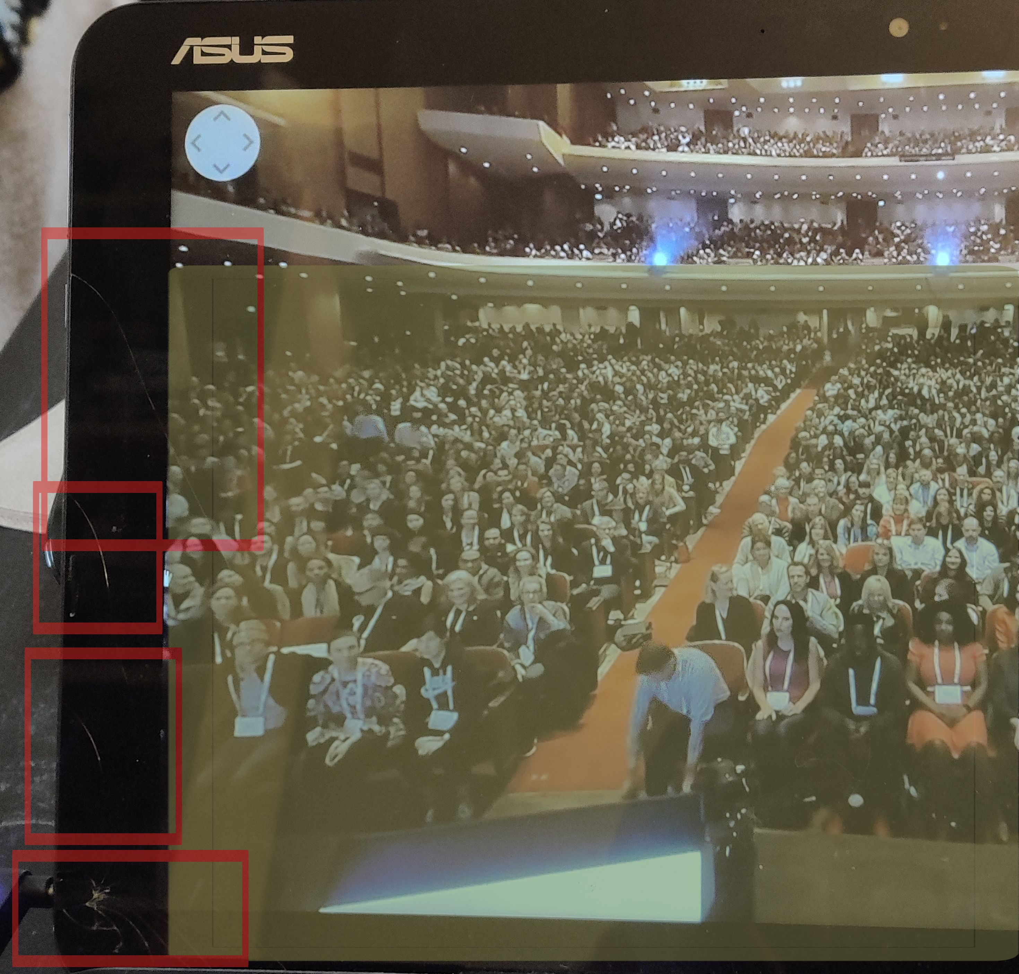
My Setup
Laptop - “Lappy”
  Originally Windows 8 to 10 upgrade era
    Performance Issues regardless of resource usage
    Barely able to handle basic web pages
  Cracked LCD touchscreen
    Cracks highlighted by red boxes
    No touch detection highlighted in yellow
  Reoccurring Issues
    WiFi and Bluetooth connectivity issues at wake up
    Weird touch pad jitter and functional problems requires reboot to temporarily clear

Slide 5
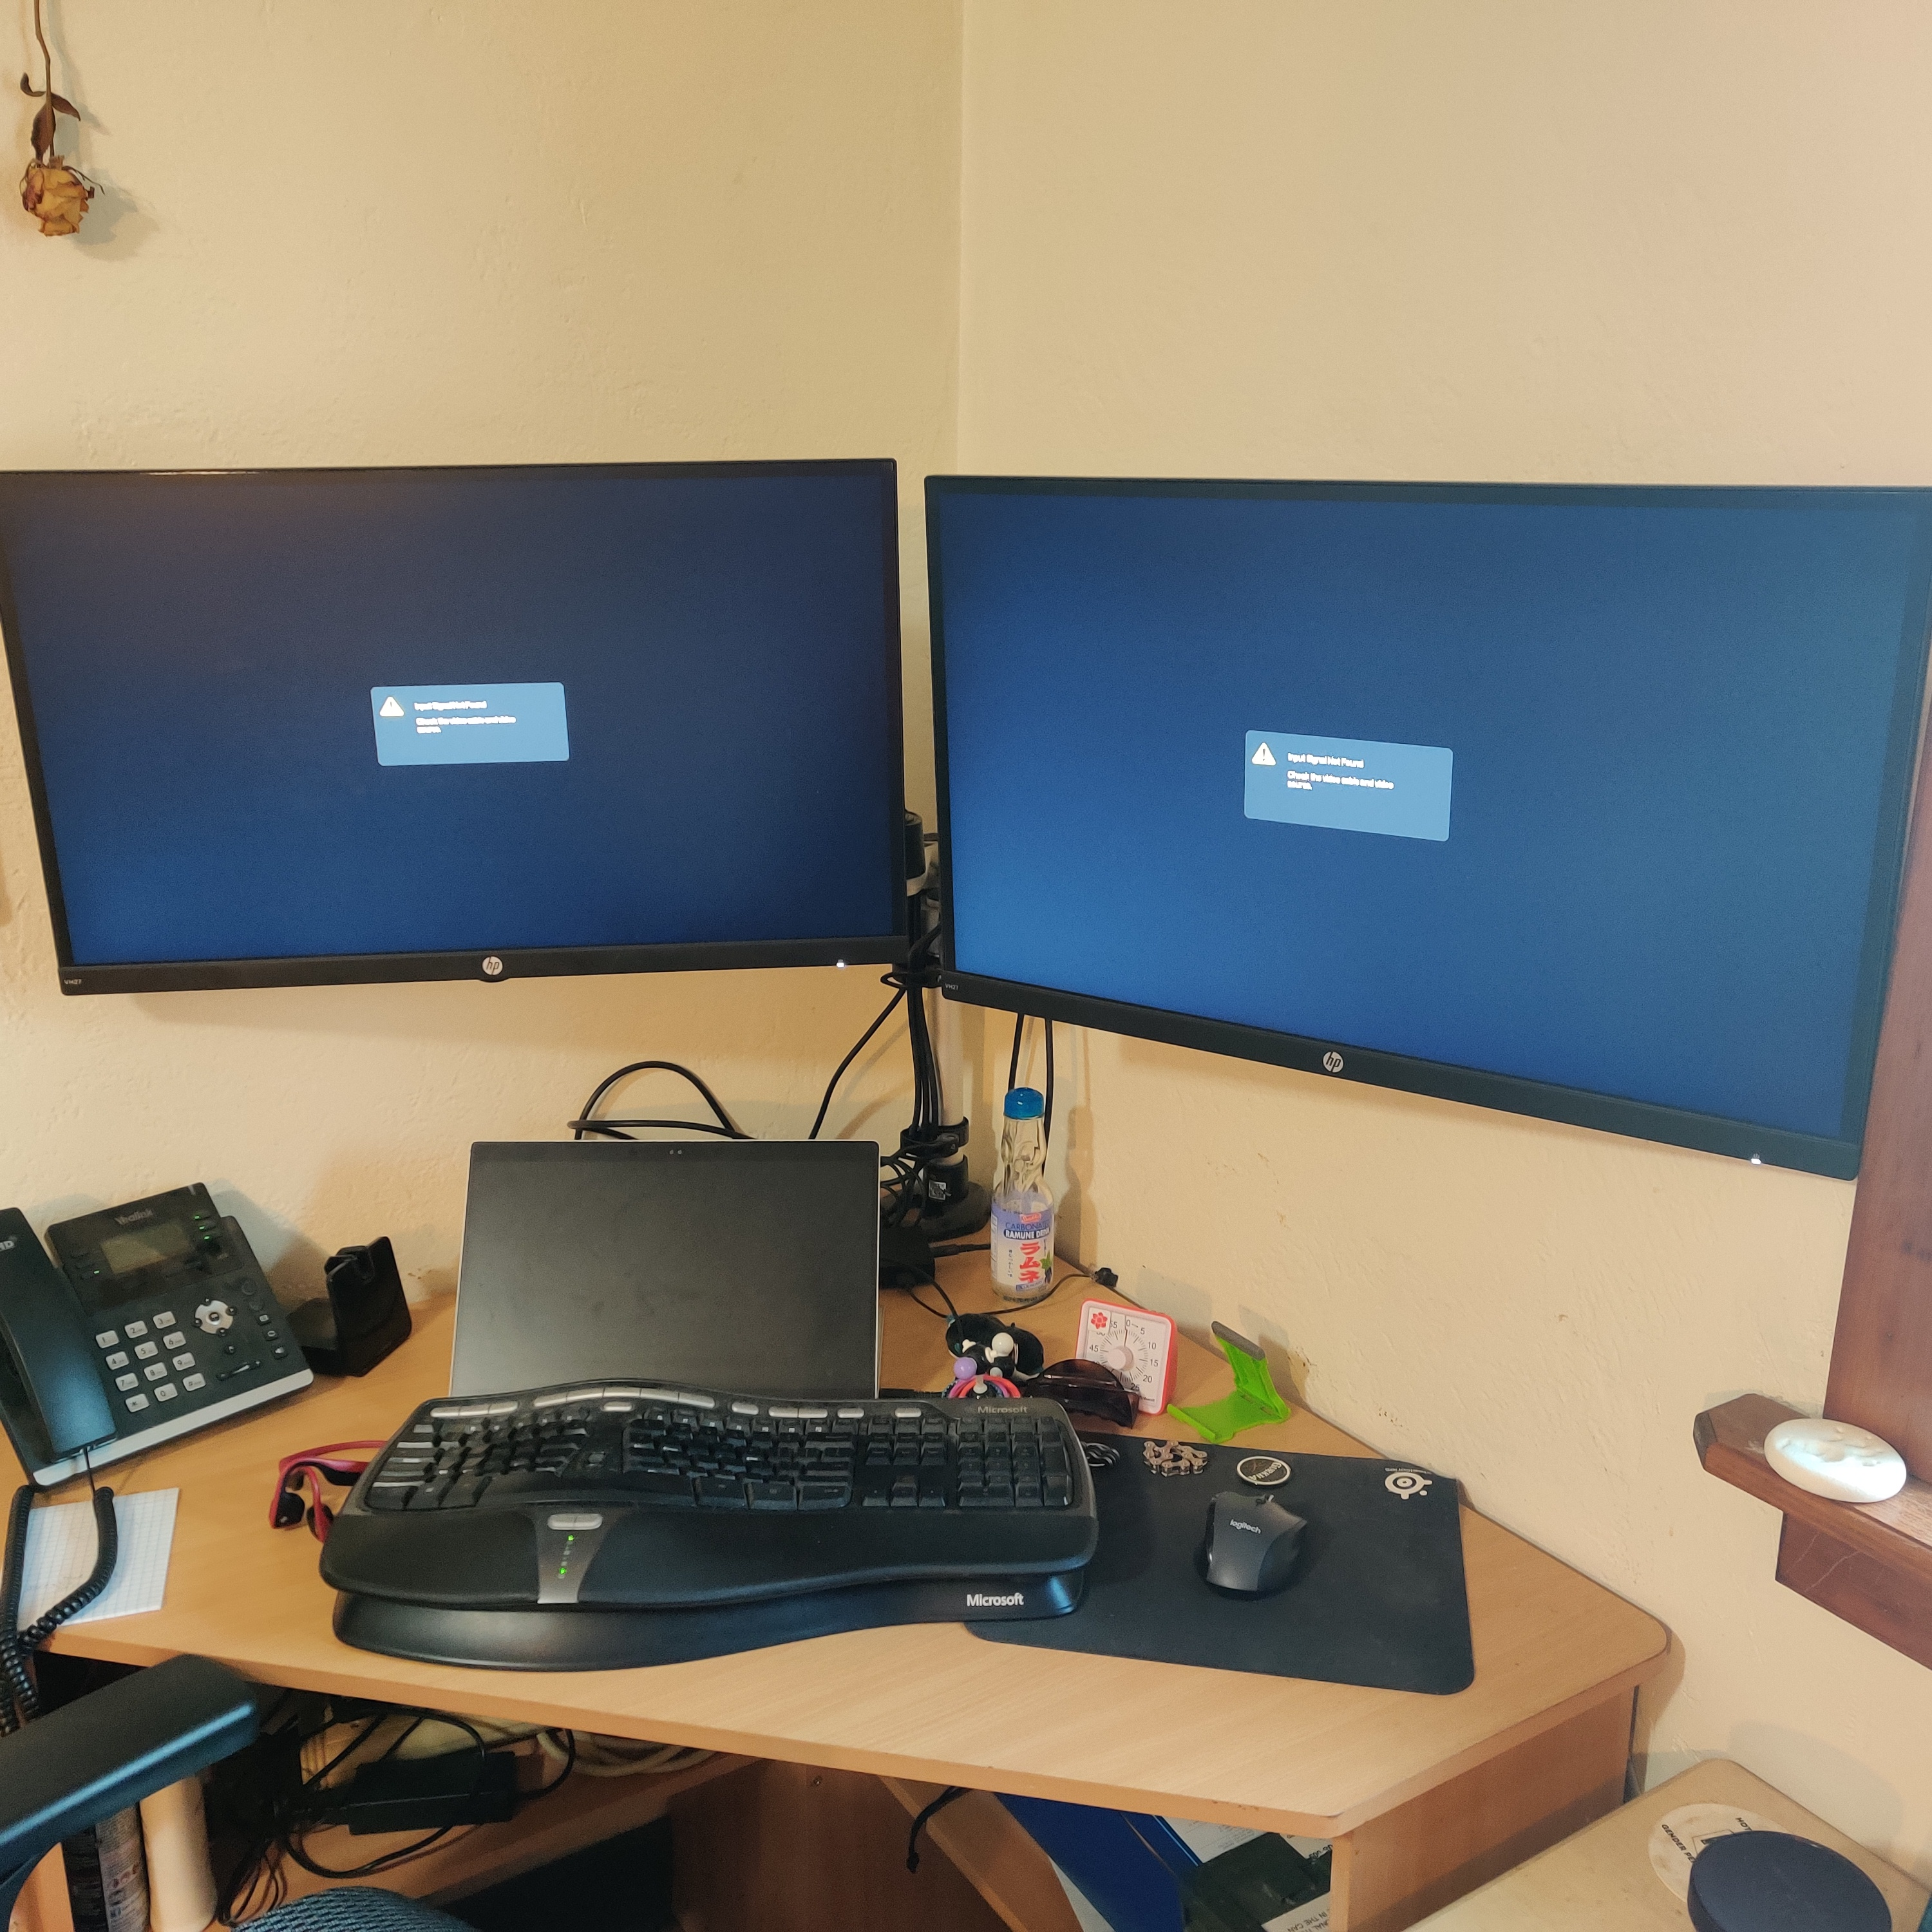
My Setup
Work Desk Area
  WFH – Corner desk with multiple monitors, doc, convertible laptop
  Personal – Wooden folding tables

Slide 6
My Setup
Mobile Phone
  Hardware OK
  OS and UI is not great, limited functionality and customization
  Missed features and awkward functionality
  Built to be used like a mobile phone and not a computer.

Slide 7
My Setup
Personal Desk Area
  Is also work area
  Limited desk space
    Tower is too big for the space available
  Home PC (not pictured)
    Video card died December 2019
    Replacement part prices became unreasonable in 2020
    Replacement part availability dried up in 2021
    Remaining components at EoL in 2022 and may have been damaged
    Replacing other components is not worth the investment

Slide 8
Welcome
Welcome to my channel
What am I doing?
  New hobby
  Existing passion
  Upcoming Projects
    Cyberdeck Build – Building a replacement for Lappy
    Educational Shorts – Computers Are Not Smart. Why Reboot? Why is it DNS?
    Instructional Videos – How to maintain your computer. Modding Keyboards.
    Working in IT – A day in the life of … What I want from ticket submission. Being honest when you don’t know the answer.

Slide 9
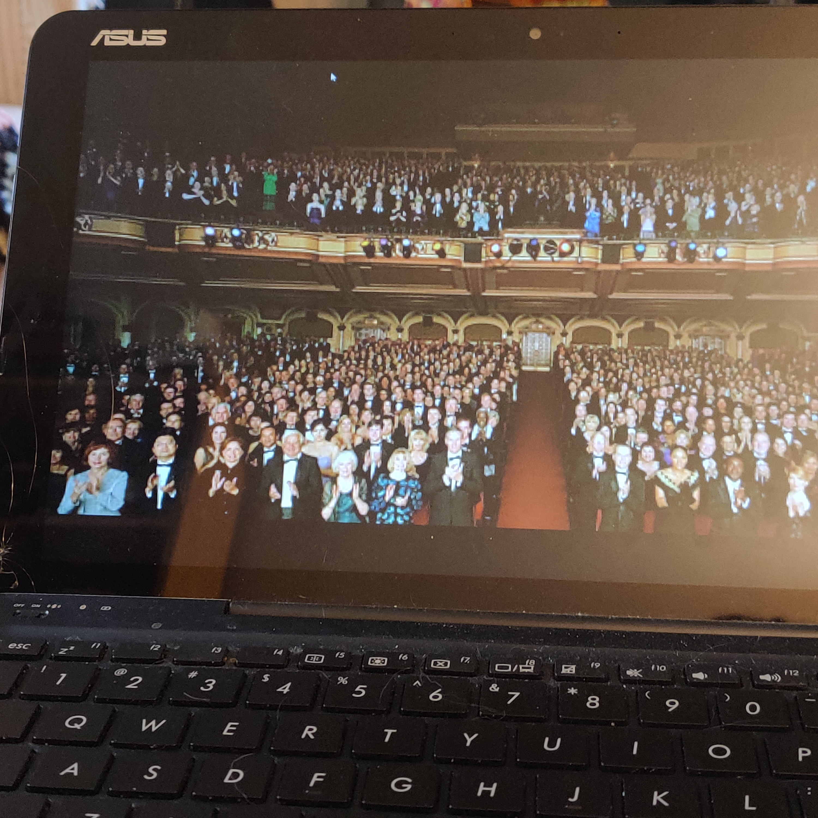
Thank You
My YouTube inspiration
  InfoTech nerds like
    @JoshMadakor
    @NetworkChuck
    @davidbombal
  Keeb nerds like
    @HipyoTech
    @Keybored
    @SwitchandClickOfficial
Done is better than perfect.

