Slide 1

05-binary-tree

Slide 2

עצים, עצים בינאריים
d = 0
h = 3
Tree – a collection of nodes connected by edges such that there is a path from every node to every other node, and there are no cycles.
Rooted Tree – a tree in which one of the nodes is selected as the root from all the others. The selected node is called the root of the tree.
Root – a node in a tree. No node points to it (it has no parent). In our example, G is the root.
Children – nodes below a parent node connected to it by edges. K, P are children of Y.
Parent – if node X is a child of node Y, then Y is the parent of X.
Leaf – a node without children (W, E, B in the example). The depth of a node x from the root r is the length of the path from r to x. The depth of A is 2, the depth of G is 0.
Height – the maximum depth of any node in the tree. In the example, the height of the tree is 3.
Size of a tree – the number of nodes in the tree (10 in the example).
Binary Tree – a tree in which each node has at most two children (right and left).
Recursive definition – an empty tree, or a root and two subtrees – right and left, both of which are binary trees.
G
d = 1
h = 2
C
Y
A
F
K
P
B
E
W
d = 3
h = 0
d = depth
h = height

Slide 3

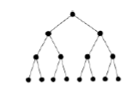

סיווג עצים בינאריים
Full Tree - A tree in which every node has either 0 or 2 children.
Perfect Tree - A special type of binary tree in which all levels (layers) are completely filled, meaning that each level in the tree contains the maximum number of nodes possible until it is completely filled. Specifically, at each level n in a perfect tree, there are exactly 2^(n-1) nodes.
Complete Tree - A complete tree is a perfect tree except for the last level, in which there may be missing nodes on the far right side.

Slide 4
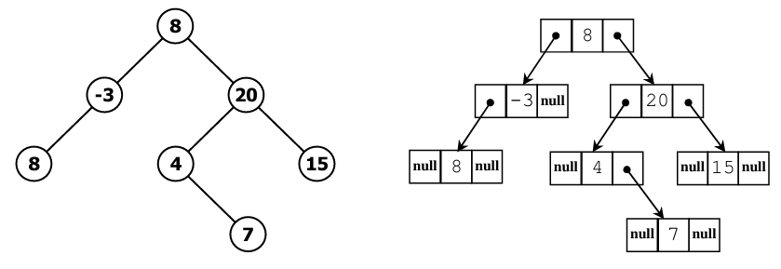
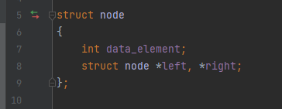
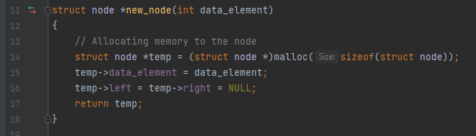
מימוש של עץ בינארי

Slide 5
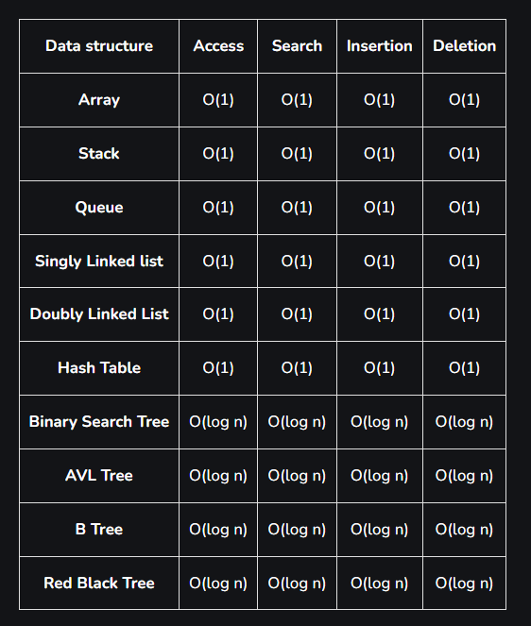
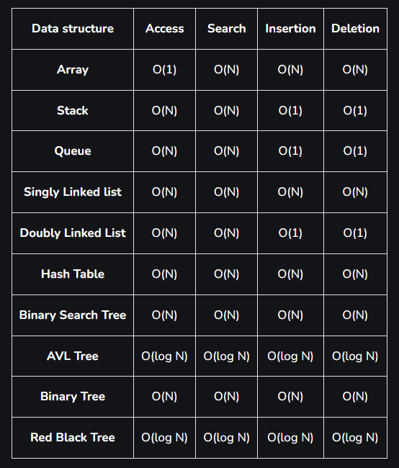
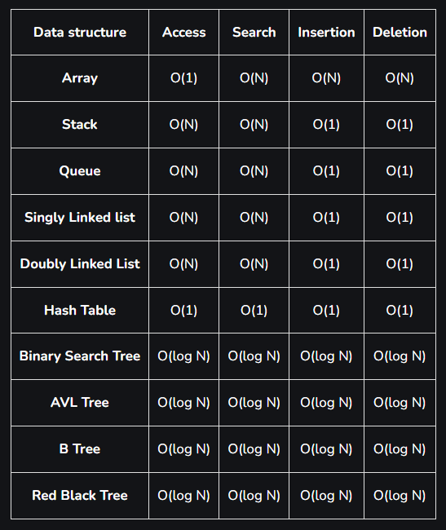
Time complexities of different data structures
Best case time complexity of different data structures for different operations
Worst Case time complexity of different data structures for different operations
The average time complexity of different data structures for different operations

Slide 6
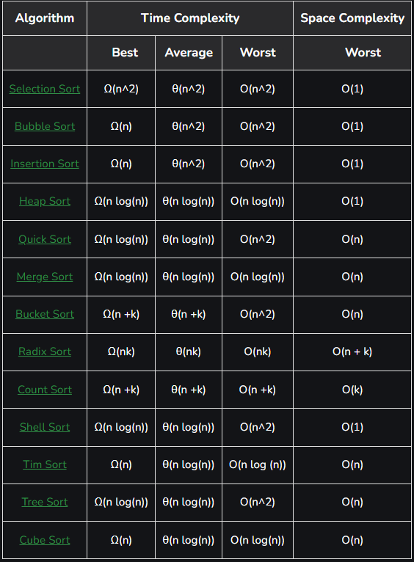
Time Complexities of
all Sorting Algorithms

Slide 7
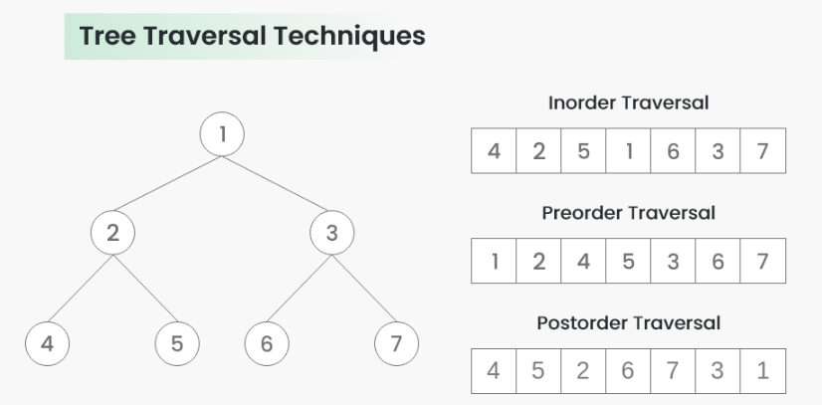
סיורים בעץ בינארי

Slide 8
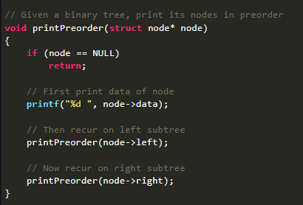
סיורים בעץ בינארי

Slide 9
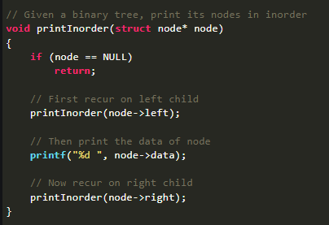
סיורים בעץ בינארי

Slide 10
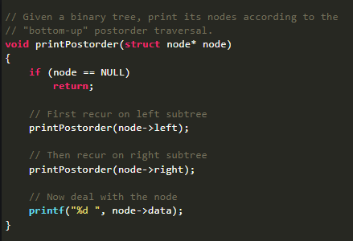
סיורים בעץ בינארי

Slide 11
דוגמה
+
Preorder: + - A * B C + D E
-
+
Inorder: A – B * C + D + E
A
*
D
E
B
C
Postorder: A B C * - D E + +

Slide 12
תרגיל 1.1
You are given the Inorder and Preorder traversal results of a binary tree. Using these traversal results, reconstruct the original binary tree.
Inorder: 2, 6, 4, 7, 1, 3, 8, 5, 9, 10
Preorder: 1, 2, 4, 6, 7, 3, 5, 8, 9, 10
2, 6, 4, 7
1
3, 8, 5, 9, 10
2
3
8, 5, 9, 10
6, 4, 7
4
5
6
7
8
9
10

Slide 13
תרגיל 1.2
You are given the Inorder and Preorder traversal results of a binary tree. Using these traversal results, reconstruct the original binary tree.
4, 10, 3
7
11,8,2
Inorder: 4, 10, 3, 1, 7, 11, 8, 2
Preorder: 7, 10, 4, 3, 1, 2, 8, 11
10
8, 11
2
9
3, 11
3
8
4
1
3

Slide 14
תרגיל 1.3
You are given the Inorder and Postorde traversal results of a binary tree. Using these traversal results, reconstruct the original binary tree.
8
5
4
Postorder: 9, 1, 2, 12, 7, 5, 3, 11, 4, 8
Inorder: 9, 5, 1, 7, 2, 12, 8, 4, 3, 11
9
7
11
3
1
12
2

Slide 15
תרגיל 2
נתון אלגוריתם הבא :
What does the algorithm return if it receives the following tree as input?
What does the algorithm do?
function(x)
// x is a node of a Binary Tree
if x = NULL then: return 0
m1 <- f(x.left)
m2 <- f(x.right)
if m1 > m2 then return m1 + 1
else return m2 + 1
5
3
7
2
4
8
1

Slide 16
תרגיל 3
What does the algorithm return if it receives the following tree as input?
What does the algorithm do?
function(x):
// x is a node of a Binary Tree
if x = NULL then
return 0
value = 0
if x.key mod 2 = 0 then
value = x.key
return value + function(x.left) + function(x.right)
5
3
7
2
4
8
1

Slide 17
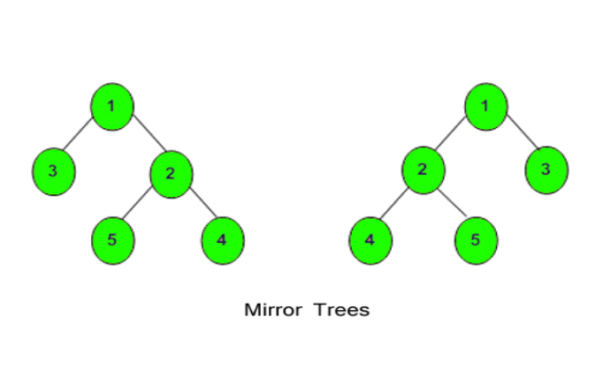
תרגיל 4
Write pseudocode that takes a binary tree as input and returns its symmetric tree.
function createMirrorTree(root):
if root = NULL then
return NULL
// Create a new node with the same key as the current root
mirrorRoot = new TreeNode(root.key)
// Recursively create the mirror of the right subtree as the left subtree of the new node
mirrorRoot.left = createMirrorTree(root.right)
// Recursively create the mirror of the left subtree as the right subtree of the new node
mirrorRoot.right = createMirrorTree(root.left)
return mirrorRoot

Slide 18
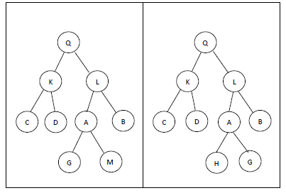
תרגיל 5
Write an algorithm that takes a pointer to the root of a binary tree as input and returns true if the tree is a sibling tree and false otherwise.
Given the following trees, which one is a sibling tree?
function isSiblingTree(root):
if root is NULL then
return true
if root.left is NULL and root.right is NULL then
return true
if root.left is not NULL and root.right is not NULL and root.left.data <= root.right.data then
return isSiblingTree(root.left) and isSiblingTree(root.right)
return false

Slide 19
תרגיל 6
Write pseudocode for an algorithm named LeafNodes, which takes the root of a binary tree as input and returns the number of leaf nodes in the tree.
function LeafNodesCount(root):
if root is null:
return 0
if root has no children:
return 1 # root is a leaf node
left_count = LeafNodesCount(root.left)
right_count = LeafNodesCount(root.right)
return left_count + right_count

Slide 20


