Slide 1
intellimood

Slide 2
The Team
Евгени Димов – капитан, back-end, machine learning
Анета Цветкова - front-end, back-end
Калин Дойчев - front-end, back-end
Костадин Костадинов - front-end, back-end, machine learning

Slide 3
IntelliMood
The app will ask how did your day went and depending on your answer will suggest activities, movies, books or music to help improve your mood. That way it will help decrease depression rates.

Slide 4


Used Technologies
Languages and Technologies:
C#, Asp.Net Core, EntityFramework Core, ML.Net, HTML, Bootstrap, CSS, JavaScript, jQuery and Ajax
IDE: Team Collaboration Tool:

Slide 5
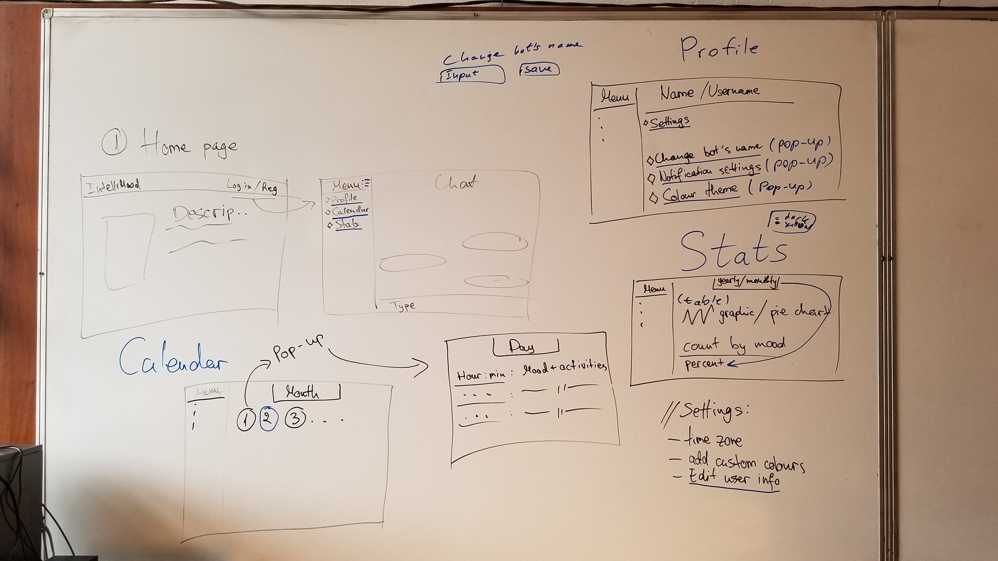
Team Work

Slide 6
Difficulties
Sidebar when logged in
Calendar
Ajax
Extracting emotions from text
ML.Net library
Mobile Friendly

Slide 7
Project Future Realization
A mobile version for both Android and IOS
Different ways of logging in (Facebook, Google, GitHub etc)
Notifications based on user time zone

Slide 8
That’s all, folks!
Questions?

