Slide 1

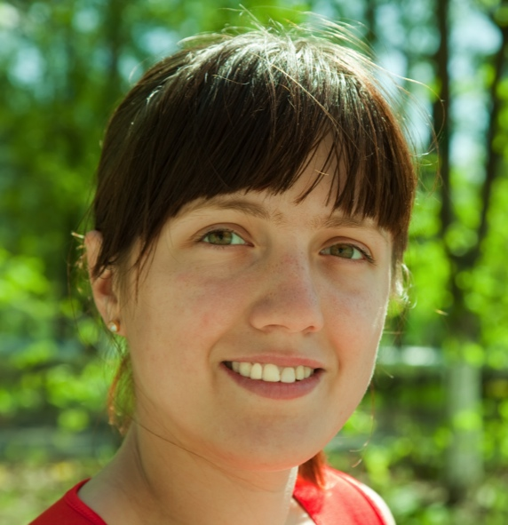

Abby Jones¹
Abby has always liked music. When she is on her way to work in the mornings, she listens to music that spans a wide variety of styles. But when she arrives at work, she turns it off, and begins her day scanning all her emails first to get an overall picture before answering any of them. (This extra pass takes time but seems worth it.) Some nights she exercises or stretches, and sometimes she likes to play computer puzzle games like Sudoku.
28 years old
Employed as an Accountant
Lives in Cardiff, Wales
Background and skills
Abby works as an accountant. She is comfortable with the technologies she uses regularly, but she just moved to this employer 1 week ago, and their software systems are new to her.
Abby says she’s a “numbers person”, but she has never taken any computer programming or IT systems classes. She likes Math and knows how to think with numbers. She writes and edits spreadsheet formulas in her work.
In her free time, she also enjoys working with numbers and logic. She especially likes working out puzzles and puzzle games, either on paper or on the computer.
Motivations and Attitudes
Motivations: Abby uses technologies to accomplish her tasks. She learns new technologies if and when she needs to, but prefers to use methods she is already familiar and comfortable with, to keep her focus on the tasks she cares about.
Computer Self-Efficacy: Abby has low confidence about doing unfamiliar computing tasks. If problems arise with her technology, she often blames herself for these problems. This affects whether and how she will persevere with a task if technology problems have arisen.
Attitude toward Risk: Abby’s life is a little complicated and she rarely has spare time. So she is risk averse about using unfamiliar technologies that might need her to spend extra time on them, even if the new features might be relevant. She instead performs tasks using familiar features, because they’re more predictable about what she will get from them and how much time they will take.
How Abby Works with Information and Learns:
Information Processing Style: Abby tends towards a comprehensive information processing style when she needs to more information. So, instead of acting upon the first option that seems promising, she gathers information comprehensively to try to form a complete understanding of the problem before trying to solve it. Thus, her style is “burst-y”; first she reads a lot, then she acts on it in a batch of activity.
Learning: by Process vs. by Tinkering: When learning new technology, Abby leans toward process-oriented learning, e.g., tutorials, step-by-step processes, wizards, online how-to videos, etc. She doesn't particularly like learning by tinkering with software (i.e., just trying out new features or commands to see what they do), but when she does tinker, it has positive effects on her understanding of the software.
¹Abby represents users with motivations/attitudes and information/learning styles similar to hers. For data on females and males similar to and different from Abby, see http://eusesconsortium.org/gender/gender.php

