Slide 1
NullSleep’s ChatApp
11/28/2018

Slide 2
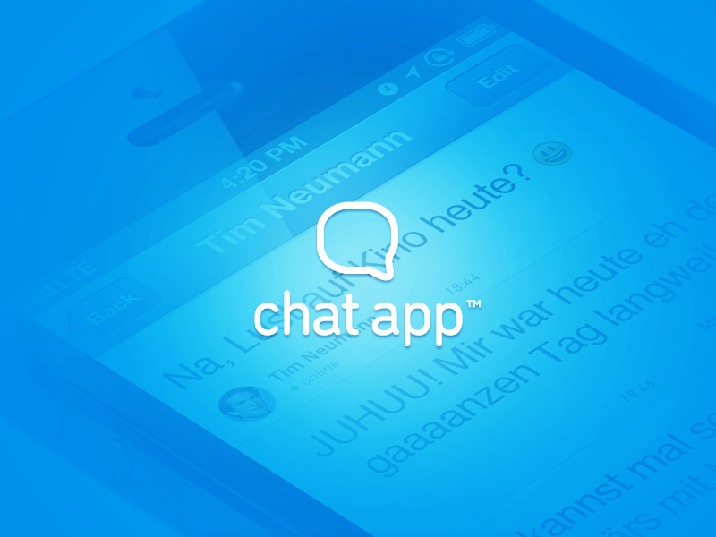
Team NullSleep
Yijun He (team lead)
Alex Teich (tech lead)
Jinxuan Cheng (doc lead)
Jianwei Jin(dev)
Shuqi Feng (dev)
Jiali Han (dev)
Mengyuan Wan (dev)

Slide 3


Framework
Events (JSON)
Response (JSON)
Events (Object)
Response (JSON)
Response (object)
Socket
Server
Response (JSON)
Clients
All communication between client side and server side are transferred through web socket.

Slide 4
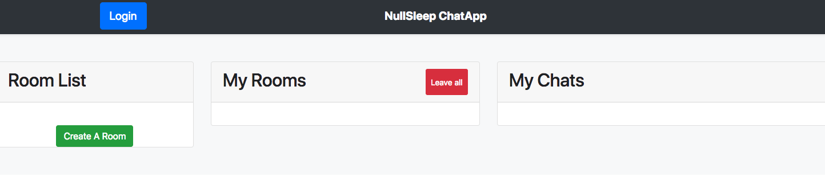
View - Login

Slide 5
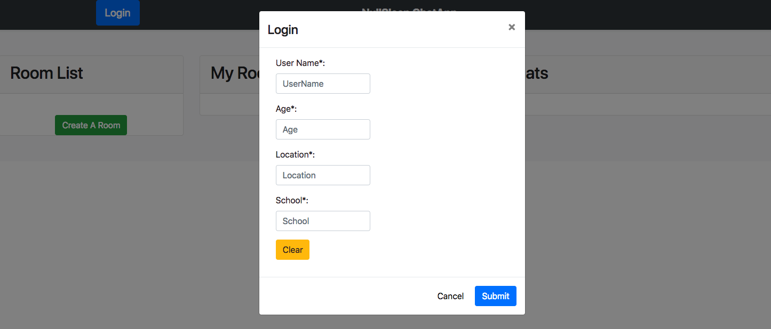
View - Login

Slide 6
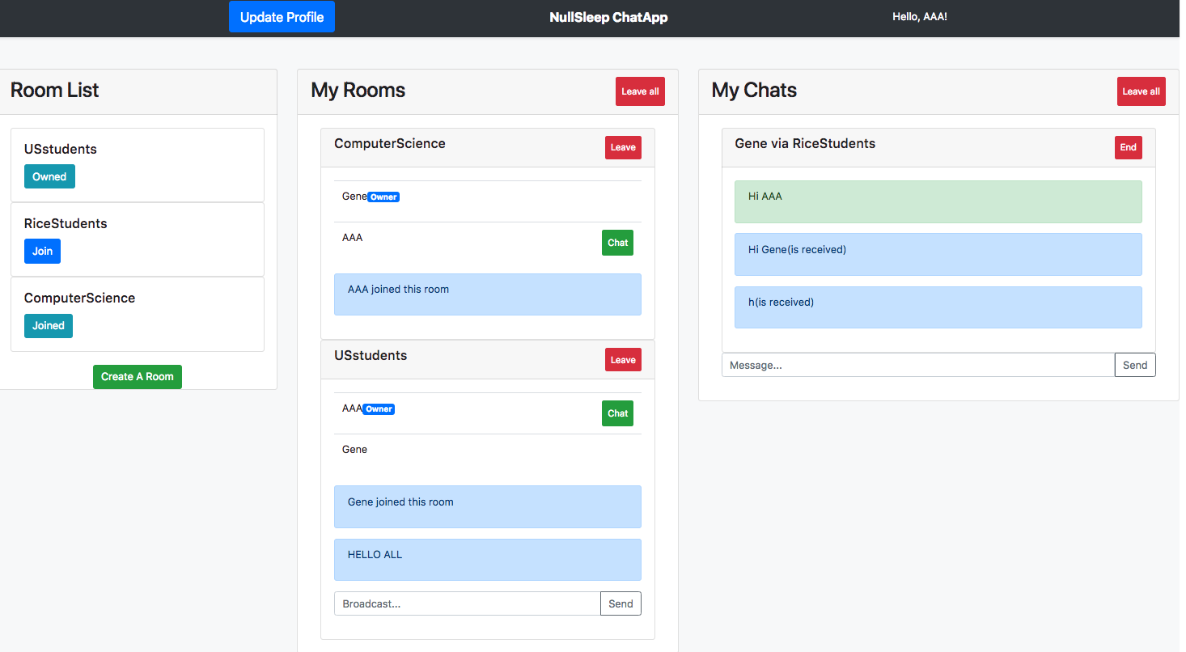
View

Slide 7
View - Room List
All available rooms are displayed in the room list
Buttons show the status/valid operation of a room for current user
Button to create a new chat room

Slide 8
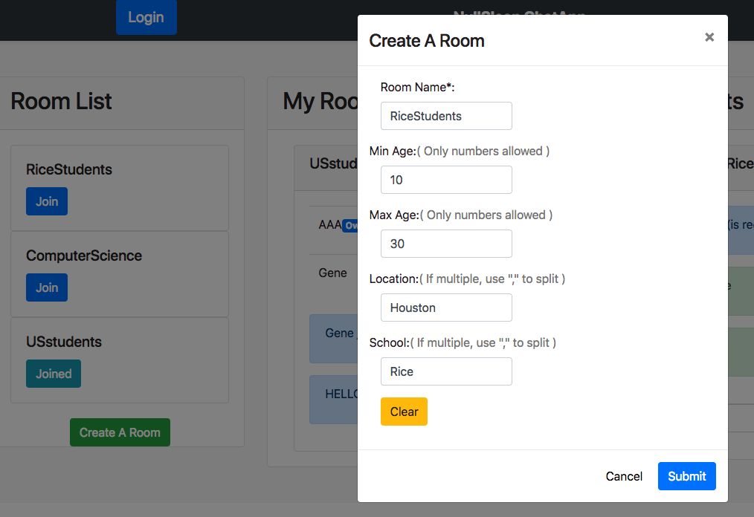
View - Create a room

Slide 9
View - My Rooms

Slide 10
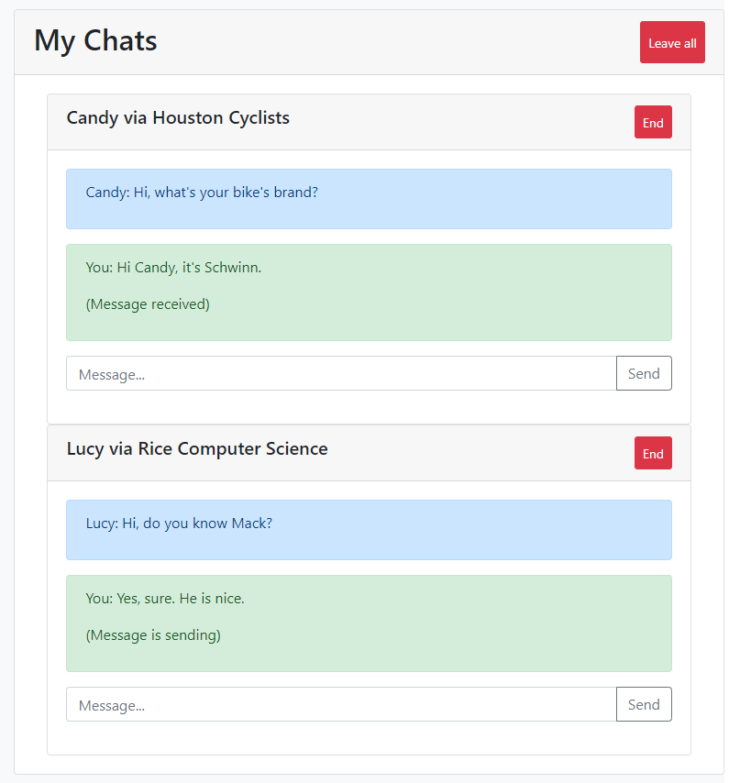
View - My Chats

Slide 11
Server to Client communication
Server sends two types of information:
allows the view to update the room information (middle column)
allows the view to update the chat information (right column)

Slide 12
Controller
ChatAppController
Setup Websocket on server side
Setup Heroku port
WebSocketController
Handle Websocket communications from client side
Utilize DispatcherAdapter

Slide 13
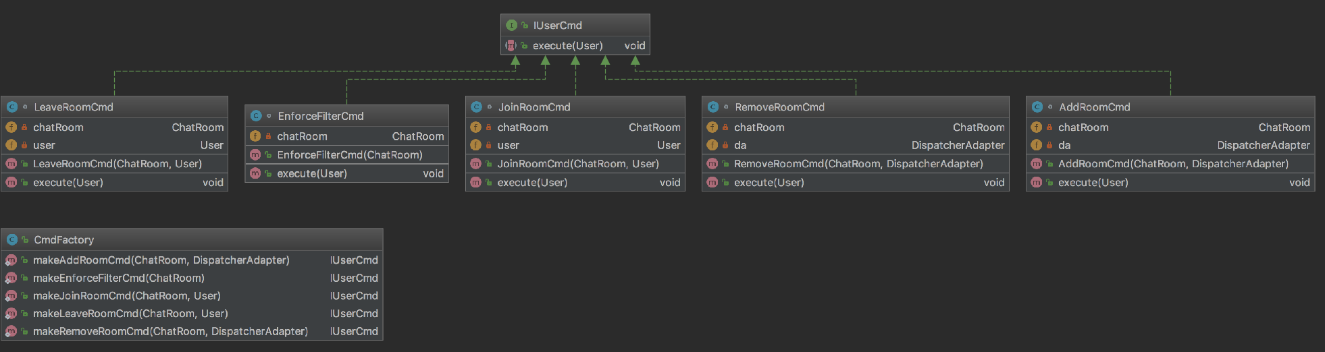
Model - Package cmd

Slide 14
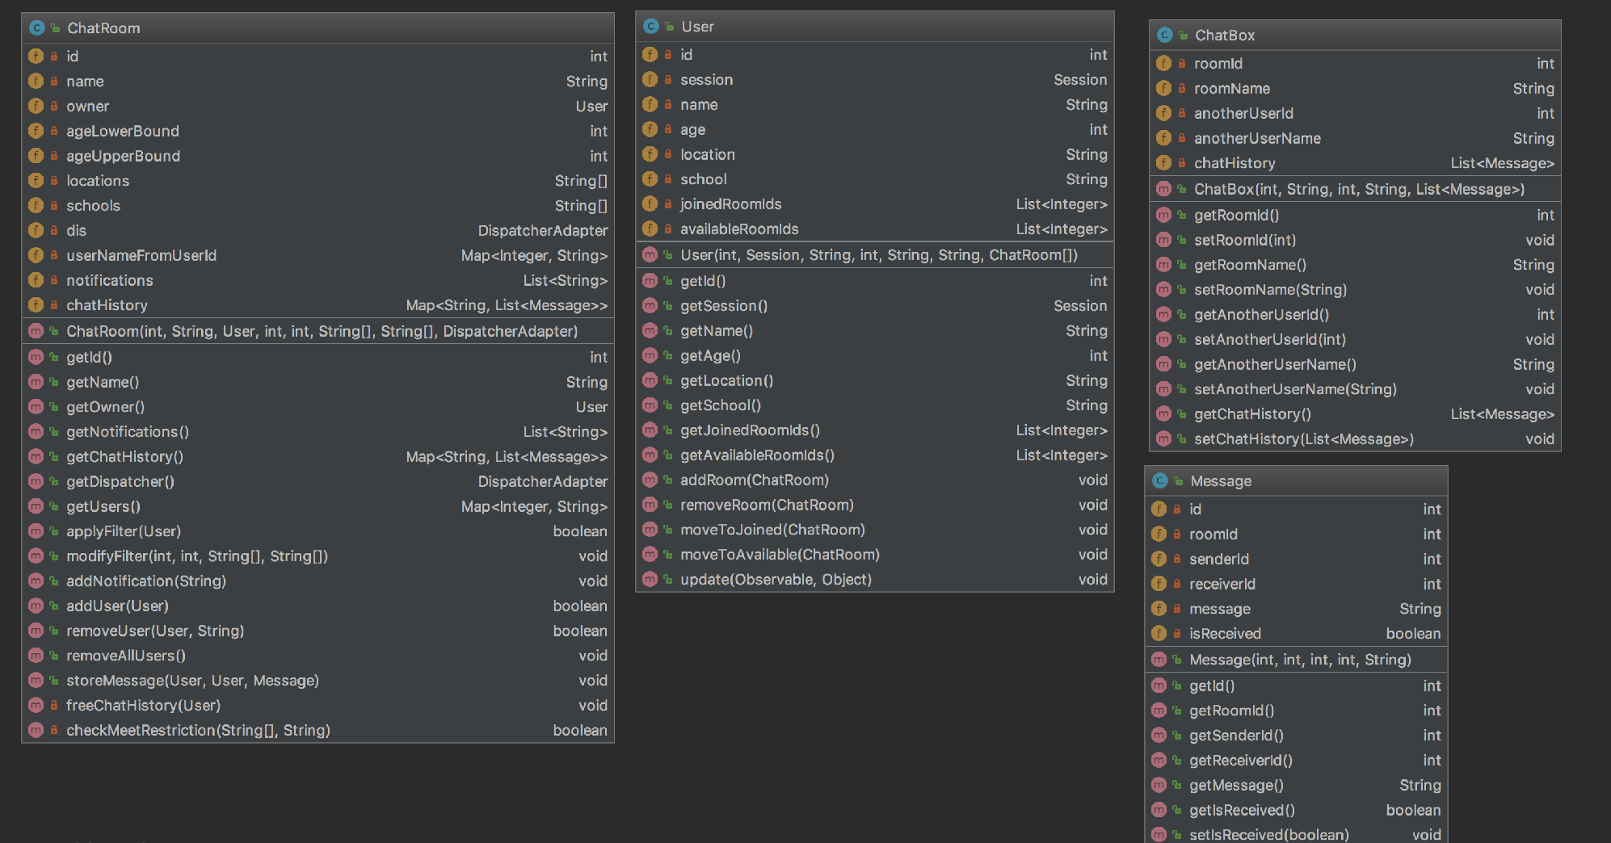
Model - Package obj

Slide 15
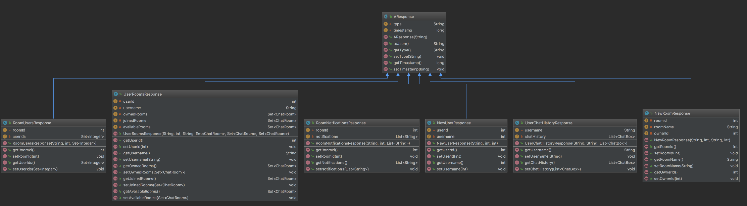
Model - Package res

Slide 16
Demo
Deploy on Heroku
URL: https://chatapp-team-nullsleep.herokuapp.com/

Slide 17
Demo

Slide 18
Q & A

