Slide 1
NullSleep’s ChatApp
11/28/2018

Slide 2
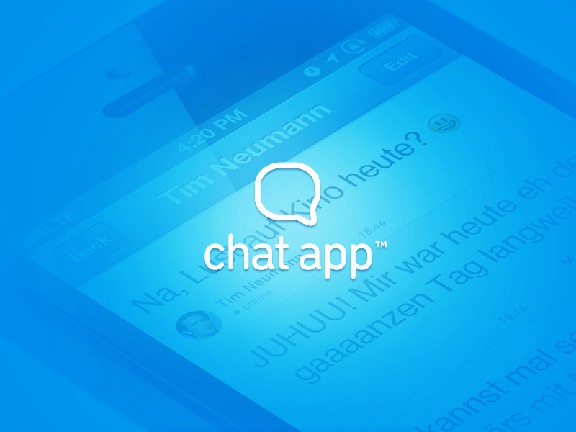
Team NullSleep
Yijun He (team lead)
Alex Teich (tech lead)
Jinxuan Cheng (doc lead)
Jianwei Jin(dev)
Shuqi Feng (dev)
Jiali Han (dev)
Mengyuan Wan (dev)

Slide 3
Design decisions
Server sends two types of information to client:
allows the view to update the room information (left and middle columns)
allows the view to update the chat information (right column)
We use special character ‘|’ as delimiter, so that inputs can contain space

Slide 4
Design decisions
To view the private message from user B, user A needs to click “chat” button first.
Broadcast messages and notifications are shown in the “My room” column only. They are not shown in private chat box.

Slide 5
Demo
Deploy on Heroku
URL: http://chatapp-team-nullsleep.herokuapp.com/

Slide 6
Controller
ChatAppController
Setup Websocket on server side
Setup Heroku port
WebSocketController
Handle Websocket communications from client side
Utilize DispatcherAdapter

Slide 7
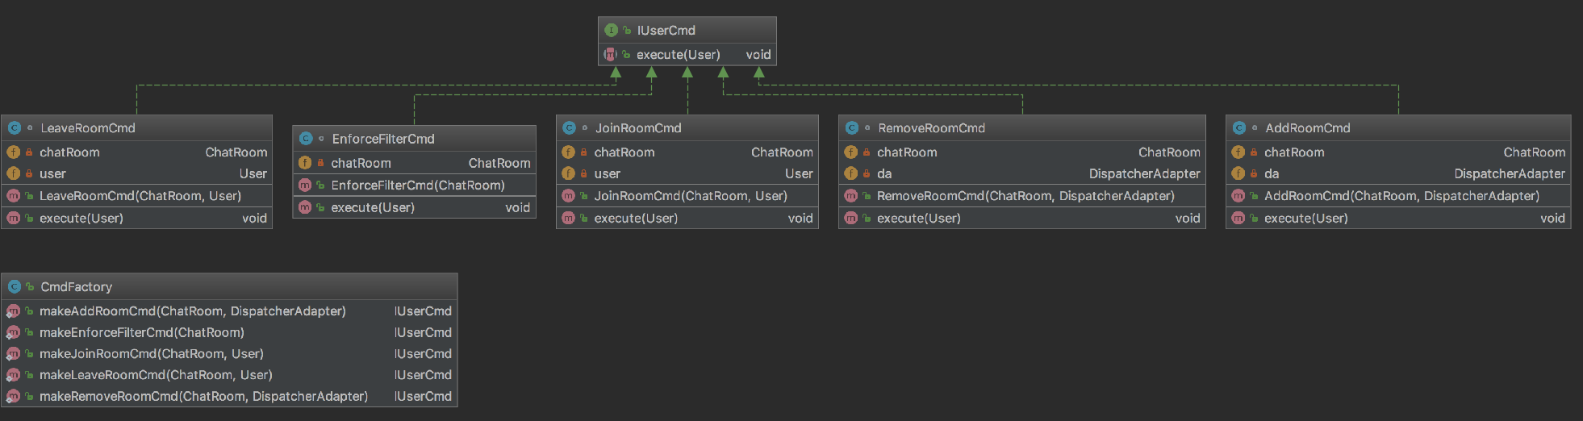
Model - Package cmd

Slide 8
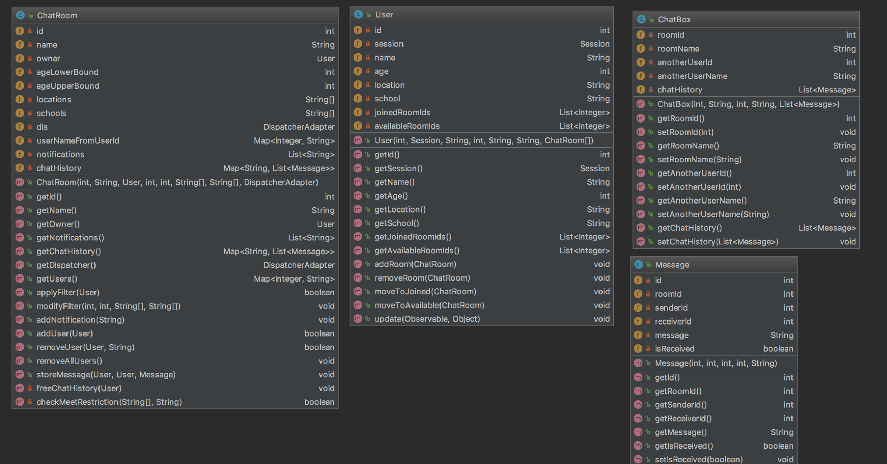
Model - Package obj

Slide 9
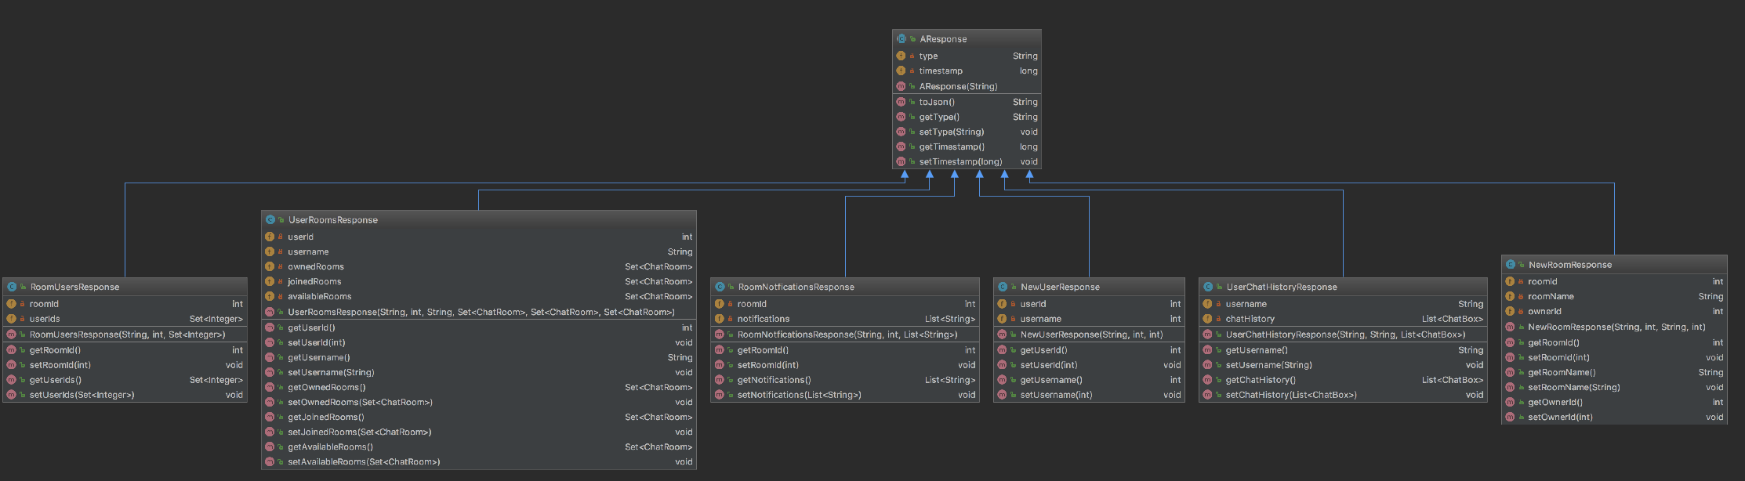
Model - Package res

Slide 10
Q & A

