Slide 1
NullSleep’s ChatApp
11/28/2018

Slide 2
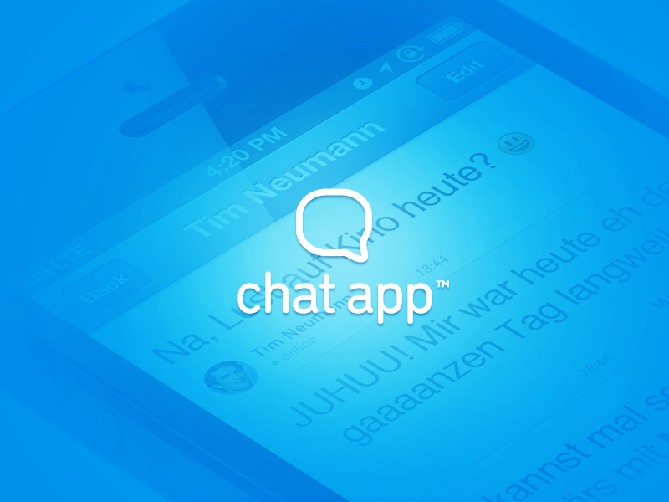
Team NullSleep
Yijun He (team lead)
Alex Teich (tech lead)
Jinxuan Cheng (doc lead)
Jianwei Jin(dev)
Shuqi Feng (dev)
Jiali Han (dev)
Mengyuan Wan (dev)

Slide 3


Framework
Events (JSON)
Response (JSON)
Events (Object)
Response (JSON)
Response (object)
Socket
Server
Response (JSON)
Clients

Slide 4
Design Decisions can remove this page???
No any endpoint in controller except for the index page (as client app)
Login, Create Room, Update Profile would be a pop-up window in client app
All communication, like client’s events and server’s responses are transferred through web socket, point to point.
No persistent storage, one webpage one application.

Slide 5
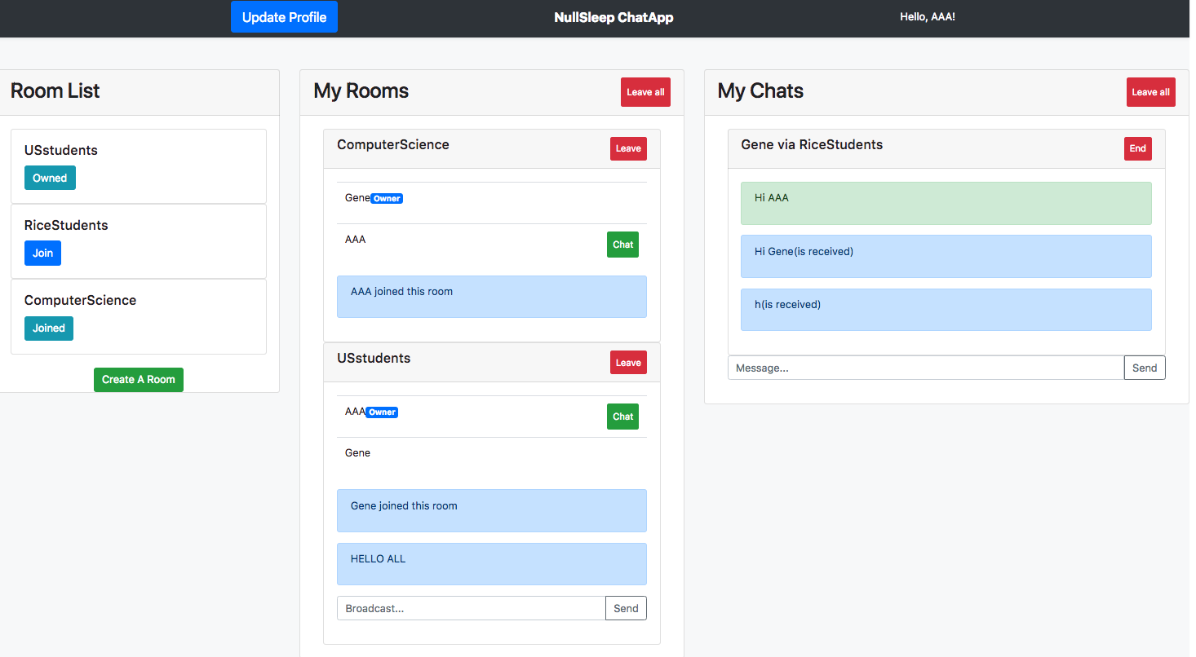
View

Slide 6
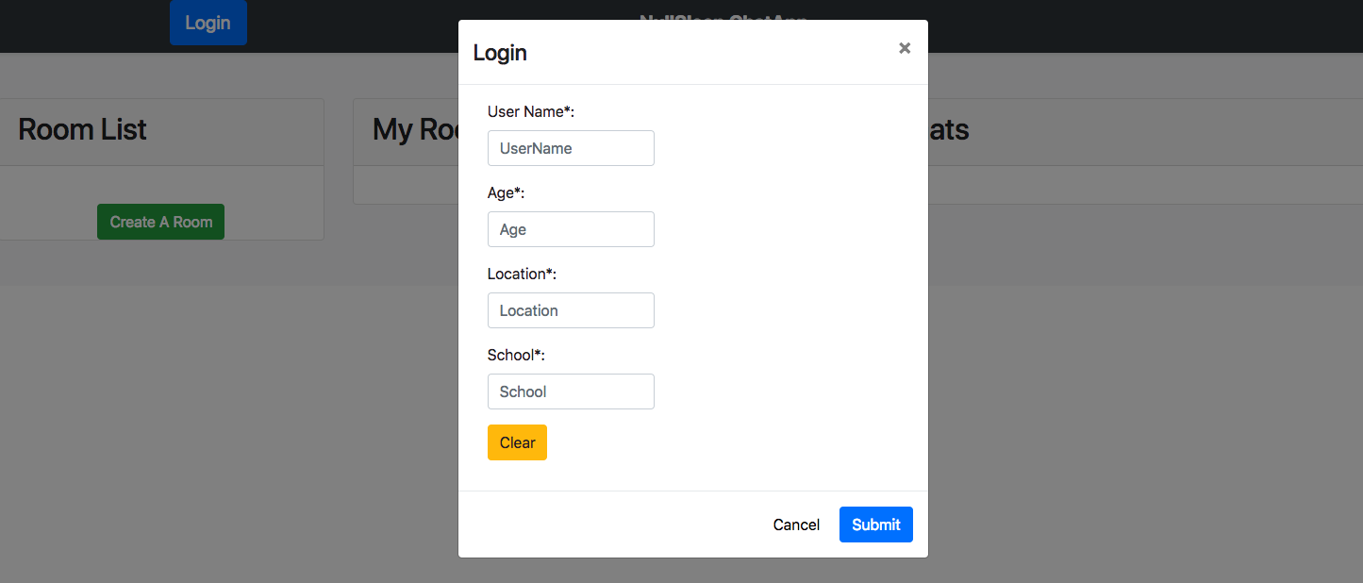
View - Login

Slide 7
View - Room List
All available rooms would be displayed in the room list
Buttons shows the status/valid operation of a room

Slide 8
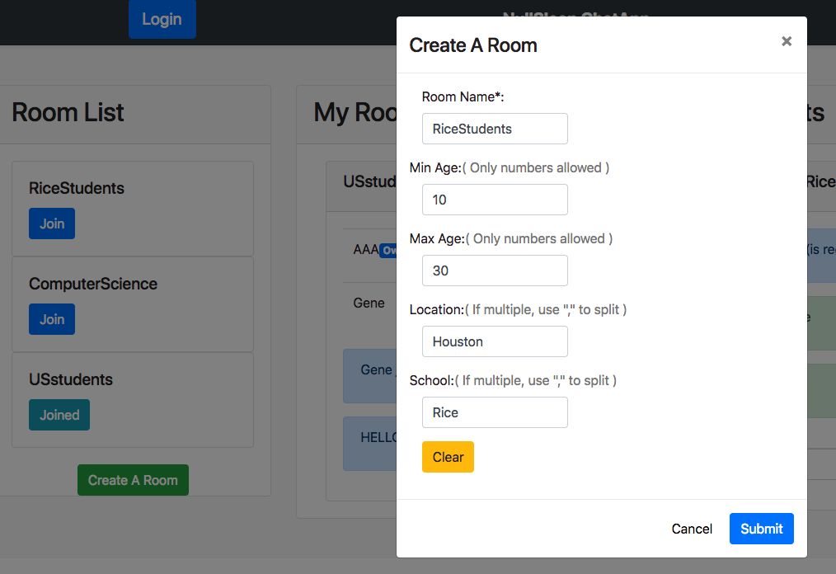
View - Create a room
When create a room, a form would pop up allow you to send the create room event to the server with the webSocket.

Slide 9
View - My Rooms

Slide 10
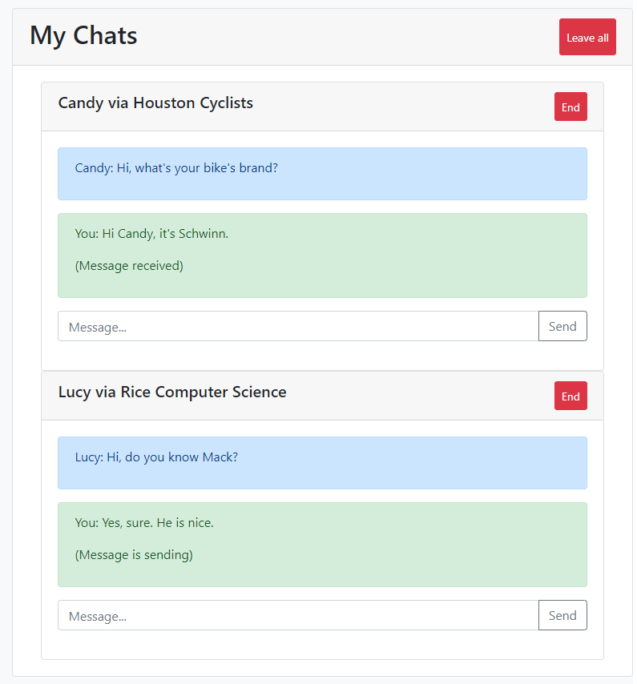
View - My Chats

Slide 11
JSON Examples to do
Server responses success (includes all the room info):
{
“type”: “login-response”,
“data”:{
“status”: “success",
“userId”: 1,
“rooms”: [
{
“roomId”: 1,
“roomName”: “Rice Computer Science”,
“roomBio”: “More than coding!”,
“joinStatus”: “can join” },
{
“roomId”: 2,
“roomName”: “Rice Computer Science Seniors”,
“roomBio”: “Hi old guys!”,
“joinStatus”: “cannot join”
}
]
}
}
Client sends:
{
“type”: “login”,
“data”: {
“user”: “Gene”,
“profile”: {
“age”: 18,
“location”: “North America”,
“school”: “Rice University”
}
}
}

Slide 12
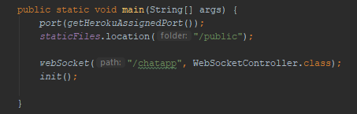
Controller – ChatAppController to do
Only index endpoint, one webSocket.

Slide 13
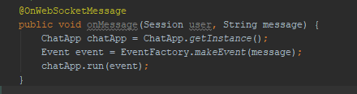
Controller – WebSocketController to do
ChatApp is singleton
Event Object is created by the EventFactory
The chatApp object runs the event

Slide 14
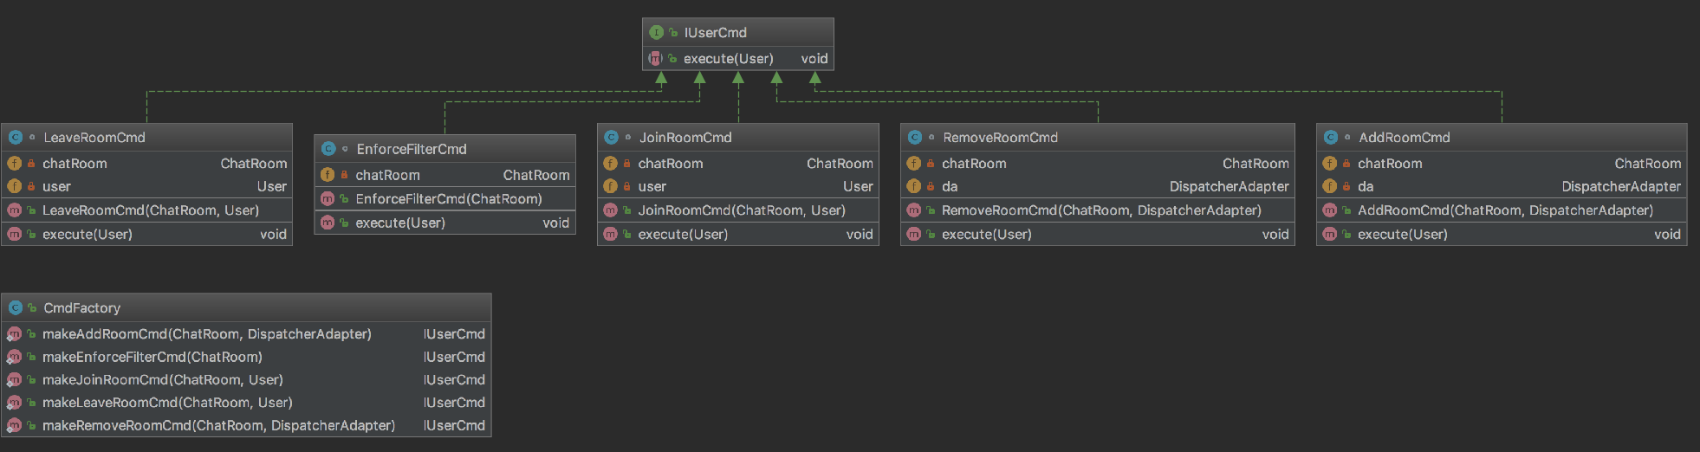
Model - Package cmd

Slide 15
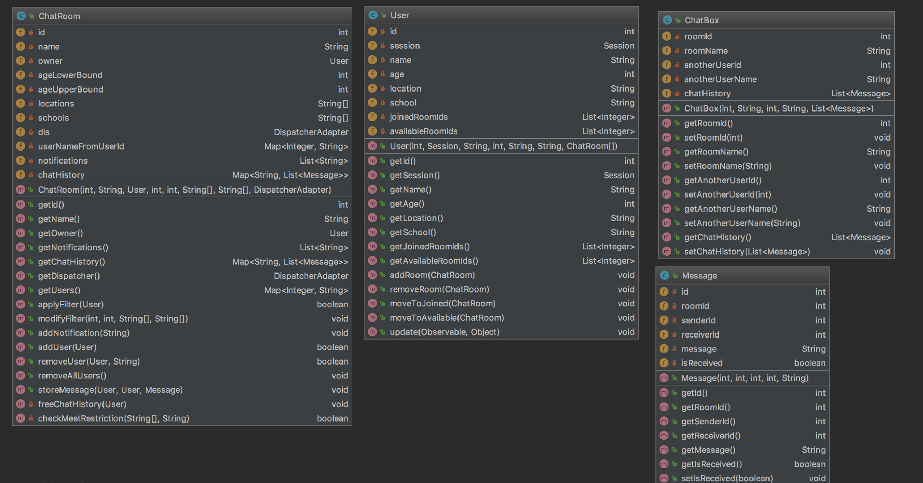
Model - Package obj

Slide 16
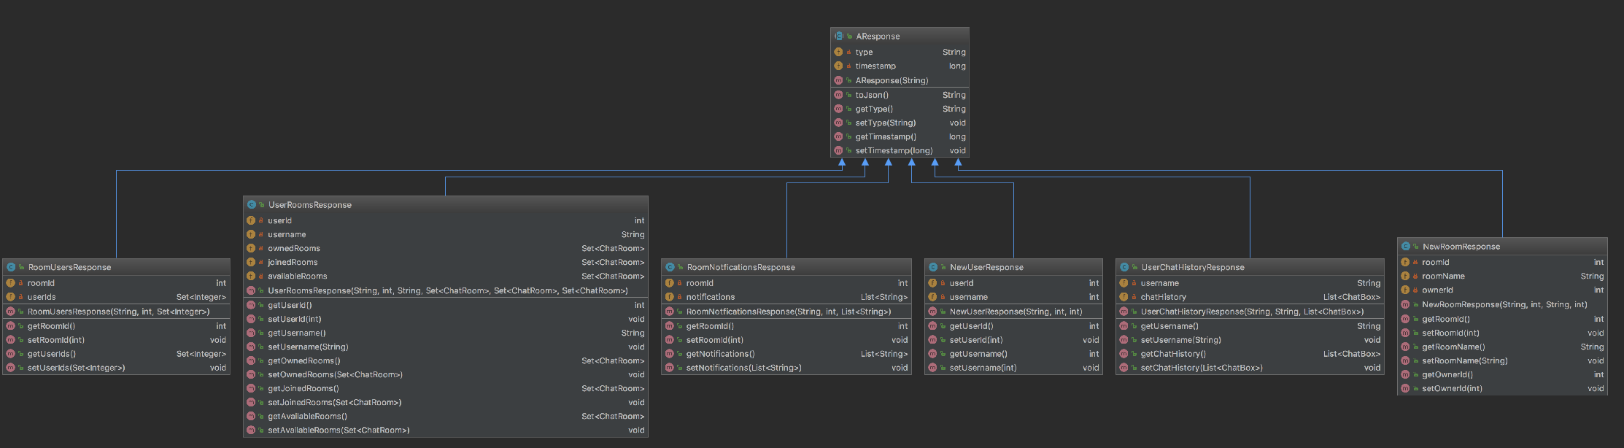
Model - Package res

Slide 17
Demo

Slide 18
Q & A

