Slide 1
7.15 group meeting
Ultrasound probe imitation learning data collection and model training
Pose calibration and force mapping
Manual script update
Policy models
7 experiment
2428 samples
2 baselines
6628 matched motion pairs
8D proxy input to normal force
ACT and diffusion training pipelines
01

Slide 2
This week turned calibration into manuscript-ready evidence
1
Rigid pose transformation
2
Normal force mapping
Validated tag-to-flange conversion on full and axis-constrained robot motions.
Trained proxy-signal mapping from IMU and Paxini measurements to KWR75B normal force.
3
Manuscript integration
4
Imitation learning baselines
Added result figure, table, and polished Section VI-A text for rigid transformation validation.
Built ACT-style and diffusion-policy-style training code; model training is running.
Main takeaway
The data migration pipeline now has quantitative calibration evidence, while the learning baselines are in place for the next group-meeting update.
Ultrasound probe imitation learning - weekly update
02

Slide 3
Force mapping now has a trained calibration model
Portable proxy signals are mapped to robot-frame normal force.
Dataset
Input
Target
Split
2428
8D
1D
1699 / 364 / 365
aligned samples from 7 sessions
pitch, roll, left/right 3-axis Paxini force
KWR75B normal force
train / val / test
Model performance
Held-out interpretation
Split
MAE (N)
RMSE (N)
R2
Pearson
- Test MAE: 1.18 N; test RMSE: 1.68 N.
- Test R2: 0.847; Pearson correlation: 0.921.
- Validation and test gaps are moderate, suggesting the mapping generalizes beyond training sessions.
Train
0.826
1.096
0.910
0.955
Validation
1.067
1.505
0.860
0.930
Test
1.183
1.683
0.847
0.921
Ultrasound probe imitation learning - weekly update
03

Slide 4
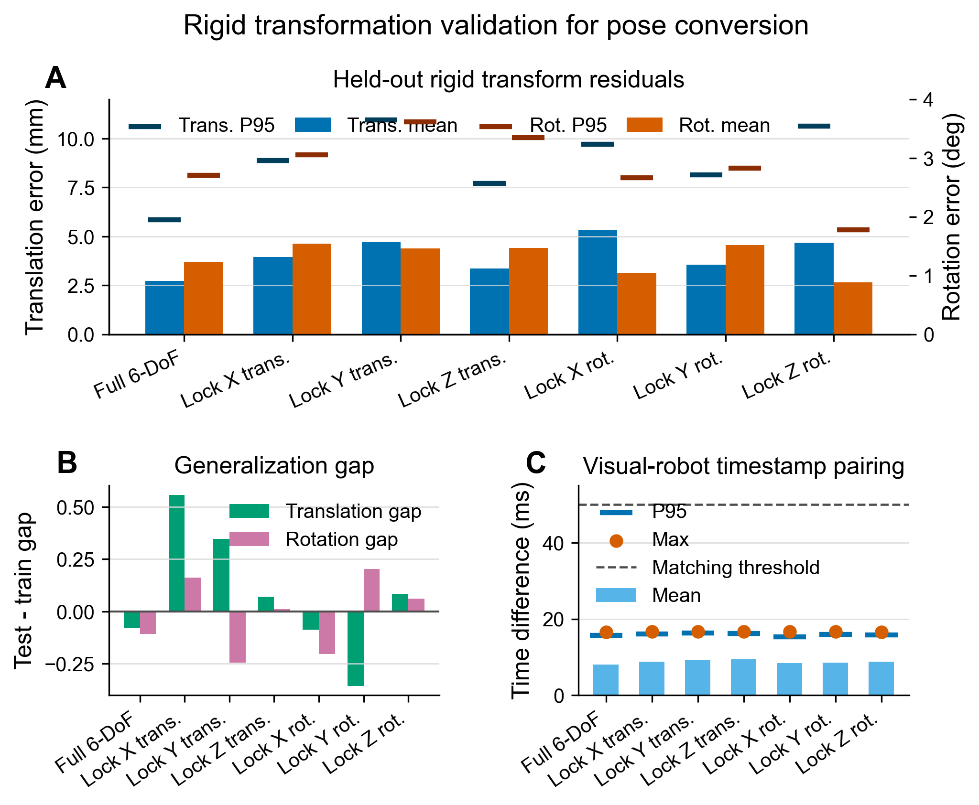
Rigid pose conversion: 6628 matched motion pairs
Full 6-DoF test error
2.73 mm
translation mean
Full 6-DoF rotation
1.24 deg
rotation mean
Pairing quality
16.72 ms
maximum test-set time difference
Ultrasound probe imitation learning - weekly update
04

Slide 5
The manuscript now has quantitative support for Section VI-A
Added artifacts
What the section now argues
- Rigid transformation validation figure in PNG/PDF/SVG.
- LaTeX table summarizing seven calibration sequences.
- Polished manuscript paragraph for Section VI-A.
- Large-font figure version for readability in manuscript and slides.
The calibrated marker-to-flange transform is stable on held-out motion pairs and can be used as a fixed conversion parameter for moving hospital-side marker trajectories into the robot end-effector frame.
Ultrasound probe imitation learning - weekly update
05

Slide 6
ACT and diffusion baselines are ready for training results
ACT-style chunk regressor
Diffusion-policy-style model
ultrasound image -> ResNet18 -> MLP -> future pose delta chunk
noisy future chunk + timestep + image condition -> MLP denoiser
- Action horizon defaults to 20 x 7 pose deltas.
- Supports with-force and without-force dataset variants.
- Splits by source session to reduce temporal leakage.
- Uses ResNet18 image condition.
- Force can be concatenated to the conditioning vector.
- Training scripts and configs are in place.
Ultrasound probe imitation learning - weekly update
06

Slide 7
Training results remain the main group-meeting update
Data conversion and calibration evidence
Manuscript Section VI-A update
ACT training
Diffusion training
Placeholder for group meeting
Insert ACT/diffusion loss curves and validation metrics once the current runs finish.
Ultrasound probe imitation learning - weekly update
07

Slide 8
Next step: connect calibrated data to policy learning
Before group meeting
Manuscript updates
Experiment follow-up
- Add ACT and diffusion loss curves.
- Report validation and test metrics.
- Identify whether force input improves pose prediction.
- Place figure between related result paragraphs.
- Keep large-font figure for readability.
- Align table and caption with final results wording.
- Check robustness across more scanning sessions.
- Compare with-force vs without-force policies.
- Prepare qualitative rollout examples if available.
Goal for the next update: move from calibrated data conversion to measurable imitation-learning performance.
Ultrasound probe imitation learning - weekly update
08

