Slide 1
7.15 group meeting
Ultrasound probe imitation learning data collection and model training
Experiment validation pipeline
Manuscript evidence
Primitive model training
Pose + force mapping
Primitive edition done
Two Structure Applied
calibrated data migration inputs
figure, table, and results text integrated
training overview ready for comparison
01

Slide 2
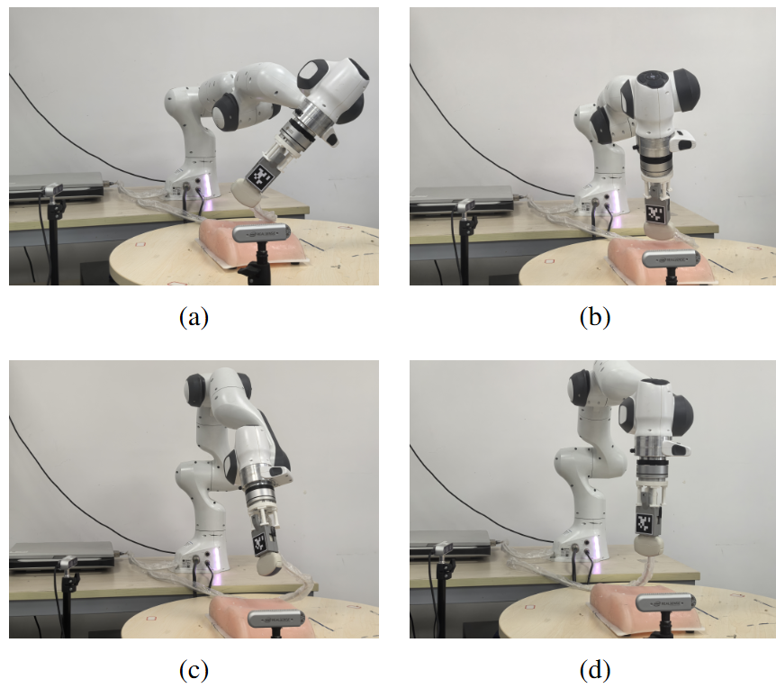
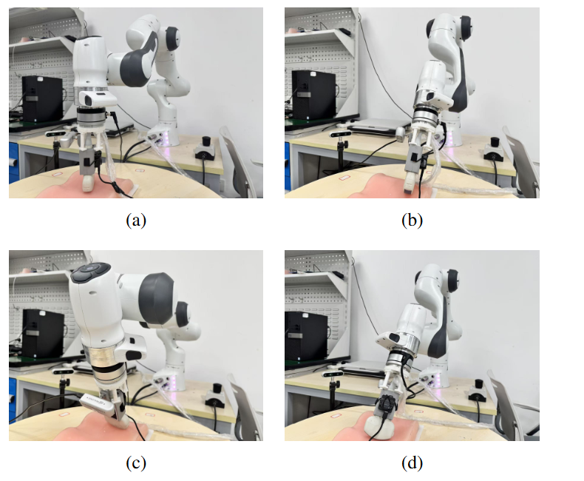
Two Groups of Experiment on Pose Calibration and Force Mapping
1
Rigid pose transformation
2
Normal force mapping
Validated tag-to-flange conversion on full and axis-constrained robot motions.
Trained proxy-signal mapping from IMU and Paxini measurements to KWR75B normal force.

Slide 3
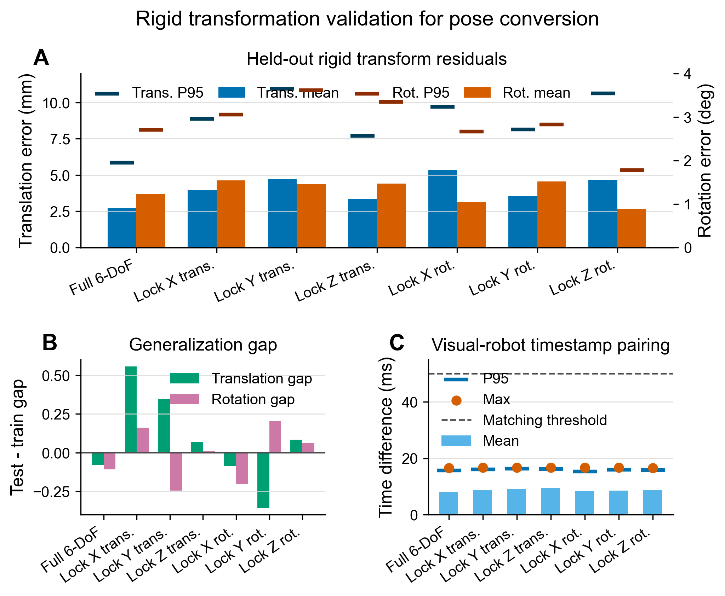
Rigid Pose Conversion
Full 6-DoF test error
2.73 mm
translation mean
Full 6-DoF rotation
1.24 deg
rotation mean
Pairing quality
16.72 ms
maximum test-set time difference
Ultrasound probe imitation learning - weekly update
04

Slide 4
Force Mapping
Dataset
Input
Target
Split
2428
8D
1D
1699 / 364 / 365
aligned samples from 7 sessions
pitch, roll, left/right 3-axis Paxini force
KWR75B normal force
train / val / test
Model performance
MAE (N): average absolute force prediction error; lower is better.
RMSE (N): error metric that penalizes larger prediction mistakes more strongly; lower is better.
R²: proportion of force variance explained by the model; closer to 1 is better.
Pearson: linear correlation between predicted and measured force; closer to 1 means stronger agreement.
Split
MAE (N)
RMSE (N)
R2
Pearson
Train
0.826
1.096
0.910
0.955
Validation
1.067
1.505
0.860
0.930
Test
1.183
1.683
0.847
0.921
Ultrasound probe imitation learning - weekly update
03

Slide 5
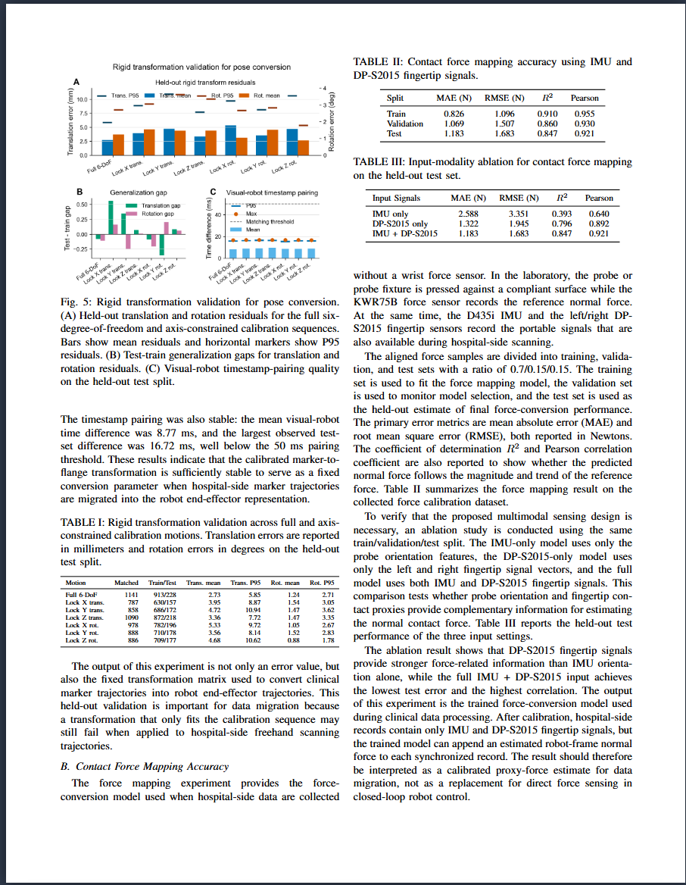
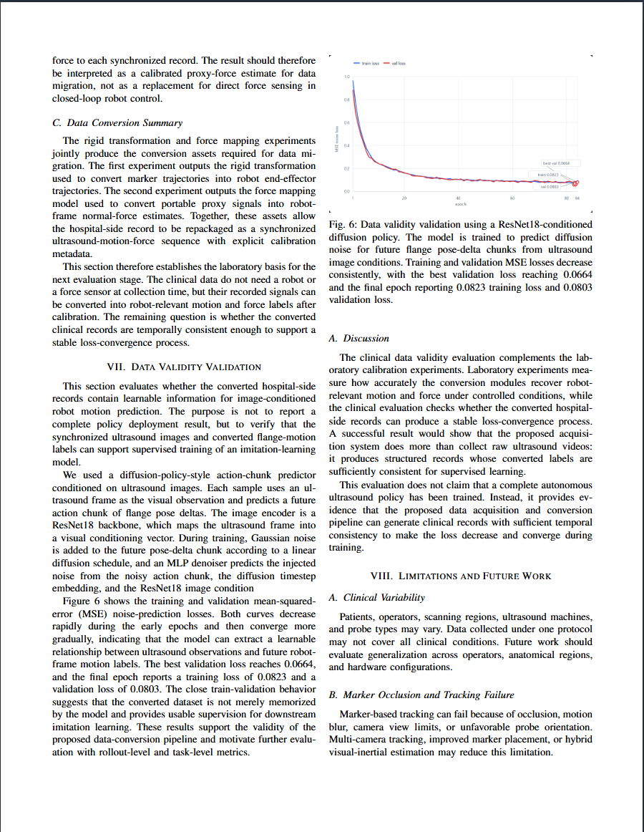
Manuscript Update
Ultrasound probe imitation learning - weekly update

Slide 6
Diffusion policy training
condition = ultrasound_image_t
Image is preporcessed by the ResNet18
target action chunk = A0 = [pose_delta_{t+1}, ..., pose_delta_{t+7}]
A_k = sqrt(ᾱ_k) * A0 + sqrt(1 - ᾱ_k) * ε
A0: real pose delta sequence (20*7)
A_k: k_th step with noise[20, 7]
ε: Guassian noise[20, 7]
β_k = linear schedule from beta_start to beta_end
α_k = 1 - β_k
ᾱ_k = ∏_{i=0}^{k} α_i
Diffusion-policy-style model
noisy future chunk + timestep + image condition -> MLP denoiser
- Uses ResNet18 image condition.
- Force can be concatenated to the conditioning vector.
- Training scripts and configs are in place.
Ultrasound probe imitation learning - weekly update
06

Slide 7
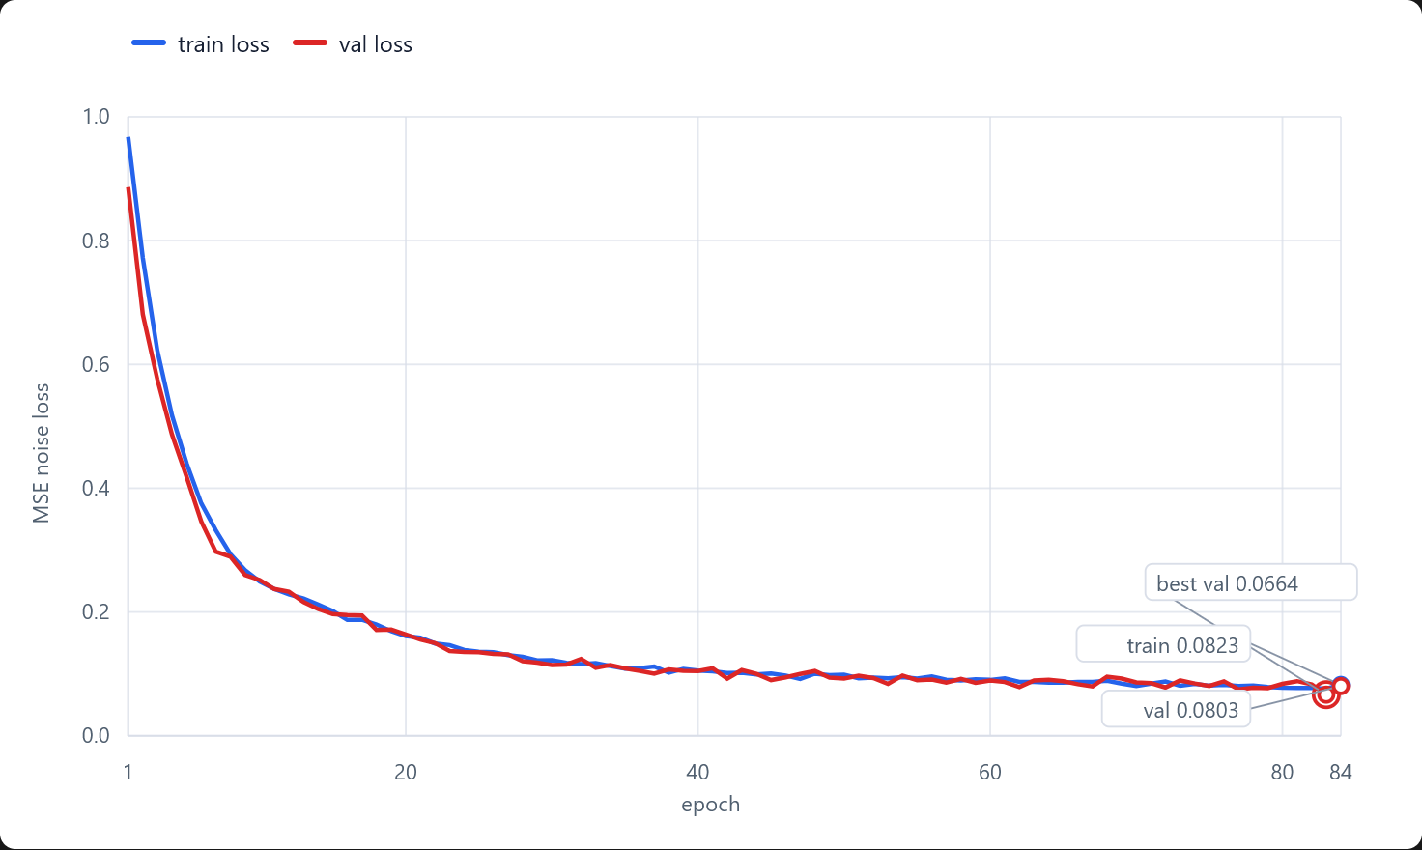
Train-Val Plot
Trained for 24h
Loss is defined as MSE(ε_pred, ε)
The training and validation losses converged closely without a noticeable generalization gap, indicating no evident overfitting during diffusion policy training.
The norm of the en-noised quaternion not equals to 1.
-q and q stand for the same rotation

Slide 8
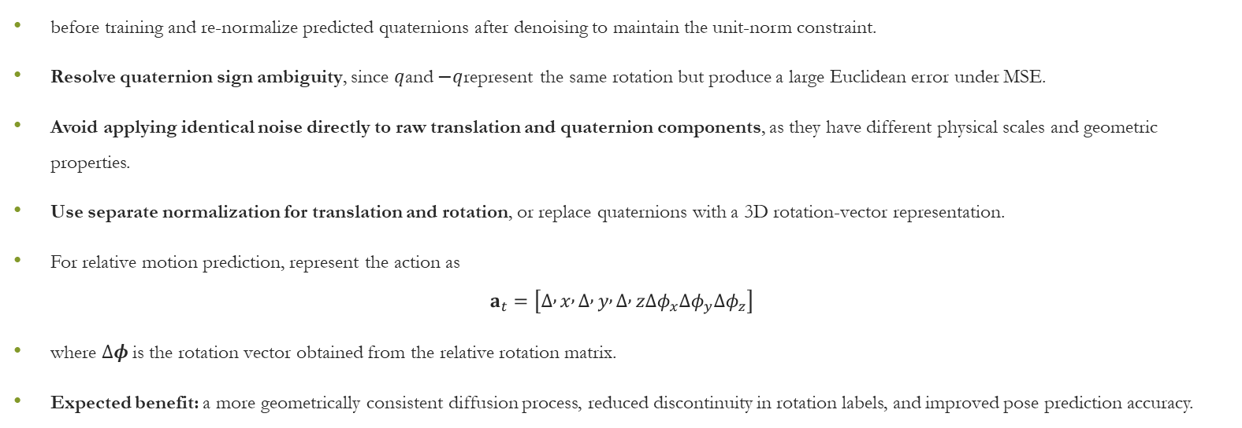
Future Improvement: Geometry-Aware Rotation Representation Normalize quaternion labels
before training and re-normalize predicted quaternions after denoising to maintain the unit-norm constraint.
Resolve quaternion sign ambiguity, since $q$and $−q$represent the same rotation but produce a large Euclidean error under MSE.
Avoid applying identical noise directly to raw translation and quaternion components, as they have different physical scales and geometric properties.
Use separate normalization for translation and rotation, or replace quaternions with a 3D rotation-vector representation.
For relative motion prediction, represent the action as $a_{t}=\left[Δ , x , Δ , y , Δ , zΔφ_{x}Δφ_{y}Δφ_{z}\right]$
where $Δφ$is the rotation vector obtained from the relative rotation matrix.
Expected benefit: a more geometrically consistent diffusion process, reduced discontinuity in rotation labels, and improved pose prediction accuracy.

Slide 9
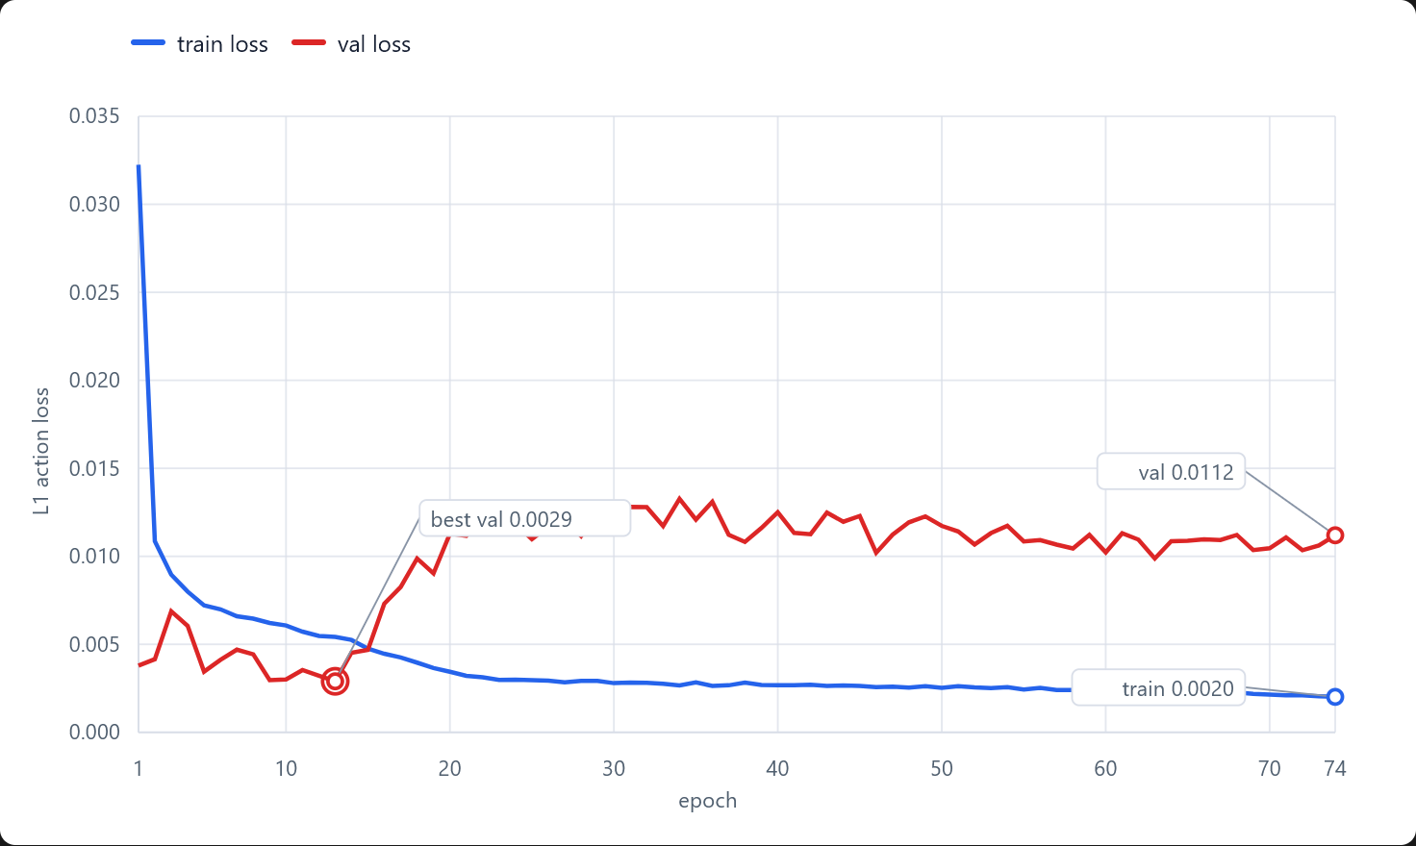
Non-time Sequence Structure
Action chunk regressor
ultrasound image -> ResNet18 -> MLP -> future pose delta chunk
- Action horizon defaults to 20 x 7 pose deltas.
- Supports with-force and without-force dataset variants.
- Splits by source session to reduce temporal leakage.
condition = ultrasound_image_t
Image is preporcessed by the ResNet18
target action chunk = A0 = [pose_delta_{t+1}, ..., pose_delta_{t+7}]
overfitting
Ultrasound probe imitation learning - weekly update
06

Slide 10
ACT is under training …

