Slide 1
2026.7.7 group meeting
Ultrasound probe scanning data collection system

Slide 2
content
Step I: hospital side raw data collection
Step II: Lab side data converting
Step III: manual script writing
Step IV: future job

Slide 3
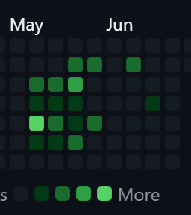
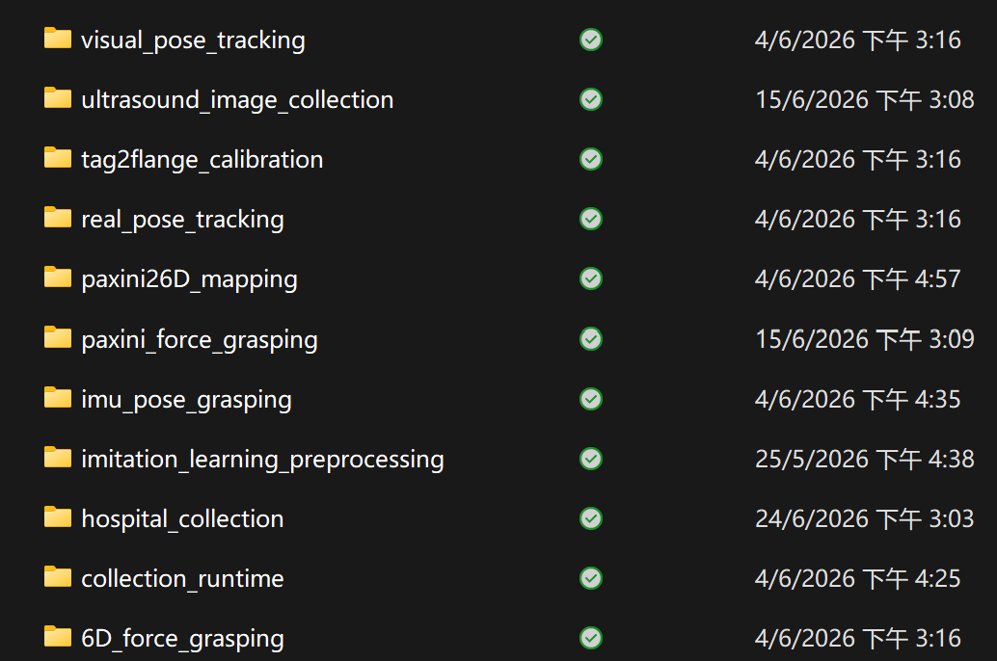
Step I. System structure overview
Hospital side for raw data collection
Ultrasound scanning frame stream
Probe 6D homogeneous matrix tacked by AprilTag algorithm
Force data recorded by PAXINI finger tip sensor.
IMU for pitch and yaw angle recording

Slide 4
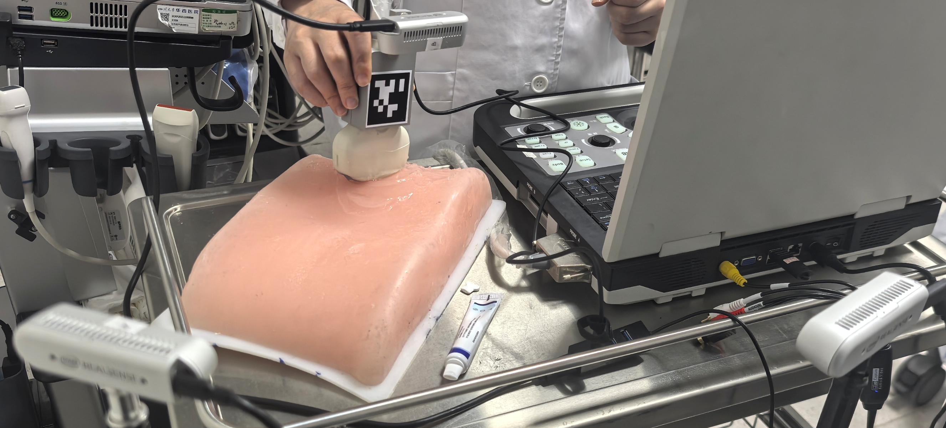
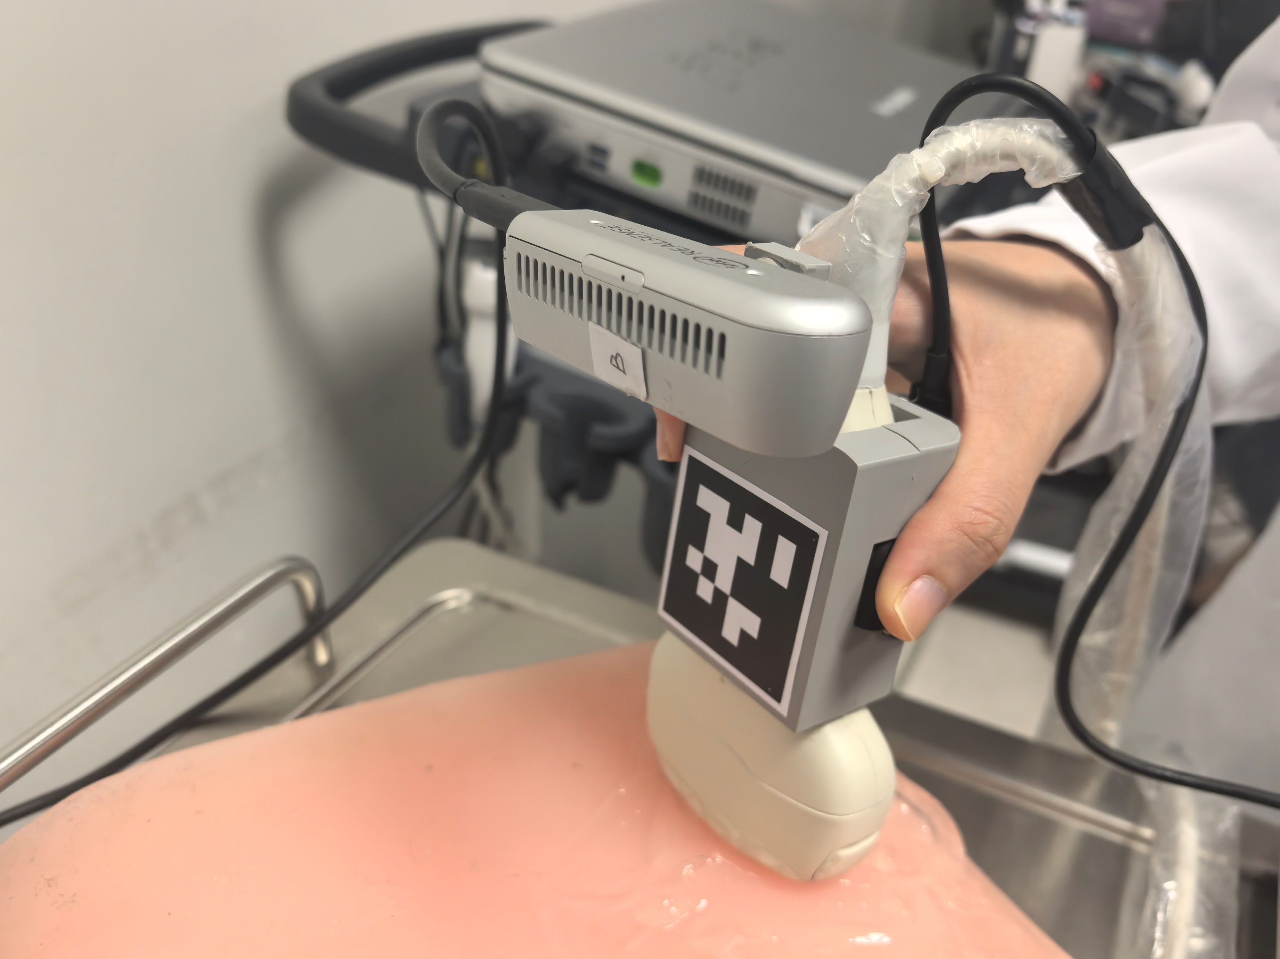
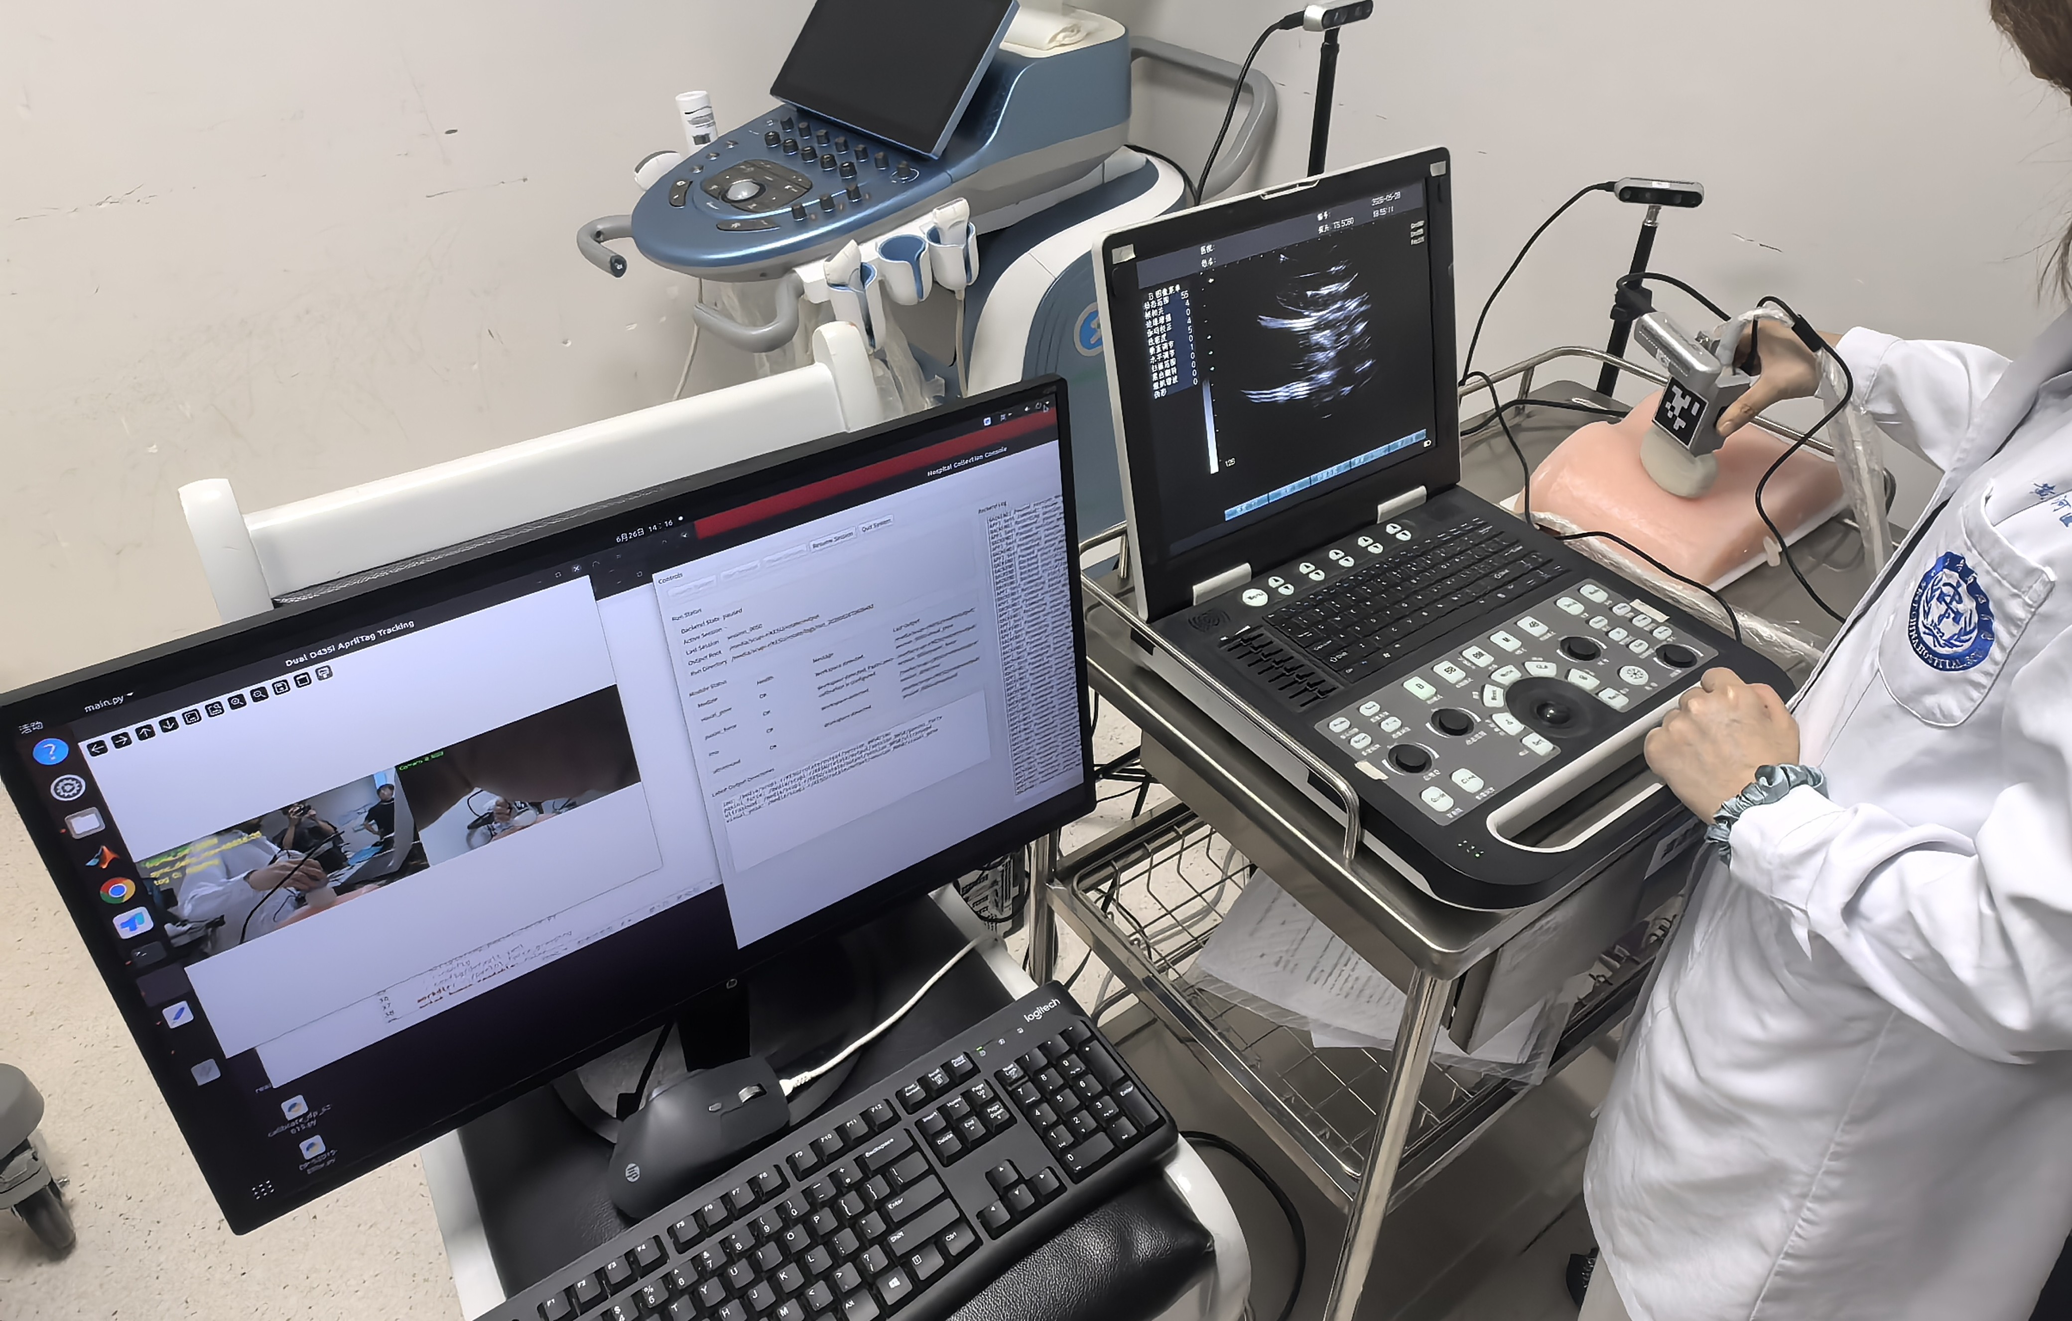
Facility Setup for data collection Overview
AprilTag
Finger tip Sensor
IMU
Camera A
Camera B
Rear perspective
Magnified probe perspective
Work Station

Slide 5
Step II: Lab side for data converting
data converting for Posture and Position
Recording the tag pose change and real pose change from the encoders of the joints on manipulator
AX = XB to calculate the transformation matrix X using the least square optimization

Slide 6
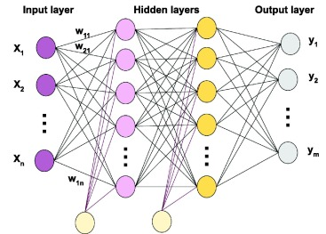
data converting for force data converting
Recording paxini finger tip force data and 6D force data.
Using Universal Approximation Theorem to do the force mapping

Slide 7
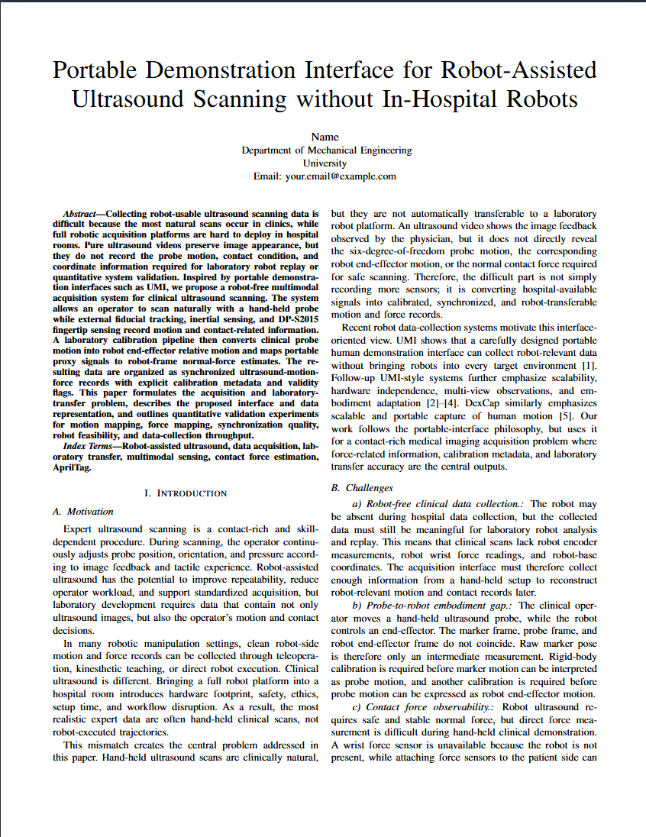
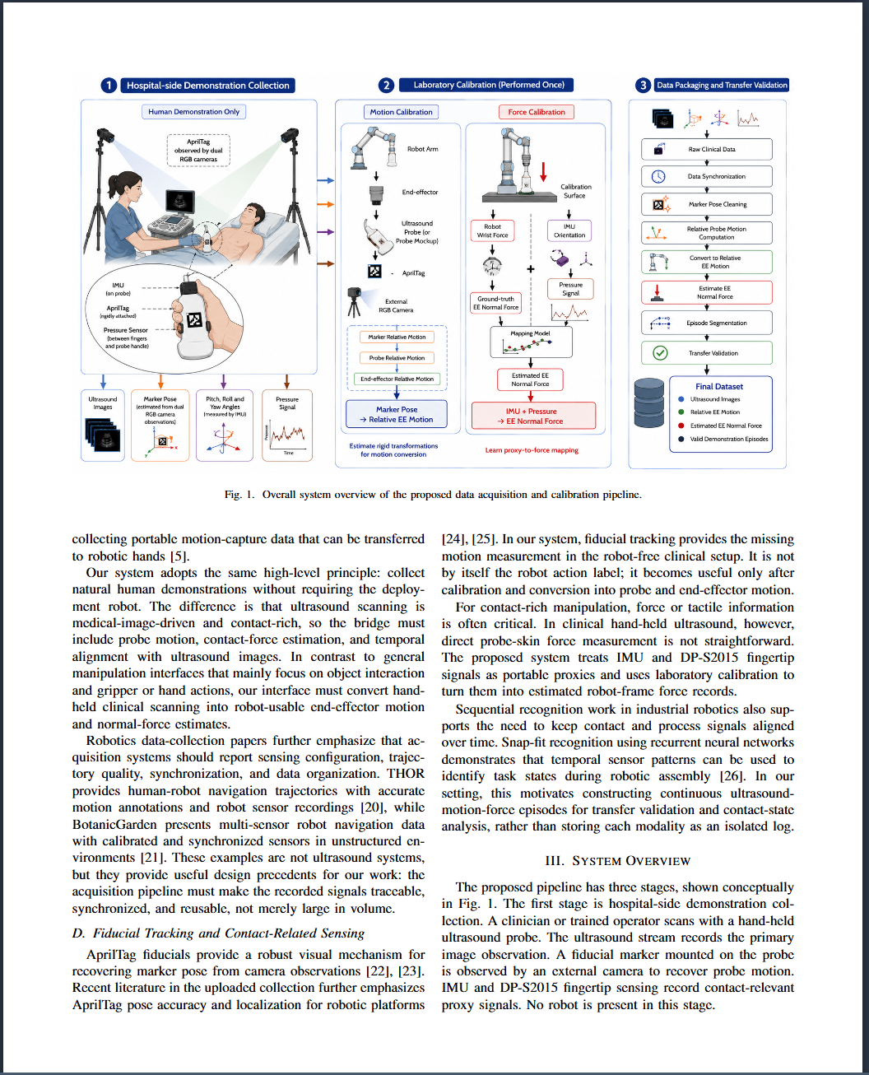
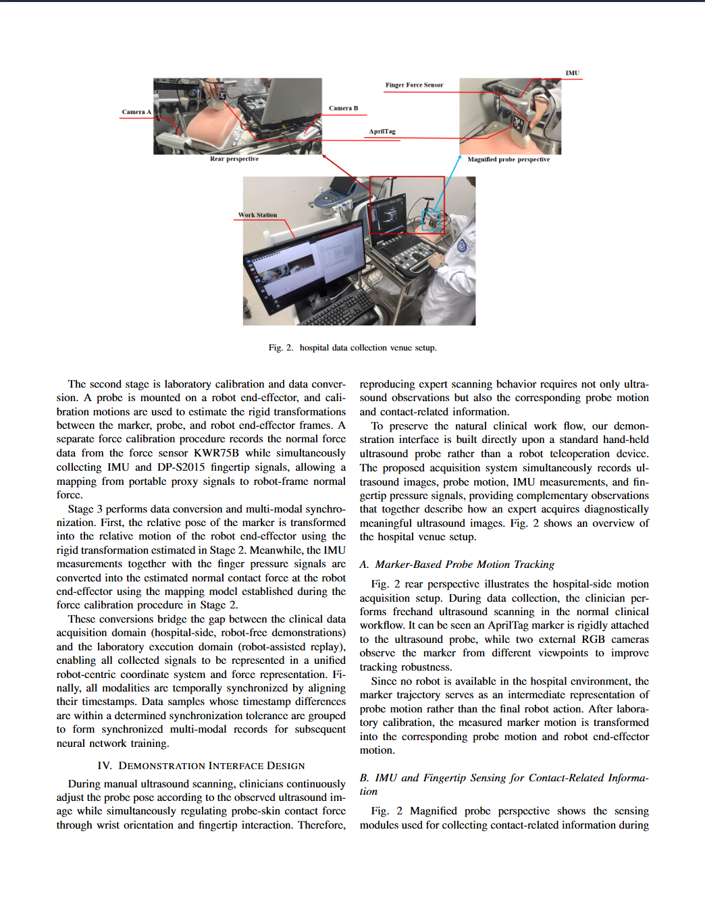
Step III: Manual script writing in progress…
…

Slide 8
Paper content overview
Introduction and motivation (done)
Related work (literature review) (done)
System overview – data categories, data collection and calibration (done)
Demonstration interface design – the reasonability to collect some specific data and the process to collection (done)
Demonstration to robot data conversion interface – theorem applied to do the conversion (done)
Experiment
Future work and limitation

Slide 9
Step Vi: future work, imitation learning
Strategy candidate: diffusion policy and ACT (action chunking with transformer)
Diffusion policy Advantages
Models multi-modal action distributions instead of averaging different demonstrations.
Generates smooth and coherent long-horizon trajectories.
Produces actions that are closer to expert demonstrations, leading to more natural robot motions.
More robust than conventional behavior cloning for complex manipulation tasks.
Limitations
Still relies on the training data distribution and has limited out-of-distribution (OOD) generalization.
Does not inherently understand task objectives; it only imitates demonstrated behaviors.
Requires a relatively large amount of demonstration data.
Iterative denoising increases inference latency compared with one-step action prediction.

Slide 10
Acting chunking with transformer:
Advantages
Efficient one-step prediction with low inference latency.
Predicts action chunks for smooth and stable control.
Simple training with deterministic regression.
Well suited for tasks with consistent expert demonstrations.
Limitations
Learns a deterministic mapping and tends to average multi-modal demonstrations.
Limited ability to model action uncertainty.
Performance degrades when multiple valid future actions exist.
More sensitive to distribution shifts (OOD) than generative policies

