Slide 1
指導教授: 朱 留 博士 Adviser :Dr. Chu, Liou
Unity Study – Music Game
Unity 研究與學習 – 音樂遊戲
彭景楠
Ching-Nan Peng
402850118
葉俊毅
Jun-Yi,Yeh
402850217
劉光祐
Kuang-Yu Liu
402850407
劉厚德
Hou-Te, Liu
402850241
顧栢維
Po-Wei. Ku
402850506

Slide 2
Outline
Introduction
Related Work
System Structure
Special Notes
Future Work and Conclusion
Q & A
Notes:
This presentation consists of the following contents:
(read the text)

Slide 3
Introduction
Rhythm Game
Unity
Notes:
This presentation consists of the following contents:
(read the text)

Slide 4
Related Work
Unity Editor
Power Editor
Notes:
This presentation consists of the following contents:
(read the text)

Slide 5
Unity Editor
What is Unity?
Why do we choose Unity?
Notes:
This presentation consists of the following contents:
(read the text)

Slide 6
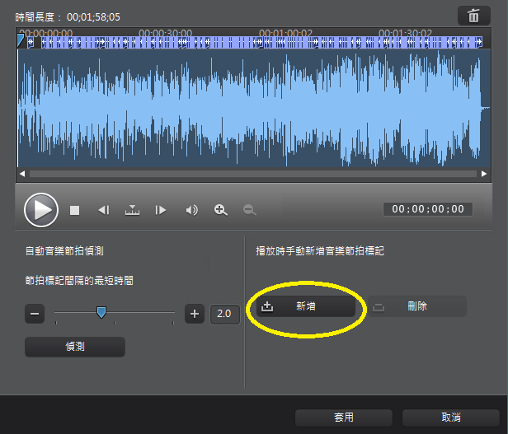
Power Editor
We use one of the Power Editor 10’s features that can add marks in the music time line.
Notes:
This presentation consists of the following contents:
(read the text)

Slide 7
Hyper Explosion
Hyper Explosion
Combined by : UI, C# Scripts, Functions In Unity, Music Edit, and Art Design.
Notes:
This presentation consists of the following contents:
(read the text)

Slide 8
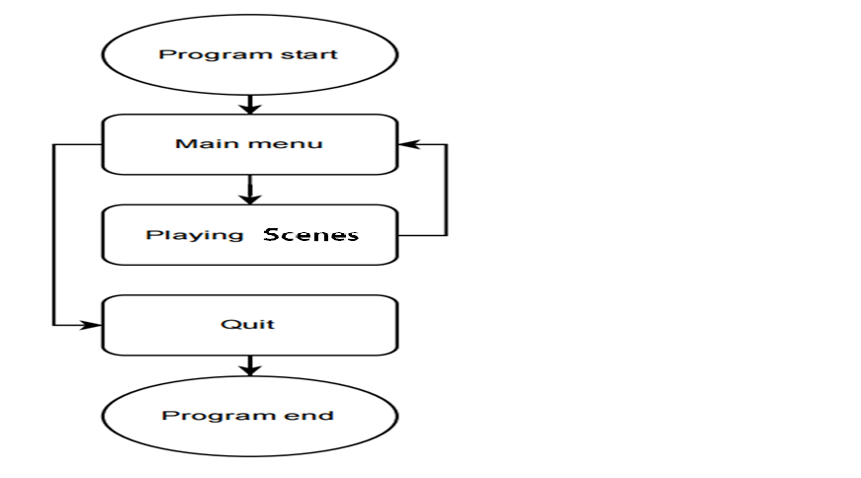
Game Structure
Notes:
This presentation consists of the following contents:
(read the text)

Slide 9
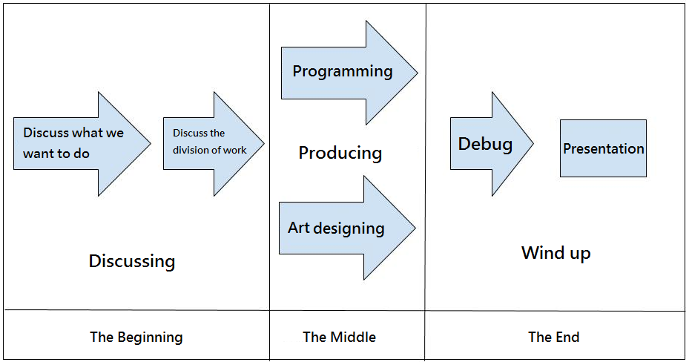
Game Developing Process
Notes:
This presentation consists of the following contents:
(read the text)

Slide 10
Special Notes
Normal Notes
Long Bar Notes
Double Click Notes
Reflective Notes
Notes:
This presentation consists of the following contents:
(read the text)

Slide 11
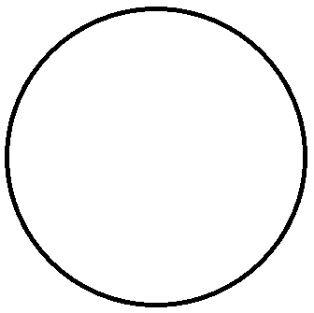
Normal Notes
The circle center launches balls.
The player clicks the balls to get points.
Click!
Notes:
This presentation consists of the following contents:
(read the text)

Slide 12
Long Bar Notes
a long bar need to click and hold by the left mouse key till it end to get points.
Click and hold !
Notes:
This presentation consists of the following contents:
(read the text)

Slide 13
Double Click Notes
Double clicked to get points!!
DoubleClick!
Notes:
This presentation consists of the following contents:
(read the text)

Slide 14
Reflective Notes
Clicking will not be destroyed but reflected to the other side and click again to get points.
Click!
And Click!
Notes:
This presentation consists of the following contents:
(read the text)

Slide 15
Game’s User Interface
Unity Editor
Photoshop
Notes:
This presentation consists of the following contents:
(read the text)

Slide 16
User Interface
Health Bar
Menu
Pause
Notes:
This presentation consists of the following contents:
(read the text)

Slide 17
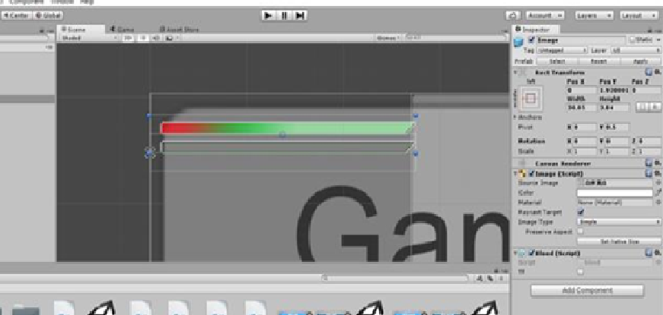
User Interface - Health Bar
Notes:
This presentation consists of the following contents:
(read the text)

Slide 18
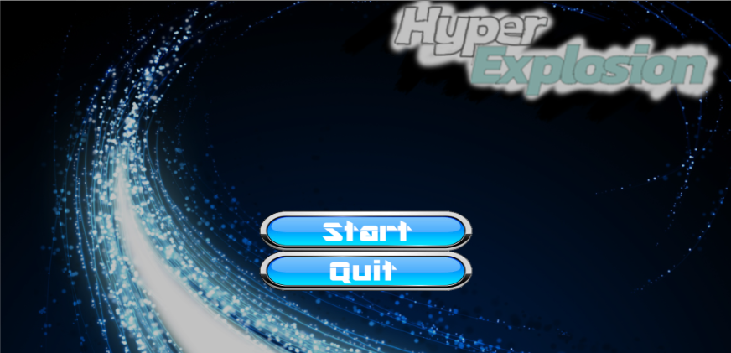
User Interface - Menu
Notes:
This presentation consists of the following contents:
(read the text)

Slide 19
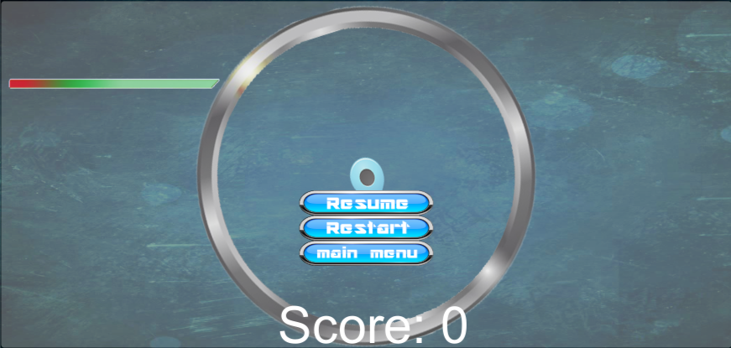
User Interface - Pause
Notes:
This presentation consists of the following contents:
(read the text)

Slide 20
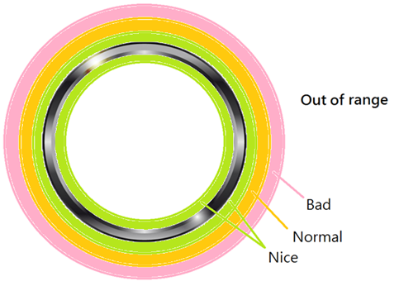
Score Configuration
Nice click : score + health +
Normal click : health +
Bad click : score- health-
Out of range : score- health-

Slide 21





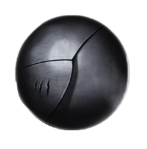

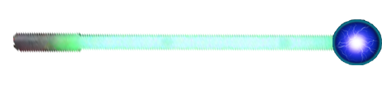
Art design
Photoshop CS6

Slide 22





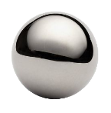



Before and after Photoshop remaking
Before (Prototype)
After

Slide 23
Music
Otonohappa↓
http://otonohappa.web.fc2.com/eindex.html
Infringement problem
Notes:
This presentation consists of the following contents:
(read the text)

Slide 24
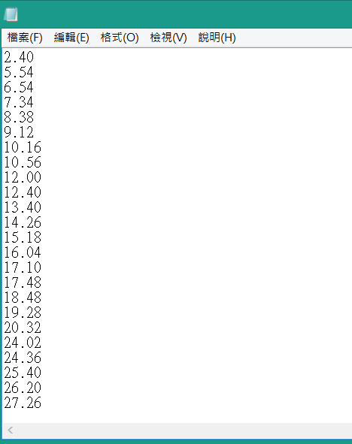
Timing
Notes:
This presentation consists of the following contents:
(read the text)

Slide 25
Debug
Time Function
Ball
Health Script
Double-click
Notes:
This presentation consists of the following contents:
(read the text)

Slide 26
Conclusion
Designed a music game.
Learned Unity.
Accomplished a group research task.
Notes:
This presentation consists of the following contents:
(read the text)

Slide 27
Future work
Database
Music songs
Different modes
Notes:
This presentation consists of the following contents:
(read the text)

Slide 28
Thank You

Slide 29
Q & A

