Slide 1

Capstone 2 Supervised Learning
How to find the value of a home

Slide 2
Dataset
Thinkful Database: House Prices
Data Dimension: 1460 x 81

Slide 3
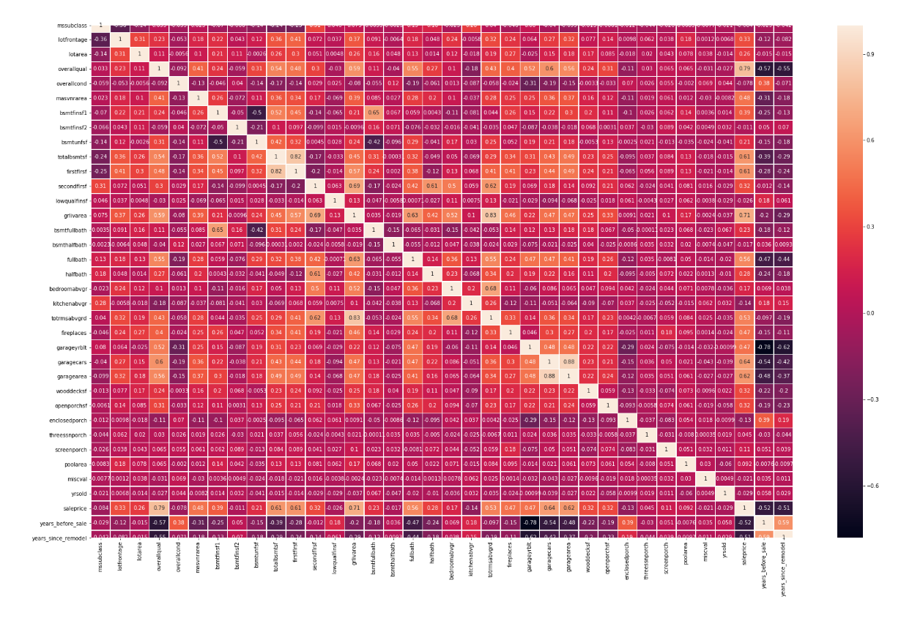
Data Exploration Part 1
Data Exploration Part 1
● Non numeric columns: 43
● Numeric columns: 38
● Target variable distribution
● Correlation Matrix
● Univariate Relation

Slide 4
Data Exploration Part 2
Data cleaning
● Filling in missing values with mean and mode
Feature Engineering
● Feature Reduction
- Consolidate columns to reduce the features
- Drop irrelevant features

Slide 5
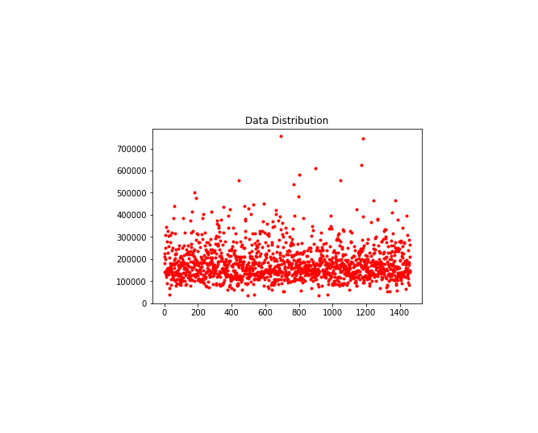
Data Distribution Plot

Slide 6
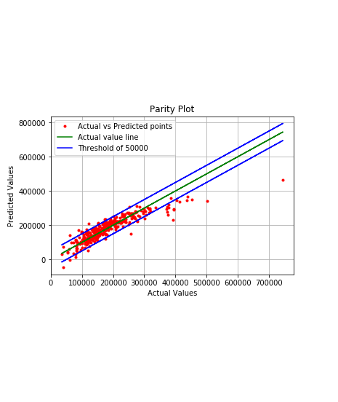
Model Selection Linear Regression
Parity Plot

Slide 7
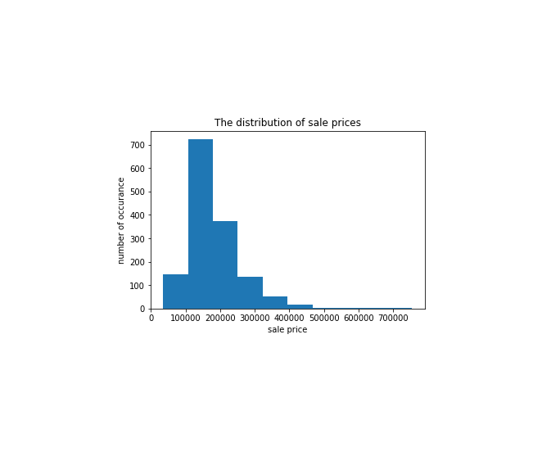
Home Sale Price
Distribution Plot

Slide 8
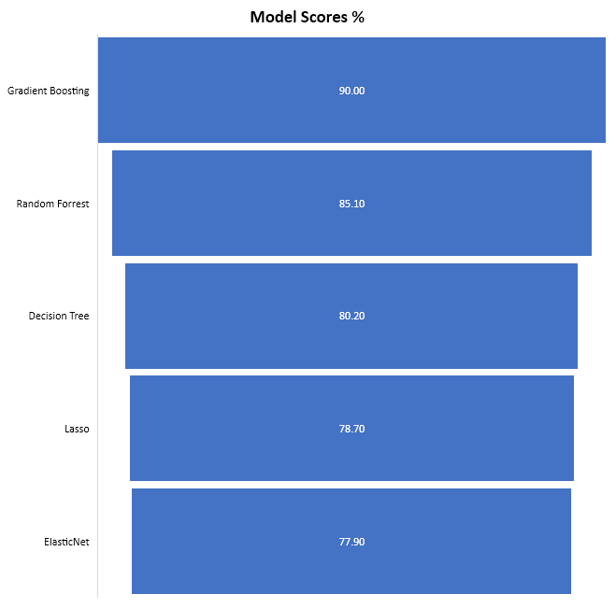
Model Performances

Slide 9
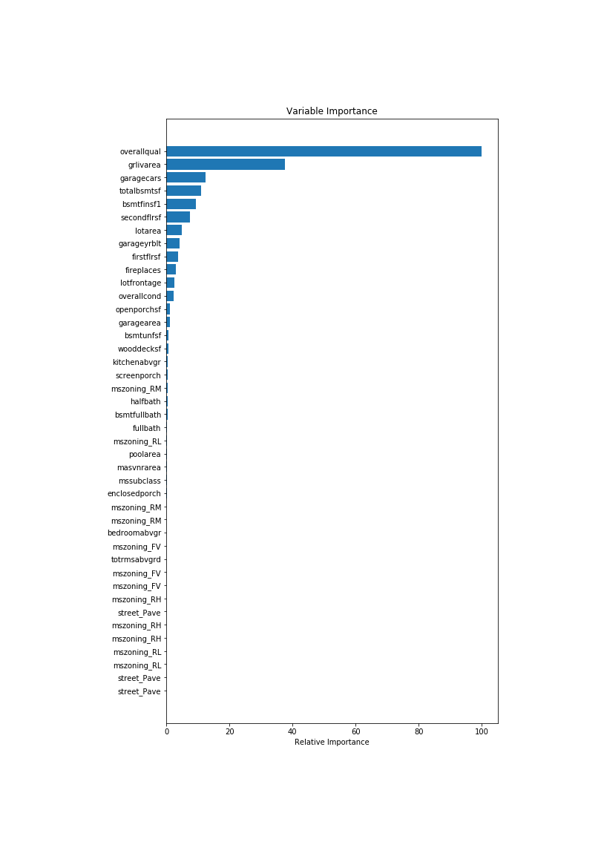
Variable Importance Selected features for Decision Trees

Slide 10
Hyperparameter tuning
Hyperparameter Optimization
- Gradient Boosting with Randomized Search

Slide 11



Practical Use
Who can benefit from this predictions
- Home buyers
- Home Builders
- Real Estate agent
Home features that drive the price

Slide 12
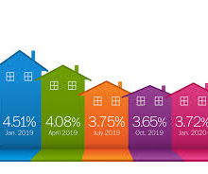

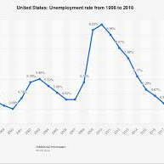

Caution
Mortgage Interest Rate ● Unemployment Rate ● Supply / Demand
Short Sales

Slide 13

Further Data Analysis:
● Remove un-correlated features and re-train ● Removing outliers ● Data Distribution ● Univariate & Bivariate

