Slide 1
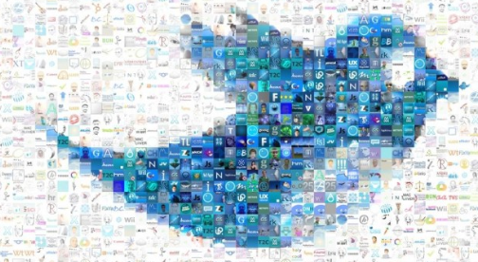
Thinkful Final Capstone NLP: Twitter Sentiment Analysis
Geneson Subra
Feb 2020

Slide 2
Overview
Goal Setting
-Determine the sentiment analysis and scope of work
Data Source
- Twitter API, Tweepy API
- JSON, SQLITE3
Text Processing
- Load Text
- Delete unwanted/ meaningless word
- Sentiment Analysis / text blob / tokenize / sentiment.polarity
Modeling
- Naïve Bayes Classifier
- other modeling
Visualization
- Get geo location for mapping
- Kriging / Interpolation – Spatial interpolation
Final Thoughts and Conclusion
- users geo location
- additional normalization
- experiment with stemming and lemmatization
Next Step
- Web App

Slide 3
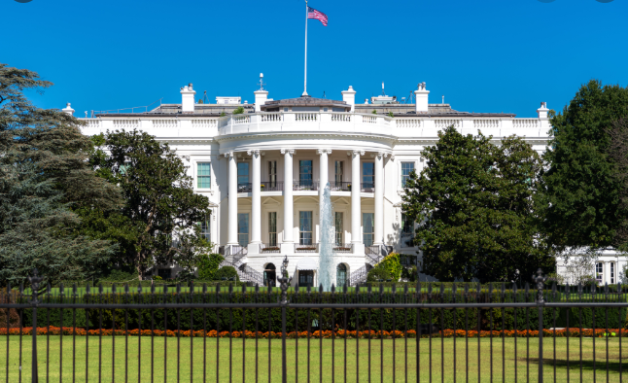
White House

Slide 4
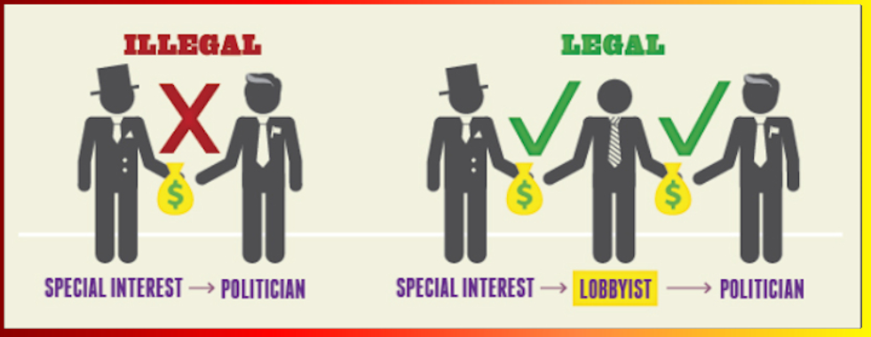
Funding

Slide 5

Exploratory Committee

Slide 6
Then What!

Slide 7
Perform market analysis to determine customer sentiment
Politics – Connecting with voters
Product Launch – Consumer Feedback
IPO – favoring the company stock
Decease – preventive measures

Slide 8
consumer_key=‘XXXXXXXXXXXXX', consumer_secret=‘XXXXXXXXXXX’, access_token_key=‘XXXXXXXXXXX’, access_token_secret=‘XXXXXXXXX'
API KEYS
Standard (free ☹)
Premium ($$)
Enterprise ($$)

Slide 9
Data Storage
Storage
● SQLITE3
● JSON

Slide 10
Text pre-processing - clean tweets - remove links - special characters - lowercase

Slide 11
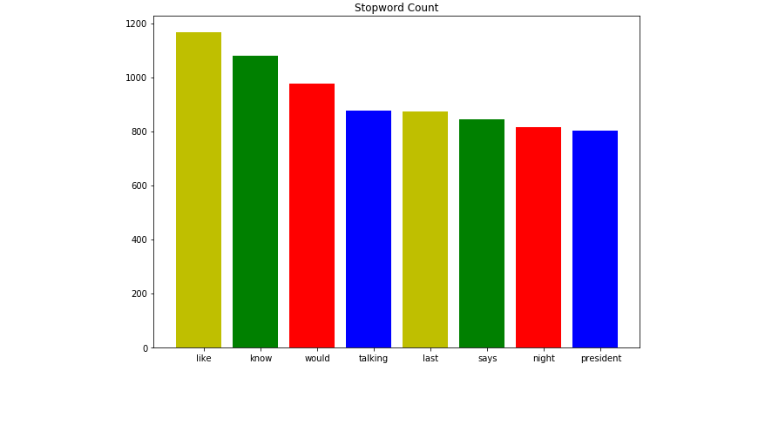
Data Exploration
remove the stop words

Slide 12
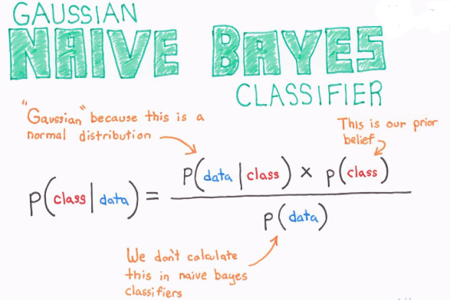
Model Selection
Naïve Bayes
Polarity: Positive, Neutral & Negative

Slide 13
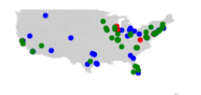
Get the Latitude & Longitude
Plot it with Shapely
Remove Alaska!

Slide 14
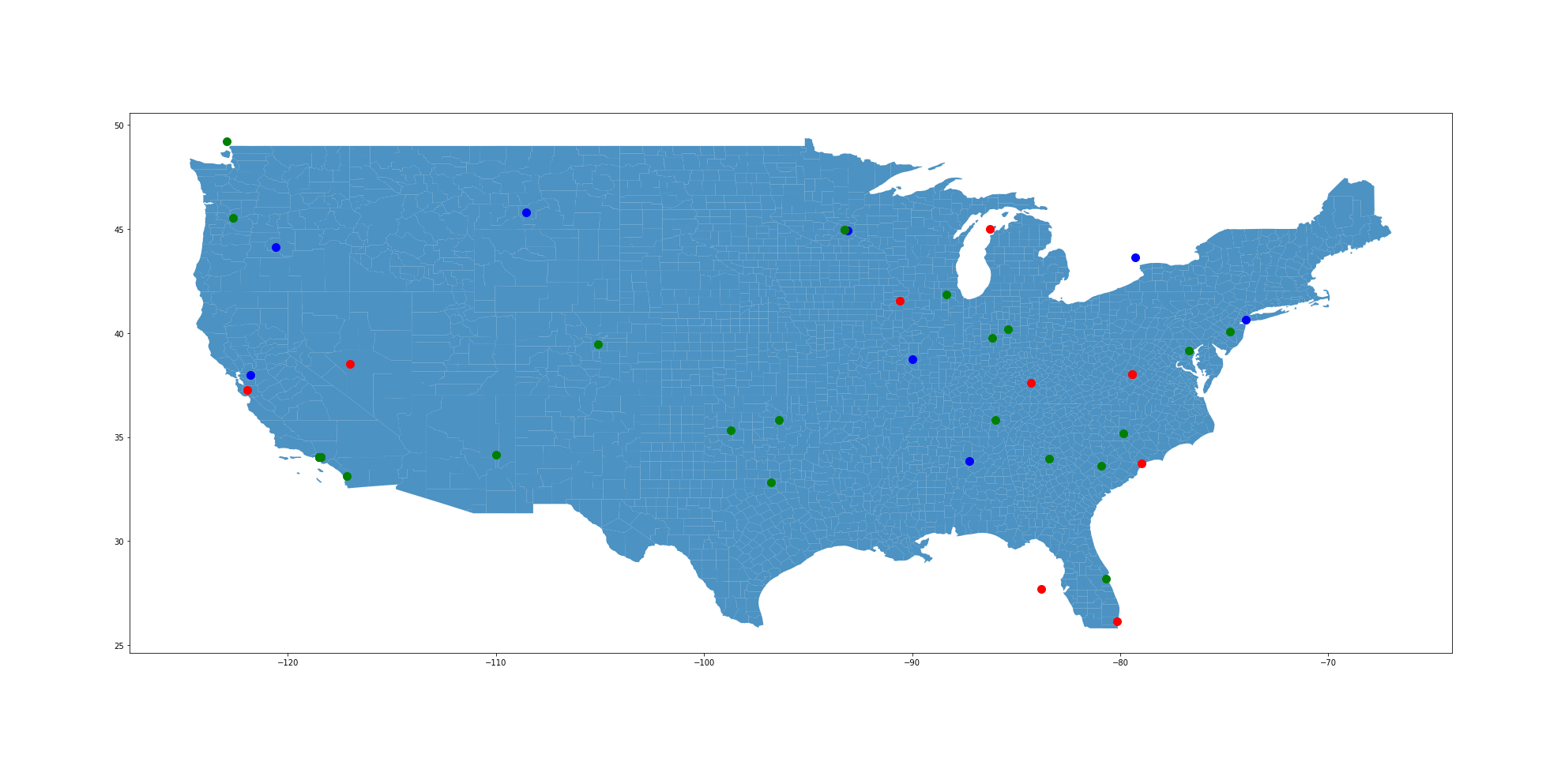
Donald Trump

Slide 15

Bernie Sanders

Slide 16
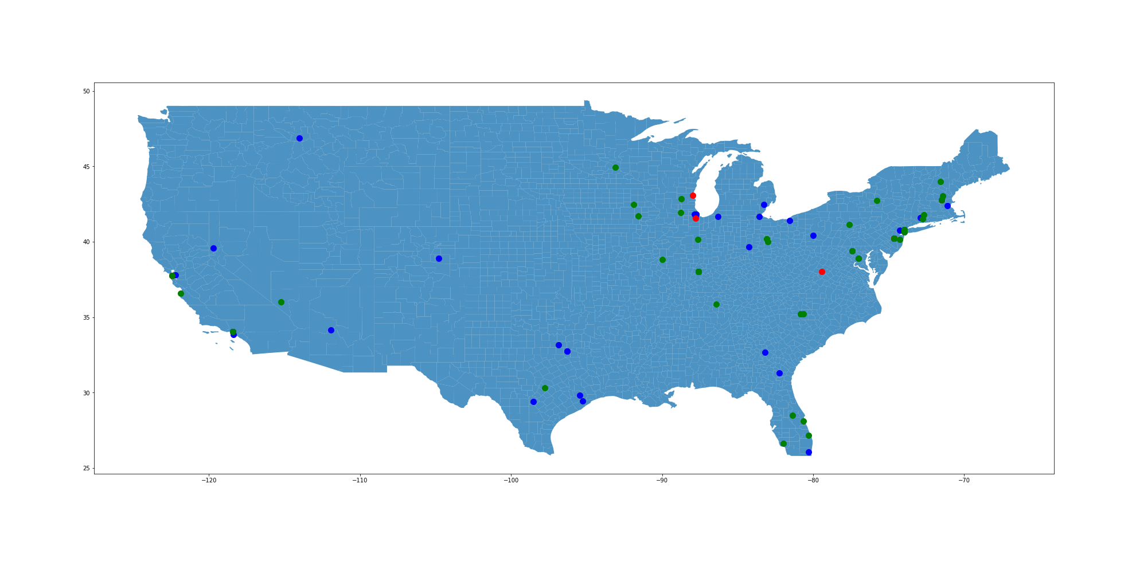
Pete Buttigieg

Slide 17

Hillary Clinton

Slide 18



Practical Use
Who can benefit from this predictions
Product Launch – Consumer Feedback
IPO – favoring the company stock
Decease – preventive measures

Slide 19
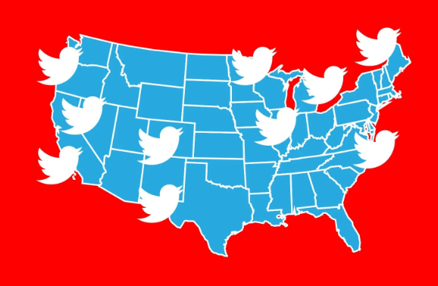
Caution
Geo location enabled

Slide 20

Further Data Analysis:
Use more data to enrich the geo-map
By state
By County
Web Interface

