Slide 1
Why to make scripts in qiime2?

Slide 2
Qiime2 log:
Qiime2 log with script:
time (2-3 days per analysis)
mistakes: YES
many analysis: HARD
standard log: NO
size of log: 5-15 pages
time (up to 3 hours)
mistakes: NO
many analysis: EASY
standard log: YES
size of log: up to 3 pages

Slide 3
Shell script = to do list for qiime2
Shell script is text file (scenario) for command line (i.e. qiime2)
How to use? bash run_paired_single.sh ok128 ok128_metadata.tsv
keyword
script file (.sh)
arguments (1 2 …)

Slide 4
run_paired_single.sh – import runs as paired and single-end sequences (~70-90 min)
Input (script arguments): data_dir=$1 barcodes_file=$2
Output: demux_paired_visual.qzv demux_single_visual.qzv

Slide 5
run_tree_taxonomy_clean.sh – runs phylogenetic tree, taxonomy, clean up feature-table (p__chloroplasts, p__mitochondria)
Input (script arguments): representative sequences (rep_seqs)=$1 feature-table (i_table)=$2 metadata-file=$3
Output: ok128_clean_table.qzv ok128_taxonomy_clean.qzv ok128_tree.qzv

Slide 6
run_diversity_ancom_aldex2.sh – generate core matrix, runs Alpha-, Beta-diversity, compositional analysis (ANCOM, aldex2)
Input (script arguments): rooted_tree=$1 i_table=$2 p_sampling_depth=$3 metadata=$4 dir=$5 column=$6 taxonomy=$7
Output: Alpha-diversity Beta-diversity ancom aldex2

Slide 7
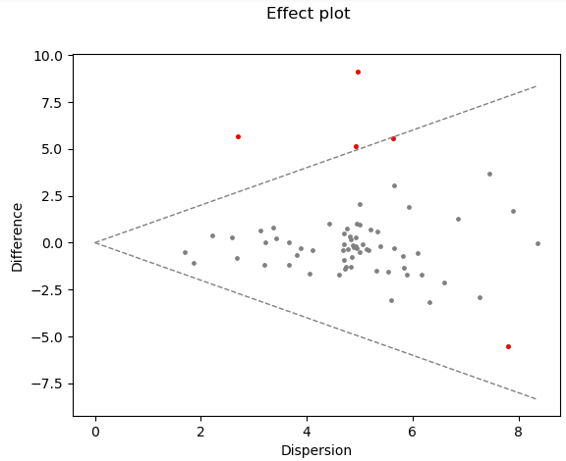
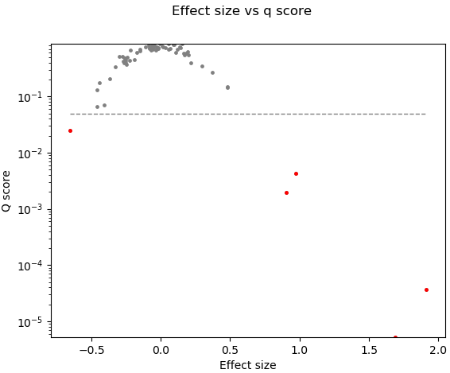
Ancom vs. ALDeX2
Ancom output:
ALDeX2 output:
OTU | rab.win.bko | rab.win.wt | diff.btw | diff.win | effect | P value
k__Bacteria;p__Bacteroidetes;c__Bacteroidia;o__Bacteroidales;f__Bacteroidaceae;g__Bacteroides | 1.02419217 | 10.023716 | 9.138394 | 5.049377 | 1.679245 | 1.17E-06
k__Bacteria;p__Bacteroidetes;c__Bacteroidia;o__Bacteroidales;f__Prevotellaceae;g__Prevotella | 2.41945411 | 8.0776529 | 5.674893 | 2.764129 | 1.91669 | 1.01E-07
k__Bacteria;p__Deferribacteres | -8.38645044 | -3.019321 | 5.320643 | 4.562689 | 1.064646 | 0.000119
Tutorial:
https://library.qiime2.org/plugins/q2-aldex2/24/
log(“taxa abundance”)
diff.btw / max(diff.win)

Slide 8
Thanks!
Link for my scripts and log examples: https://github.com/Genebio/scripts-qiime2

